Slide 1

Arkansas Statewide Epidemiological
Outcomes Workgroup
Thrice-Annual Meeting
05/28/2026
Supported by: SAMHSA Substance Abuse Block Grant 1B08TI087025-01

Slide 2
Today’s Agenda
Introductions and Mission Statement
National Updates (A. Oliveto)
Arkansas Health Survey (M. Nino)
Highlights from the 2025 Profiles Report (R. Thompson)
National Survey on Drug Use Trends (R. Thompson)
Deeper APNA Data Dive: 5-year Trends in Use, Risk and Sources of Substances (J. Thostenson)
Evidence for Selected E-Cig Prevention Intervention(s) (A. Oliveto)
Year End SEOW Review
Discussion/Wrap Up

Slide 3
SEOW Mission
SEOW’s mission is to guide successful prevention efforts in the state of Arkansas by:
Analyzing, monitoring and sharing data trends in substance use and other environmental, behavioral, and health-related factors.
Informing data-driven policy and practice decision-making regarding prevention priorities at local and state levels.
Disseminating evidence-based education and prevention materials to the larger public.

Slide 4
National Updates
Alison Oliveto, PhD
SEOW Team Leader
UAMS

Slide 5

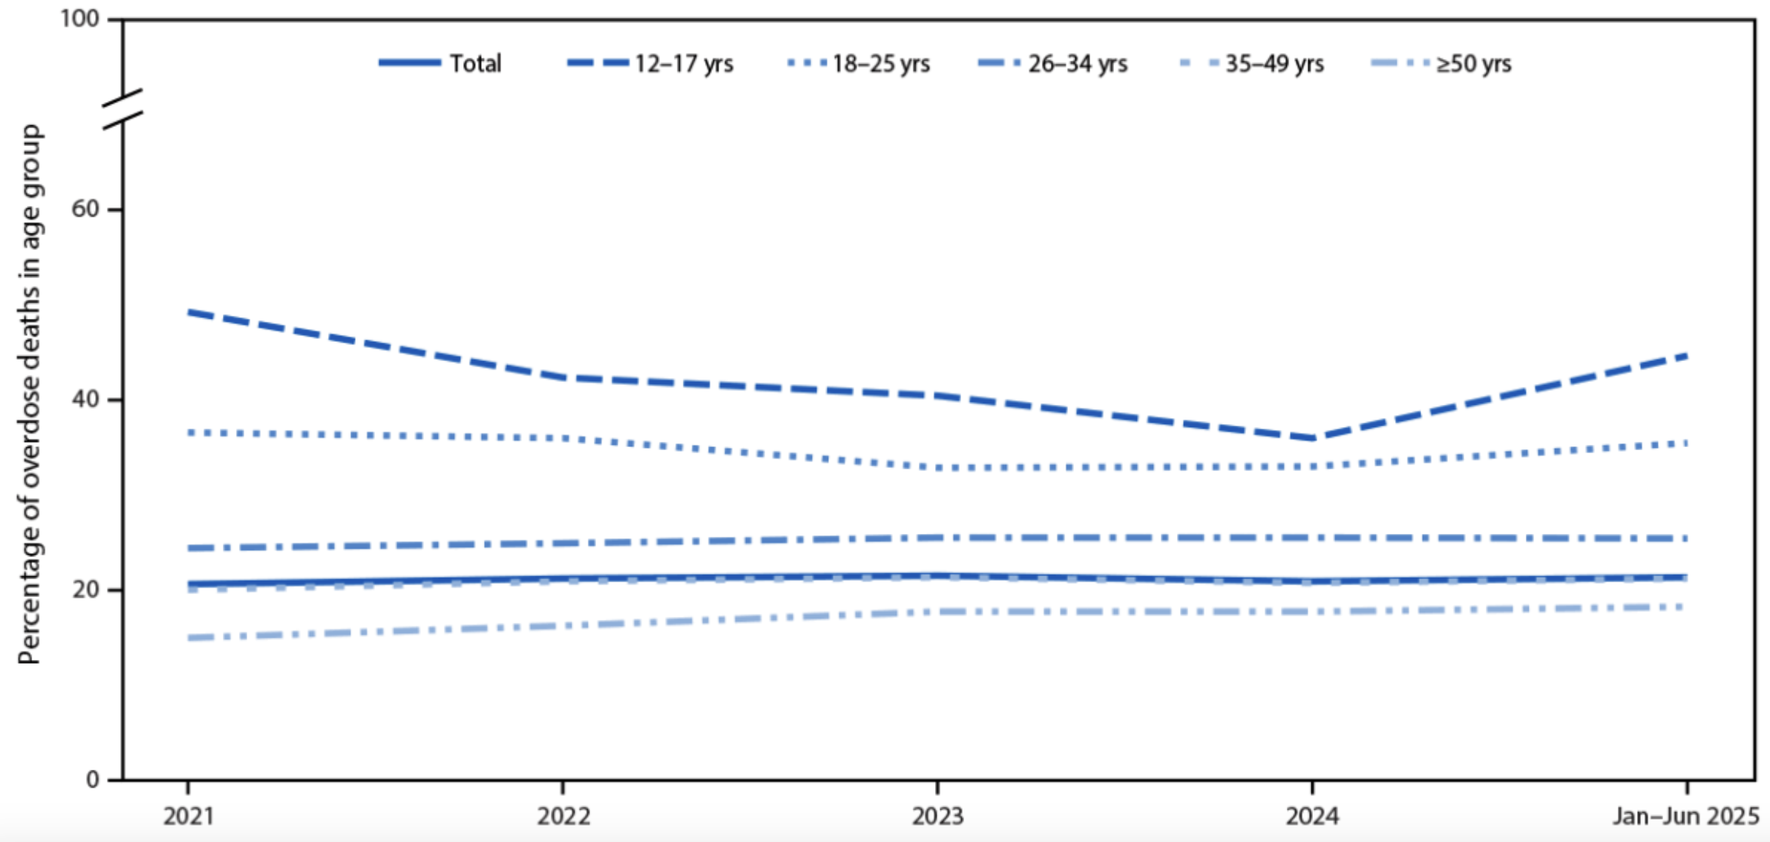
Notes from the Field: Cannabis Detection Among Overdose Deaths - United States, 2021-2025
Percentage* of overdose deaths with cannabis detected, by decedent age group —
State Unintentional Drug Overdose Reporting System, United States, January 2021–June
2025
Tanz LJ, Quader ZS, Mattson CL, Vivolo-Kantor AM. Notes from the Field: Cannabis Detection Among Overdose Deaths — United States, 2021–2025. MMWR Morb Mortal Wkly Rep 2026;75:539–541. DOI: http://dx.doi.org/10.15585/mmwr.mm7534a2
Notes:
From January 2021–June 2025, cannabis detected in 21.0% of all overdose deaths; prevalence was stable over time, despite increasing cannabis use from 2021 to 2024 among adults 26 and older.
% of deaths with cannabis on board highest among those aged 12–17 years and decreased with increasing age.
Among those aged 12–17 years, cannabis detected in 42.7% (439) of overdose deaths, despite this age group having the lowest prevalence of self-reported past-year cannabis use and stable or slightly declining prevalence of cannabis use in recent years.
Detection of cannabis decreased from 49.2% in 2021 to 35.9% in 2024 and increased to 44.6% during January–June 2025.
Most adolescent deaths with cannabis detected also involved illegally manufactured fentanyls (88.6%) or stimulants (69.0%).

Slide 6
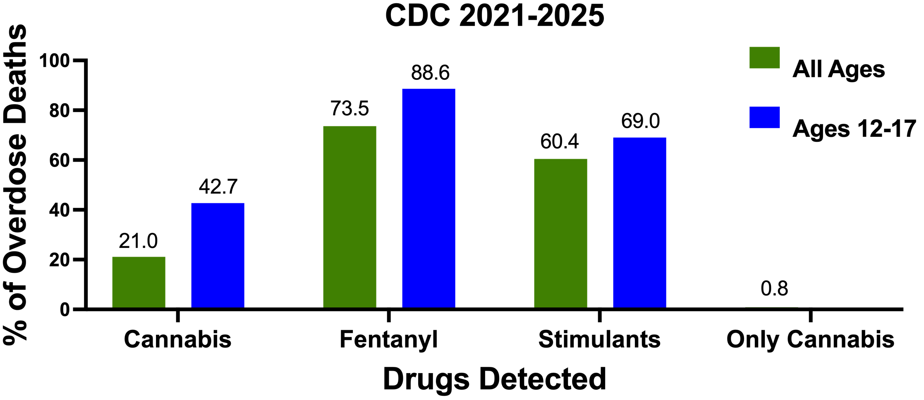
Notes from the Field: Cannabis Detection Among Overdose Deaths - United States, 2021-2025
Tanz LJ, Quader ZS, Mattson CL, Vivolo-Kantor AM. Notes from the Field: Cannabis Detection Among Overdose Deaths — United States, 2021–2025. MMWR Morb Mortal Wkly Rep 2026;75:539–541. DOI: http://dx.doi.org/10.15585/mmwr.mm7534a2
Notes:
From January 2021–June 2025, cannabis detected in 21.0% of all overdose deaths; prevalence was stable over time, despite increasing cannabis use from 2021 to 2024 among adults 26 and older.
% of deaths with cannabis on board highest among those aged 12–17 years and decreased with increasing age.
Among those aged 12–17 years, cannabis detected in 42.7% (439) of overdose deaths, despite this age group having the lowest prevalence of self-reported past-year cannabis use and stable or slightly declining prevalence of cannabis use in recent years.
Detection of cannabis decreased from 49.2% in 2021 to 35.9% in 2024 and increased to 44.6% during January–June 2025.
Most adolescent deaths with cannabis detected also involved illegally manufactured fentanyls (88.6%) or stimulants (69.0%).

Slide 7
Takeaway: cannabis detection signals polysubstance use
Overdose deaths caused by cannabis are rare
Testing is inconsistent, so detection is likely undercounted
Youth cannabis use is an early-intervention opportunity
Tanz LJ, Quader ZS, Mattson CL, Vivolo-Kantor AM. Notes from the Field: Cannabis Detection Among Overdose Deaths — United States, 2021–2025. MMWR Morb Mortal Wkly Rep 2026;75:539–541. DOI: http://dx.doi.org/10.15585/mmwr.mm7534a2

Slide 8


Risk Factors for E-Cigarette Ban Relaxation in Homes With Adolescents
Youth (12-17 yrs) in the Population Assessment of Tobacco and Health (PATH) Study whose parents held a strict vaping ban in 2016 (n= 6,514; 51.5% male) AND their parents provided follow-up data on up to four occasions through 2020 on whether the ban was relaxed.
Maggs JL, Staff J, Mongilio JM, Miller SE, Vuolo M, Kelly BC. Risk Factors for E-Cigarette Ban Relaxation in Homes With Adolescents. J Adolesc Health. 2024 Nov;75(5):766-771. doi: 10.1016/j.jadohealth.2024.05.006. Epub 2024 Jul 14. PMID: 39007788; PMCID: PMC11490403.

Slide 9
Risk Factors for E-Cigarette Ban Relaxation in Homes With Adolescents
Initial Findings:
82.5%
of PATH households had a strict vaping ban in 2016
9 in 10 of those parents also banned smoking and saw vaping as harmful
1 in 10 youth did not know about the ban
Maggs JL, Staff J, Mongilio JM, Miller SE, Vuolo M, Kelly BC. Risk Factors for E-Cigarette Ban Relaxation in Homes With Adolescents. J Adolesc Health. 2024 Nov;75(5):766-771. doi: 10.1016/j.jadohealth.2024.05.006. Epub 2024 Jul 14. PMID: 39007788; PMCID: PMC11490403.

Slide 10
Risk Factors for E-Cigarette Ban Relaxation in Homes With Adolescents
13.5% (about one in seven) of households with strict vaping bans relaxed them in a subsequent wave. Odds of relaxing bans were HIGHER if, at baseline:
  Parents vaped or smoked tobacco
  Youth smoked tobacco
  Parents reported no smoking ban
  Youth did not know that their household had a vaping ban
  Parents perceived low harm from vaping
Maggs JL, Staff J, Mongilio JM, Miller SE, Vuolo M, Kelly BC. Risk Factors for E-Cigarette Ban Relaxation in Homes With Adolescents. J Adolesc Health. 2024 Nov;75(5):766-771. doi: 10.1016/j.jadohealth.2024.05.006. Epub 2024 Jul 14. PMID: 39007788; PMCID: PMC11490403.

Slide 11
Risk Factors for E-Cigarette Ban Relaxation in Homes With Adolescents
Odds of relaxing bans were LOWER if, at baseline, parents had:
A college degree
A graduate degree
Children who were non-Hispanic Black
Children who were Hispanic
(non-Hispanic White youth less likely to have a vaping ban in the first place and more likely to have bans relaxed)
Maggs JL, Staff J, Mongilio JM, Miller SE, Vuolo M, Kelly BC. Risk Factors for E-Cigarette Ban Relaxation in Homes With Adolescents. J Adolesc Health. 2024 Nov;75(5):766-771. doi: 10.1016/j.jadohealth.2024.05.006. Epub 2024 Jul 14. PMID: 39007788; PMCID: PMC11490403.

Slide 12
Risk Factors for E-Cigarette Ban Relaxation in Homes With Adolescents
Conclusions
Consistent home rules may delay teen nicotine use
Most parents kept their ban; those who relaxed did so early
Well-child visits are an underused point to reinforce vape-free homes
Well-child check-ups with medical providers are a significant and underutilized opportunity to support families by reinforcing the value of a vape-free home
Maggs JL, Staff J, Mongilio JM, Miller SE, Vuolo M, Kelly BC. Risk Factors for E-Cigarette Ban Relaxation in Homes With Adolescents. J Adolesc Health. 2024 Nov;75(5):766-771. doi: 10.1016/j.jadohealth.2024.05.006. Epub 2024 Jul 14. PMID: 39007788; PMCID: PMC11490403.
Notes:
While most parents with strict vaping bans maintained them over time, almost one in seven households relaxed their strict policy against e-cigarette use in the home, with most doing so within 1-2 years.
Parents can delay and possibly deter adolescent nicotine uptake with consistent norms and home rules.
Well-child check-ups with medical providers are a significant and underutilized opportunity to support families by reinforcing the value of a vape-free home.

Slide 13
Risk Factors for E-Cigarette Ban Relaxation in Homes With Adolescents
Questions/Future Directions
What strategies would be effective in correcting societal misinformation about vaping’s harmlessness?
What socially acceptable strategies can parents use to maintain nicotine-free rules and norms for children, family, and friends?
What effective strategies to support cessation of nicotine use broadly can be implemented?
Maggs JL, Staff J, Mongilio JM, Miller SE, Vuolo M, Kelly BC. Risk Factors for E-Cigarette Ban Relaxation in Homes With Adolescents. J Adolesc Health. 2024 Nov;75(5):766-771. doi: 10.1016/j.jadohealth.2024.05.006. Epub 2024 Jul 14. PMID: 39007788; PMCID: PMC11490403.

Slide 14

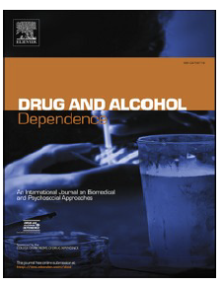
Youth’s perception of parental limitation of youth screen time is associated with lower odds of nicotine vaping among US youth: Results from the
2024 National Survey on Drug Use and Health (NSDUH)
Emerging evidence that:
Media use is associated with ↑ levels of youth vaping.
  More frequent media use may ↑ exposure to vaping portrayals, lowering perceived risk and increasing acceptability
  Excessive screen time might disrupt kids’ neurobiological functions, which relate to mental health symptoms, common reasons for nicotine vaping among youth.
Limiting youth media use may be associated with ↑ overall well-being and ↓ substance use and mental health symptoms among youth.
Lee J, Mattingly DT. Youth's perception of parental limitation of youth screen time is associated with lower odds of nicotine vaping among US youth: Results from the 2024 National Survey on Drug Use and Health (NSDUH). Drug Alcohol Depend. 2026 Sep 1;286:113260. doi: 10.1016/j.drugalcdep.2026.113260. Epub 2026 Jul 4. PMID: 42425048.
Notes:
including watching television shows and using social media,

Slide 15
Youth’s perception of parental limitation of youth screen time is associated with lower odds of nicotine vaping among US youth: Results from the
2024 National Survey on Drug Use and Health (NSDUH)
Used youth (aged 12–17) data from the 2024 NSDUH (N=11,334) to estimate associations between youth’s past-year perception of parental limitation of screen time (past-year youth’s perception of parental limitation of youth screen time (never, seldom, sometimes, or always) and past-month nicotine vaping (Yes/No).
Lee J, Mattingly DT. Youth's perception of parental limitation of youth screen time is associated with lower odds of nicotine vaping among US youth: Results from the 2024 National Survey on Drug Use and Health (NSDUH). Drug Alcohol Depend. 2026 Sep 1;286:113260. doi: 10.1016/j.drugalcdep.2026.113260. Epub 2026 Jul 4. PMID: 42425048.

Slide 16
Youth’s perception of parental limitation of youth screen time is associated with lower odds of nicotine vaping among US youth: Results from the
2024 National Survey on Drug Use and Health (NSDUH)
5.5% of adolescents reported past-month nicotine vaping
29.9% of adolescents reported that parents never limited screen time, compared with 16.6% who reported always limiting screen time.
Higher levels of youth’s perception of screen time limitation were associated with lower odds of past-month nicotine vaping
Lee J, Mattingly DT. Youth's perception of parental limitation of youth screen time is associated with lower odds of nicotine vaping among US youth: Results from the 2024 National Survey on Drug Use and Health (NSDUH). Drug Alcohol Depend. 2026 Sep 1;286:113260. doi: 10.1016/j.drugalcdep.2026.113260. Epub 2026 Jul 4. PMID: 42425048.

Slide 17
Youth’s perception of parental limitation of youth screen time is associated with lower odds of nicotine vaping among US youth: Results from the
2024 National Survey on Drug Use and Health (NSDUH)
Conclusions:
Youth’s perception of parental limitation of screen time was associated with lower odds of nicotine vaping among youth.
Limitations
Direct parental reports of restriction of youth screen time were not assessed
Other potential factors, like parental monitoring in general, may more strongly associate with vape use.
Lee J, Mattingly DT. Youth's perception of parental limitation of youth screen time is associated with lower odds of nicotine vaping among US youth: Results from the 2024 National Survey on Drug Use and Health (NSDUH). Drug Alcohol Depend. 2026 Sep 1;286:113260. doi: 10.1016/j.drugalcdep.2026.113260. Epub 2026 Jul 4. PMID: 42425048.

Slide 18
American Academy of Pediatrics
Family Media Use Plan https://www.healthychildren.org/English/fmp/Pages/MediaPlan.aspx#/
GOAL: Limit media use by youth (e.g., screen-free zones or time at home, storing phones in a parent’s bedroom or kitchen), to help prevent potential social, behavioral, mental, and physical health effects.
Supporting youth autonomy and monitoring media use without imposing overly restrictive limits may mitigate the association between screen media use and mental health challenges among youth.
Liu, X., Liu, J., Flores, D.D., McDonald, C.C., 2024. Family factors related to adolescent screen media use and mental health outcomes: a systematic review and recommendation for practices. J. Adolesc. 96 (7), 1401–1427. https://doi.org/ 10.1002/jad.12367.
; Moreno MA, Radesky J, Walsh MC, et al. The Family Media Plan. Pediatrics. 2024;154(6):e2024067417

Slide 19

American Academy of Pediatrics
Family Media Use Plan https://www.healthychildren.org/English/fmp/Pages/MediaPlan.aspx#/
Online Tool: Parents can build a personalized technology agreement to manage screen time and digital habits.
https://www.healthychildren.org/English/fmp/Pages/MediaPlan.aspx#/
Liu, X., Liu, J., Flores, D.D., McDonald, C.C., 2024. Family factors related to adolescent screen media use and mental health outcomes: a systematic review and recommendation for practices. J. Adolesc. 96 (7), 1401–1427. https://doi.org/ 10.1002/jad.12367. Moreno MA, Radesky J, Walsh MC, et al. The Family Media Plan. Pediatrics. 2024;154(6):e2024067417
Notes:
(e. g., supporting youth autonomy and monitoring media use without imposing overly restrictive limits)

Slide 20
American Academy of Pediatrics
Family Media Use Plan https://www.healthychildren.org/English/fmp/Pages/MediaPlan.aspx#/
Key Features of the AAP Family Media Use Plan
Custom Rules: Set screen-free zones (e.g., dinner table, bedrooms) and choose device curfews before bedtime
The 5 Cs Framework: Consider your child, content quality, self-regulation (calm), activities that media might crowd out, and open communication.
Whole-Family Approach: Includes guidelines and positive habit modeling for parents and caregivers, not just children.
Age-Based Guidance: Tailor goals specific to every developmental stage, from toddlers to teens
Additional Resource Page: https://www.aap.org/en/patient-care/media-and-children/center-of-excellence-on-social-media-and-youth-mental-health/5cs-of-media-use/?srsltid=AU7gw4WdKGP8ILrabPh-5DXrBiORJsL9zyE0tp37vEsxQ1nV78JLLUGX
Liu, X., Liu, J., Flores, D.D., McDonald, C.C., 2024. Family factors related to adolescent screen media use and mental health outcomes: a systematic review and recommendation for practices. J. Adolesc. 96 (7), 1401–1427. https://doi.org/ 10.1002/jad.12367. Moreno MA, Radesky J, Walsh MC, et al. The Family Media Plan. Pediatrics. 2024;154(6):e2024067417
Notes:
(e. g., supporting youth autonomy and monitoring media use without imposing overly restrictive limits)

Slide 21
National Updates
Discussion
How do we correct the belief that vaping is harmless?
How can parents keep nicotine-free rules without social friction?
Which nicotine cessation supports can we scale?

Slide 22
Evidence for Selected E-Cig Prevention Interventions
Alison Oliveto, PhD
SEOW Team Leader

Slide 23

Catch My Breath
C
CATCH My Breath is a school-based program widely used for vaping education in schools.
Consists of four 40-min classroom sessions that include slide-show lectures, discussion opportunities, and peer-led small group activities.
Peer-led teaching approach empowers students with the knowledge and skills needed to make informed decisions about e-cigarettes and resist social pressures to vape
Informed by tobacco youth prevention researchers and practitioners
Years of real-world implementation, and a youth advisory board

Slide 24
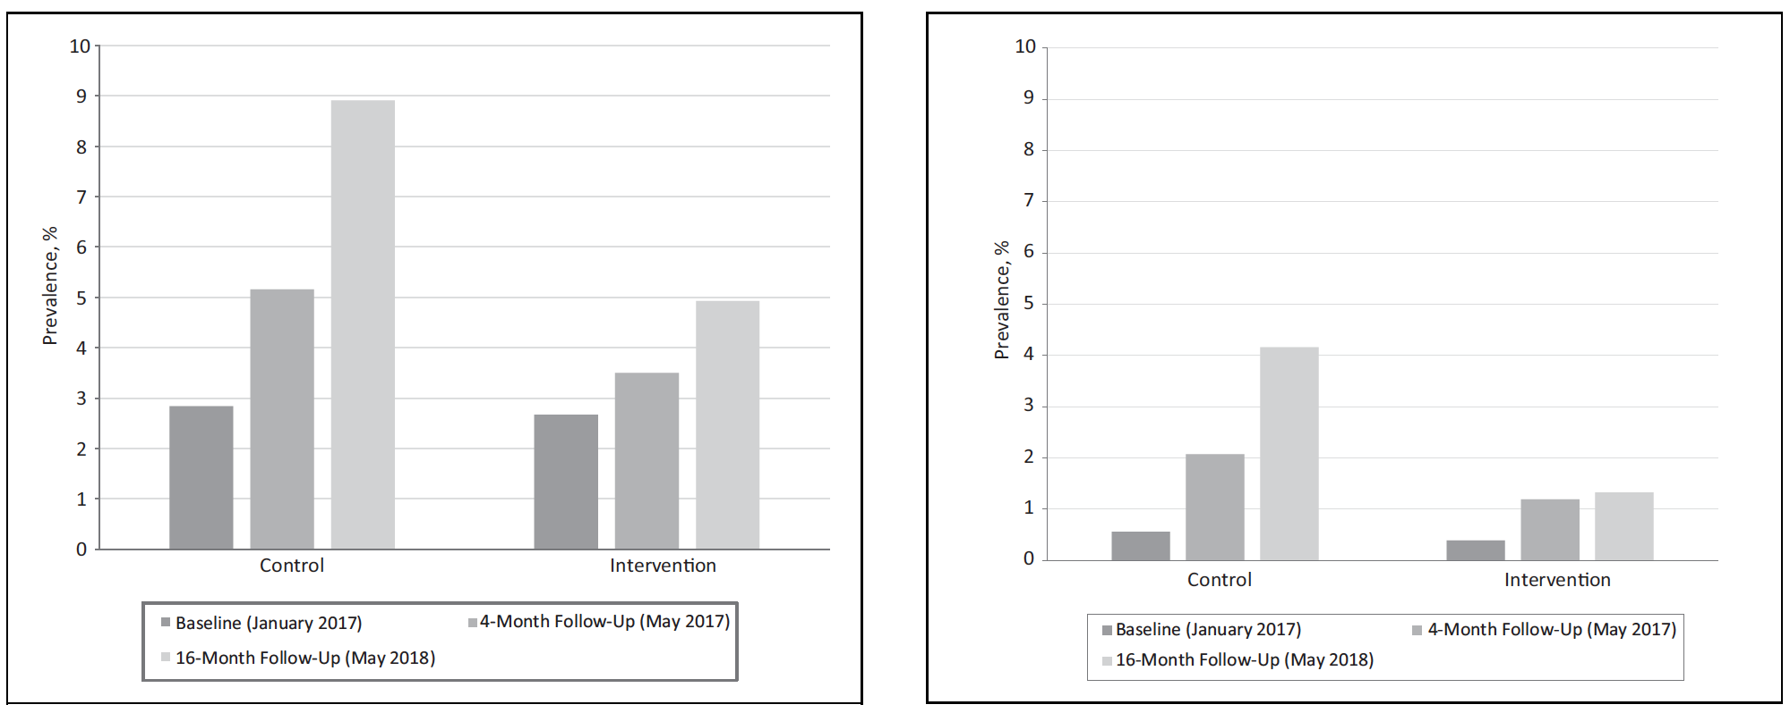
Catch My Breath - Evidence
Pilot Controlled trial: Twelve middle schools in Texas (6 intervention schools
and 6 control schools) participated in CMB during 2016-2017.
Pre, 4 mo and 6-mo post measures
Lifetime E-Cig Use
Past 30-Day E-Cig Use
*
N.S.
Increased knowledge significant at both follow up points
Kelder SH, Mantey DS, Van Dusen D, Case K, Haas A, Springer AE. A Middle School Program to Prevent E-Cigarette Use: A Pilot Study of “CATCH My Breath”. Public Health Reports®. 2020;135(2):220-229. doi:10.1177/0033354919900887

Slide 25
Catch My Breath - Evidence
Uncontrolled pre/post 6,217 students, 25 schools (WV, KY), 2019–2023
5.1% → 4.4%
current e-cigarette use, pre to post (p = .005)
84%
said they were less likely to vape
Knowledge and beliefs improved on 5 of 8 items
Appalachia: small drop in current use, no comparison group
Verdict: encouraging, but no comparison group while vaping was already falling
Burchfield K, Doyle D, Mantey D, Bennett T, Baus A. The CATCH My Breath Vaping Prevention Curriculum: An Evaluation of Impacts in Central Appalachian Middle and High Schools, 2019-2023. Journal of Primary Care & Community Health. 2024;15. doi:10.1177/21501319241277393
Notes:
No fidelity measures but appeared to have an immediate effect.
No comparator
Uncontrolled trial: 6217 students across 25 middle and high schools in West Virginia and Kentucky received the CMB program from 2019 to 2023, primarily to middle school students.
Results:
About 84% reported being less likely to use e-cigarettes following the program.
Significant improvements in e-cigarette knowledge and beliefs on 5 of 8 items, including knowledge composite score (4.15-4.75, P < .001)
Decreases in current e-cigarette use (5.1% to 4.4%; P = .005) and peer influence (4.9% to 4.0%; P = .025) from pre- to post-test

Slide 26
Catch My Breath - Evidence
Uncontrolled pre/post 10 Ontario high schools, 2022–23; 4-week follow-up
5.5 → 7.5
average knowledge score
Fewer students believed most peers vape
Changes similar for boys and girls
Ontario: knowledge ↑, intentions to vape unchanged
Verdict: no change in intentions to vape; no comparison group
Cole AG, Fairs L, Mantey D, Philipneri A, Degano C, Bianco M, Kelder SH. The impact of the 'CATCH My Breath' vaping prevention curriculum among high school students in Ontario, Canada: Results of a pilot test. Prev Med Rep. 2024 Oct 29;48:102919. doi: 10.1016/j.pmedr.2024.102919. PMID: 39534462; PMCID: PMC11554917.
Notes:
Uncontrolled trial: 10 high schools across Ontario delivered CMB lessons between October 2022 and April 2023. Students completed an online survey before being exposed to CMB and 4-weeks after the lessons.
Results:
Significant increase in average knowledge score from pre- (5.5) to post- (7.5) test.
Significantly fewer students thought that most people in high school vape post-test.
No significant changes in intentions to vape and pre/post changes were similar for boys and girls.
No impact on intentions
No comparator

Slide 27
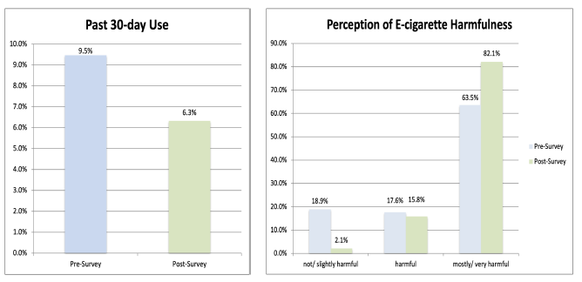
Catch My Breath - Evidence
Uncontrolled pre/post (poster) one Middle Tennessee high school; 1-month follow-up
Past 30-day use
↓ 33.7%
Rated vaping mostly/very harmful
↑ 29.3%
Tennessee: large drops reported, but small and unpublished
Verdict: small sample, not peer reviewed, 1-month outcomes only
https://trace.tennessee.edu/entities/publication/158e3598-0b99-4103-a3fd-9785278531b0
Notes:
Uncontrolled trial (poster only): Practice improvement project in a public high school in middle TN. Delivered CMB (4 lessons) over two days. Pre- and 1-mo post measures
Results:
Past 30-day use decreased by 33.7%
Perception of e-cigarette harmfulness as not/slightly harmful ↓ by 88.9%.
Perception of e-cigarette harmfulness as mostly/very harmful ↑ by 29.3%.
Small sample
No fidelity measures but appeared to have an immediate effect
Not controlled
Not published
No longer term outcomes – 1 month only

Slide 28
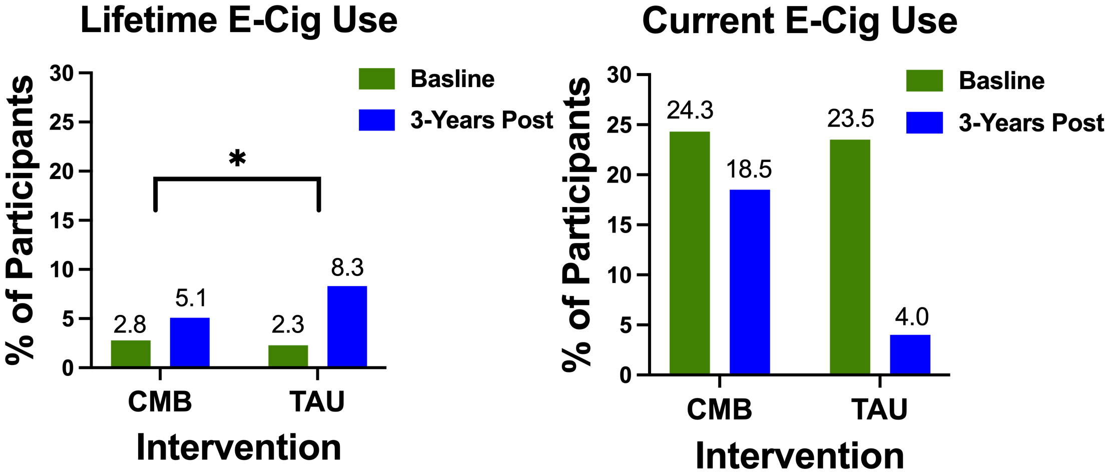
Catch My Breath - Evidence
RCT (poster, ClinicalTrials.gov) 2,054 students, 22 Texas middle schools; 6th → 8th grade
CT.gov
Lifetime vaping, 6th → 8th grade
CMB 2.8% → 14.1%
Control 2.4% → 17.8%
4.1-point net difference favoring CMB
3.7% Net Difference
RCT: smaller rise in lifetime vaping; no effect on current use
Verdict: no effect on past-30-day vaping or on ever or P30D smoking
https://catch.org/catch-my-breath-adds-three-peer-reviewed-publications-and-more-to-evidence-base/
https://clinicaltrials.gov/study/NCT04843501?tab=results#results-overview
Notes:
RCT (poster and CT.gov): In Spring 2020, we recruited n=2,054 middle school students (6th grade at baseline) from n=22 Texas middle schools. Collected 6 waves of data in 6-month intervals. Primary outcomes baseline and 3 years post lifetime and current e-cig use.
Results (Poster):
From 6th to 8th grade, prevalence of lifetime use of e- cigarettes increased from 2.8% to 14.1% among the CMB cohort and 2.4% to 17.8% among the control group; a 4.1% net difference in favor of the CMB program.
No significant treatment effects were observed for lifetime combustible tobacco smoking or past 30-day e-cigarette use or combustible tobacco products.

Slide 29
CATCH My Breath may delay nicotine vaping onset; no controlled evidence it cuts current use
Study | Design | Prevents starting? | Reduces current use?
Texas pilot, 2016–17 | Controlled pilot | ✓ at 6 months | ✗ n.s.
Appalachia, 2019–23 | Uncontrolled | — | ↓ uncontrolled
Ontario, 2022–23 | Uncontrolled | — | — (intentions n.s.)
Tennessee (poster) | Uncontrolled | — | ↓ uncontrolled
Texas RCT, 2020–23 | RCT (unpublished) | ✓ smaller rise | ✗ n.s.
Bottom line: not harmful and may help prevent initiation; no evidence it meaningfully reduces current use.

Slide 30
11 studies met the following criteria:
Targeted adolescents
Evaluated an e-cig preventive intervention
Conducted in a secondary school
Used a RCT, cluster RCT, or quasi-experimental design
Compared an intervention to a control
Most (8) studies targeted both vaping and tobacco use
Gardner LA, Rowe AL, Newton NC, Egan L, Hunter E, Devine EK, Aitken T, Thornton L, Teesson M, Stockings E, Champion KE. A Systematic Review and Meta-analysis of School-Based Preventive Interventions Targeting E-Cigarette Use Among Adolescents. Prev Sci. 2024 Oct;25(7):1104-1121. doi: 10.1007/s11121-024-01730-6. Epub 2024 Sep 26. PMID: 39325296; PMCID: PMC11519311.
Notes:
RCT - a scientific experiment where researchers randomly assign participants into different groups to test if a new treatment or intervention works
Cluster RCT - a study design where entire groups or "clusters" of individuals—such as schools, clinics, or communities—are randomly assigned to treatment or control groups, rather than randomizing individual people
Quasi-Experimental Design - a research methodology used to test cause-and-effect relationships when random assignment of participants to groups is not possible or ethical

Slide 31
Meta-analyses found:
No evidence that school-based interventions prevented e-cigarette use at the longest follow-up (6 and 36 months post-intervention (OR = 0.43, 95% CI = 0.16, 1.12; p = 0.09).
  Subgroup analyses identified significant effects at post-test and when studies with < 12-month follow-up were omitted.
    This subgroup included the Catch My Breath pilot RCT.
Gardner LA, Rowe AL, Newton NC, Egan L, Hunter E, Devine EK, Aitken T, Thornton L, Teesson M, Stockings E, Champion KE. A Systematic Review and Meta-analysis of School-Based Preventive Interventions Targeting E-Cigarette Use Among Adolescents. Prev Sci. 2024 Oct;25(7):1104-1121. doi: 10.1007/s11121-024-01730-6. Epub 2024 Sep 26. PMID: 39325296; PMCID: PMC11519311.
Notes:
Our meta-analysis found no evidence that school-based interventions were significantly associated with the prevention of e-cigarette use at the longest followup,
which ranged between 6 and 36 months post-intervention. However, effects were significant when examined at post-test and again when studies with follow-up < 12 months were omitted. Our narrative synthesis supported this mixed finding and showed that three (Beeres et al., 2022; Bonell et al., 2020; Kelder et al., 2020) of the six trials found significant intervention effects in the expected direction, while one intervention inadvertently increased e-cigarette use (Williams et al., 2022).

Slide 32
Meta-analyses found:
No effect on lifetime tobacco use at the longest follow-up (OR = 1.01, 95% CI = 0.65, 1.59, p = 0.95)
↓ past 30-day tobacco use (OR = 0.59, 95% CI = 0.39, 0.89, p = 0.01) (which encompassed e-cigarettes in some studies)
Found some school-based interventions prevented or reduced e-cigarette and/or tobacco use; however, some increased use.
Gardner LA, Rowe AL, Newton NC, Egan L, Hunter E, Devine EK, Aitken T, Thornton L, Teesson M, Stockings E, Champion KE. A Systematic Review and Meta-analysis of School-Based Preventive Interventions Targeting E-Cigarette Use Among Adolescents. Prev Sci. 2024 Oct;25(7):1104-1121. doi: 10.1007/s11121-024-01730-6. Epub 2024 Sep 26. PMID: 39325296; PMCID: PMC11519311.

Slide 33
Meta-analyses found:
In the short-term, school-based interventions associated with improved:
  Knowledge (SMD = − 0.38, 95% CI = − 0.68, − 0.08, p = 0.01)
  Intentions (SMD = − 0.15, 95% CI = − 0.22, − 0.07, p = 0.0001)
  Attitudes (SMD = − 0.14, 95% CI = − 0.22, − 0.06; p = 0.0007)
Overall, quality of evidence was low-to-moderate.
Gardner LA, Rowe AL, Newton NC, Egan L, Hunter E, Devine EK, Aitken T, Thornton L, Teesson M, Stockings E, Champion KE. A Systematic Review and Meta-analysis of School-Based Preventive Interventions Targeting E-Cigarette Use Among Adolescents. Prev Sci. 2024 Oct;25(7):1104-1121. doi: 10.1007/s11121-024-01730-6. Epub 2024 Sep 26. PMID: 39325296; PMCID: PMC11519311.
Notes:
lack of reporting of methods and missing outcome data. Among non-randomized studies, one (Asdigian et al., 2023) was judged at serious riskof bias across outcomes due to bias in the classification of interventions and outcome measurement. There was Moderate risk of bias judgement for all other studies, primarily due to potential bias in the measurement of outcomes, again related to insufficient availability of pre-specified protocols, and confounding.

Slide 34
Summary
E-cigarette prevention programs may have short-lived beneficial effect on preventing e-cigarette use
BUT: Too much underlying variability in the study designs, interventions, and follow-up assessment points to have strong certainty in this conclusion
classroom education and skills training delivered over multiple sessions consistently associated with reductions in e-cigarette use onset
parental/adult involvement may enhance effects
interventions showing increased use appeared broad, without specific classroom education and skills training, nor a theoretical underpinning.
Gardner LA, Rowe AL, Newton NC, Egan L, Hunter E, Devine EK, Aitken T, Thornton L, Teesson M, Stockings E, Champion KE. A Systematic Review and Meta-analysis of School-Based Preventive Interventions Targeting E-Cigarette Use Among Adolescents. Prev Sci. 2024 Oct;25(7):1104-1121. doi: 10.1007/s11121-024-01730-6. Epub 2024 Sep 26. PMID: 39325296; PMCID: PMC11519311.
Notes:
“Theme week”
Need to do more than raise awareness – give skills

Slide 35
Limitations:
small number of studies and high heterogeneity decreased ability to make meaningful comparison of key intervention characteristics and their efficacy
quality of evidence very low or low for some outcomes
effects were generally small and short-lived
More high-quality research needed to develop efficacious interventions, and schools must be supported to adopt evidence-based programs
Gardner LA, Rowe AL, Newton NC, Egan L, Hunter E, Devine EK, Aitken T, Thornton L, Teesson M, Stockings E, Champion KE. A Systematic Review and Meta-analysis of School-Based Preventive Interventions Targeting E-Cigarette Use Among Adolescents. Prev Sci. 2024 Oct;25(7):1104-1121. doi: 10.1007/s11121-024-01730-6. Epub 2024 Sep 26. PMID: 39325296; PMCID: PMC11519311.
Notes:
“Theme week”
Need to do more than raise awareness – give skills

Slide 36
Discussion

Slide 37
SEOW: Year in Review
Regularly monitored and shared with SEOW members national substance use and health related outcomes data
Updated ARPrevention.org website periodically with resources, meeting slides and reports
Continued working with AG Office on One Pill can Kill campaign on AR college campuses (Train the Trainers)
Hosted 3 Tri-Annual SEOW Meetings
  Coordinated event, invited speakers, set agenda, responded to SEOW member requests, prepared and presented slides, summarized and disseminated meeting activities

Slide 38
SEOW: Year in Review
Prepared and delivered SIX Presentations across various venues in 2026:
  “Mapping the Data: Prevention Indicators Across Arkansas and Region 6.” Region 6 Task Force, July 7th, Morrilton, AR
  “Leveraging technology to enhance the feasibility, fidelity, and sustainability of adolescent substance use prevention interventions.” June 27th, Prevention Summit, Benton, AR
  “Xylazine and Other Adulterants in the Drug Supply,” Lunch & Learn Webinar, May 20th, UALR MidSOUTH, Little Rock, AR
  “Understanding Regional Substance Misuse Trends to Inform Effective Prevention Strategies.” Regional Substance Misuse Prevention, Mental Health Awareness & Digital Wellness Summitt,” April 28th, Texarkana, AR
  “Adolescent Nonmedical Prescription Drug Use Prevention: Focus on Opioids.” UAMS MATRIARC Project ECHO Seminar Series, April 17th, Little Rock, AR
  “Substance Use Among Older Adults: Ethical Considerations.” UAMS Geriatric ECHO Seminar Series, March 18th, Little Rock, AR

Slide 39
SEOW: Year in Review
Published peer-reviewed article that used APNA data:
  Clawson A, Thostenson JD, Oliveto AH, Bollinger M. (2026) Beyond Contextual Smoking Norms: The Importance of Family-level Nicotine Use Risk Factors among Rural and Nonrural Youth Living in Arkansas. Preventive Medicine Reports 67. 103520, ISSN 2211-3355, https://doi.org/10.1016/j.pmedr.2026.103520.(https://www.sciencedirect.com/science/article/pii/S2211335526001488)
Prepared 2026 Annual Profiles Report (draft under review by MidSOUTH and DHS)
Responded to data requests as received

Slide 40
Future Possible Directions
Investigate ways to:
Enhance parental involvement in a meaningful way
Leverage technology to extend and sustain prevention efforts
Help people reduce/quit use across the lifespan
Target high risk factors (e.g., sensation seeking)
Introduce weighting in APNA findings
Enhance data source identification and collection

Slide 41
Discussion
&
Wrap Up

Slide 42
Thank you!

