Slide 1

Deeper APNA Data Dive
Five-year Trends in Use, Risk, and Sources

Slide 2
Deeper APNA Data Dive:
Five-Year Trends in Use, Risk, and Sources
State-wide rates of various APNA questions 2021 to 2025
Visual trend lines: rates plotted over time
  Demographics
  Risk Perception & Use:
    Alcohol, Nicotine, Marijuana, RX/OTC
  Source of substances:
    Alcohol, Cigarettes, E-cigarettes, Marijuana, Marijuana vape, RX/OTC

Slide 3
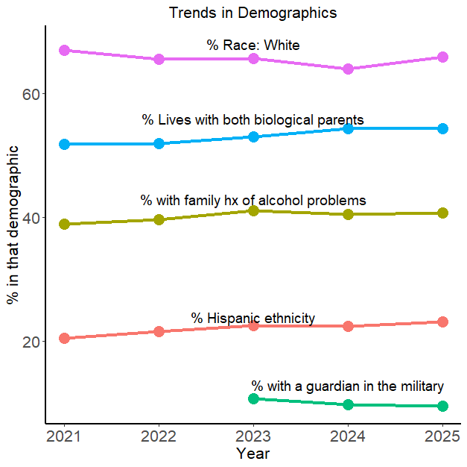
Demographic trends:
  Race: White is steady/high
  Living w/ both parents: slight increasing trend
  Family history of alcohol problems looks steady
  Ethnicity: Hispanic slight increase
  Military guardian: only 3 years of data so far
  Data caveat: represents APNA respondents, not AR population
Notes:
Should I add race: black?, other demographics??

Slide 4
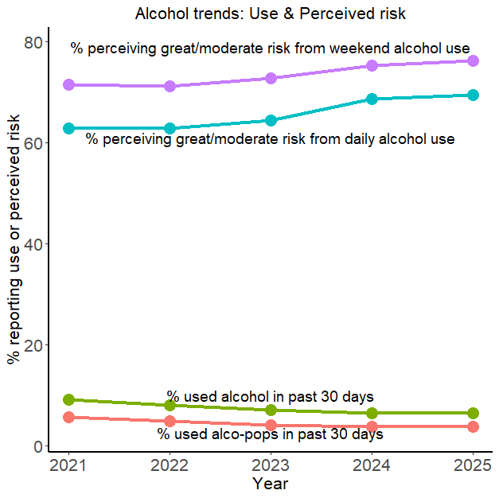
Alcohol trends: Perceived Risk & Use
  Risk perception: increasing trend
  Higher level for weekend than daily
  Use: decreasing trend
  Alco-pop APNA question going away
Notes:
Alco-pop question going away (?)

Slide 5
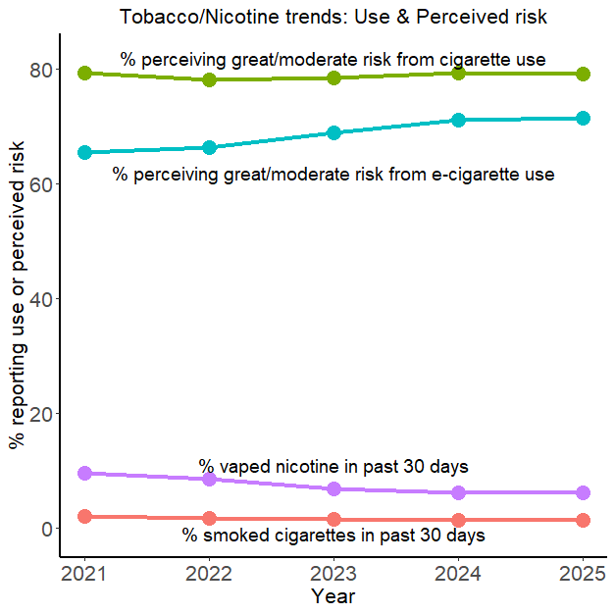
Tobacco/Nicotine trends: Perceived Risk & Use
  Risk perception steady for cigarettes, increased for e-cigarette
  Cigarette use low and flat
  Nicotine vaping higher but decreasing

Slide 6
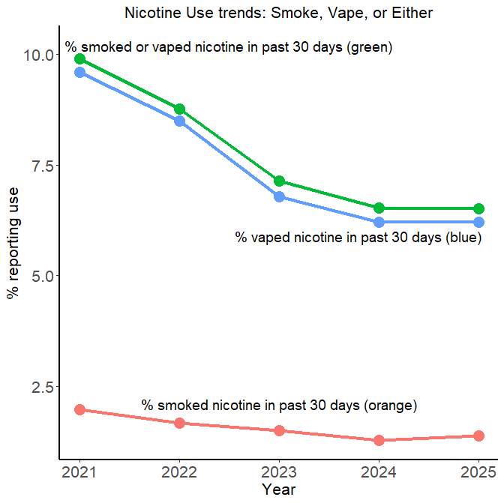
Nicotine Use zoom-in:
  Vaping or Either use decreasing trend over past 5 years
  Either use just slightly higher than vaping. Vaping drives nicotine/tobacco use.

Slide 7
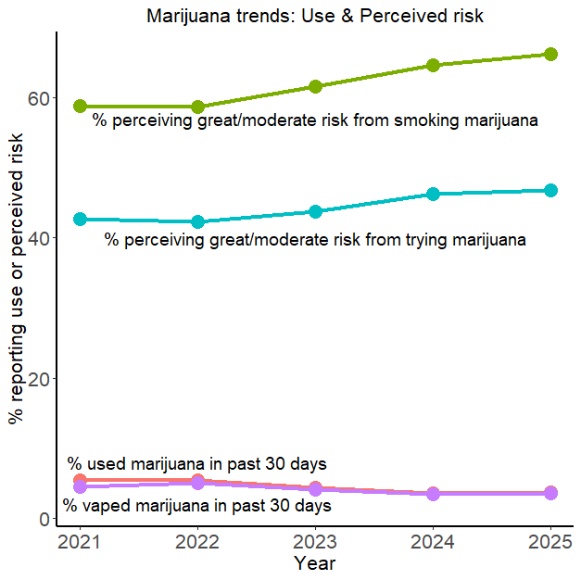
Marijuana trends: Perceived Risk & Use
  Risk perception increasing trend smoking or trying
  Higher level for smoking than trying
  Use & vaping decreasing trend

Slide 8
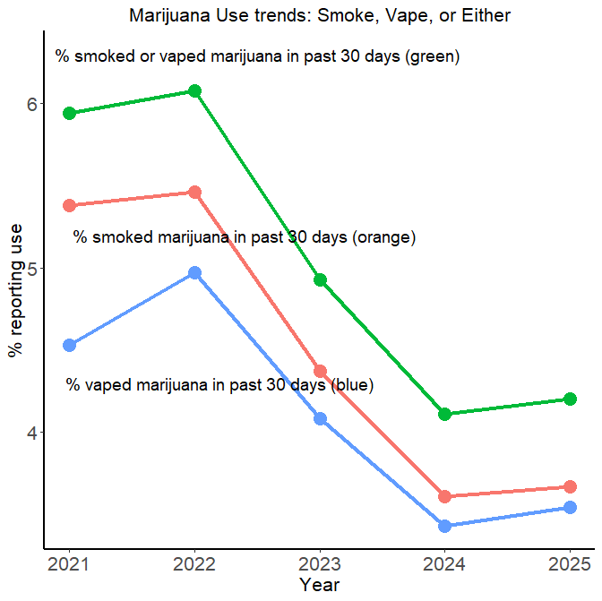
Marijuana Use zoom-in:
  Smoking, vaping, or either have similar decreasing trend over past 5 years
  Either smoke or vape ~half a percentage point higher than only smoked

Slide 9
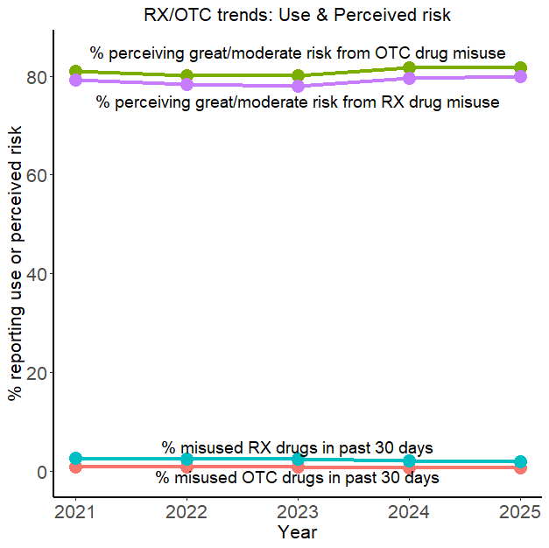
RX/OTC trends: Perceived Risk & Use
  Risk perception & Use trends fairly flat

Slide 10
Discussion … Questions … Comments … Feedback
Discussion for Trends
  In general, risk perception increasing, use decreasing
  Tobacco/Nicotine use driven by vaping
  Marijuana use: divided between smoking and vaping, but currently more smoking

Slide 11
Trends in Sources of substances
Source of substance
  Alcohol, Cigarettes, E-cigarettes, Marijuana, Marijuana vape, RX/OTC
Top 6 sources(by 2025 %) shown in trend line plots
  Other sources not plotted are noted
Data notes:
  Substance source rates based only on users
  Source percentages may add up to over 100% since users may check-off more than 1 source
Notes:
top 6 because some substances have 6 possible sources
(non-users excluded from numerator and denominator)

Slide 12
Alcohol Sources
I bought it myself with a fake ID
I bought it myself without a fake ID
I got it delivered (Liquor store delivery, etc.)
I bought it online
I got it from someone I know age 21 or older
I got it from someone I know under age 21
I got it from my brother or sister
I got it from home with my parents' permission
I got it from home without my parents' permission
I got it from another relative
A stranger bought it for me
I took it from a store or shop
Other

Slide 13
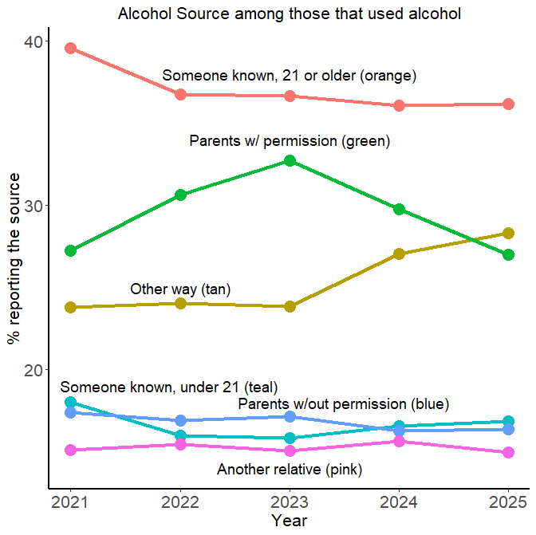
Alcohol sources:
  Primary sources: 21+ known people and parents
Sources not plotted:
  Took from shop/store
  Delivered
  Myself w/ fake ID
  Myself w/out fake ID
  Online/Internet
  Sibling
  Stranger
Notes:
Takeaway: permissiveness of parents & others 21+

Slide 14
Cigarettes Sources
I bought them myself with a fake ID
I bought them myself without a fake ID
I got them from someone I know age 21 or older
I got them from someone I know under age 21
I got them from my brother or sister
I got them from home with my parents' permission
I got them from home without my parents' permission
I got them from another relative
A stranger bought them for me
I took them from a store or shop
Other

Slide 15
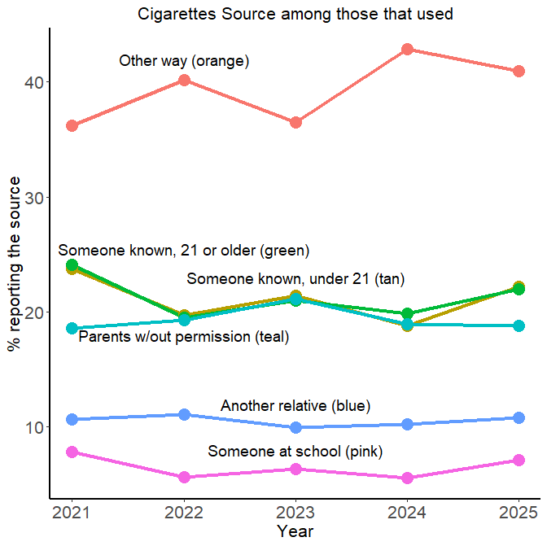
Cigarettes sources:
  Besides “other way”, someone known(any age), & parents without permission primary sources
Sources not plotted:
  Myself w/ fake ID
  Myself w/out fake ID
  Parents w/ permission
  Stranger
  Took from Shop/Store

Slide 16
E-cigarette Sources
I bought them in a store such as a convenience store, supermarket, discount store, or gas station
I got them on the Internet
I got them at a store that sells electronic cigarettes, such as a "vape shop"
I got them from a family member
I got them from a friend
A stranger got them for me
I took them from a store or shop
I got them some other way

Slide 17
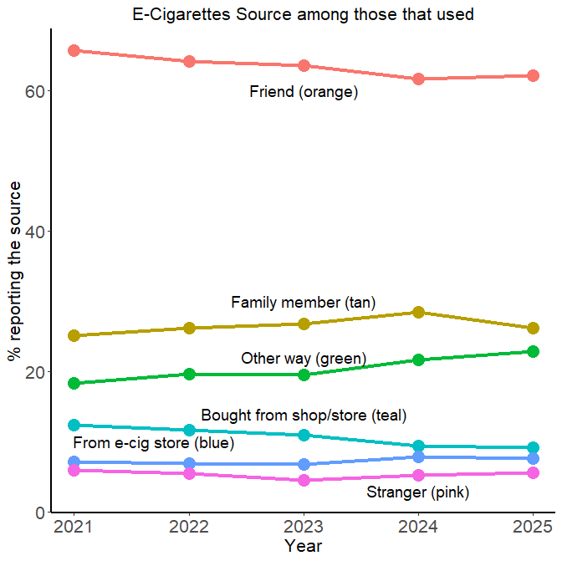
E-cigarettes sources:
  Friend is way out ahead
  2 store sources each around 10%
Sources not plotted:
  Online/Internet
  Took from Shop/Store

Slide 18
Marijuana Sources
I bought it myself
I got it from someone at school
I got it from someone with a medical marijuana card
I got it from my brother or sister
I got it from another relative
Other

Slide 19
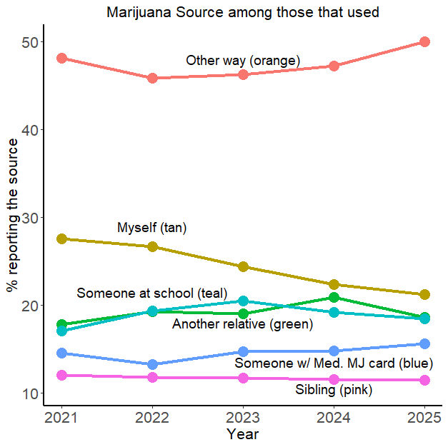
Marijuana sources:
  Other way & myself, seems uninformative
  Someone w/ MJ card, ‘low’, but over 10% still a notable source
(All sources asked about plotted)

Slide 20
Marijuana Vaping Product Sources
I bought it myself
I got it from someone at school
I got it from someone with a medical marijuana card
I got it from my brother or sister
I got it from another relative
Other

Slide 21
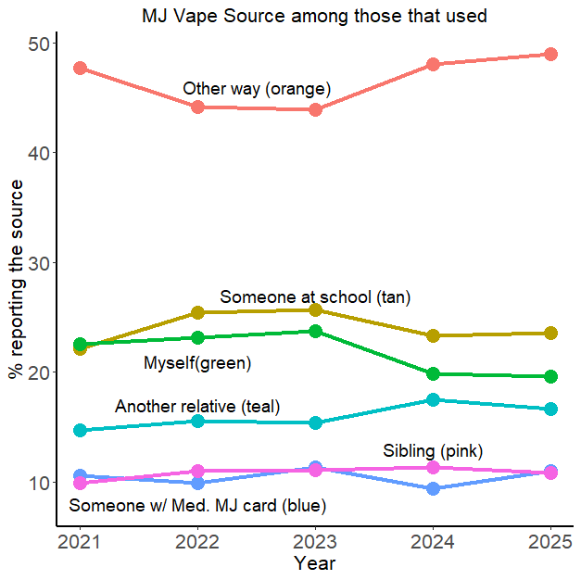
Marijuana Vape sources:
  Other way & myself, seems uninformative
  Also: someone at school
  Someone w/ MJ card, ‘low’, but over 10% still a notable source
(All sources asked about plotted)

Slide 22
RX/OTC Sources
I bought it or took it from a store or shop
I got it from my parents with permission
I got it from home without permission
I got it from a relative with permission
I got it from a relative without permission
I got it from a friend's home with permission
I got it from a friend's home without permission
I got it from a friend while at school
I got it from a friend while at a party
I got it from a friend, elsewhere
I got it from an internet sale

Slide 23
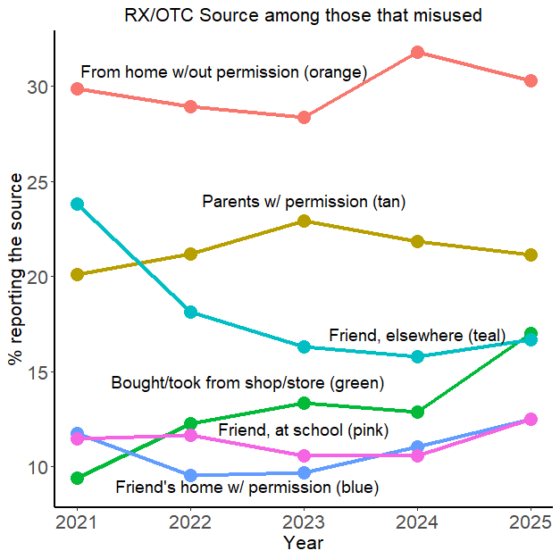
RX/OTC sources:
  Home/parents without and with permission
  Also friends
  Rising: shop/store
Sources not listed:
  Friend, at a party
  Friend’s home w/out permission
  Online/Internet
  Relative w/ permission
  Relative w/out permission

Slide 24
Discussion … Questions … Comments … Feedback
Alcohol:
  Parents w/ permission & known people over 21
  Parents without permission & known people under 21 still over 10
Cigarettes:
  Other way: non-informative
  Parents w/out permission still around 20%
E-cigarettes:
  Friend is way out ahead,
  From a store still around 10%
Marijuana & Marijuana vape:
  Other way/Myself: non-informative
  Someone w/ Medical Marijuana card over 10%
RX/OTC:
  From home/parents with & without permission
  Bought/took from store is rising

