Slide 1
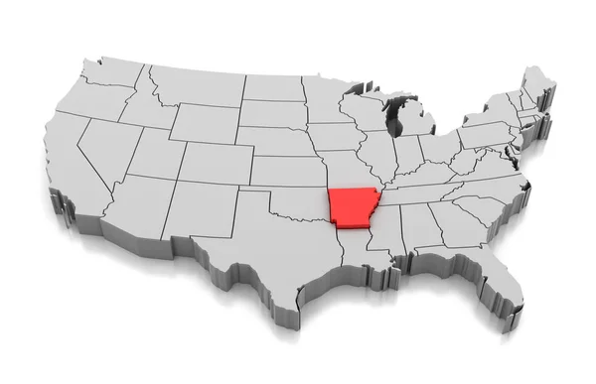

Substance Use
Arkansas vs. United States
Ronald G. Thompson, Jr., Ph.D., MSW, LCSW
Associate Professor, Department of Psychiatry
University of Arkansas for Medical Sciences

Slide 2
Overview
2025 Arkansas State Epidemiological Profile of Substance Use
      Youth Substance Use
      Adult Substance Use
National Survey on Drug Use and Health (NSDUH)
      2021-2024 Trends

Slide 3
Youth Substance Use
2025
Arkansas vs. United States
2025 Arkansas State Epidemiological Profile of Substance Use
Notes:
Brief preview of 2025 Annual Profile

Slide 4
Youth Alcohol Use
Source: APNA and MTF
Notes:
Compared to U.S. students, rates of lifetime alcohol use were lower among Arkansas 10th and 12th grade students, particularly among 12th grade students
However, Arkansas 8th graders rates exceeded the national rates
Arkansas students reported lower current use than their national counterparts at grades 10 and 12.
However, 8th graders in Arkansas report higher current use than U.S. 8th graders
Bottom Line:
Start alcohol prevention efforts at or before 6th grade
Target 12th graders for intervention (last ditch effort)

Slide 5
Youth Marijuana Use
Source: APNA and MTF
Notes:
Rates for both lifetime and current marijuana use
Among Arkansas 8th, 10th, and 12th graders
were below national figures in 2025
rose with grade level
Arkansas used at half the rate as US across all grades
Bottom Line:
Start marijuana prevention efforts at or before 6th grade

Slide 6
Youth Marijuana E-Cigarette Use
Source: APNA and MTF
Notes:
Rates for both lifetime and current marijuana e-cigarette use
Among Arkansas 8th, 10th, and 12th graders
were below national figures in 2025
increased with grade level
Bottom Line:
Start marijuana e-cigarette prevention efforts at or before 6th grade

Slide 7
Youth Cigarette and Smokeless Tobacco Use
Source: APNA and MTF
Notes:
Arkansas rates of current cigarette and tobacco use exceeded national figures among 8th and 10th, but not 12th grade students in 2025
Smokeless tobacco rates are slightly higher than cigarette use
Bottom Line
Start nicotine prevention efforts early

Slide 8
Youth Nicotine E- Cigarette Use
Source: APNA and MTF
Notes:
Current and lifetime nicotine e-cigarette use rises with grade level.
Lifetime use among Arkansas students in grades 8, 10, and 12 was lower than among their national counterparts in 2025.
Current use was also lower at grades 10 and 12
However, current use among Arkansas 8th graders was comparable to the national figure.
Bottom Line
Start prevention efforts early

Slide 9
Youth Flavored E-Cigarette Use
Source: APNA and MTF
Notes:
Lifetime prevalence of flavored vaping was lower among Arkansas 8th, 10th, and 12th graders than among their national counterparts.
Particularly among 12th graders
Current flavored vape use for Arkansas youth was lower at grade 12 and essentially equal at grade 10 to national estimates
Arkansas 8th graders reported slightly higher current use than the national figure.

Slide 10
Summary: Youth Substance Use
Arkansas youth report lower use than national counterparts for most substances
Cigarette and smokeless tobacco have improved substantially since 2019.
Vaping has displaced smoking as the dominant form of nicotine use
Start young and maintain prevention efforts in systematic and developmentally-appropriate way
Target specific grade levels (developmental levels)
Tailor to individual risk profile and/or specific personality traits (impulsivity, sensation seeking, anxiety sensitivity, hopelessness)

Slide 11
Targeted Trait | Substance Use Motivation | Typical Substance Profile | Targeted Intervention Strategy
Sensation Seeking | Enhancement (seeking high-intensity or novel euphoric feelings) | Early alcohol initiation, binge drinking, and stimulant/illicit drug use | Cognitive behavioral tools to identify safe, high-stimulus alternatives; learning to manage risk-taking impulses.
Impulsivity | Lack of behavioral control (acting without thinking about consequences) | Broad polysubstance use, early-onset cannabis use, and severe behavioral issues | Mindfulness and cognitive exercises designed to pause reward-seeking behavior and improve executive decision-making.
Anxiety Sensitivity | Coping with physical fear (using substances to dull bodily panic) | Anxiolytics, alcohol, or sedative misuse | Psychoeducation on physical panic loops, helping youth reframe physical anxiety symptoms as non-threatening.
Hopelessness | Coping with emotional pain (using substances to self-medicate low mood) | Opioid misuse, severe prescription drug dependency, and alcohol abuse | Cognitive restructuring to identify and challenge negative thinking patterns, depressive cognitive biases, and low self-worth.

Slide 12
Discussion Questions
What explains Arkansas having half the rates for both lifetime and current marijuana use as US? What are we doing right?
Why do rates of current cigarette and tobacco use drop below national average in 12th grade? What are we doing right?
What are we missing with 8th graders in terms of prevention for nicotine e-cigarette use to delay initiation? Developmental stage? School transitions?
What explains the decrease in current flavored vaping in 12th grade?
How to achieve parental involvement (fathers in particular) in prevention efforts?

Slide 13
Adult Substance Use
2023 – 2024
Arkansas vs. United States
2025 Arkansas State Epidemiological Profile of Substance Use

Slide 14
Adult Alcohol Use
Source: NSDUH
Source: BRFSS
Notes:
BRFSS = Behavioral Risk Factor Surveillance System
Past-month adult alcohol use in Arkansas was below the national estimate in every age group examined.
Current adult alcohol use in Arkansas remained stable and consistently below the national estimate from 2019 through 2024
Bottom Line

Slide 15
Adult Alcohol Binging and Heavy Drinking
Source: BRFSS
Notes:
Picture changes when looking at adult problematic alcohol use
Rates of current binging and heavy drinking are much closer to (and sometimes higher than) the national average
Bottom Line
Need to focus efforts on reducing intensity and frequency of alcohol consumption

Slide 16
Adult Cigarette Use
Source: BRFSS
Source: NSDUH
Notes:
The prevalence of smoking among Arkansas and U.S. adults has declined since 2016.
Despite this, 2024 smoking prevalence in the state was 52 percent higher than that for all U.S. adults.
Current cigarette use is higher in Arkansas relative to the U.S., with the difference proportionally largest among those aged 26+ group at about 1.4 times the national rate
Bottom Line

Slide 17
Adult Marijuana Use
Source: NSDUH
Notes:
Past-year marijuana use in Arkansas was close to the national estimate across all age groups.
Relative to U.S. adults, past year marijuana use was slightly higher among Arkansas adults aged 18 and older and aged 26 and older.
Past year marijuana use was slightly lower among Arkansas adults aged 18-25 relative to their national counterparts
Past year marijuana use was much higher among both Arkansas and U.S. young adults than among adults 26 and older.
Past-month marijuana use was slightly higher among Arkansas adults relative to U.S. adults aged 18 and older and 26 and older.
As with past-year use, prevalence was highest among both Arkansas and U.S. young adults relative to adults aged 26 and older
Bottom Line
Adult marijuana use driven by young adults

Slide 18
Adult Rx Pain Reliever & Heroin Use
Source: NSDUH
Notes:
Past-year prescription pain reliever misuse in Arkansas was indistinguishable from the national estimate in every age group examined in 2023-2024.
Past-year heroin use was rare in both Arkansas and the U.S.
Across all age ranges, heroin use was lower among Arkansas adults relative to their national counterparts
Bottom Line

Slide 19
Adult Opioid Use & Prescription Dispensing
Source: NSDUH
Source: CDC
Notes:
Past-year opioid use in Arkansas was close to the national estimate across age groups.
Opioid use was higher among Arkansas adults aged 18 and older and aged 26 and older compared with their U.S. counterparts.
Opioid prescription dispensing rates declined substantially in both Arkansas and the United States between 2013 and 2024.
Arkansas fell from 120.9 prescriptions per 100 persons to 68.8, a decline of 43 percent.
The national rate fell from 78.1 to 35.4, a decline of 55 percent.
Arkansas exceeded the national rate in every year and had the highest dispensing rate in the country in 2024
Bottom Line

Slide 20
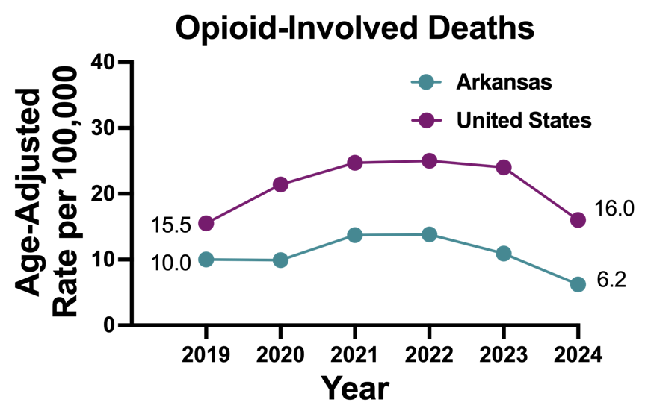
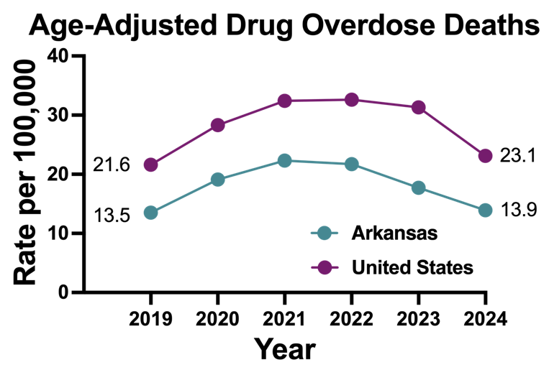
Drug Overdose Deaths
Source: CDC, CDC Wonder
Source: NCHS FastStats
Notes:
Arkansas's age-adjusted rate of opioid-involved overdose deaths was below the national rate every year from 2019 to 2024.
Both rates rose in 2021 and stayed near their peaks through 2022.
Both rates then declined, and the decline was steeper in Arkansas.
In 2024, Arkansas' opioid-involved death rate was about 60 percent lower than the national rate.
Arkansas's age-adjusted drug overdose death rate has been below the national rate every year since 2019.
In 2024, Arkansas’ drug overdose death rate was about 40 percent lower than the national rate.
Bottom Line

Slide 21
Adult Cocaine & Methamphetamine Use
Source: NSDUH
Notes:
Arkansas estimates for past-year cocaine use were lower than national estimates in every age group
The largest gap was among young adults ages 18–25 (1.6% vs. 2.7%).
Past-year methamphetamine use followed a different pattern in 2023-2024.
Arkansas at or higher than US rates
Arkansas ranked 11th in the nation for past-year adult prevalence of methamphetamine use in 2023-2024.
Bottom Line

Slide 22
Summary: Adult Substance Use
Arkansas adults are less likely than adults nationally to drink at all, but among those who do drink, consumption frequency and intensity is problematic
Among adults, the state remains a national outlier on three indicators:
  the highest opioid dispensing rate in the country
  the third highest adult smoking prevalence
  11th nationally for methamphetamine use

Slide 23
National Survey on Drug Use and Health (NSDUH)
2021 – 2024 Trends

Slide 24
Alcohol Use
50.6
52.5
51.5
48.5
42.5
42.4
43.7
43.3
29.7
27.7
26.5
24.9
22.5
21.8
20.0
18.9
7.3
6.8
3.6
4.1
7.0
6.1
3.2
3.7
Notes:
Rates of current alcohol use in Arkansas is the same or lower than those on the US
Rates of current alcohol binging in Arkansas is the same or lower than those on the US
Rates are higher among 18-25 year olds
Bottom Line

Slide 25
Tobacco/Cigarette Use
20.1
29.8
27.7
16.4
21.4
24.4
21.9
15.7
15.0
19.2
11.3
12.7
17.5
15.3
3.2
2.5
1.6
1.7
11.3
10.1
2.4
1.9
1.5
1.3
Notes:
Past month tobacco and cigarette use is at the same rate or higher for Arkansans than overall national population
Increase in 18-25 year old tobacco use
Bottom Line

Slide 26
Nicotine Vaping
29.4
30.2
24.0
23.9
9.1
9.2
9.2
11.2
6.8
6.4
6.8
7.6
Notes:
Current nicotine vaping is higher among Arkansans the US population for all age groups
Trend cannot be determined with only two data time points but appears to be on the rise
Bottom Line

Slide 27
Marijuana Use
25.3
24.7
37.3
35.8
23.3
30.3
33.2
20.5
17.3
23.3
13.3
15.0
19.0
21.2
10.3
11.2
12.9
15.5
6.3
6.5
11.2
10.8
6.2
6.0
Notes:
Arkansas past year and current marijuana use rates are generally at or below national rates
However, rates have been increasing among younger and older adults
Bottom Line
Target efforts on older adults in particular

Slide 28
Nonmedical Rx/Opioid Use
4.2
4.2
3.2
3.2
3.0
3.2
3.4
3.4
3.1
2.5
3.2
2.5
3.0
2.9
1.9
1.9
1.8
2.5
1.8
2.4
1.9
1.7
1.8
1.7
Notes:
Arkansas rates of nonmedical prescription and opioid use at or higher than US rates
Rates appear to be decreasing among young and older adults
Bottom Line

Slide 29
Illicit Drug Use
26.6
25.8
21.5
24.6
18.2
4.3
3.7
14.8
4.0
3.6
3.4
8.2
12.0
16.5
1.8
2.3
3.4
2.9
7.4
7.4
1.8
2.2
2.2
5.9
Notes:
Rates of illicit drug use are at or below national rates
Marijuana use seems to be the driving force among young adults
Bottom Line

Slide 30
Methamphetamine Use
2.1
1.1
1.2
1.0
1.0
0.2
0.5
0.4
0.1
0.4
0.1
0.2
Notes:
Arkansas rates of methamphetamine use are at or higher than national rates
Significant decrease among younger and older adults
Arkansas has dropped from 11th in country to 20th for methamphetamine use
Bottom Line

Slide 31
Summary: NSDUH
Arkansas is fairing better than than the US overall in terms of substance use except for problematic alcohol use, nicotine and tobacco use, vaping, and marijuana
Large reductions in opioid and methamphetamine use noted

Slide 32
Conclusions
Holding our own in AR
Start young
Target and tailor and individualize
Utilize technology

Slide 33
Discussion Questions
What prevention efforts are ongoing across the State?
What types (media campaigns, interventions) and at what levels (state/district/school/class/individual)?
Who keeps track of their implementation and evaluation?

Slide 34
THANK YOU MUCH

