Slide 1

Arkansas Statewide Epidemiological
Outcomes Workgroup
Thrice-Annual Meeting
05/22/2026
Supported by: SAMHSA Substance Abuse Block Grant 1B08TI087025-01

Slide 2
Today’s Agenda
Introductions and Mission Statement
Quick Facts: Updates from the Literature (A. Oliveto)
Updates on Adulterants in the Drug Supply (A. Oliveto)
Arkansas Drug Trends (N. Schoenborn)
Deeper APNA Data Dive: Demographics (J. Thostenson)
2021-2025 Arkansas Collegiate Survey Results (D. Slagle)
Veteran and Military-Connected Families in Arkansas (M. Bollinger)
CDC’s ENGAGE resource (A. Oliveto)
Discussion/Wrap Up

Slide 3
SEOW Mission
SEOW’s mission is to guide successful prevention efforts in the state of Arkansas by:
Analyzing, monitoring and sharing data trends in substance use and other environmental, behavioral, and health-related factors.
Informing data-driven policy and practice decision-making regarding prevention priorities at local and state levels.
Disseminating evidence-based education and prevention materials to the larger public.

Slide 4
Quick Facts
Updates from the Literature
Alison Oliveto, PhD
SEOW Team Leader
UAMS

Slide 5

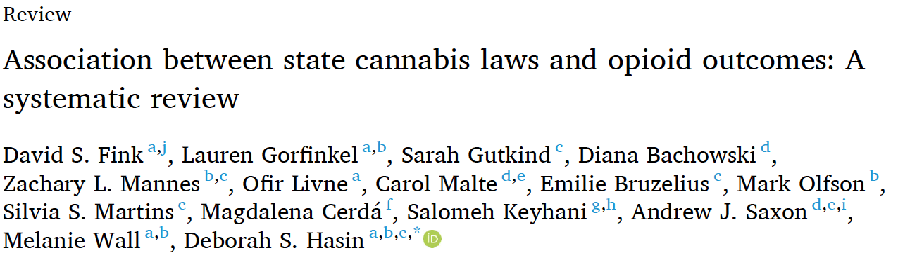
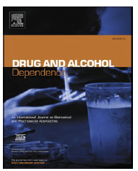
Systematic literature review to investigate relationship of state MCL and RCL to rates of opioid prescriptions, nonmedical use, opioid use disorder (OUD), opioid-related hospitalizations and emergency department visits, and overdose deaths.
RESULTS
Findings on MCL, RCL and opioid prescribing or on opioid-related ED visits/hospitalizations were mixed.
No study found decreases in non-medical opioid use after MCL enactment
Only one study found decreased non-medical use after RCL enactment
No studies found that MCL or RCL decreased OUD
MCL enactment associated with lower opioid overdose mortality rates in earlier but not more recent studies
Results of studies of RCL and opioid overdose fatalities were mixed
CONCLUSIONS
MCL and RCL are just two factors in a complex set of influences on opioid outcomes that require further study. Meanwhile, cannabis legalization should not be considered an effective policy for curbing the opioid epidemic.

Slide 6
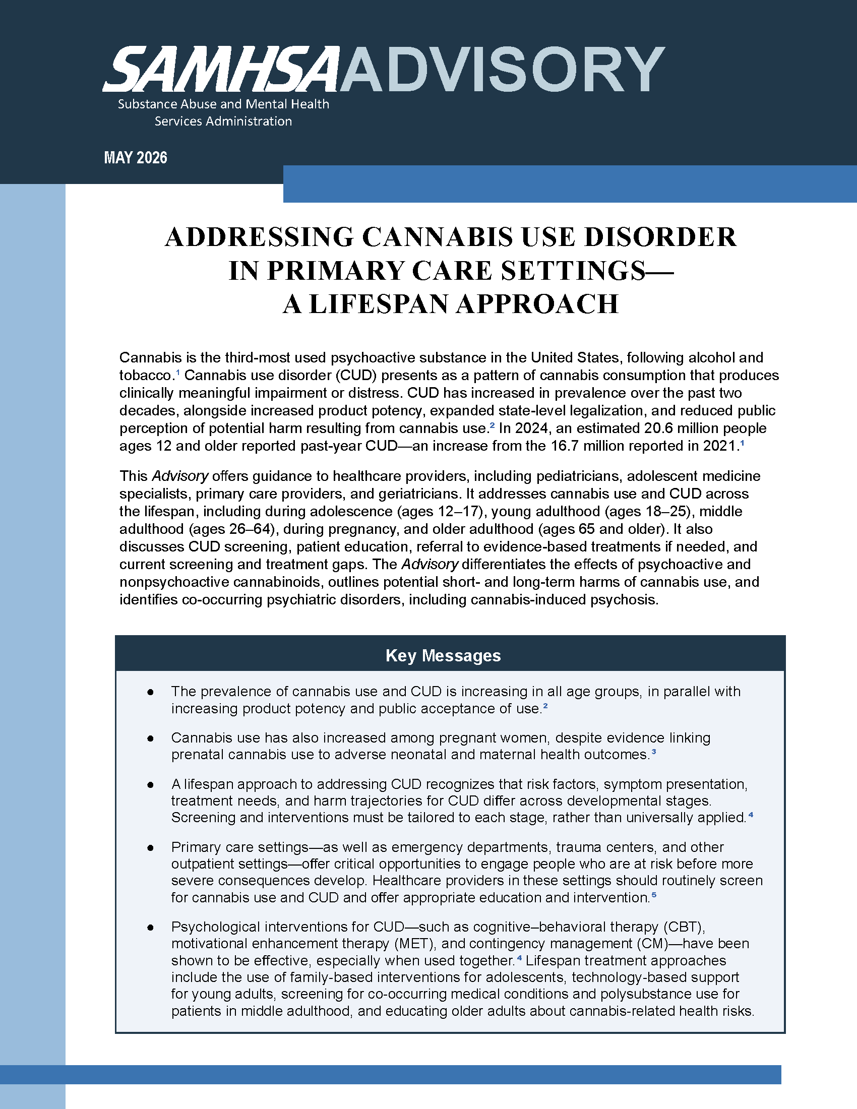
Offers guidance to healthcare providers
Addresses cannabis use and CUD across the lifespan and during pregnancy
Discusses CUD screening, patient education, referral to evidence-based treatments if needed, and current screening and treatment gaps.
Differentiates effects of psychoactive and nonpsychoactive cannabinoids
Outlines potential short- and long-term harms of cannabis use
Identifies co-occurring psychiatric disorders, including cannabis-induced psychosis.
https://library.samhsa.gov/sites/default/files/advisory-cannabis-use-pep26-07-003.pdf

Slide 7
US Drug Overdose Deaths Decrease by 14% from 2024 to 2025
Third straight year where a decrease in drug overdose deaths occurred!
69,973 deaths in 2025, similar to those observed in 2019
Concerns raised about sustainability of downward trend:
  Governmental cuts to programs such as drug testing kits and sterile syringe supplies
  Novel potent opioid and non-opioid adulterants in the drug supply increasing
https://www.pbs.org/newshour/health/u-s-overdose-deaths-fell-again-in-2025-but-some-worry-about-policy-and-drug-supply-changes

Slide 8
Updates on Adulterants in the Drug Supply
Alison Oliveto, PhD
SEOW Team Leader
UAMS

Slide 9
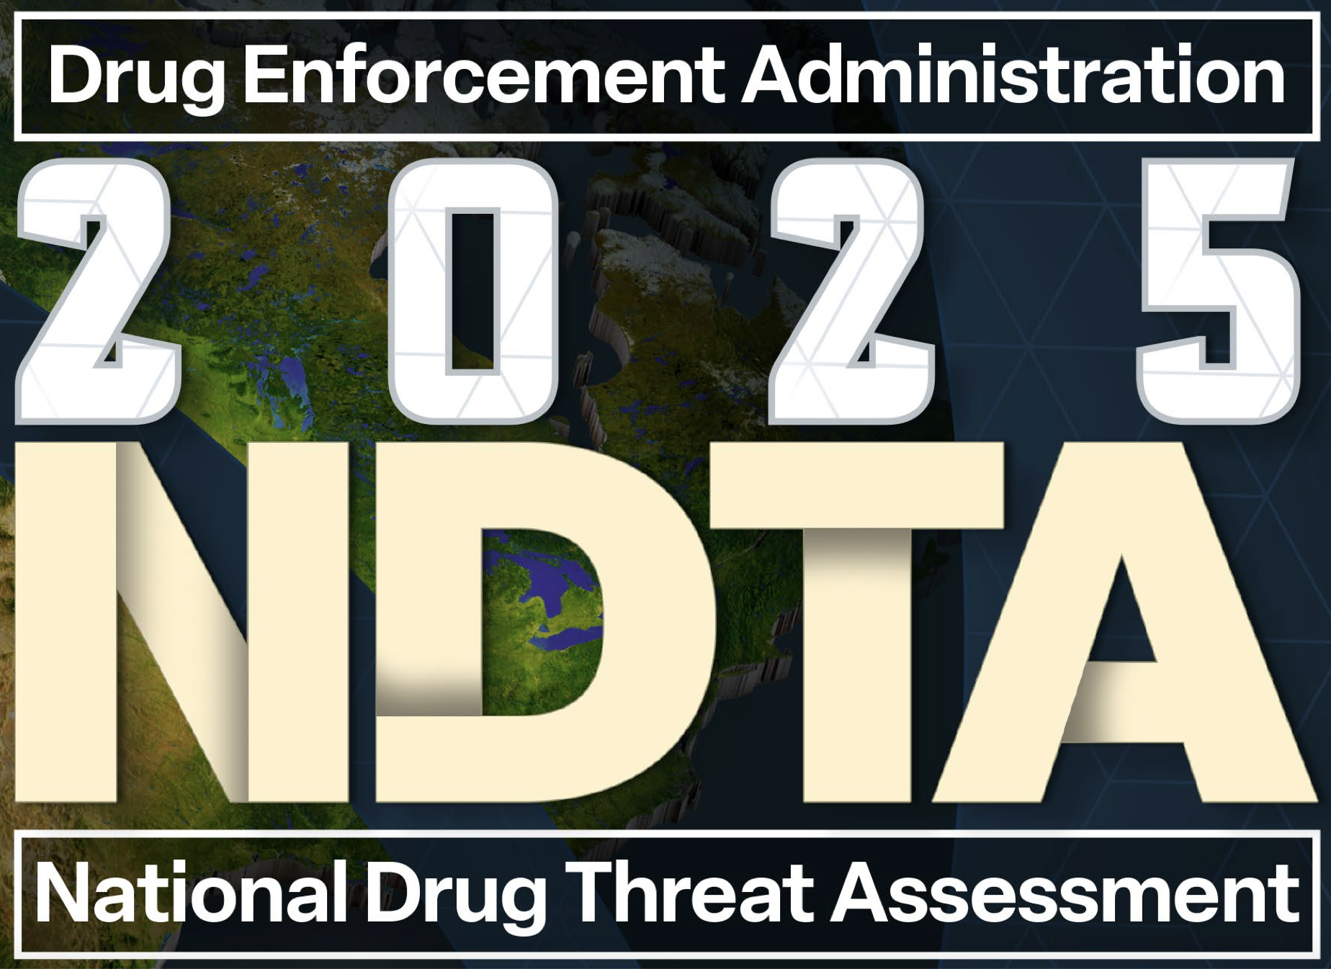
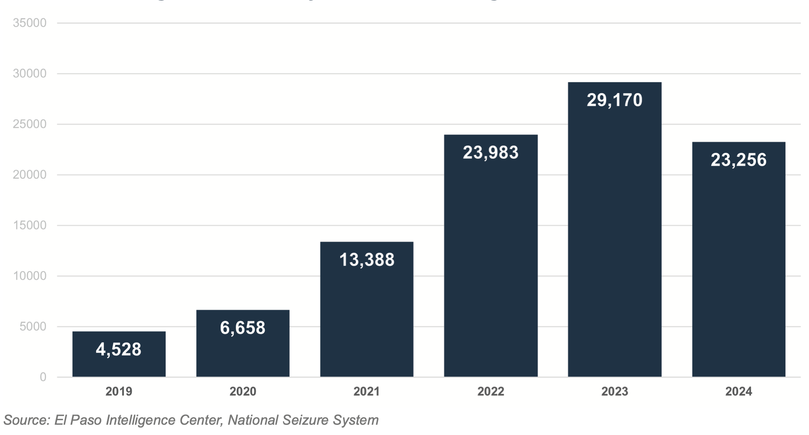
Fentanyl Seizures in Kg, 2019-2024
https://www.dea.gov/sites/default/files/2025-05/2025%20National%20Drug%20Threat%20Assessment_Web%205-12-2025.pdf

Slide 10
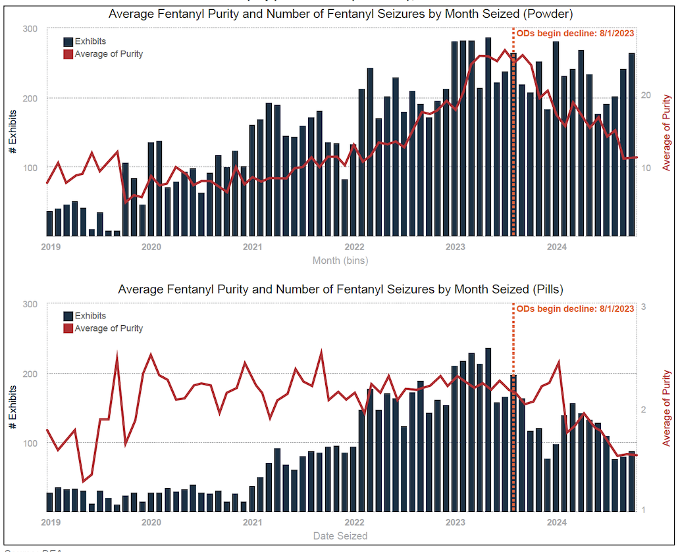
Fentanyl purity ↓ throughout 2024 and some key precursor chemicals many Mexico-based fentanyl cooks need were unavailable.
US fentanyl supply continues to be adulterated with animal tranquilizers, anesthetics, and other novel synthetic opioids.
https://www.dea.gov/sites/default/files/2025-05/2025%20National%20Drug%20Threat%20Assessment_Web%205-12-2025.pdf
Notes:
cannabinoids provide modest, condition-specific analgesia and should be considered adjunctive rather than first-line options, reserved for patients unresponsive to conventional therapy. Future progress requires standardized formulations, harmonized international regulations, long-term safety data, and large-scale randomized controlled trials to clarify their role in evidence-based pain management.
Cannabinoid therapies in chronic pain provide only modest analgesic benefits while exposing patients to frequent and sometimes disabling adverse effects. The reported out- comes indicate mild to moderate disturbances of the central nervous and gastrointestinal systems, but incidence rates and long-term safety remain poorly documented
Clinical data consistently reveal dizziness, dry mouth, fatigue, nausea, headache, somnolence, confusion, disorientation, and vision disturbances as the most prevalent ad- verse outcomes
In real-world practice, discontinuation occurs in 6.3% of patients within twelve weeks, most commonly due to dizziness, confusion, fatigue, or throat irritation

Slide 11
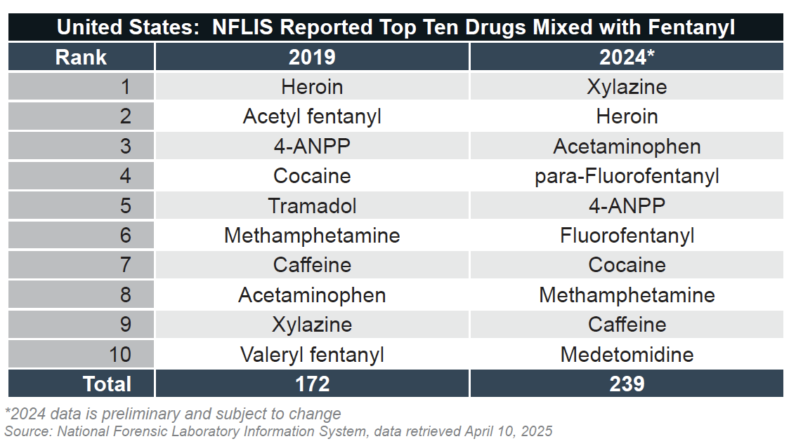
25X stronger than fentanyl
Fentanyl precursor/metabolite
2X stronger than fentanyl
https://www.dea.gov/sites/default/files/2025-05/2025%20National%20Drug%20Threat%20Assessment_Web%205-12-2025.pdf
Notes:
cannabinoids provide modest, condition-specific analgesia and should be considered adjunctive rather than first-line options, reserved for patients unresponsive to conventional therapy. Future progress requires standardized formulations, harmonized international regulations, long-term safety data, and large-scale randomized controlled trials to clarify their role in evidence-based pain management.
Cannabinoid therapies in chronic pain provide only modest analgesic benefits while exposing patients to frequent and sometimes disabling adverse effects. The reported out- comes indicate mild to moderate disturbances of the central nervous and gastrointestinal systems, but incidence rates and long-term safety remain poorly documented
Clinical data consistently reveal dizziness, dry mouth, fatigue, nausea, headache, somnolence, confusion, disorientation, and vision disturbances as the most prevalent ad- verse outcomes
In real-world practice, discontinuation occurs in 6.3% of patients within twelve weeks, most commonly due to dizziness, confusion, fatigue, or throat irritation

Slide 12
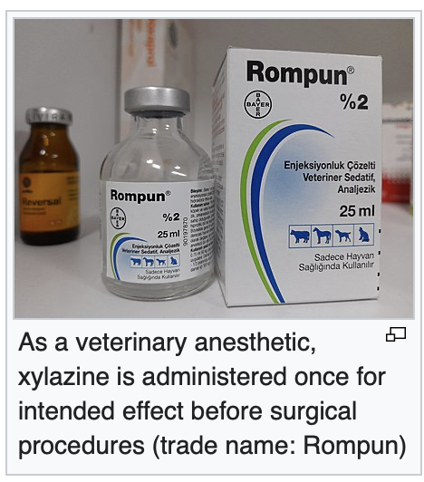
Xylazine
A non-opioid sedative, analgesic, and muscle relaxant only authorized in the US for veterinary use
Xylazine by itself can cause:
  Drowsiness, unconsciousness, coma
  Dangerously slowed breathing
  Dangerously low heart rate, and blood pressure
  Irregular heartbeat
  Lowered body temperature
Xylazine appears to worsen the life-threatening effects of opioids
wikipedia
Narcan is less effective in reversing overdose when xylazine is present and doesn’t alter xylazine’s effects at all!
https://www.dea.gov/sites/default/files/2022-12/The%20Growing%20Threat%20of%20Xylazine%20and%20its%20Mixture%20with%20Illicit%20Drugs.pdf
Notes:
These magnitudes are clinically relevant, placing cannabis alongside well-established risk factors for psychosis rather than as a minor or incidental contributor.

Slide 13
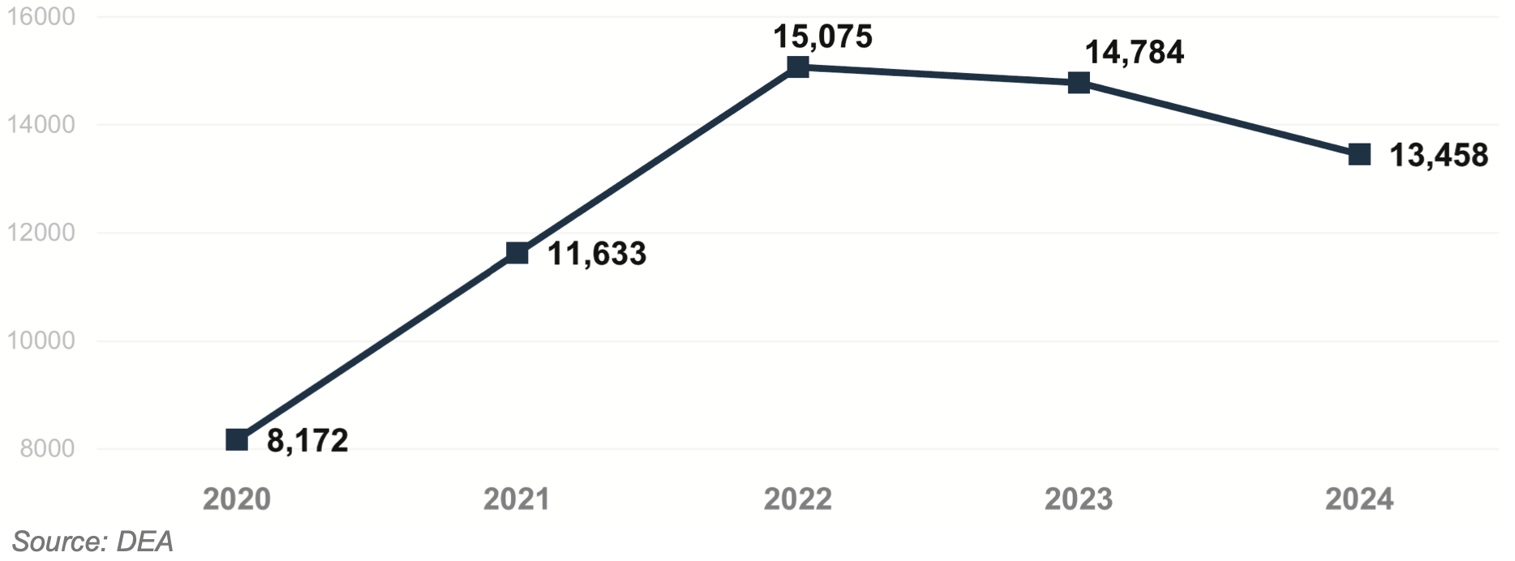
Number of Fentanyl Exhibits Containing Xylazine
Xylazine most prevalent in drug samples seized in New Jersey, Virginia, Ohio, Maryland, Pennsylvania, and Florida.
While xylazine remains the #1 adulterant found in fentanyl powder, medetomidine adulteration is increasing.
https://www.dea.gov/sites/default/files/2025-05/2025%20National%20Drug%20Threat%20Assessment_Web%205-12-2025.pdf
Notes:
This progression shows that cannabis-induced psychosis is not simply an acute toxic state but a potential entry point into a chronic psychiatric trajectory, particularly in young and vulnerable populations.

Slide 14
Novel Synthetic Opioids (NSOs)
Novel non-fentanyl opioids in the illicit drug supply
  Subclass of synthetic opioids referred to as nitazenes:
    Isotonitazene Metonitazene Etonitazene
  Subclass of synthethic opioids referred to as orphines or benzimidazolones:
    Brorphine Cychlorphine
  NSOs are structurally unrelated to fentanyl, but have been found to be up to:
    1000-fold more potent than morphine
    10 times more potent than fentanyl
  So, 1/10 of a sesame seed can be fatal to someone not tolerant to opioids!

Slide 15
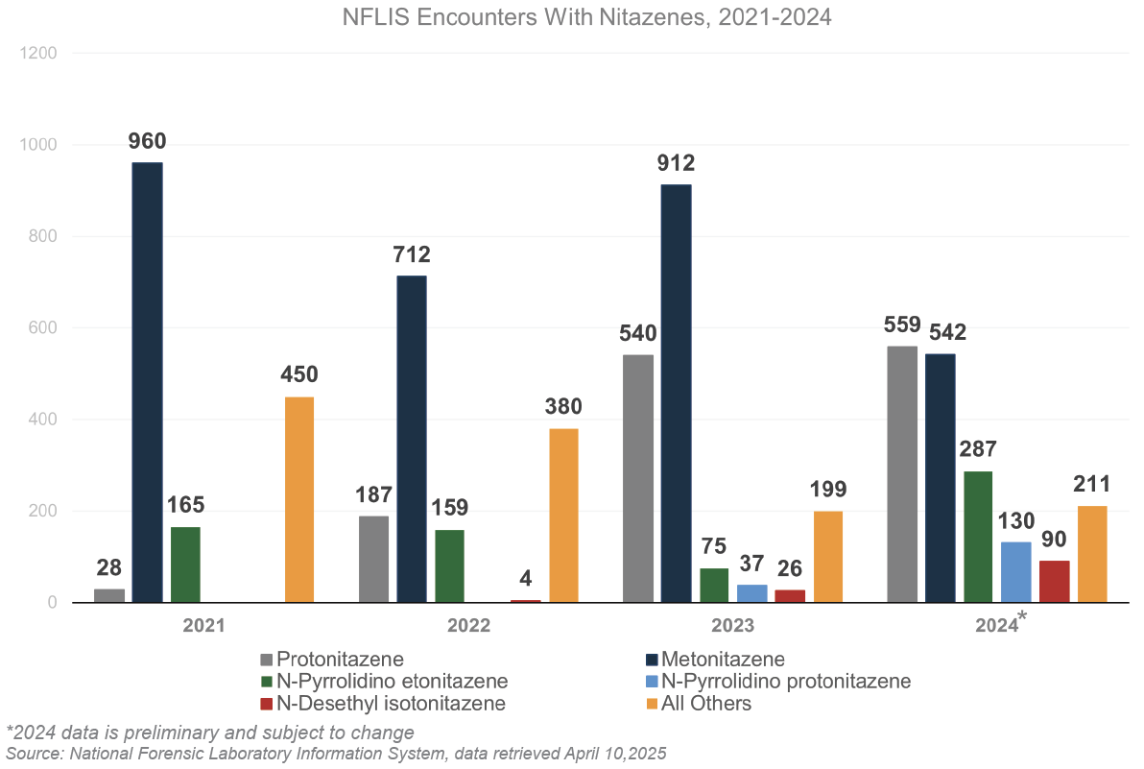
Nitazene Detections by DEA Forensic Laboratories
2021-2024*
Different nitazenes appearing in fentanyl mixtures in the United States since 2019.
More naloxone needed to reverse a nitazene-involved overdose.
https://www.dea.gov/sites/default/files/2024-05/5.23.2024%20NDTA-updated.pdf
Notes:
Estonia story

Slide 16
Arkansas Drug Threats
Substance | What is it? | Status in Arkansas
Xylazine | Veterinary sedative/analgesic often added to fentanyl, not approved for human use, causes severe CNS depression, intensifies and extends the high from fentanyl | Appeared in 2021 (1 case), reappeared in 2024 (8 cases) and 2025 (3 cases)
Medetomidine | Potent veterinary sedative, not approved for human use, used as an adulterant in fentanyl, profound sedation and CNS depression, 247 detections in 2023 to 8,233 in 2025 mostly in the Northeast and Midwest | Not detected in Arkansas
Nitazenes | Novel Synthetic Opioid, often found in counterfeit pills mixed with fentanyl, cocaine, or benzos, users typically do not know they are consuming them | Two (2) cases in Arkansas in 2024
Cychlorphine | Highly potent, illicit, synthetic opioid associated with severe overdose risk. First identified in 2024. | One (1) confirmed OD case in 2026. (2) drug exhibits identified in 2026.
Bromazolam | Illicit benzo not approved for medical use, increasingly common in counterfeit pills, appeared in the U.S. in 2019. Recently emergency scheduled (Schedule I) by DEA in 2026. | Appeared in 2024 with five (5) cases and in 2025 with three (3) cases
Synthetic Cannabinoids | Man-made chemicals designed to activate the same brain receptors as THC, often sprayed on plant material and sold as “K2”, “Spice”, etc. Can cause severe psychosis, seizures, and deadly toxicity | 2019 (7), 2020 (1), 2023 (5), 2024 (13), 2025 (34).

Slide 17
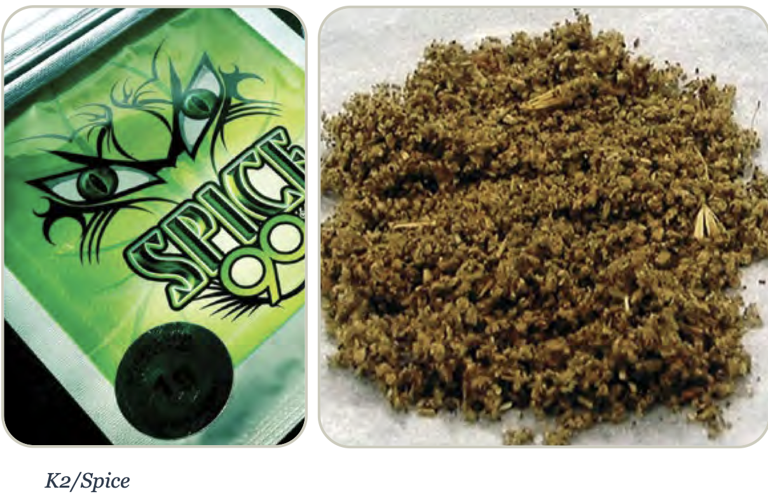
Synthetic Cannabinoids
[K2, Spice, Black Mamba, Kush, Kronic, and Genie]
Manufactured compounds often behaving as strong agonists at the body's cannabinoid receptors rather than partial agonists like natural THC
Chemicals often sprayed onto dried, shredded plant material for smoking or sold as concentrated liquids for vaping. Also found in illicit drug supply as an adulterant
Synthetic cannabinoids can cause severe, life-threatening symptoms, including:
  Physical: Seizures, heart attacks, stroke, kidney failure, breathing problems, chest pain, and rapid heart rate.
  Mental: Intense anxiety, confusion, paranoia, hallucinations, and violent behavior
https://nida.nih.gov/research-topics/synthetic-cannabinoids; https://www.dea.gov/sites/default/files/2025-01/K2-Spice-Drug-Fact-Sheet.pdf
Notes:
Synthetic drugs contain a mixture of psychoactive compounds that mostly bind cannabinoid receptors with high potency. These synthetic drugs replicate the effects of natural cannabis and Δ9-tetrahydrocannabinol but they induce more severe adverse effects including respiratory difficulties, hypertension, tachycardia, chest pain, muscle twitches, acute renal failure, anxiety, agitation, psychosis, suicidal ideation, and cognitive impairment. Chronic use of synthetic cannabinoids has been associated with serious psychiatric and medical conditions and even death.

Slide 18
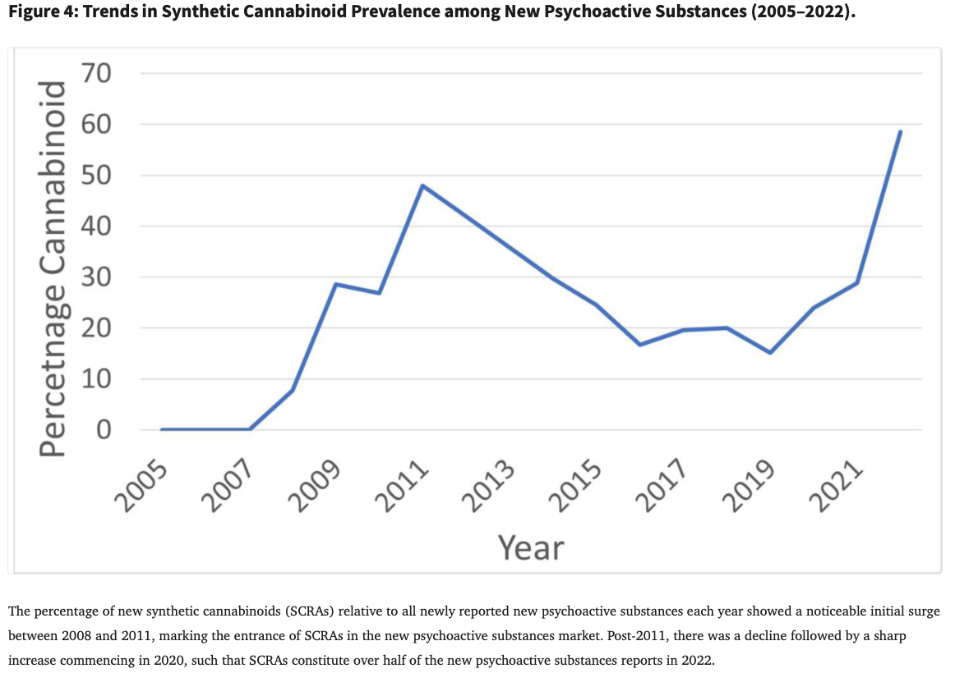
Cannabinoid Use Prevalence Among NPS’s in Europe 2005-2022
Jones AT, Marwan Abu Taha A, Miller GP. The resurgence of synthetic cannabinoid receptor agonists as adulterants in the Era of Cannabis legalization: Lessons from prior epidemics and clinical implications. Neurosci Biobehav Rev. 2025 Mar;170:106043. doi: 10.1016/j.neubiorev.2025.106043. Epub 2025 Feb 6. PMID: 39922438; PMCID: PMC11870277

Slide 19
U.S. Cannabinoid Use Prevalence
U.S. PY Use showed 50% ↑ from 0.17% in 2021 to 0.26% in 2023 (NSDUH)
Use most common among:
  Males
  Younger adults
  People with lower education/income
  People living in non-metropolitan areas
  People who already smoke or vape plant-based cannabis
Synthetic marijuana question in APNA last asked in 2020:
  Lifetime: 1.0% of students (down from 2.4% in 2015)
  P30D: 0.5% of students (down from 0.6% in 2015)
Notes:
Need pragmatic RCTs comparing cannabis effectiveness with other pharmacological agents and psychotherapies with longer follow-up times and larger sample sizes are required to make stronger conclusions about cannabis effectiveness in PTSD management.

Slide 20
Summary
Although fentanyl has been the ultimate “adulterant” that took over the drug supply, fentanyl is becoming increasingly adulterated with other dangerous substances
These novel adulterants complicate harm reduction approaches to opioid overdose and may offset any alleviation of the overdose crisis
Vigilance and novel harm reduction approaches are needed

Slide 21
Discussion

Slide 22
Arkansas Drug Trends
Nicole Schoenborn, PhD

Slide 23
CDC’s ENGAGE
Resource
Alison Oliveto, PhD

Slide 24

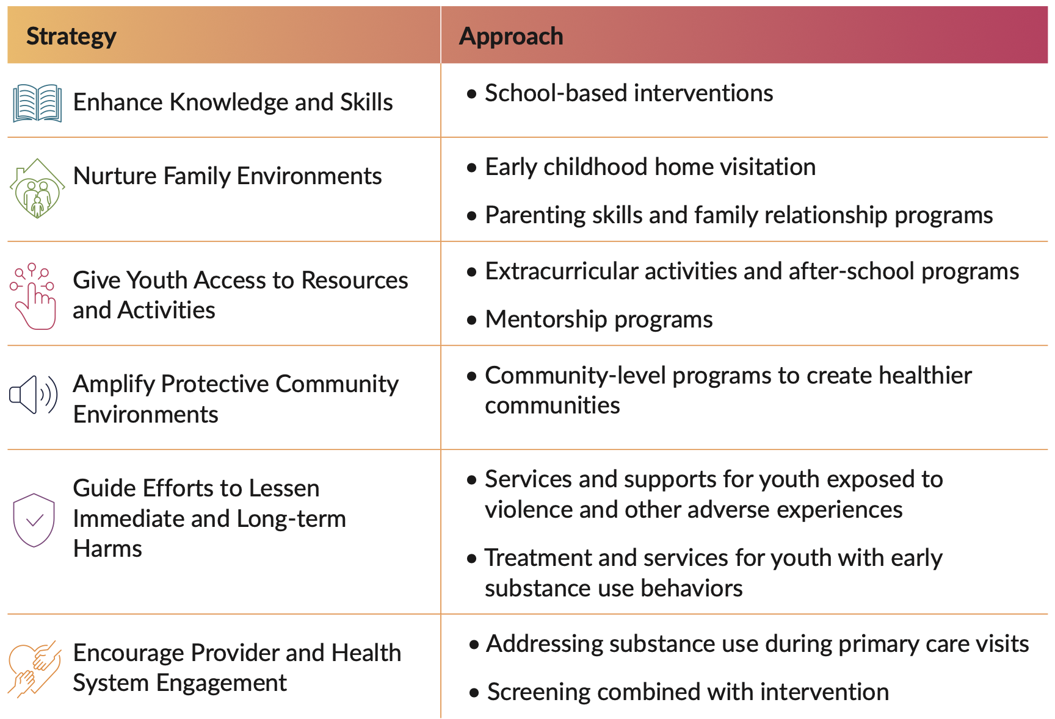
Centers for Disease Control and Prevention (2025). ENGAGE: Evidence-Based Strategies to Prevent Youth Substance Use. Atlanta, GA: National Center for Injury Prevention and Control, Centers for Disease Control and Prevention.

Slide 25
Strategy 1: Enhance Knowledge and Skills
Typically school-based programs aiming to enhance drug refusal skills, knowledge of the risk of substance use, social and emotional support, and communication skills.
Life Skills Training (LST): critical drug refusal skills, personal self-management skills (i.e., goal setting and self-esteem) and social skills. Curricula for students in elementary school, middle school, and high school
Good Behavior Game (GBG): to develop positive class rules aimed at reducing disruptive classroom behavior among children ages 5 to 11 years old. Students are assigned to teams and given cards that are only taken away if one of the students violates the assigned class rules. Teachers encourage students to manage their own behavior as well as their teammates in their assigned groups. If teams have at least one card at the end of the game, they are rewarded.
Centers for Disease Control and Prevention (2025). ENGAGE: Evidence-Based Strategies to Prevent Youth Substance Use. Atlanta, GA: National Center for Injury Prevention and Control, Centers for Disease Control and Prevention.

Slide 26
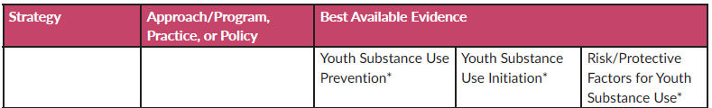
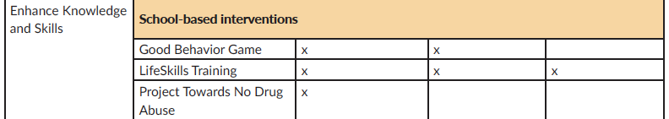
Strategy 1: Summary of Evidence
Centers for Disease Control and Prevention (2025). ENGAGE: Evidence-Based Strategies to Prevent Youth Substance Use. Atlanta, GA: National Center for Injury Prevention and Control, Centers for Disease Control and Prevention.

Slide 27
Strategy 2: Nurture Family Environments
Offered to specific age groups, and their content reflects the appropriate developmental needs of children at different developmental stages.
Strengthening Families Program (SFP 10-14): promotes positive parenting and caregiving and family relationships through group classes, with seven separate training sessions for caregivers and children 10-14 years. Weekly sessions are conducted in community settings such as schools or community centers, followed by a family session where caregivers and children practice their skills, work on conflict resolution, and complete activities to increase family cohesiveness.
Strong African American Families (SAAF): adapted from SFP 10-14, is designed for late childhood (5-11 years) and early adolescence (12-14 years) and their families to strengthen family relationships and teach parents to help youth develop skills to reach positive goals.
Familias Unidas: a family intervention for preventing drug use and sexual risk behavior among Hispanic youth aged 12-16 years. Through eight in-person multiparent group sessions and four family sessions, Familias Unidas is designed to help parents or caregivers understand how to help protect adolescents from risky behaviors and teach parents and caregivers more about children’s health and well-being.
Centers for Disease Control and Prevention (2025). ENGAGE: Evidence-Based Strategies to Prevent Youth Substance Use. Atlanta, GA: National Center for Injury Prevention and Control, Centers for Disease Control and Prevention.

Slide 28
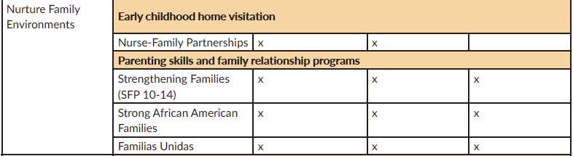
Strategy 2: Summary of Evidence
Centers for Disease Control and Prevention (2025). ENGAGE: Evidence-Based Strategies to Prevent Youth Substance Use. Atlanta, GA: National Center for Injury Prevention and Control, Centers for Disease Control and Prevention.

Slide 29
Strategy 3: Give Youth Access to Resources and Activities
Extracurricular activities and after-school programs help youth develop leadership and academic skills, and promote physical activity, responsibility, and future planning. Organized activities (e.g., sports, arts, community service clubs) promote growth, caring relationships with non-parental adults, and strong positive peer networks. Participating in mentoring programs encourages healthy development.
Raising Healthy Children Program (1-12 grade): promotes positive youth development through educational and family support systems. It incorporates school, family, and individual programs, focusing on building strong connections to help create success in school and life.
Big Brothers, Big Sisters of America (BBBS): a one-to-one mentoring program that pairs adult volunteers with youth, fostering a relationship through regular meetings and recreational and social activities multiple times a month.
Centers for Disease Control and Prevention (2025). ENGAGE: Evidence-Based Strategies to Prevent Youth Substance Use. Atlanta, GA: National Center for Injury Prevention and Control, Centers for Disease Control and Prevention.

Slide 30
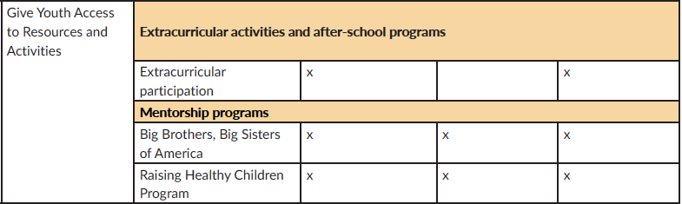
Strategy 3: Summary of Evidence
Centers for Disease Control and Prevention (2025). ENGAGE: Evidence-Based Strategies to Prevent Youth Substance Use. Atlanta, GA: National Center for Injury Prevention and Control, Centers for Disease Control and Prevention.

Slide 31
Strategy 4: Amplify Protective Community Environments
Building social skills and support networks to prevent youth substance use. Community coalitions that lead evidence-based prevention programs in school and community settings support healthy choices, reduce youth substance use and create healthier communities.
Communities that Care (CTC): helps communities develop or enhance a partnership coalition to assess specific community needs. Coalitions select/implement evidence-based interventions that promote healthy development and reduce problem behaviors. CTC provides tools to prevent youth substance use by focusing on risk and protective factors unique to each community and helps community coalitions create a prevention plan, create partnerships, and continuously evaluate and adjust program needs.
PROSPER (PROmoting School-community-university Partnerships to Enhance Resilience): implements evidence-based prevention programs through community partnerships between researchers, practitioners, and public-school systems [one school-based and one family-based intervention and are supported by PROSPER implementation coaches].
Centers for Disease Control and Prevention (2025). ENGAGE: Evidence-Based Strategies to Prevent Youth Substance Use. Atlanta, GA: National Center for Injury Prevention and Control, Centers for Disease Control and Prevention.

Slide 32
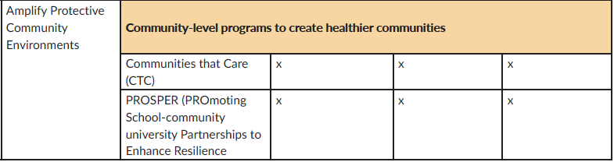
Strategy 4: Summary of Evidence
Centers for Disease Control and Prevention (2025). ENGAGE: Evidence-Based Strategies to Prevent Youth Substance Use. Atlanta, GA: National Center for Injury Prevention and Control, Centers for Disease Control and Prevention.

Slide 33
Strategy 5: Guide Efforts to Lessen Immediate and Long-term Harms
Providing services and support for youth exposed to violence and other adverse experiences can support youth at increased risk for substance use, as well as providing treatment (trauma-informed care/emotional support) and services to youth with early substance use behaviors.
KEEP SAFE program: designed to lessen the impact of ACEs among children in foster care.
Coping Power program: builds a sense of school connection and offers coping skills for aggressive behavior–two risk factors for youth substance use.
Multidimensional Family Therapy (MDFT): an integrated mental health treatment program that helps families respond to individual, family, and environment factors associated with youth substance use.
Centers for Disease Control and Prevention (2025). ENGAGE: Evidence-Based Strategies to Prevent Youth Substance Use. Atlanta, GA: National Center for Injury Prevention and Control, Centers for Disease Control and Prevention.

Slide 34
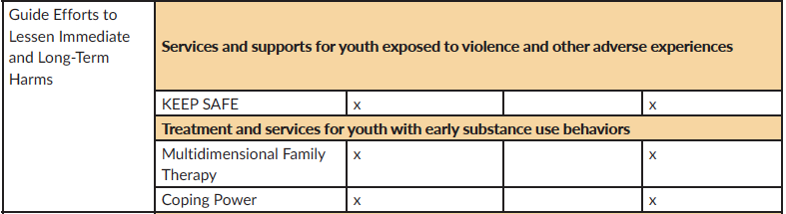
Strategy 5: Summary of Evidence
Centers for Disease Control and Prevention (2025). ENGAGE: Evidence-Based Strategies to Prevent Youth Substance Use. Atlanta, GA: National Center for Injury Prevention and Control, Centers for Disease Control and Prevention.

Slide 35
Strategy 6: Encourage Provider and Health System Engagement
Healthcare providers interact with youth throughout important developmental milestones, creating opportunities to discuss problem behaviors among youth. Early screening combined with intervention can help ensure that youth have access to treatment and support services to lower their likelihood of engaging in negative health behaviors such as substance use.
Bright Futures: well-child and adolescent care guidance developed by healthcare professionals and subject matter experts for use with primary care providers.
Substance Use Screening, Brief Intervention, and Referral to Treatment (SBIRT): recommended as a part of youth’s routine health care.
Centers for Disease Control and Prevention (2025). ENGAGE: Evidence-Based Strategies to Prevent Youth Substance Use. Atlanta, GA: National Center for Injury Prevention and Control, Centers for Disease Control and Prevention.

Slide 36
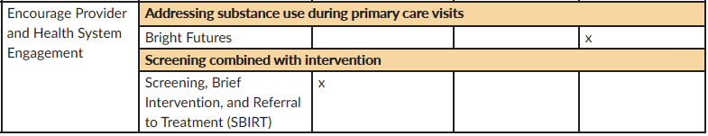
Strategy 6: Summary of Evidence
Centers for Disease Control and Prevention (2025). ENGAGE: Evidence-Based Strategies to Prevent Youth Substance Use. Atlanta, GA: National Center for Injury Prevention and Control, Centers for Disease Control and Prevention.
Centers for Disease Control and Prevention (2025). ENGAGE: Evidence-Based Strategies to Prevent Youth Substance Use. Atlanta, GA: National Center for Injury Prevention and Control, Centers for Disease Control and Prevention.

Slide 37
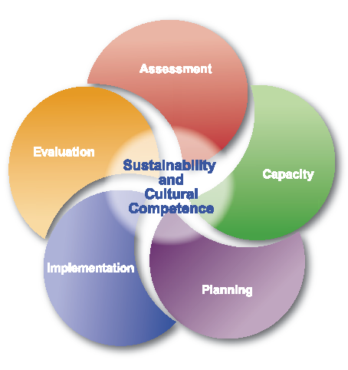
Strategic Prevention Framework
Assessment: identification of local prevention needs based on data
Capacity: building local resources and readiness to address prevention needs
Planning: determining methods to address prevention needs effectively
Implementation: delivering evidence-based programs and practices as intended
Evaluation: examining process and outcomes of programs and practices.

Slide 38

CAUTION
Evidence-Based
Versus
Evidence-Informed
Adapting Evidence-Based Programs
Level of Involvement of Stakeholders
Monitoring Fidelity of Intervention
Interventions Targeting Specific Substances
Need for Facilitator Training

Slide 39
Discussion
&
Wrap Up

Slide 40
Thank you!

