Slide 1

Deeper APNA Data Dive
State-level Trends in Substance Use and Risk Perception by Demographic factors

Slide 2
State-level Trends in Substance Use and Risk Perception by Demographic factors
Previously:
  Analyzed trends in rates of substance use and risk perception (state and regionally)
  APNA Self-reported past 30 day use of 8 substances:
    Alcohol, Cigarettes, Marijuana, RX drugs, Smokeless tobacco, Vaping(flavor, marijuana, nicotine)
  APNA Perceived moderate/great risk of 8 substances (protective factor):
    Alcohol(daily, weekend), Cigarettes, E-cigarettes, Marijuana, RX drugs, Vaping(occasionally, regularly)

Slide 3

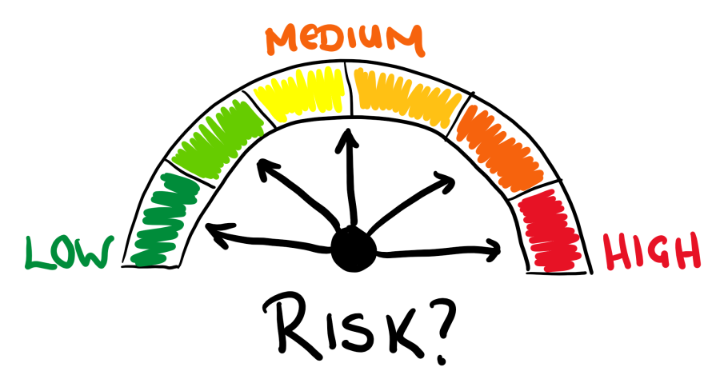
State-level Trends in Substance Use and Risk Perception by Demographic factors
General question: "The following questions ask about substances used in the past 30-Days. On how many occasions (if any) have you:" (used this substance)
  1) 0
  2) 1-2
  3) 3-5
  4) 6-9
  5) 10+
General question: "How much do you think people risk harming themselves (physically or in other ways) if they:" (use this substance)
  1) No risk
  2) Slight risk
  3) Moderate risk
  4) Great risk
  5) Can't say, drug unfamiliar
Any Use vs. No use
Moderate/Great risk vs. No/Slight/Can’t say

Slide 4
State-level Trends in Substance Use and Risk Perception by Demographic factors
Now:
  Analyzing at state-level, but adjusting trends by demographic factors
The Demographics factors:
  Gender(Female v. Male)
  Race(Non-White v. White)
  Ethnicity(Hispanic v. Non-Hispanic)
  Grade(6th, 8th, 10th, 12th)
Infographic displays for each outcome
  Is there a trend over 2021 to 2024 within each group?
  Do trends differ between groups?

Slide 5
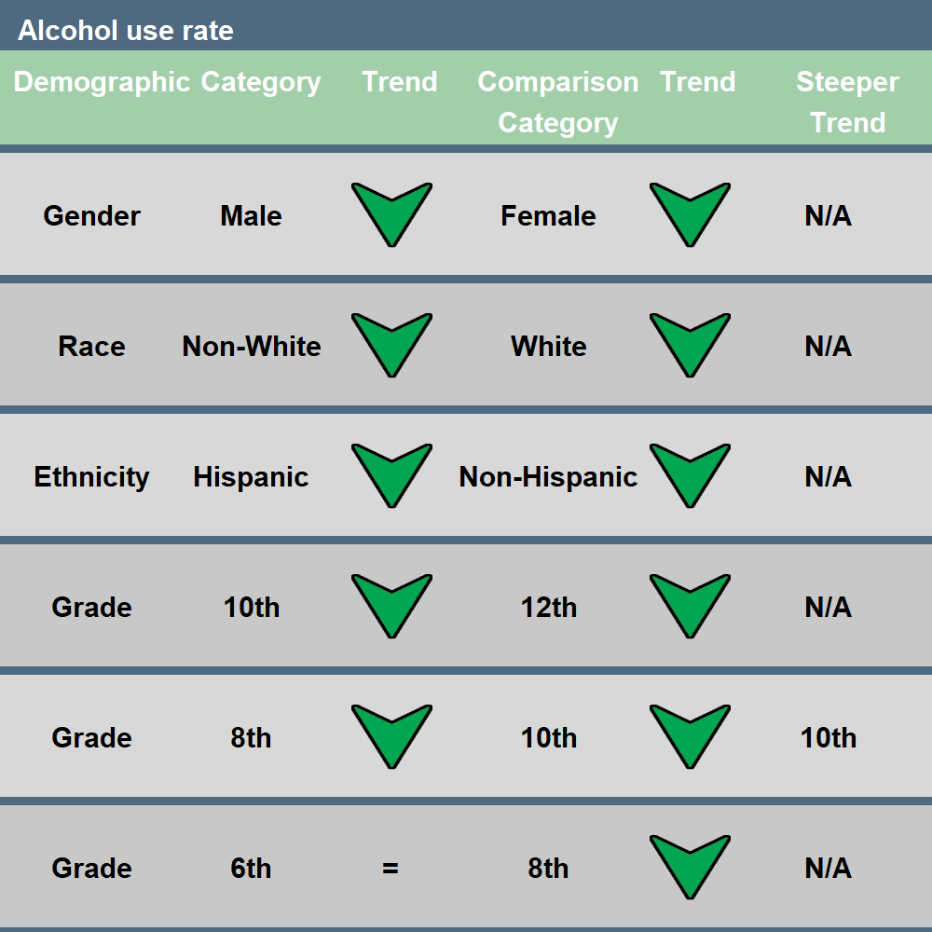
Arrows indicate statistically significant trend in that direction
Green arrows: a decrease in use or increase in risk perception
Red arrows: an increase in use or decrease in risk perception.
“=“ indicates no significant trend
“N/A” neither trend is significantly steeper
2021-2024 Trend Results:
Use decreasing in every demographic category except 6th graders
Decreasing more sharply in 10th graders than in 8th graders
Notes:
Alcohol Use:
--10th 13.09% vs. 8th 6.30%: 10th has a steeper decrease, but is starting from a higher rate in 2021

Slide 6
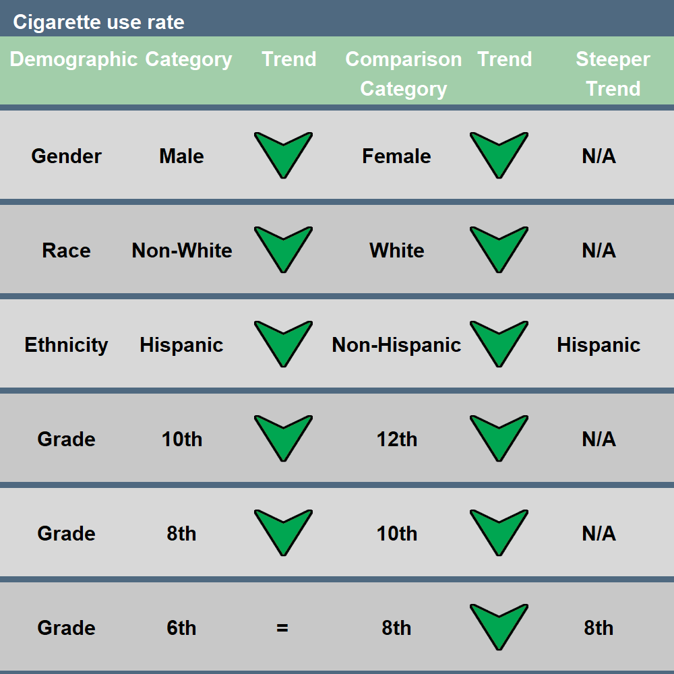
Arrows indicate statistically significant trend in that direction
Green arrows: a decrease in use or increase in risk perception
Red arrows: an increase in use or decrease in risk perception.
“=“ indicates no significant trend
“N/A” neither trend is significantly steeper
2021-2024 Trend Results:
Use decreasing in every demographic category except 6th graders
Decreasing more sharply in Hispanic than in Non-Hispanic
Notes:
Cigarettes Use:
--Hispanic 1.45% vs. Non-hispanic 2.11%: Hispanic has steeper decrease, but similar starting points in 2021
--8th 1.55% vs. 6th 0.63: 8th has steeper decrease, though similar starting points but 8th slightly higher and more room to go down, while 6th is low and stable

Slide 7
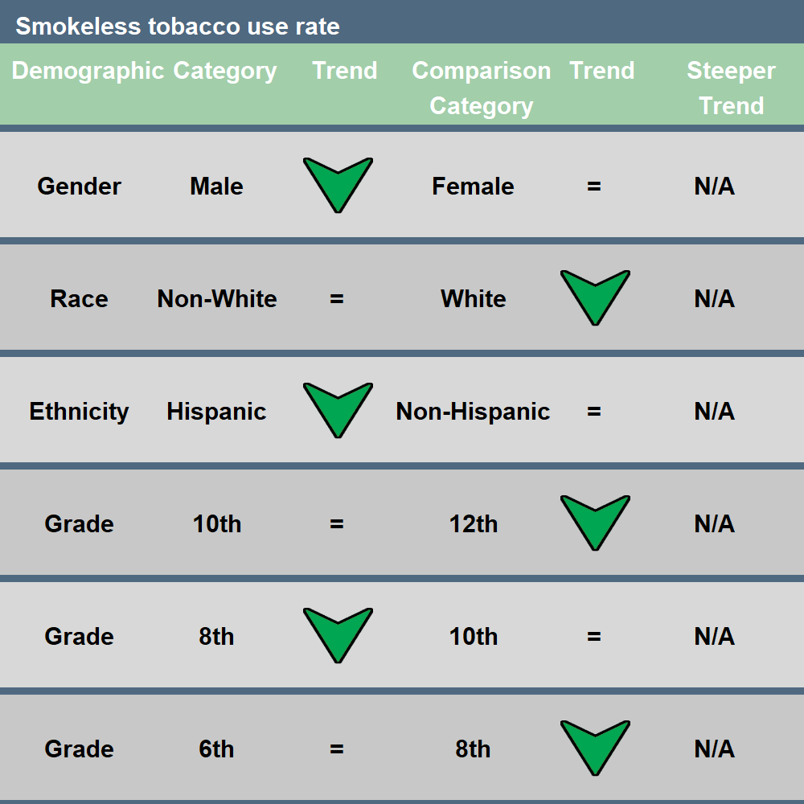
Arrows indicate statistically significant trend in that direction
Green arrows: a decrease in use or increase in risk perception
Red arrows: an increase in use or decrease in risk perception.
“=“ indicates no significant trend
“N/A” neither trend is significantly steeper
2021-2024 Trend Results:
Decreasing in Males, White race, Hispanic ethnicity, 12th and 8th graders

Slide 8
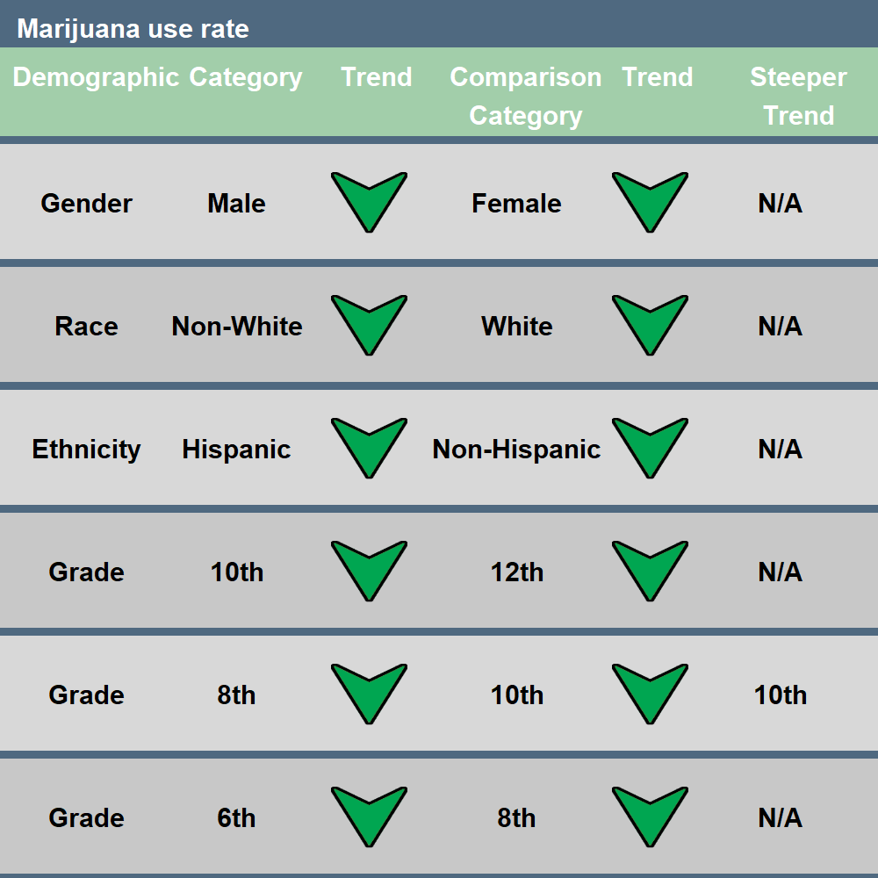
Arrows indicate statistically significant trend in that direction
Green arrows: a decrease in use or increase in risk perception
Red arrows: an increase in use or decrease in risk perception.
“=“ indicates no significant trend
“N/A” neither trend is significantly steeper
2021-2024 Trend Results:
Decreasing in every demographic group analyzed
Decreasing more sharply in 10th graders than in 8th graders
Notes:
Marijuana Use:
--10th 8.44% vs. 8th 3.45%: 10th starts higher than 8th, so can go down more steeply

Slide 9
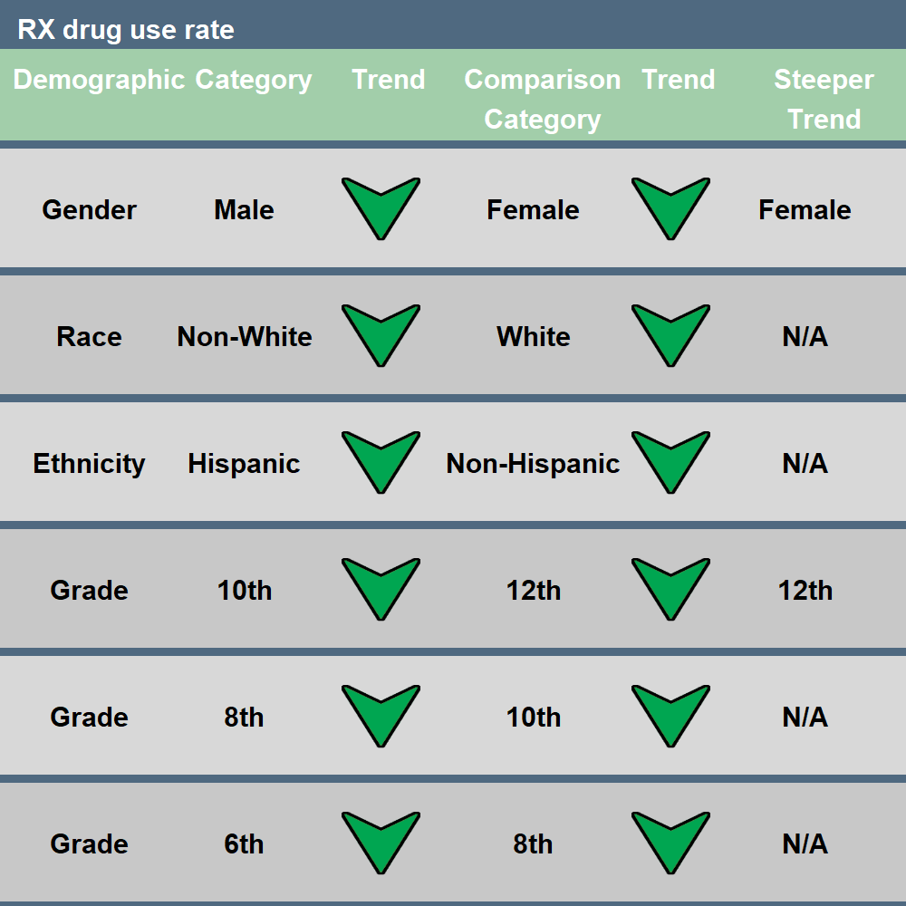
Arrows indicate statistically significant trend in that direction
Green arrows: a decrease in use or increase in risk perception
Red arrows: an increase in use or decrease in risk perception.
“=“ indicates no significant trend
“N/A” neither trend is significantly steeper
2021-2024 Trend Results:
Decreasing in every demographic group analyzed
Decreasing more sharply in Females than in Males
Decreasing more sharply in 12th graders than in 10th graders
Notes:
RX drugs Use:
--Female 3.27% vs. Male 2.20%: Females start slightly higher, so more room to go down.
--12th 2.59% vs. 10th 2.31%: similar starting points, 12th just slightly higher, but steeper decrease.

Slide 10
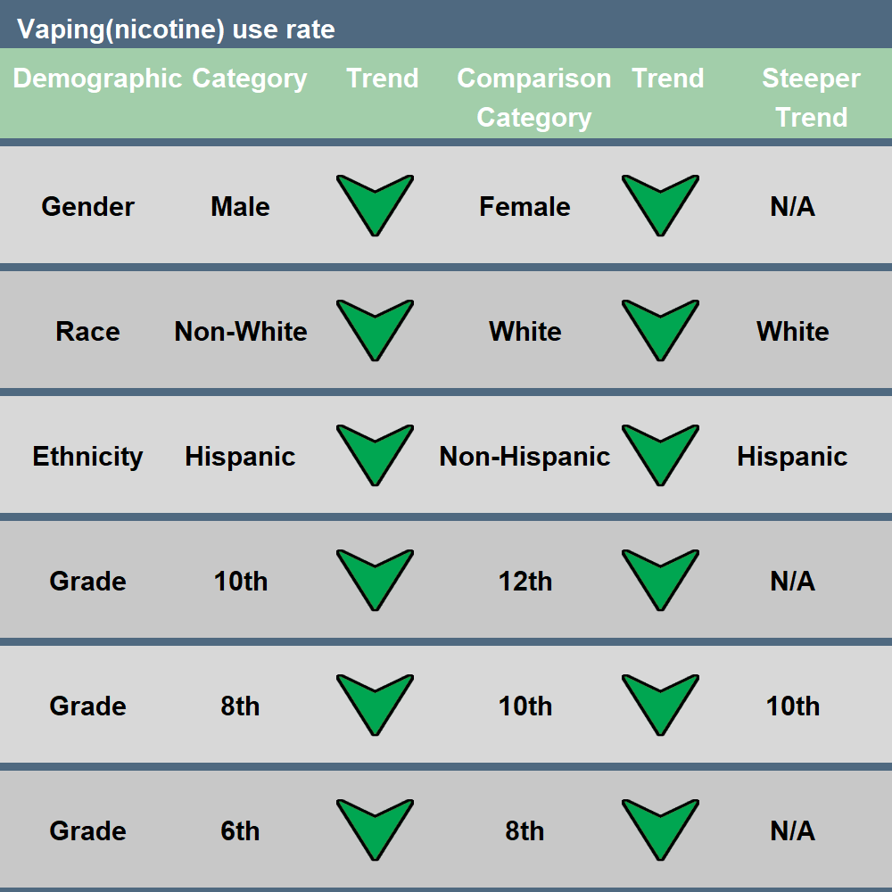
Arrows indicate statistically significant trend in that direction
Green arrows: a decrease in use or increase in risk perception
Red arrows: an increase in use or decrease in risk perception.
“=“ indicates no significant trend
“N/A” neither trend is significantly steeper
2021-2024 Trend Results:
Decreasing in every demographic group analyzed
Decreasing more sharply in White than Non-White
Decreasing more sharply in Hispanic than in Non-Hispanic
Decreasing more sharply in 10th graders than in 8th graders
Notes:
Vaping Nicotine Use:
--White 11.52% vs. Non-white 5.67%: White starts rather higher, so can decrease more steeply
--Hispanic 7.68% vs. Non-hispanic 10.14% Hispanic starts lower but also decreases more steeply
--10th 14.82% vs. 8th 7.55% 10th starts rather higher so can decrease more steeply

Slide 11
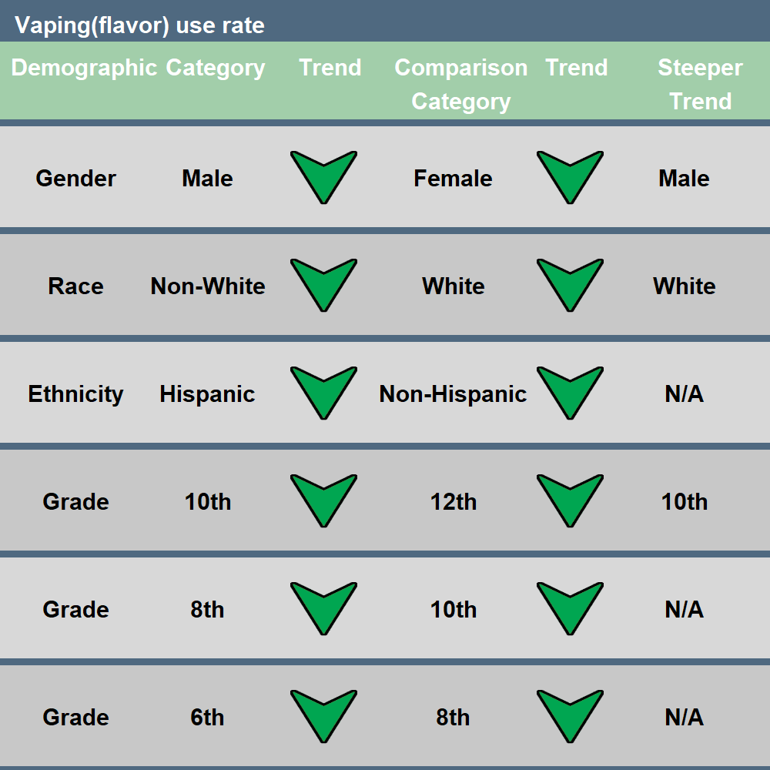
Arrows indicate statistically significant trend in that direction
Green arrows: a decrease in use or increase in risk perception
Red arrows: an increase in use or decrease in risk perception.
“=“ indicates no significant trend
“N/A” neither trend is significantly steeper
2021-2024 Trend Results:
Decreasing in every demographic group analyzed
Decreasing more sharply in Males than in Females
Decreasing more sharply in White than Non-White
Decreasing more sharply in 10th graders than in 12th graders
Notes:
Vaping Flavor Use:
--Male 4.03% vs. Female 6.11%: males start slightly lower but still decrease more steeply
--White 5.28% vs. Non-white 4.82%: White starts slightly higher so can decrease more steeply
--10th 7.09% vs. 12th 5.84: 10th starts higher, can decrease more steeply

Slide 12
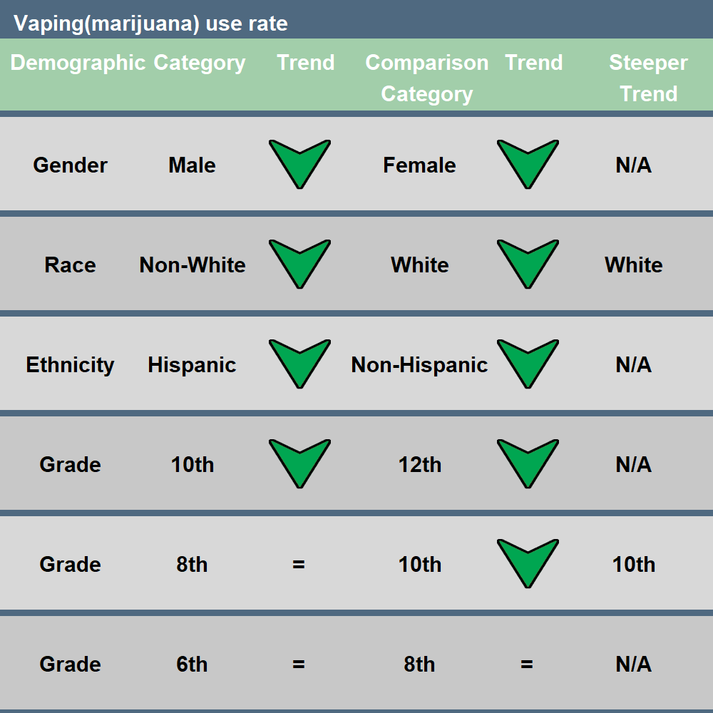
Arrows indicate statistically significant trend in that direction
Green arrows: a decrease in use or increase in risk perception
Red arrows: an increase in use or decrease in risk perception.
“=“ indicates no significant trend
“N/A” neither trend is significantly steeper
2021-2024 Trend Results:
Decreasing in every demographic category except 8th and 6th graders
Decreasing more sharply in White than Non-White
Decreasing more sharply in 10th graders than in 8th graders
Notes:
Vaping Marijuana Use:
--White 4.96% vs. Non-white 3.62%: White starts higher, can decrease more steeply
--10th 7.28% vs. 8th 2.94%: 10th starts rather higher so can decrease more steeply

Slide 13
Summary of Trends in Substance Use
Use shows decreasing trends across the state for most demographic groups and most substances, except:
  Alcohol and Cigarette use stable in 6th graders
  Smokeless tobacco use stable in: Females, Non-White race, Non-Hispanic ethnicity, 6th & 10th graders
  Marijuana vaping use stable in: 6th & 8th graders
Demographic groups with steeper trends:
  12th (vs. 10th) graders: RX drugs
  10th (vs. 8th) graders: Alcohol, Marijuana, Vaping nicotine, Vaping marijuana
  10th (vs. 12th) graders: Vaping flavor
  8th (vs. 6th) graders: Cigarettes
  Female (vs. Male): RX drugs
  Male (vs. Female): Vaping flavor
  Hispanic (vs. Non-Hispanic): Cigarettes, Vaping nicotine
  White (vs. Other): Vaping flavor, Vaping marijuana, Vaping nicotine

Slide 14
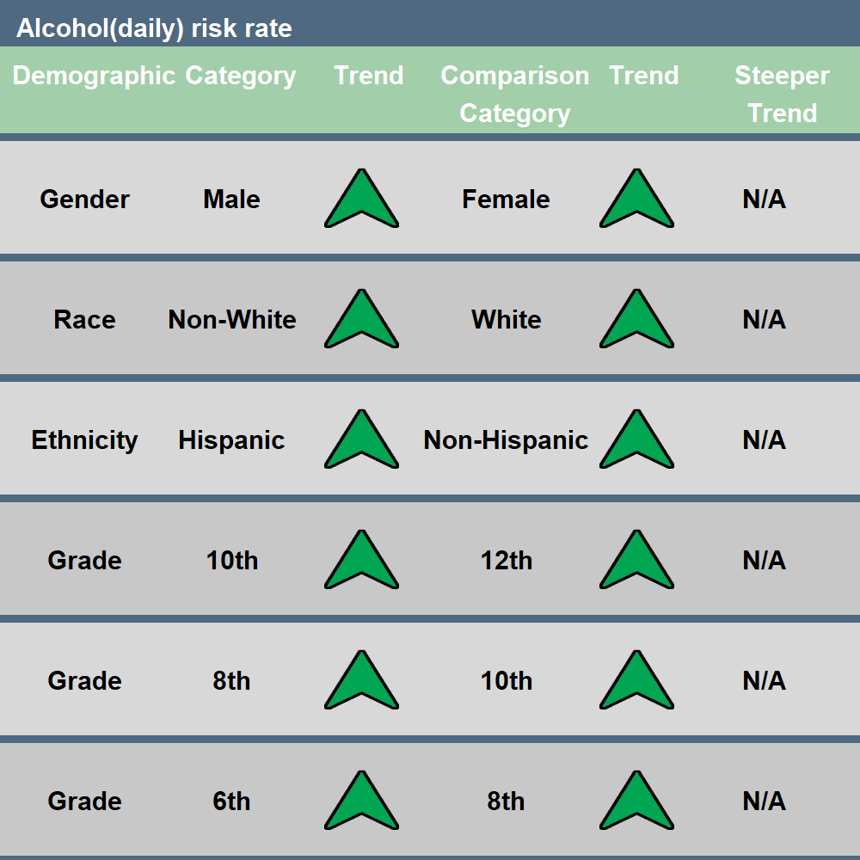
Arrows indicate statistically significant trend in that direction
Green arrows: a decrease in use or increase in risk perception
Red arrows: an increase in use or decrease in risk perception.
“=“ indicates no significant trend
“N/A” neither trend is significantly steeper
2021-2024 Trend Results:
Increasing in every demographic category analyzed

Slide 15
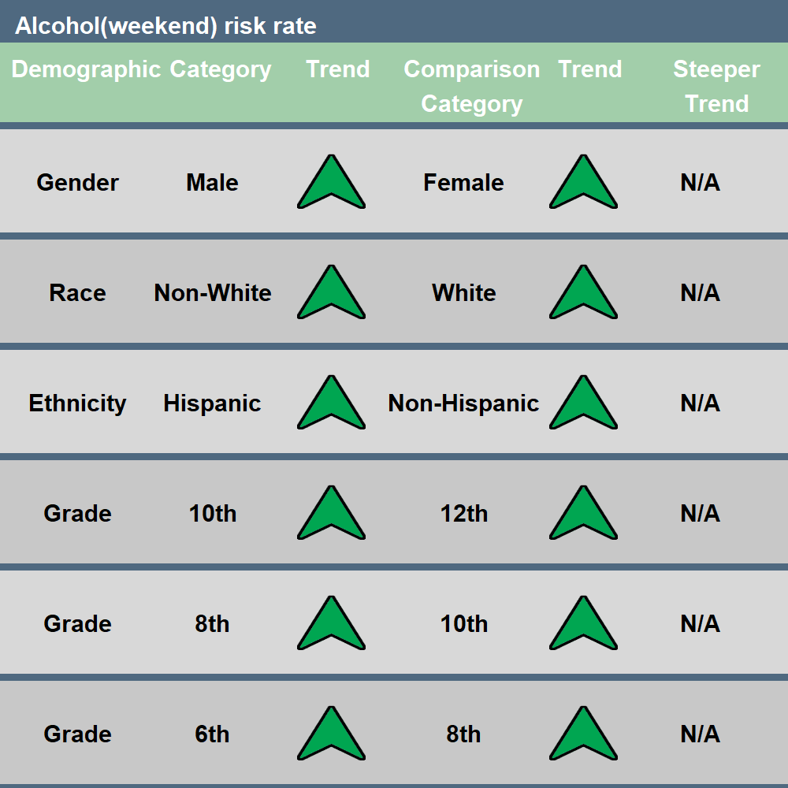
Arrows indicate statistically significant trend in that direction
Green arrows: a decrease in use or increase in risk perception
Red arrows: an increase in use or decrease in risk perception.
“=“ indicates no significant trend
“N/A” neither trend is significantly steeper
2021-2024 Trend Results:
Increasing in every demographic category analyzed

Slide 16
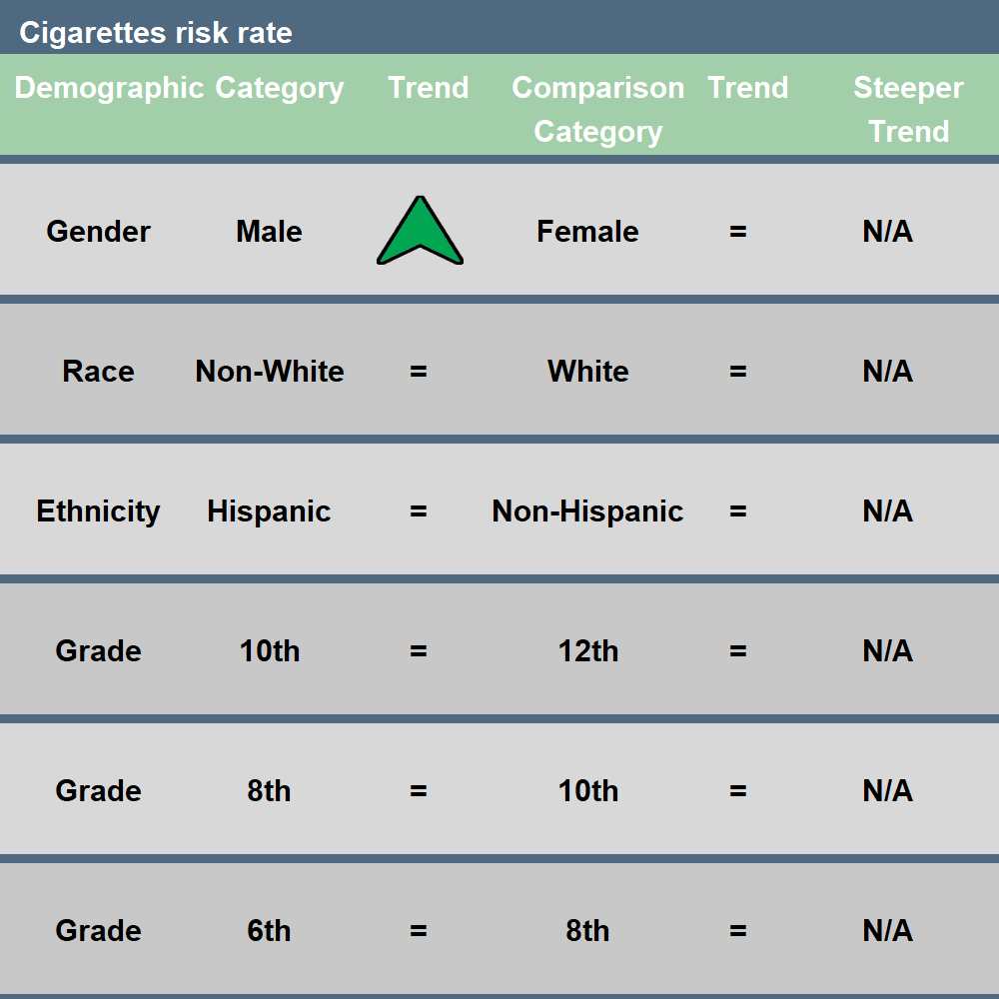
Arrows indicate statistically significant trend in that direction
Green arrows: a decrease in use or increase in risk perception
Red arrows: an increase in use or decrease in risk perception.
“=“ indicates no significant trend
“N/A” neither trend is significantly steeper
2021-2024 Trend Results:
Increasing only in Males

Slide 17
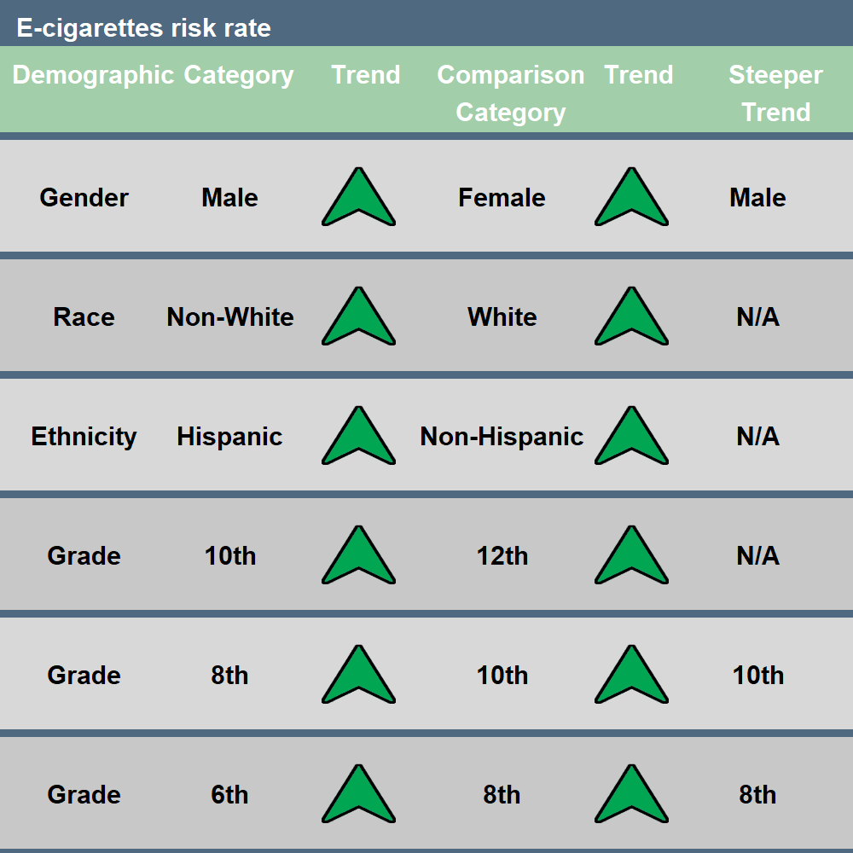
Arrows indicate statistically significant trend in that direction
Green arrows: a decrease in use or increase in risk perception
Red arrows: an increase in use or decrease in risk perception.
“=“ indicates no significant trend
“N/A” neither trend is significantly steeper
2021-2024 Trend Results:
Increasing in every demographic category analyzed
Increasing more sharply in Males than in Females
Increasing more sharply in 10th than 8th graders, and in 8th than 6th graders
Notes:
E-Cigarettes Risk Perception:
--Male 63.58% vs. Female 67.80%: Males start lower so can increase more steeply
--10th 63.10% vs. 8th 67.14%: 10th starts lower so can increase more steeply
--8th 67.14% vs. 6th 67.44%: 8th starts only slightly lower, so can increase more steeply

Slide 18
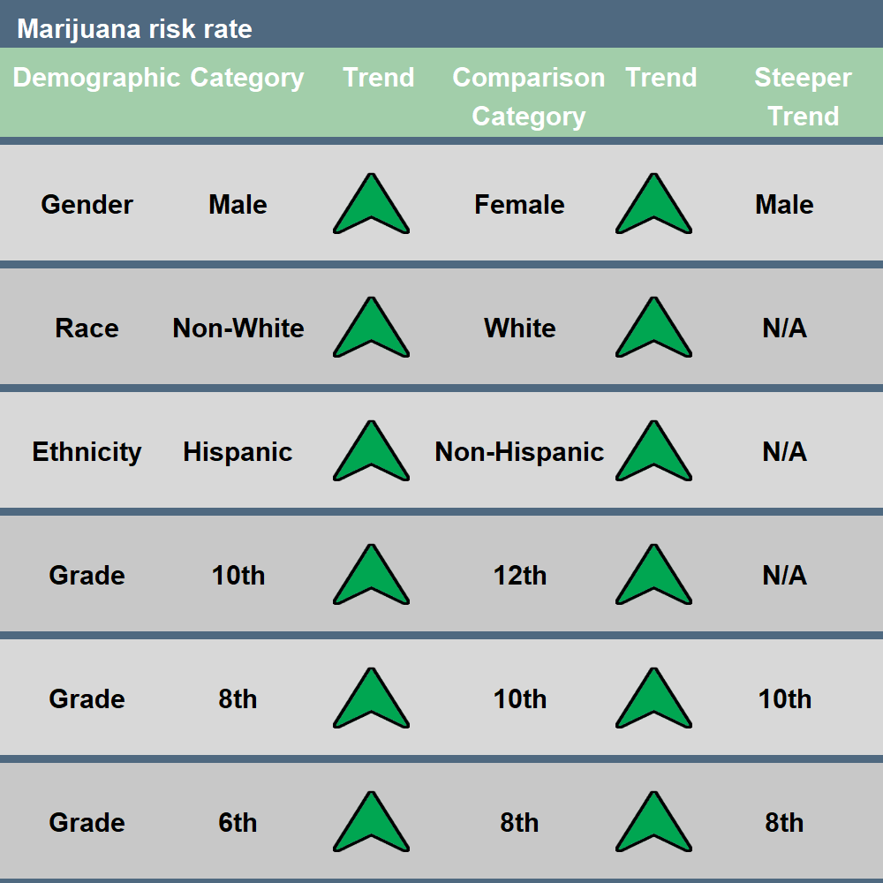
Arrows indicate statistically significant trend in that direction
Green arrows: a decrease in use or increase in risk perception
Red arrows: an increase in use or decrease in risk perception.
“=“ indicates no significant trend
“N/A” neither trend is significantly steeper
2021-2024 Trend Results:
Increasing in every demographic category analyzed
Increasing more sharply in Males than in Females
Increasing more sharply in 10th than 8th graders, and in 8th than 6th graders
Notes:
Marijuana Risk Perception:
--Male 56.26% vs. Female 62.14%: Males start lower so can increase more steeply
--10th 53.06% vs. 8th 64.76%: 10th starts rather lower so can increase more steeply
--8th 64.76% vs. 6th 65.76%: 8th starts a bit lower, increases more steeply

Slide 19
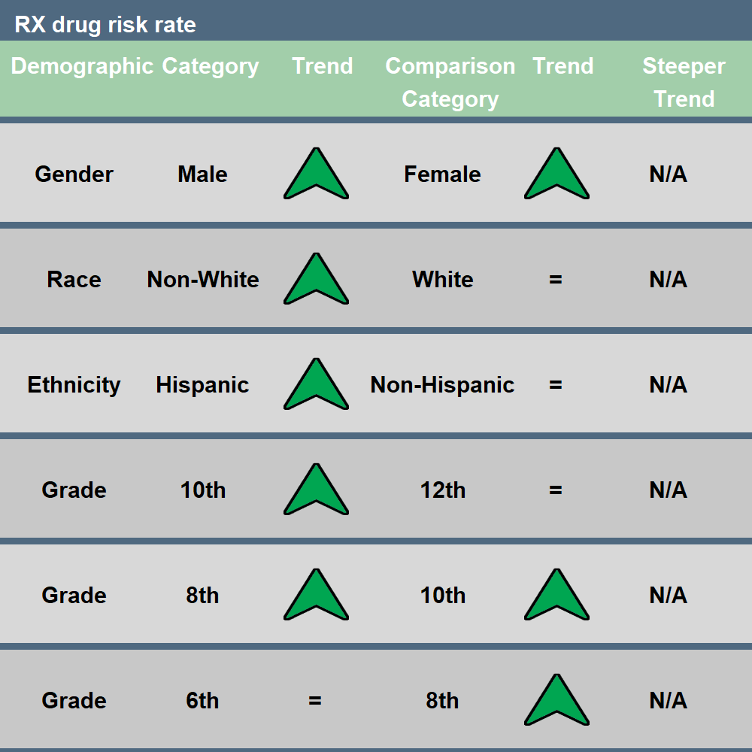
Arrows indicate statistically significant trend in that direction
Green arrows: a decrease in use or increase in risk perception
Red arrows: an increase in use or decrease in risk perception.
“=“ indicates no significant trend
“N/A” neither trend is significantly steeper
2021-2024 Trend Results:
Increasing in Males, Females, Non-White, Hispanic, 10th, and 8th graders

Slide 20
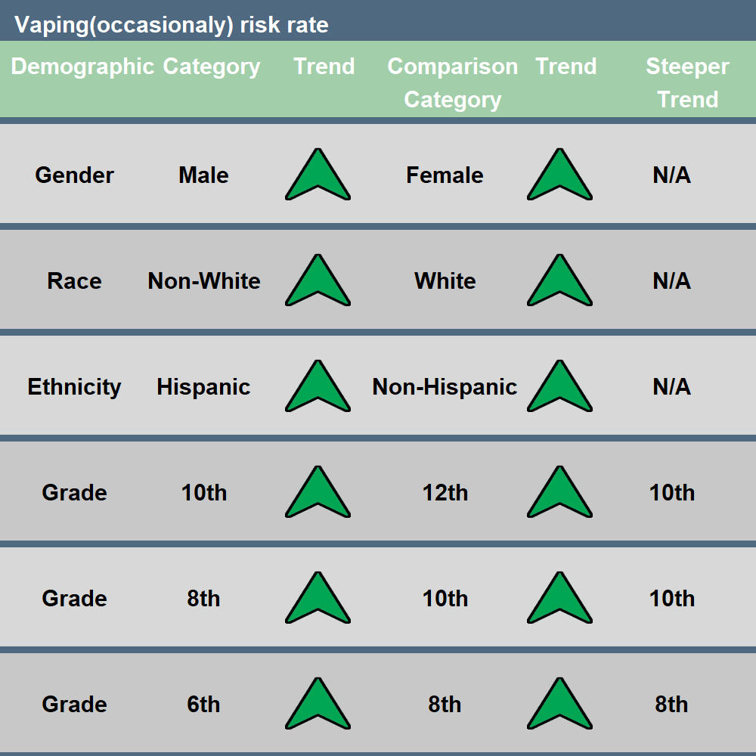
Arrows indicate statistically significant trend in that direction
Green arrows: a decrease in use or increase in risk perception
Red arrows: an increase in use or decrease in risk perception.
“=“ indicates no significant trend
“N/A” neither trend is significantly steeper
2021-2024 Trend Results:
Increasing in every demographic category analyzed
Increasing more sharply in 10th than 12th graders, 10th than 8th graders, and in 8th than 6th graders
Notes:
Vaping Occasionally Risk Perception:
--10th 59.72% vs. 12th 58.32%: 10th starts slightly higher but still increases more steeply
--10th 59.72% vs. 65.10: 10th starts lower, increases more steeply
--8th 65.10% vs. 6th 65.31%: 8th starts very slightly lower, increases more steeply

Slide 21
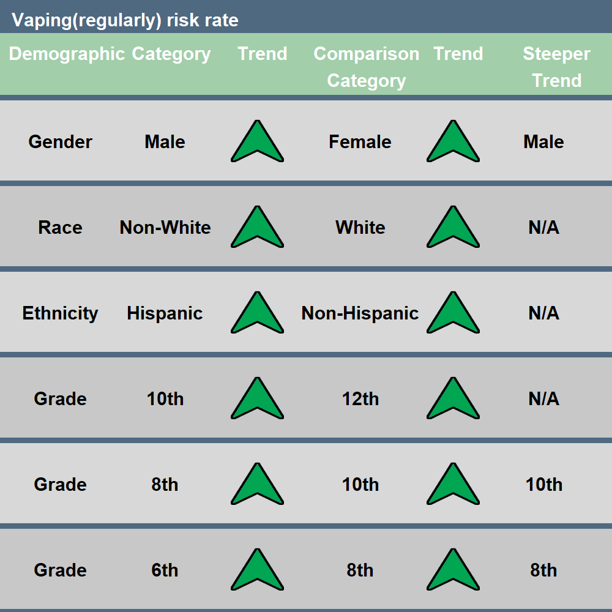
Arrows indicate statistically significant trend in that direction
Green arrows: a decrease in use or increase in risk perception
Red arrows: an increase in use or decrease in risk perception.
“=“ indicates no significant trend
“N/A” neither trend is significantly steeper
2021-2024 Trend Results:
Increasing in every demographic category analyzed
Increasing more sharply in Males than in Females
Increasing more sharply in 10th than 8th graders, and in 8th than 6th graders
Notes:
Vaping Regularly Perception:
--Male 71.69% vs. Female 76.47%: Male starts lower, increases more steeply
--10th 74.24% vs. 8th 76.21%: 10th starts a bit lower, increases more steeply
--8th 76.21% vs. 6th 71.28%: 8th starts higher but still increases more steeply

Slide 22
Summary of Trends in Risk Perception
Perception of Risk shows increasing trends across the state for most demographic groups and most substances, except:
  Perception of Risk of Cigarettes is only increasing among males
  Perception of Risk of RX drugs stable among: 6th & 12th graders, White race, & Non-Hispanic ethnicity
Demographic groups with steeper trends:
  10th (vs. 12th) graders: Vaping(occasionally)
  10th (vs. 8th) graders: E-cigarettes, Marijuana, Vaping(occasionally), Vaping(regularly)
  8th (vs. 6th) graders: E-cigarettes, Marijuana, Vaping(occasionally), Vaping(regularly)
  Male (vs. Female): E-cigarettes, Marijuana, Vaping(regularly)

Slide 23
Overall summary slide
Questions?
Comments?
Feedback?
Future steps:
  Demographic trends at Regional level?
  Race/Ethnicity factor breakdown?
What outcomes, analysis, reporting would be helpful to regional prevention providers and others?

