Slide 1

Deeper APNA Data Dive: Trends in Associations between Risk/Protective Factors and Marijuana Use
Deeper APNA Data Dive: Trends in Associations between Risk/Protective Factors and Marijuana Use

Slide 2
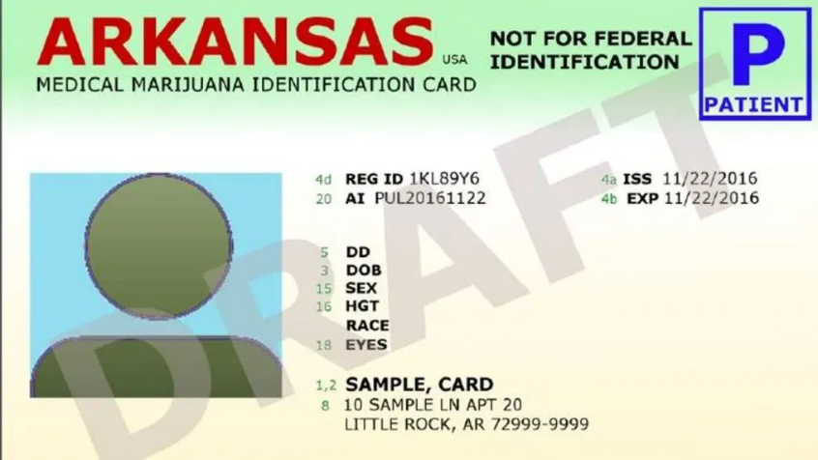
Associations between Risk/Protective Factors and Marijuana Use
Exploring association of risk/protective factors and marijuana use from APNA data 2014 through 2024, in context of medical marijuana developments
2016: medical marijuana law passage
2019: first dispensaries opened

Slide 3
Associations between Risk/Protective Factors and Marijuana Use
Self-reported marijuana use in past 30 days
Any use vs. no use
Also examined Frequent use(6 or more times in past month) vs. infrequent use (1 to 5 times in past month)
Results omitted here, associations were present, though weaker, with few instances of significant trends over time
Risk/Protective factors definitions explained in more detail as we go along

Slide 4
Associations between Risk/Protective Factors and Marijuana Use
Association of factors & MJ use measured by odds ratio
Odds Ratio >1.0: Factor & Use go in the same direction, risk
OR=2.5, the factor & use are 2.5 times as likely together
Odds Ratio <1.0: Factor & Use go in opposite directions, protective
OR=0.5, the factor & use are half as likely together
Breslow-Day test: “consistency/homogeneity” of odds ratio across the years
If p<0.05: some “general” change/differences over the years
Pattern of change/link to MM events is interpretation, perhaps further investigation

Slide 5
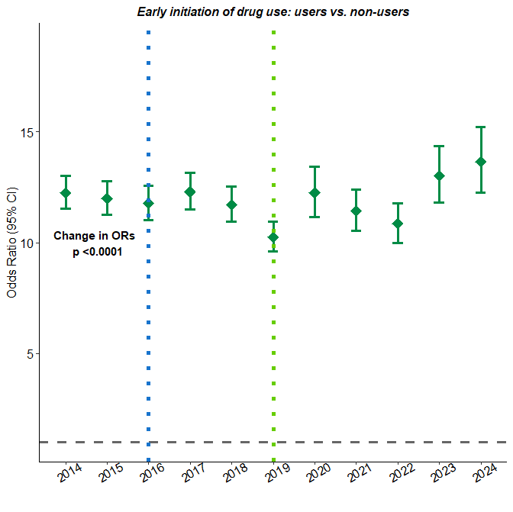
Understanding the Odds Ratios plots
Vertical dotted blue line at 2016 notes passage of MM law in AR
Vertical dotted green line at 2019 notes dispensary openings beginning in AR
P-value of Breslow-Day test for “homogeneity” of odds ratio over time
Odds ratio of each year plotted by dark green diamond with whiskers of the 95% confidence interval
Scale of y-axis above 1.0 for risk factors, will change to 0 to 1 for protective factors
Horizontal dashed gray line at 1.0. If whiskers cross do not cross this line, the OR is significant itself

Slide 6
Risk/Protective Factor Definitions
Validated survey algorithm
Each factor based on multiple questions in APNA
Example: “Do you enjoy being in school?”
1='Never' 2='Rarely' 3='Sometimes' 4='Often' 5='Almost always’
Mean of coded responses(sometimes reversed) are compared to grade-specific cut-offs to become a 0/1 dichotomous variable
See also: Appendix E available here:
https://arkansas.isadata.com/regions.php?year=2024

Slide 7
Early initiation of drug use
How old were you when you first:
smoked marijuana?
smoked a cigarette, even just a puff?
had more than a sip or two of beer, wine or hard liquor (for example, vodka, whiskey, or gin)?
began drinking alcoholic beverages regularly, that is, at least once or twice a month?
Direction: 1 indicates early initiation of drug use, risk

Slide 8
Early initiation of drug use
ORs of 10+, strong association with use
Significant change in ORs over time: appears to be getting stronger(higher OR) lately
Strengthened after dispensary openings? Weakened after law passage?

Slide 9
Perceived Availability of Drugs
If you wanted to get some beer, wine or hard liquor (for example, vodka, whiskey, or gin), how easy would it be for you to get some?
If you wanted to get some cigarettes, how easy would it be for you to get some?
If you wanted to get some marijuana, how easy would it be for you to get some?
If you wanted to get a drug like cocaine, LSD, or amphetamines, how easy would it be for you to get some?
Direction: 1 indicates perceiving easy availability of drugs, risk

Slide 10
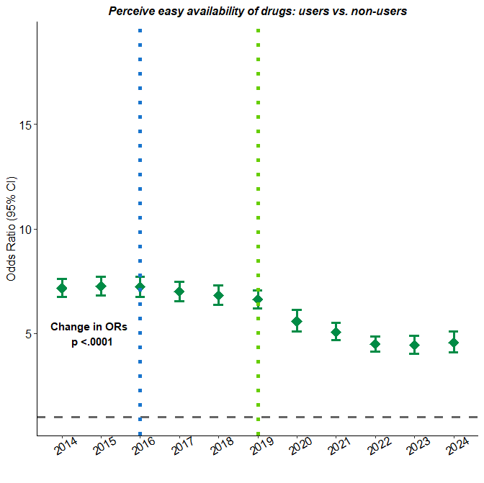
Perceived Availability of Drugs
ORs of 4+, strong association with use
Significant change in ORs over time: appears to be getting weaker(lower OR)
Weakened after dispensary openings? Users & non-users perceive easy availability?

Slide 11
Family history of anti-social behavior
Has anyone in your family ever had a severe alcohol or drug problem?
Have any of your brothers or sisters ever:
drunk beer, wine or hard liquor (for example, vodka, whiskey or gin)?
smoked marijuana?
smoked cigarettes?
taken a handgun to school?
been suspended or expelled from school?
About how many adults (over 21) have you known personally who in the past year have:
used marijuana, crack, cocaine, or other drugs?
sold or dealt drugs?
done other things that could get them in trouble with the police, like stealing, selling stolen goods, mugging or assaulting others, etc?
gotten drunk or high?
Direction: 1 indicates a family history of anti-social behavior, risk

Slide 12
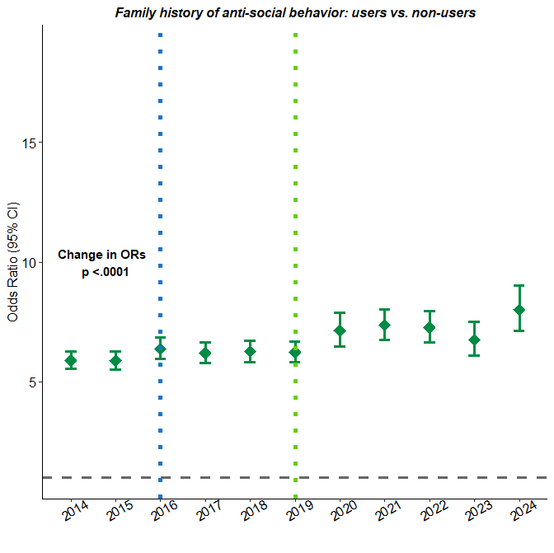
Family history of anti-social behavior
ORs of 5+, strong association with use
Significant change in ORs over time: appears to be getting stronger(higher OR) over time
Strengthened after dispensary openings?

Slide 13
Parental Attitudes Favorable toward ATOD Use
How wrong do your parents feel it would be for you to:
drink beer, wine or hard liquor (for example, vodka, whiskey or gin) regularly?
smoke cigarettes?
smoke marijuana?
Direction: 1 indicates parental attitudes favorable toward ATOD use, risk

Slide 14
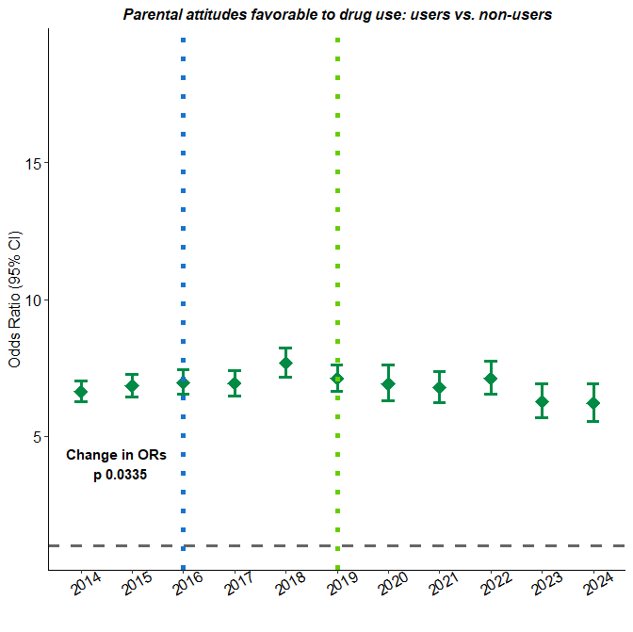
Parental Attitudes Favorable toward ATOD Use
ORs of 5+, strong association with use
Significant change in ORs over time: quadratic pattern?
Was increasing before dispensary openings, decreasing after? Just fluctuating?

Slide 15
Peer Favorable Attitudes toward ATOD Use
How wrong do you think it is for someone your age
to drink beer, wine or hard liquor (for example, vodka, whiskey or gin) regularly?
to smoke cigarettes?
to smoke marijuana?
to use LSD, cocaine, amphetamines or another illegal drug?
Direction: 1 indicates peer attitudes favorable toward ATOD use, risk

Slide 16
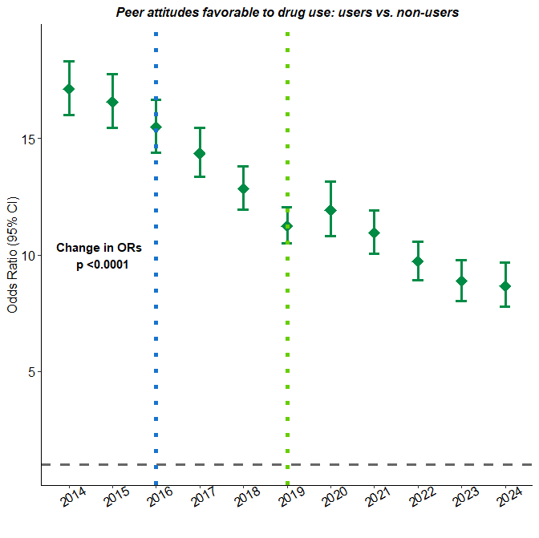
Peer Favorable Attitudes toward ATOD Use
ORs of 10+, strong association with use
Significant change in ORs over time: consistently, dramatically, decreasing
Seems irrespective of MM events?

Slide 17
Low Perceived risk of drug use
How much do you think people risk harming themselves (physically or in other ways)
if they: smoke one or more packs of cigarettes per day?
if they: smoke marijuana once or twice a week?
if they: try marijuana once or twice?
take one or two drinks of an alcoholic beverage (beer, wine, liquor) nearly every day?
Direction: 1 indicates perceiving lower risk from drug use, risk

Slide 18
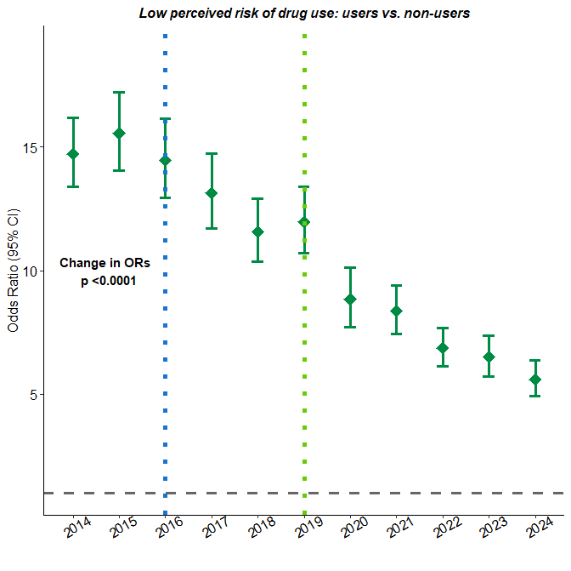
Low Perceived risk of drug use
ORs of 5 to 15, strong association with use
Significant change in ORs over time: consistently, dramatically, decreasing
Did decrease start with MM passage?
Weaker association: non-users are perceiving lower risk of drug use but still staying non-users?

Slide 19
Poor Academic Performance
Putting them all together, what were your grades like last year?
Are your school grades better than the grades of most students in your class?
Direction: 1 indicates poor academic performance, risk

Slide 20
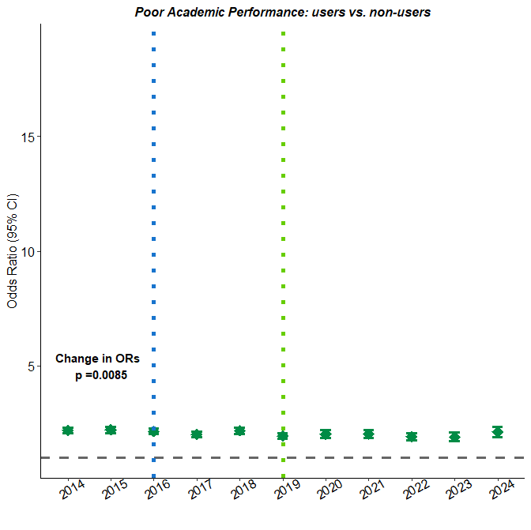
Poor academic performance
ORs of around 2, still significant association with use
Significant change in ORs over time: up and down fluctuation, may simply be picking up differences between highest and lowest years
Possibly lower ‘on average’ after MM events?

Slide 21
Transitions & mobility
Have you changed homes in the past year?
How many times have you changed homes since kindergarten?
Have you changed schools (including changing from elementary to middle and middle to high school) in the past year?
How many times have you changed schools since kindergarten?
Direction: 1 indicates more transition/moves, risk

Slide 22
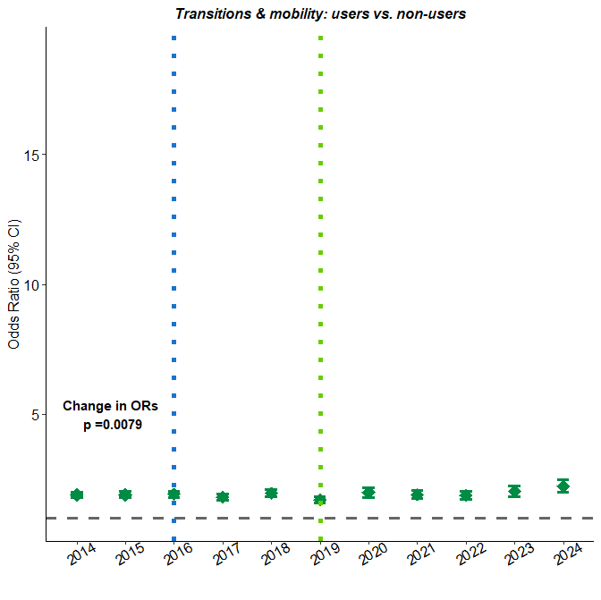
Transitions & mobility
ORs around 2, association with use
Significant change in ORs over time: appears to be getting stronger
Strengthened after dispensary openings?

Slide 23
Poor family management
My parents ask if I’ve gotten my homework done.
Would your parents know if you did not come home on time?
When I am not at home, one of my parents knows where I am and whom I am with.
The rules in my family are clear.
My family has clear rules about alcohol and drug use.
If you drank some beer or wine or liquor (for example, vodka, whiskey, or gin) without your parents’ permission, would you be caught by your parents?
If you skipped school, would you be caught by your parents?
If you carried a handgun without your parents’ permission, would you be caught by your parents?
Direction: 1 indicates poor family management, risk

Slide 24
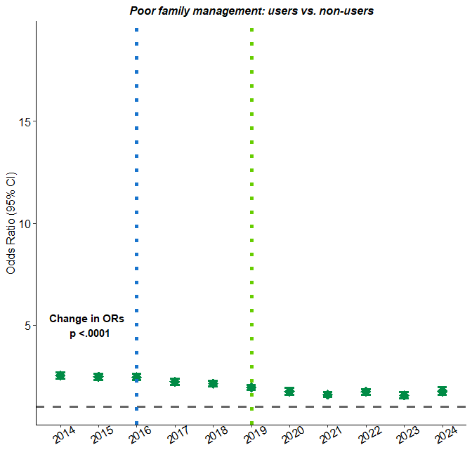
Poor family management
ORs of 1.5 to 2.5, association with use
Significant change in ORs over time: weakening
Weakened after MM passage, further weakening after dispensary openings

Slide 25
Low commitment to school
How often do you feel that the schoolwork you are assigned is meaningful and important?
How interesting are most of your courses to you?
How important do you think the things you are learning in school are going to be for your later life?
Now, thinking back over the past year in school, how often did you: Enjoy being in school?
Now, thinking back over the past year in school, how often did you: Hate being in school?
Now, thinking back over the past year in school, how often did you: Try to do your best work in school?
During the LAST FOUR WEEKS, how many whole days have you missed because you skipped or “cut”?
Direction: 1 indicates low commitment to school, risk

Slide 26
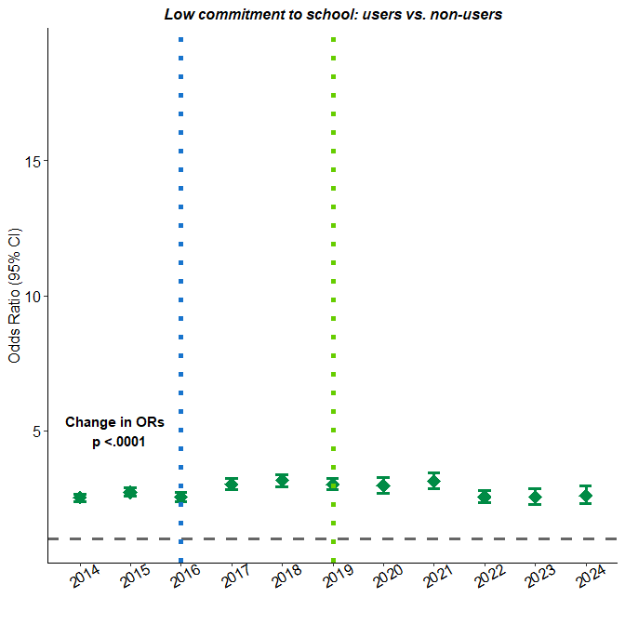
Low commitment to school
ORs of 2 to 3, association with use
Significant change in ORs over time: quadratic pattern? Weak early, then stronger, but again weaker?
Strengthened after MM passage, weakened after dispensary openings?

Slide 27
Protective Factors
Change to scale of y-axis
Protective factors and MJ use have an inverse or negative association
Odds ratios from 0.0 to 1.0
Odds ratios closer to 1.0 (‘larger’) are weaker
OR=0.50 means one-half as likely together
OR=0.25 means one-quarter as likely together

Slide 28
Pro-social school opportunities
In my school, students have lots of chances to help decide things like class activities and rules.
There are lots of chances for students in my school to talk with a teacher one-on-one.
Teachers ask me to work on special classroom projects.
There are lots of chances for students in my school to get involved in sports, clubs, and other school activities outside of class.
I have lots of chances to be part of class discussions or activities.
Direction: 1 indicates more pro-social school opportunities, protective

Slide 29
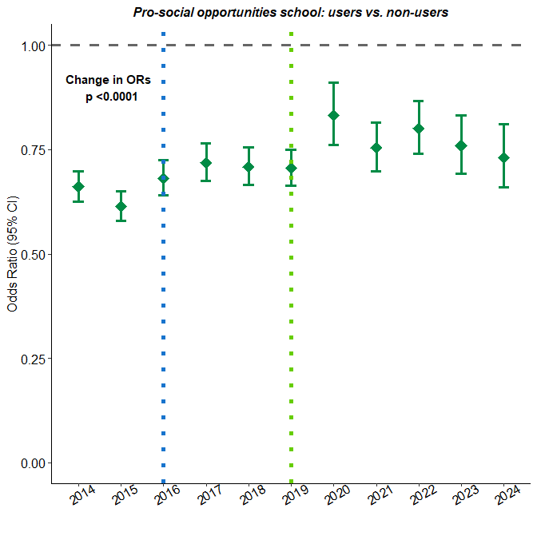
Pro-social school opportunities
ORs of 0.6 to 0.8, inverse association with use
Significant change in ORs over time: appears to be getting weaker(OR closer to 1.0) lately
Weakened after MM passage and after dispensary openings?

Slide 30
Pro-social school rewards
My teacher(s) notices when I am doing a good job and lets me know about it.
The school lets my parents know when I have done something well.
I feel safe at my school.
My teachers praise me when I work hard in school.
Direction: 1 indicates more pro-social school rewards, protective

Slide 31
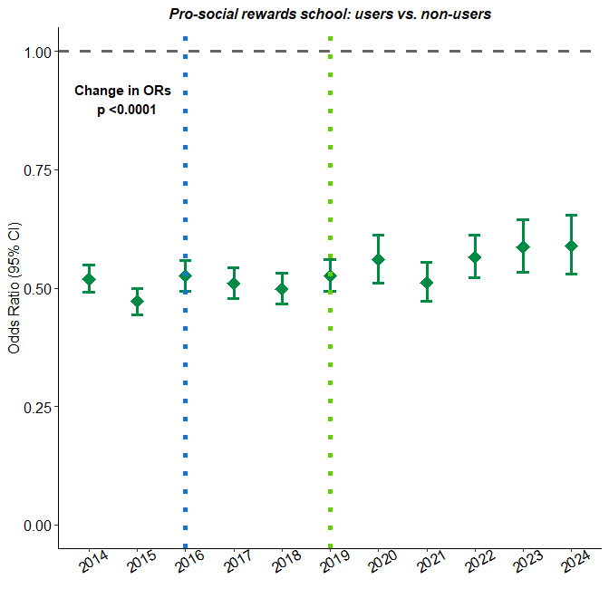
Factor description
ORs of around 0.5, stronger inverse association than opportunties
Significant change in ORs over time: appears to be getting weaker(OR closer to 1.0)
Weakened after MM events?

Slide 32
Perceive marijuana use as moderate/great risk
Single question, not a scale-score factor
How much do you think people risk harming themselves (physically or in other ways) if they: try marijuana once or twice?
Direction: 1 indicates perceiving moderate/great risk from marijuana use, protective

Slide 33
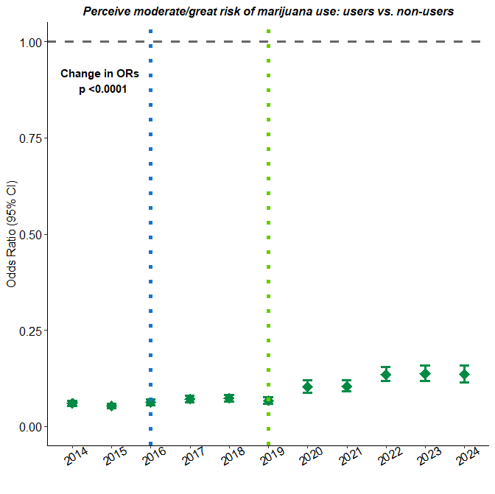
Perceive marijuana use as moderate/great risk
ORs under 0.2, strong inverse association with use
Significant change in ORs over time: appears to be weakening(OR closer to 1.0)
Weakening after dispensary openings?
While strong, and highly significant, the link between perceiving risk and using is lessened

Slide 34
Summary
 | Weakened | Strengthened
Risk | Perceive easy availability, Favorable peer attitudes, Low perceived risk, Poor academic performance, Poor family management | Early initiation, Anti-social family, Transitions & mobility
Protective | Pro-social school opps, Pro-social school rewards, Perceive great/moderate risk of marijuana | None examined

Slide 35
Summary
Further study:
Further factors, and/or individual questions to examine
More formally examine possibly link of changes in association and MM events
Over time changes in associations of these risk factors and substances besides marijuana
Factor of reduced APNA participation
Discussion, Comments, Questions

