Slide 1

Arkansas Statewide Epidemiological Outcomes Workgroup Thrice-Annual Meeting 09/18/2025
Supported by: SAMHSA Substance Abuse Block Grant 1B08TI087025-01

Slide 2
Today’s Agenda
Welcome, Introductions, Mission – A. Oliveto
AR Headstart: J. Govan
National Updates: NSDUH Substances Use Trends – A. Oliveto
Local Updates: APNA Substance Use Trends – A. Oliveto
APNA Deeper Data Dive: Trends in Associations between Risk/Protective Factors and Marijuana Use – J. Thostenson
Geospatial Mapping of Risk Perception and Substance Use in AR Youth – M. Bollinger
Data Source Gaps and Opportunities – M. Bollinger
GUARD (Generating Understanding and Awareness for Responsible Drug Use): An Innovative Adolescent Nonmedical Prescription Drug Use Prevention Program – R. Thompson
SEOW Year in Review – A. Oliveto
Discussion and Wrap Up

Slide 3
SEOW Mission
SEOW’s mission is to guide successful prevention efforts in the state of Arkansas by:
Analyzing, monitoring and sharing data trends in substance use and other environmental, behavioral, and health-related factors.
Informing data-driven policy and practice decision-making regarding prevention priorities at local and state levels.
Disseminating evidence-based education and prevention materials to the larger public.

Slide 4
National Updates: NSDUH Substance Use Trends Alison Oliveto, PhD SEOW Team Leader UAMS

Slide 5
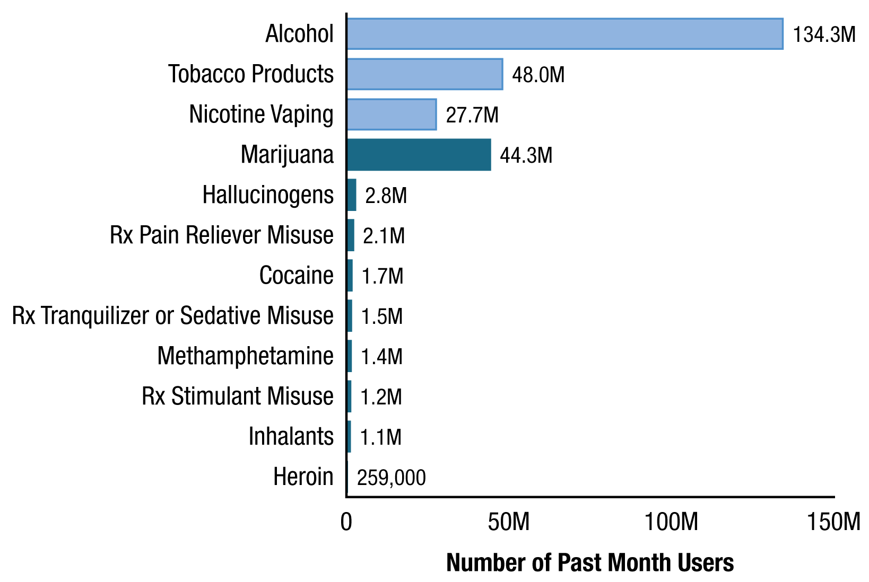
Past Month Substance Use: Among People Aged 12+; 2024
58.3% (168.0 M) used one or more substances in the past year
13.8 M misused prescription drugs in the past year:
7.6M Rx opioids
4.6M sedatives
3.9M Rx Stimulants
Source: SAMHSA and NSDUH

Slide 6
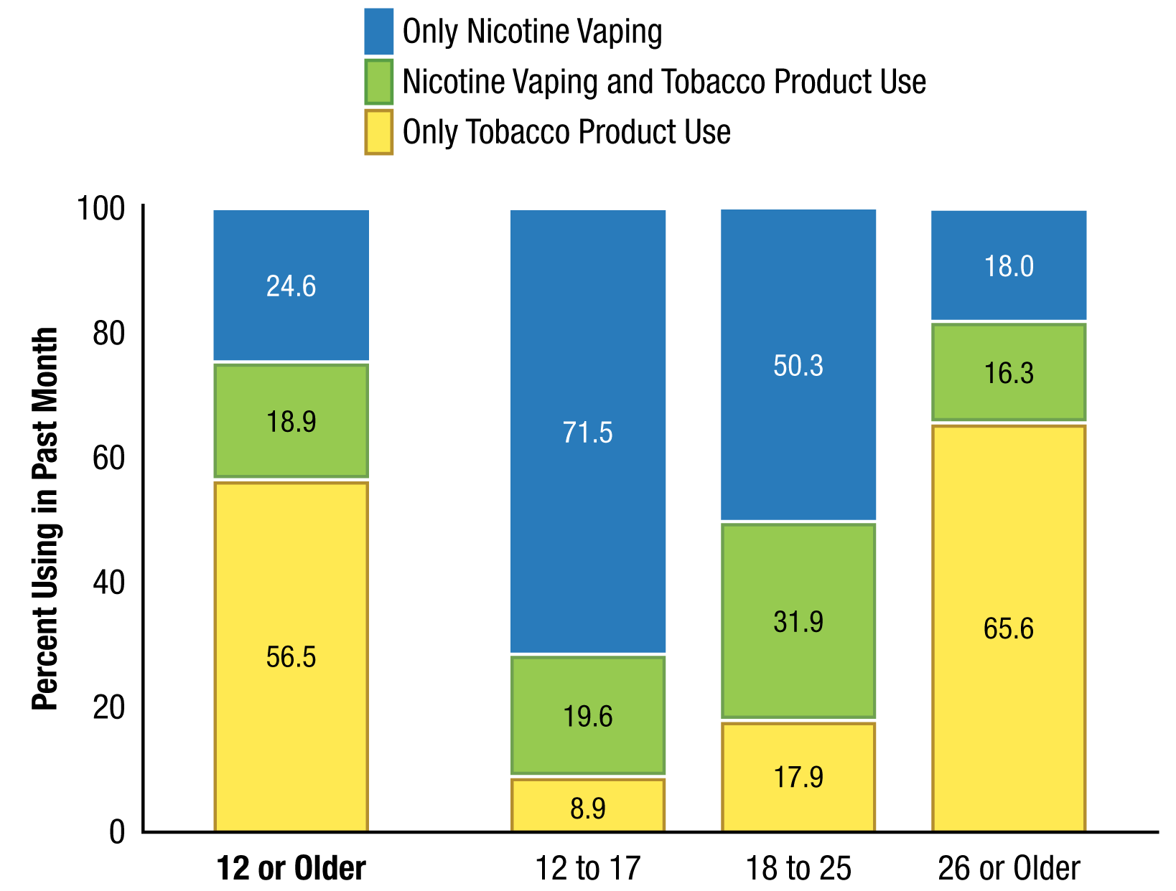
Type of Past Month Tobacco Product Use or Nicotine Vaping: Among Past Month Nicotine Product Users Aged 12+; 2024
Source: SAMHSA and NSDUH

Slide 7
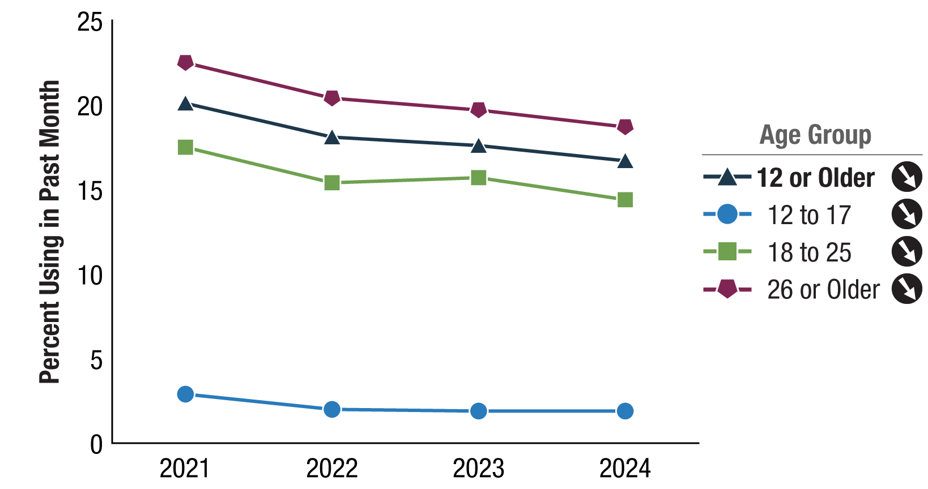
Past Month Tobacco Product Use: Among People Aged 12+; 2021-2024
Source: SAMHSA and NSDUH

Slide 8
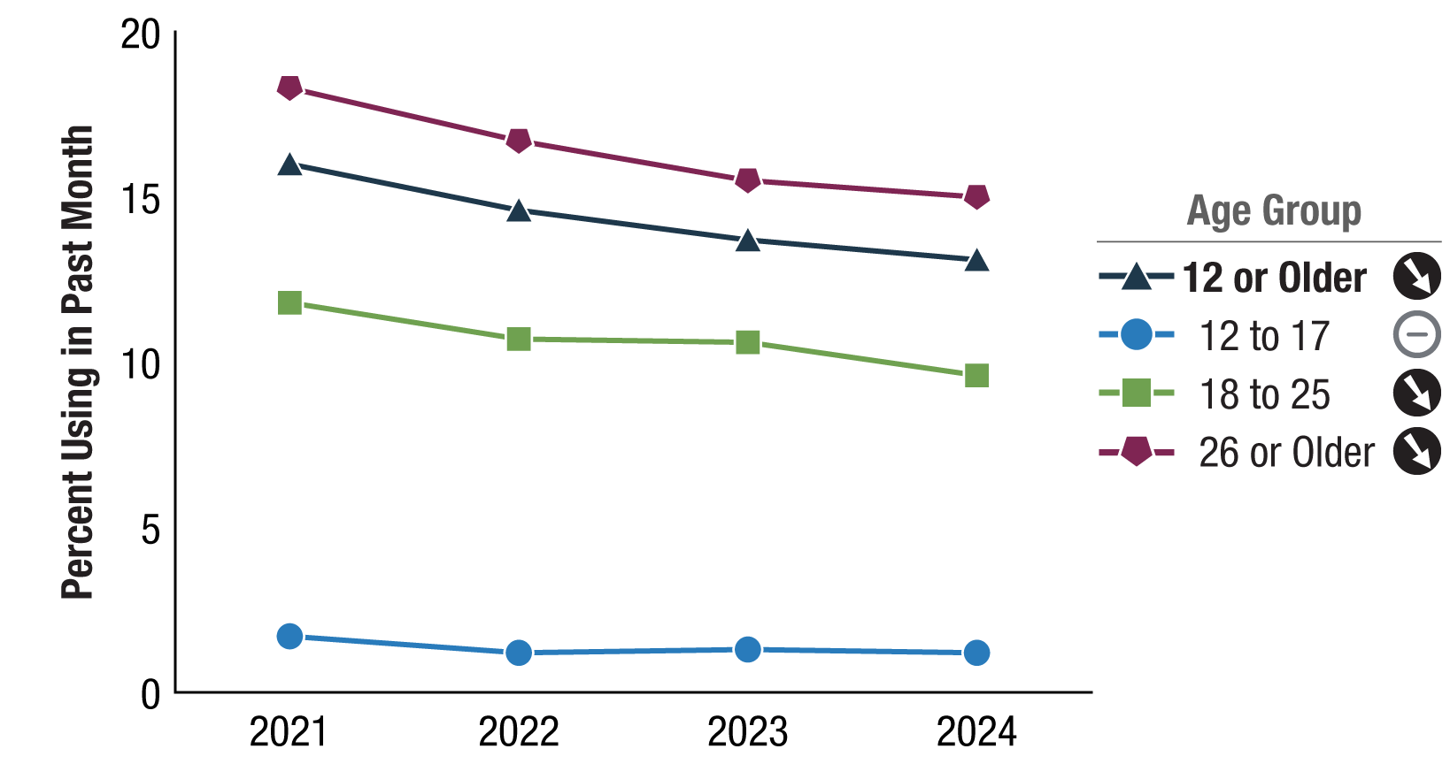
Past Month Cigarette Use: Among People Aged 12 or Older; 2021-2024
Source: SAMHSA and NSDUH

Slide 9
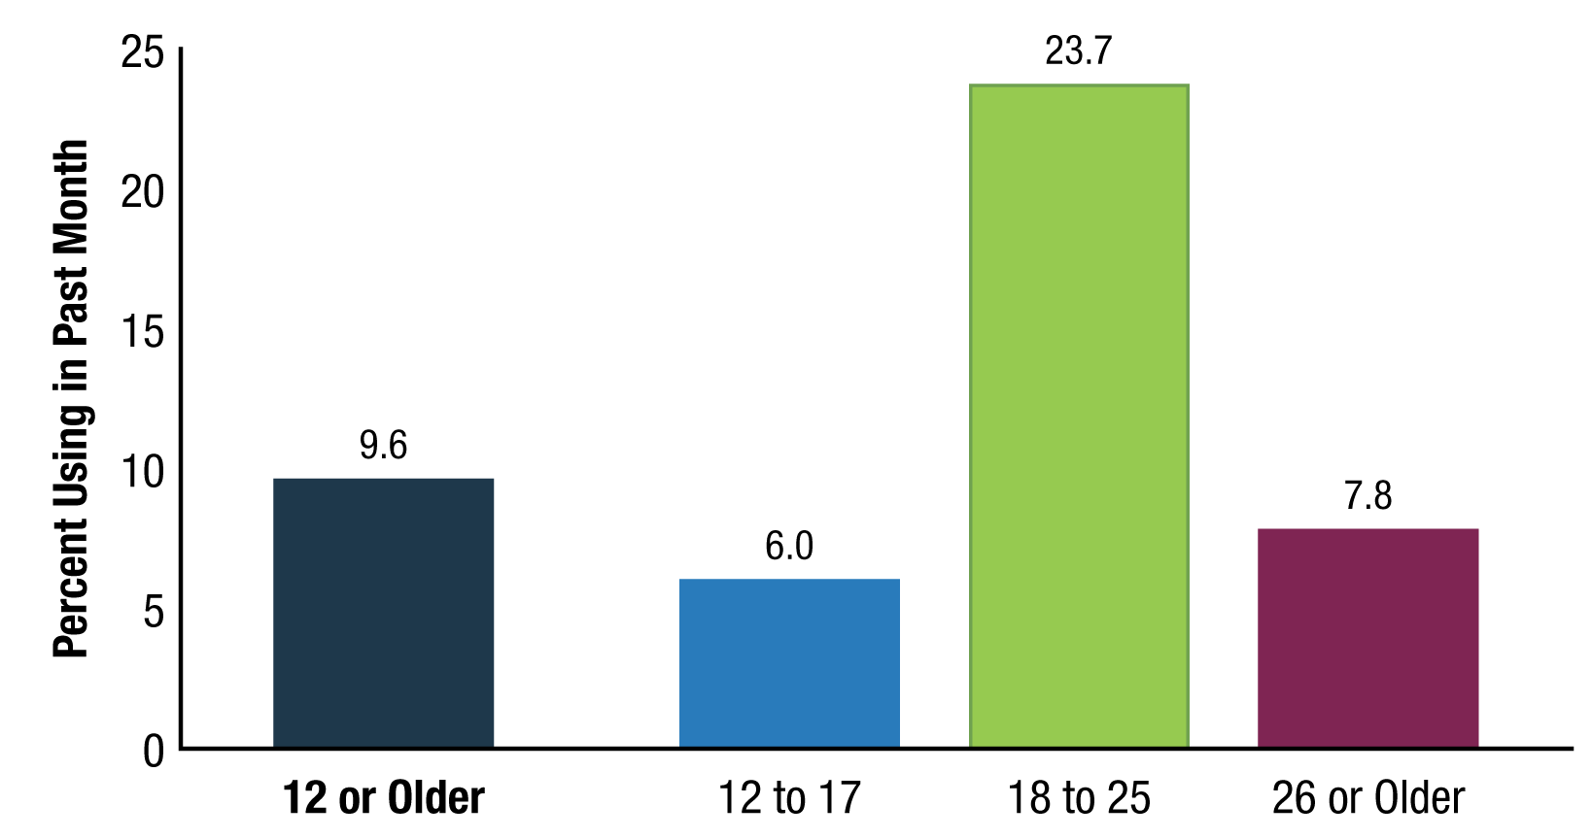
Past Month Nicotine Vaping: Among People Aged 12 or Older; 2024
Source: SAMHSA and NSDUH
Source: SAMHSA and NSDUH

Slide 10
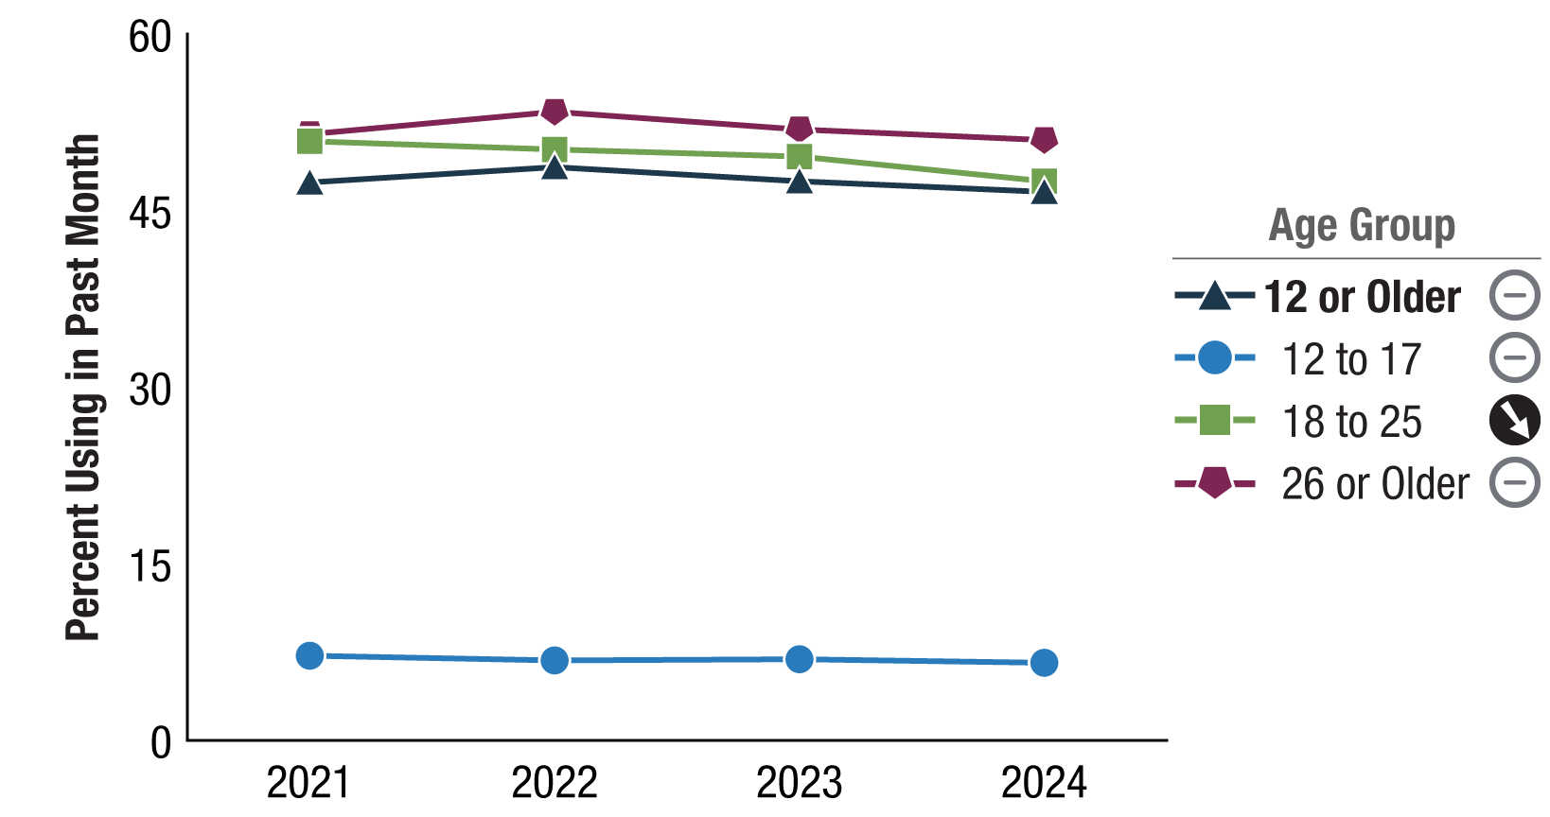
Past Month Alcohol Use: Among People Aged 12+; 2021-2024
Binge and heavy use ↓ for those 18+ but not 12-17
Source: SAMHSA and NSDUH

Slide 11
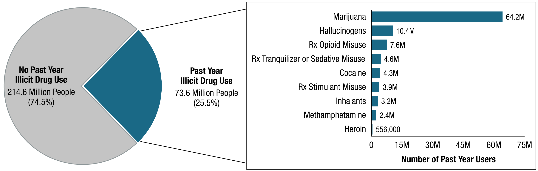
Past Year Illicit Drug Use: Among People Aged 12 or Older; 2024
Source: SAMHSA and NSDUH

Slide 12
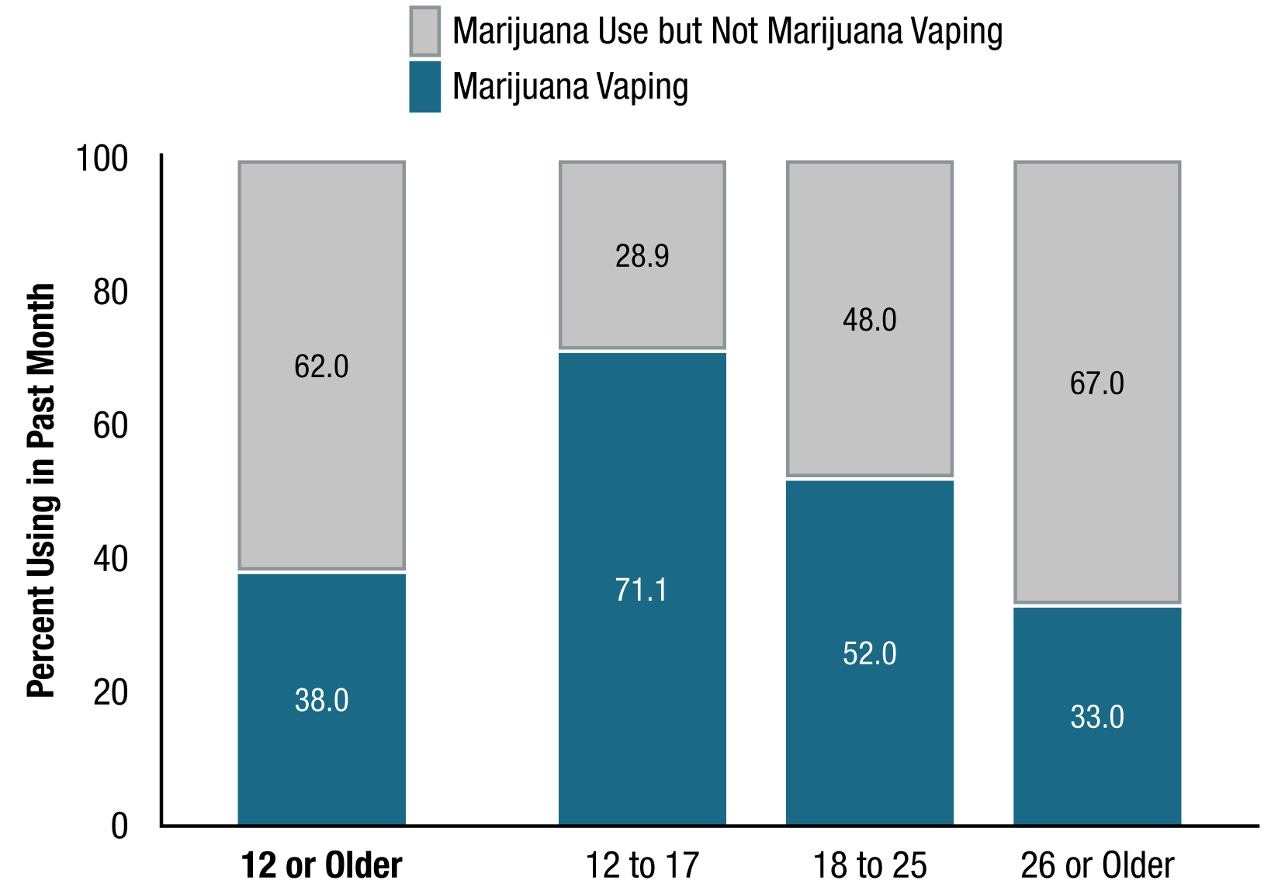
Type of Past Month Marijuana Use: Among Past Month Marijuana Users Aged 12+; 2024
Source: SAMHSA and NSDUH

Slide 13
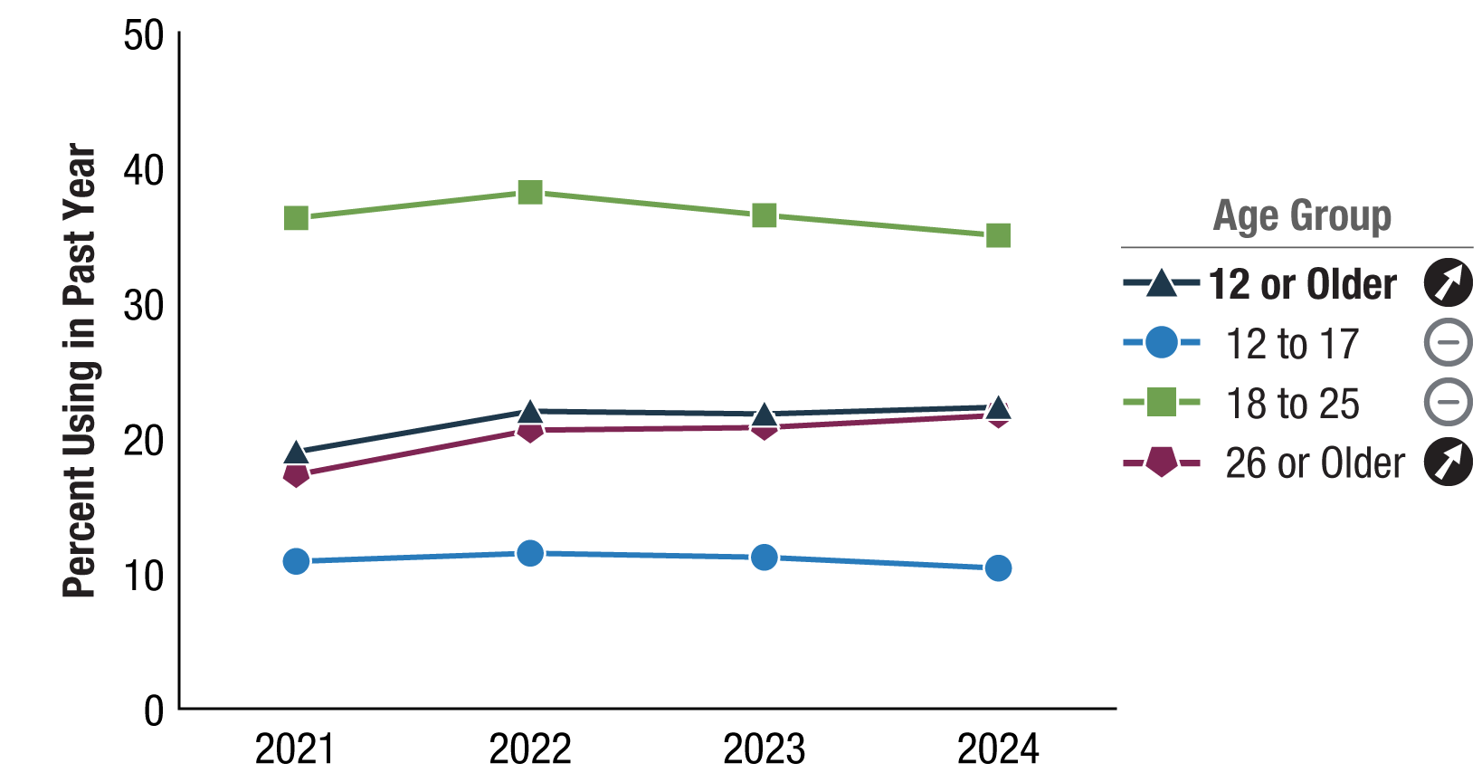
Past Year Marijuana Use: Among People Aged 12 or Older; 2021-2024
Source: SAMHSA and NSDUH

Slide 14
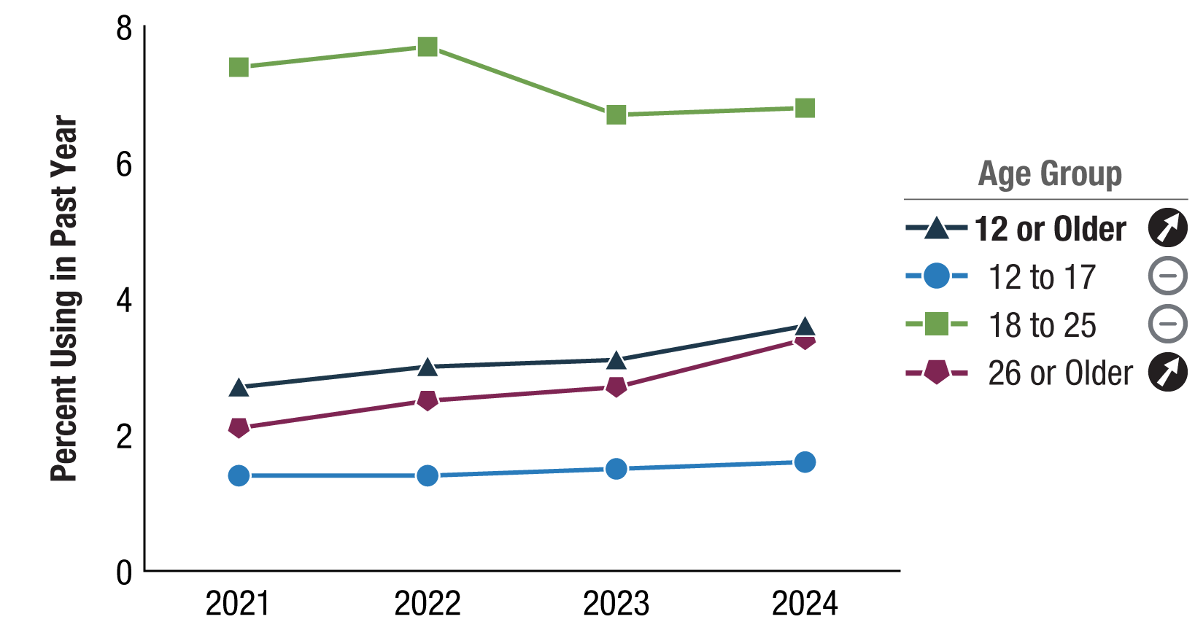
Past Year Hallucinogen Use: Among People Aged 12 or Older; 2021-2024
Source: SAMHSA and NSDUH

Slide 15
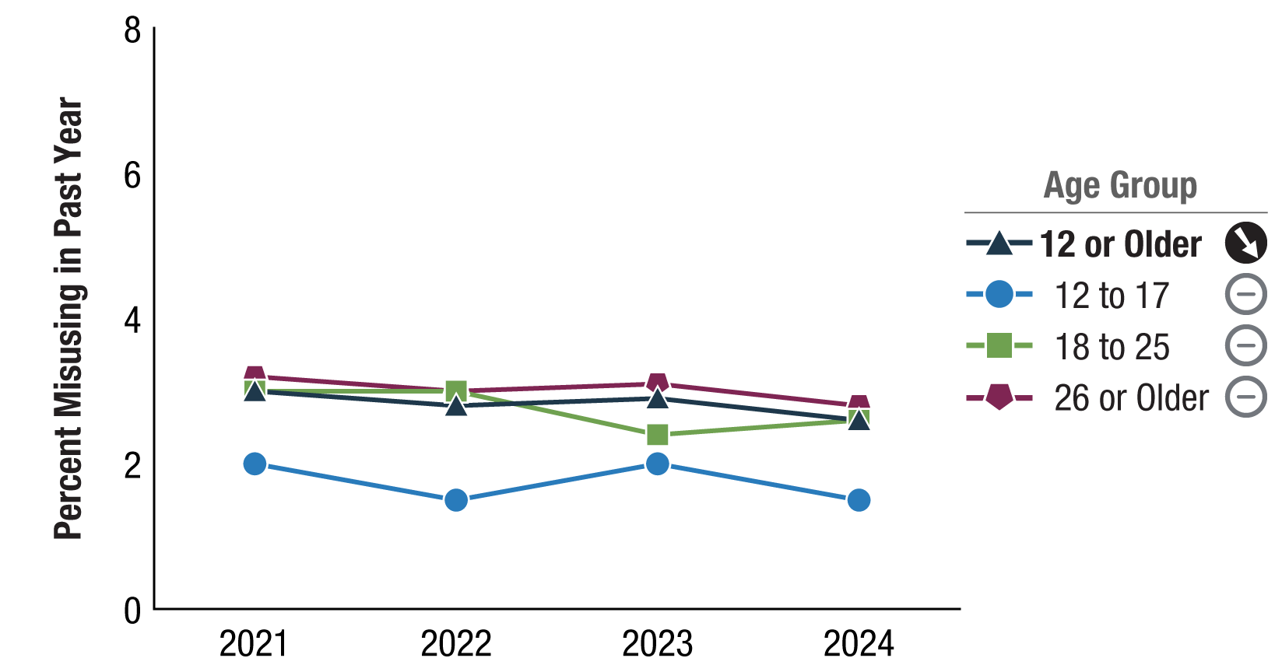
Past Year Prescription Opioid Misuse: Among People Aged 12 or Older; 2021-2024
Source: SAMHSA and NSDUH

Slide 16
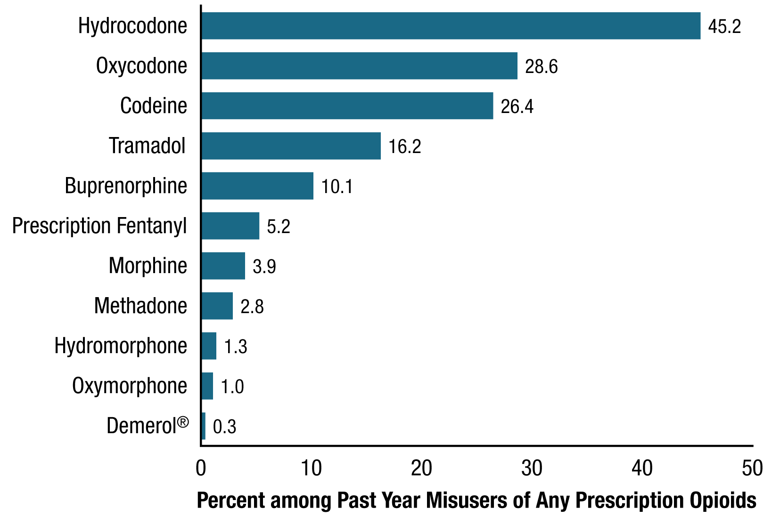
Past Year Prescription Opioid Subtype Misuse: Among People Aged 12 or Older Who Misused Any Prescription Opioid in the Past Year; 2024
Source: SAMHSA and NSDUH
Notes:
adolescents most commonly reported use of alcohol, nicotine vaping, and cannabis in the 12 months prior to the survey
Cigs: 7.1%, 3.8%, 1.9%

Slide 17
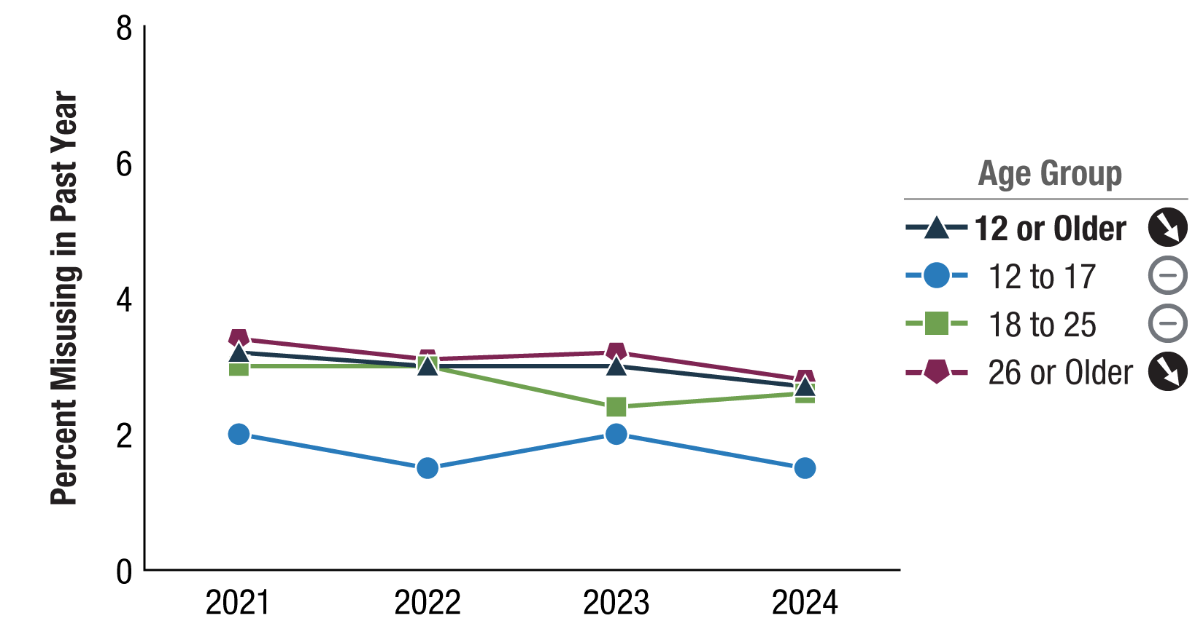
Past Year Opioid Misuse: Among People Aged 12 or Older; 2021-2024
Source: SAMHSA and NSDUH

Slide 18
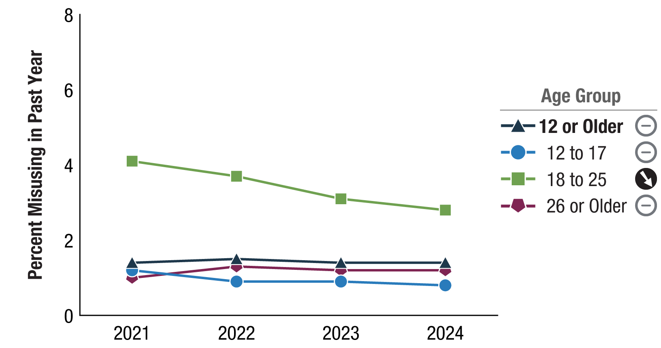
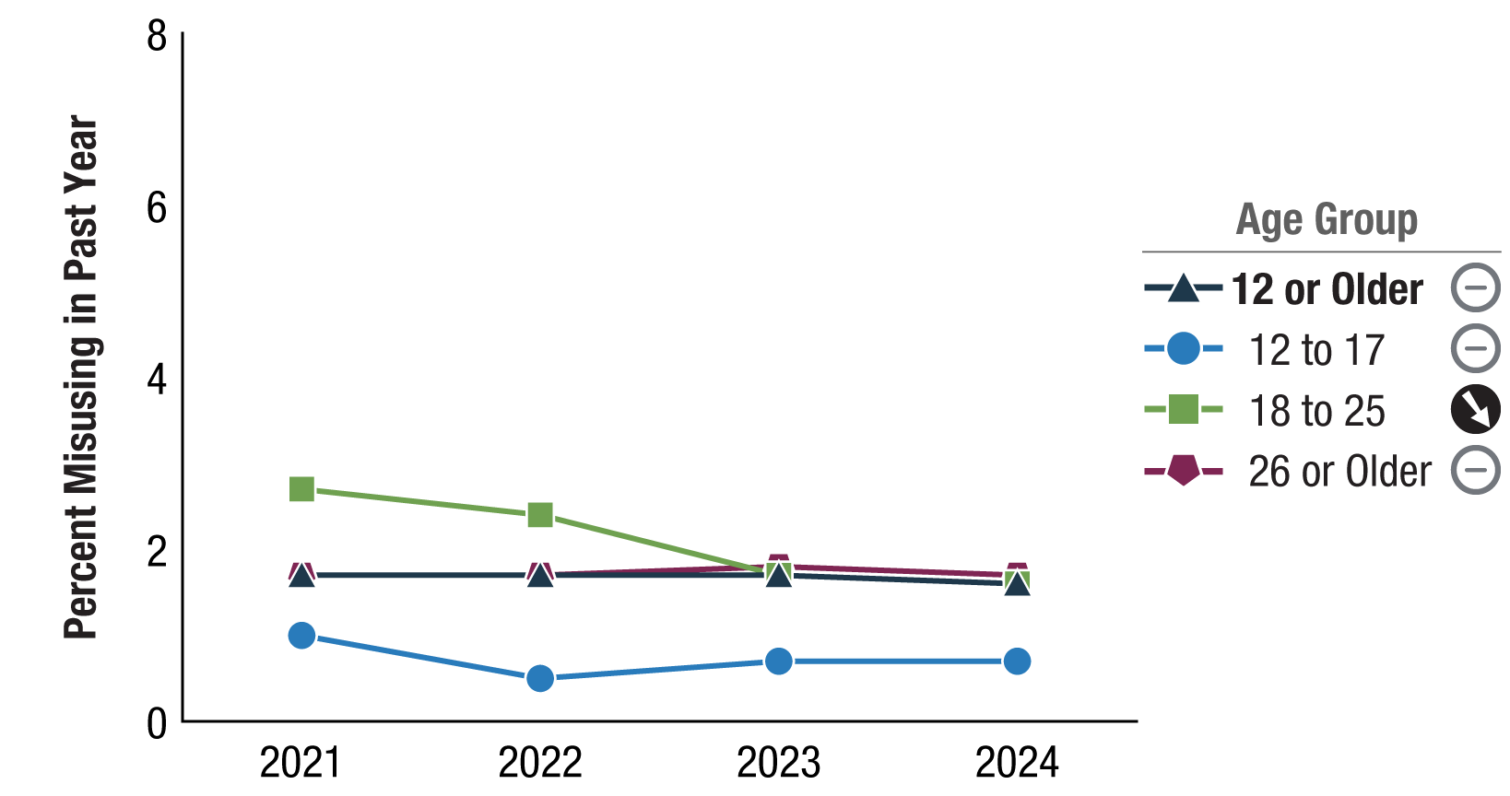
Past Year Prescription Stimulant Misuse: Among People Aged 12 or Older; 2021-2024
Past Year Prescription Tranquilizer or Sedative Misuse: Among People Aged 12 or Older; 2021‑2024
Source: SAMHSA and NSDUH

Slide 19
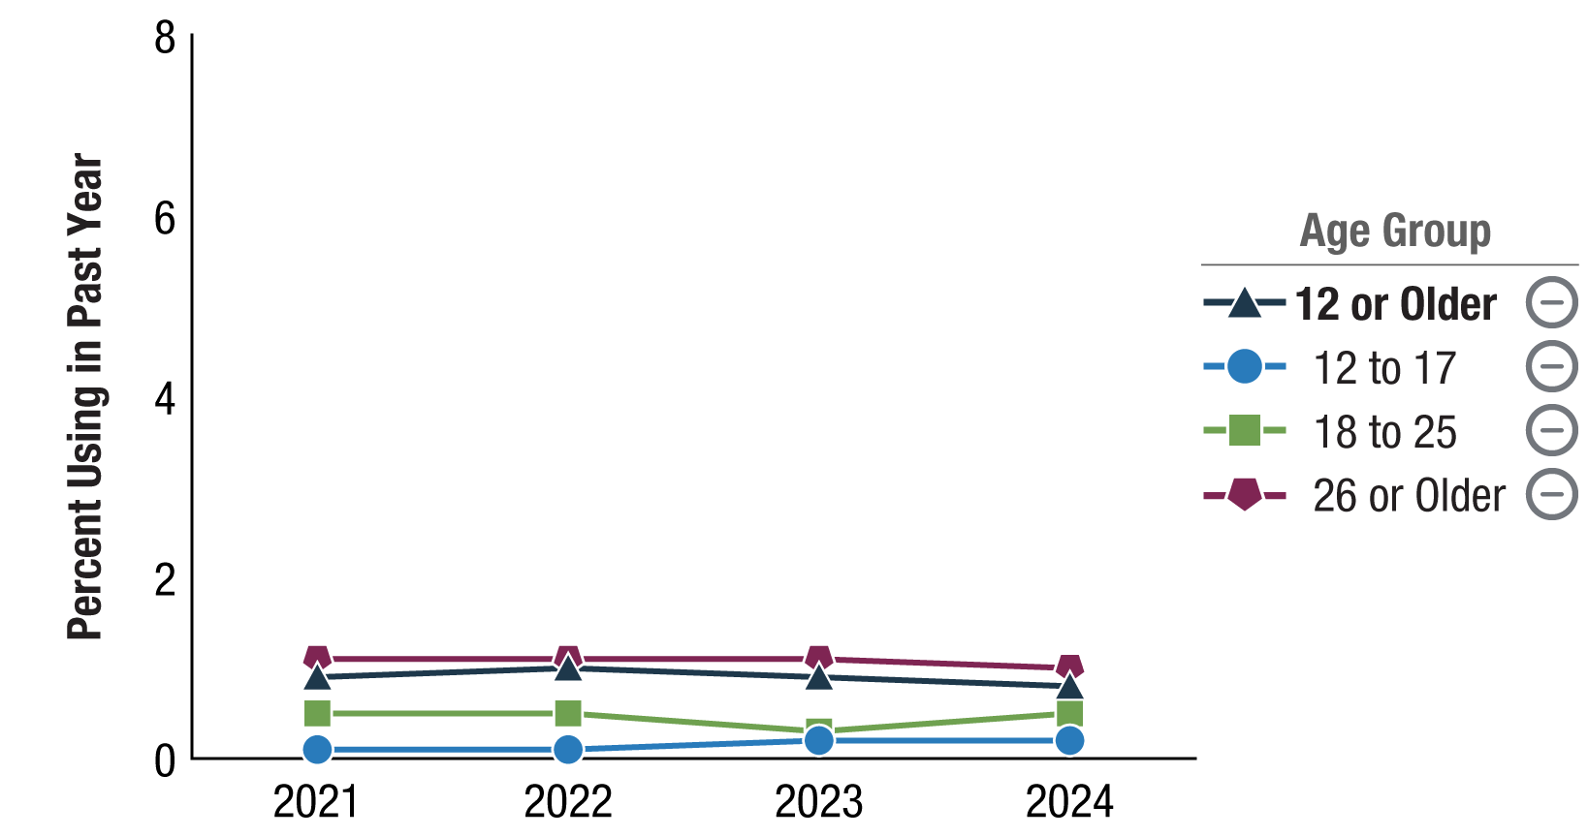
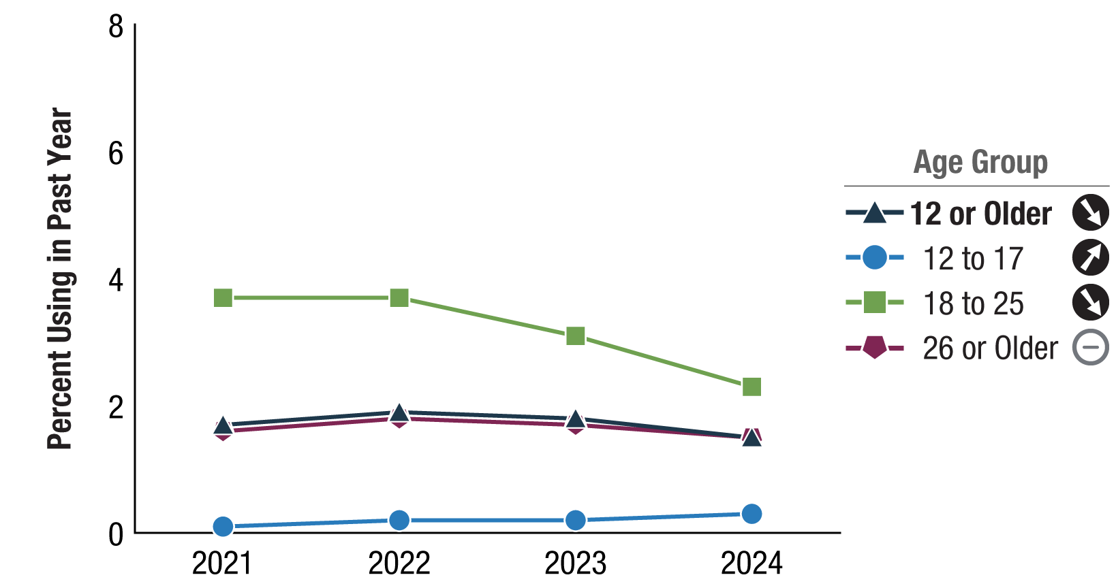
Past Year Methamphetamine Use: Among People Aged 12 or Older; 2021-2024
Past Year Cocaine Use: Among People Aged 12 or Older; 2021-2024
Source: SAMHSA and NSDUH

Slide 20
Summary of Drug Use Trends 2021-2024 (NSDUH)
Drug Used | 12+ Years | 12-17 Years | 18-25 Years | 26+ Years
Tobacco Products (Past Month) | ↓ | ↓ | ↓ | ↓
Cigarettes (past month) | ↓ | -- | ↓ | ↓
Alcohol (past month) | -- | -- | ↓ | --
Marijuana (Past Year) | ↑ | -- | -- | ↑
Hallucinogens (Past Year) | ↑ | -- | -- | ↑
Opioids (Past Year) | ↓ | -- | -- | ↓
Rx Opioids (Past Year) | ↓ | -- | -- | --
Rx Stimulants (Past Year) | -- | -- | ↓ | --
Rx Sedatives (Past Year) | -- | -- | ↓ | --
Methamphetamine (Past Year) | -- | -- | -- | --
Cocaine (Past Year) | ↓ | ↑ | ↓ | --

Slide 21
Local Updates: APNA Substance Use Trends Alison Oliveto, PhD SEOW Team Leader UAMS

Slide 22
AR Youth Substance Use Trends
Age of initiation continues to ↓ since 2019
Cigarette use is at or above national rates in 2024
Smokeless tobacco use was lower than (8th), higher than (10th), or similar to (12th) use by their respective national cohorts
APNA and MTF

Slide 23
AR Youth Substance Use Trends
Nicotine E-Cig use below national rates in 2024
Age of initiation of a vaping product ↓ since 2020
APNA and MTF

Slide 24
AR Youth Substance Use Trends
Age of initiation continues to ↓ since 2020
Alcohol use was higher than (8th) and lower than (10th and 12th) use by their respective national cohorts in 2024
APNA and MTF

Slide 25
AR Youth Substance Use Trends
Age of initiation continues to ↓ since 2020
MJ and MJ e-cig use lower than respective national cohorts in 2024
APNA and MTF

Slide 26
AR Youth Substance Use Trends
Age of initiation continues to ↓ since 2015
MJ and MJ e-cig use lower than respective national cohorts in 2024
APNA and MTF

Slide 27
Summary of Drug Use Trends 2020-2024 (APNA)
Drug Used (Past Month) | 6th Grade | 8th Grade | 10th Grade | 12th Grade
Cigarettes | -- | ↓ | ↓ | ↓
Smokeless Tobacco | -- | ↓ | ↓ | ↓
Nicotine E-Cigs | ↓ | ↓ | ↓ | ↓
Alcohol | -- | ↓ | ↓ | ↓
Marijuana | ↓ | ↓ | ↓ | ↓
Marijuana E-Cigs | -- | -- | ↓ | ↓
Rx Drugs | ↓ | ↓ | ↓ | ↓

Slide 28
Discussion

Slide 29
SEOW Year in Review Alison Oliveto, PhD SEOW Team Leader UAMS

Slide 30
SEOW Activities
Held tri-annual half-day SEOW meetings that included invited speakers
Monitored local and national data updates and trends
Uploaded relevant resources to ARPrevention.org
Disseminated trainings, seminars, and SEOW-related articles of interest
Gave 10 talks around the state
Presented stats/rationale for importance of NARCAN training in a training video
Presented two posters on dry vs wet county alcohol-related data at national conference and on SEOW activities at UAMS Medical Showcase
Co-authored journal manuscript on environmental factors associated with tobacco use (under review)
Prepared 2024 Annual Epidemiological Profiles Report (draft to OSAMH and MidSOUTH by next week)

Slide 31
Future Directions: Discussion

Slide 32
Action Plan/Wrap-Up/Next Meeting

Slide 33
Thank you!

