Slide 1

Arkansas Statewide Epidemiological Outcomes Workgroup Thrice-Annual Meeting 01/22/2025
Supported by: SAMHSA Substance Abuse Block Grant 1B08TI087025-01

Slide 2
Today’s Agenda
Welcome/Introductions/SEOW Mission (A. Oliveto)
A social ecological approach to reducing tobacco exposure across generations (A. Clawson)
APNA Data Deeper Dive: More Detailed Analyses of Factors Associated with Current Substance Use (J. Thostenson)
Substance-Related Arrests: Association with Demographics (J. Thostenson)
ACE’s Data Deeper Dive (M. Bollinger)
Situating Arkansas in the Regional and National Substance Use Data (K. Chakoian)
Updates on Selected Substance Abuse Stats (A. Oliveto)
Action Plan/Wrap-Up/Next Meeting

Slide 3
SEOW Mission
SEOW’s mission is to guide successful prevention efforts in the state of Arkansas by:
Analyzing, monitoring and sharing data trends in substance use and other environmental, behavioral, and health-related factors.
Informing data-driven policy and practice decision-making regarding prevention priorities at local and state levels.
Disseminating evidence-based education and prevention materials to the larger public.

Slide 4
A Social Ecological Approach to Reducing Tobacco Exposure Across Generations Ashley Clawson, PhD UAMS

Slide 5
Updates on National and Local Trends

Slide 6
Updates on Substance Use and Tobacco/Vaping

Slide 7
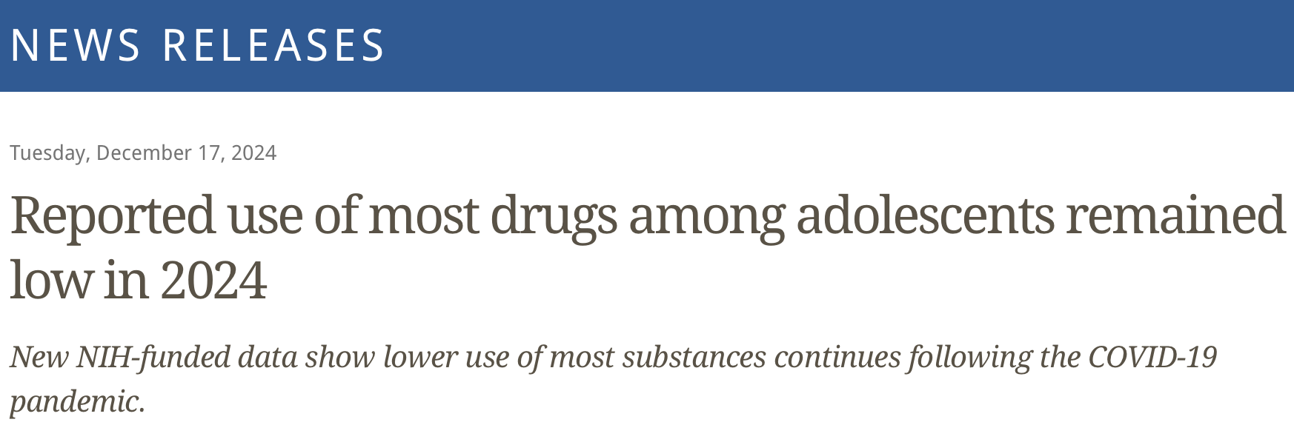

Monitoring the Future 2024
PY Alcohol use remained stable for 8th graders (12.9%) and ↓ among 10th (26.1% vs 30.6% in 2023) and 12th (41.7% vs 45.7% in 2023) graders.
PY Nicotine vaping remained stable for 8th (9.6%) and 12th (21.0%) graders and ↓ among 10th (15.4% vs 17.6% in 2023) graders
PY Nicotine pouch use remained stable for 8th (0.6%) graders and ↑ among 10th (3.4% vs 1.9% in 2023) and 12th (5.9% vs 2.9% in 2023) graders.
https://www.nih.gov/news-events/news-releases/reported-use-most-drugs-among-adolescents-remained-low-2024
Notes:
adolescents most commonly reported use of alcohol, nicotine vaping, and cannabis in the 12 months prior to the survey
Cigs: 7.1%, 3.8%, 1.9%

Slide 8
Monitoring the Future 2024
PY Cannabis use remained stable among 8th (7.2%) and 10th (15.9%) graders and ↓ among 12th graders (25.8% vs 29.0% in 2023).
PY Cannabis vaping remained stable among 8th (5.6%), 10th (11.6%) and 12th (17.6%) graders.
PY Delta-8 THC use was 2.9% (8th graders) and 7.9% (10th graders) in 2024 and remained stable among 12th graders (12.3%)
https://www.nih.gov/news-events/news-releases/reported-use-most-drugs-among-adolescents-remained-low-2024

Slide 9
Monitoring the Future 2024
PY Any illicit drug use other than marijuana remained stable among 10th (4.4%) and 12th (6.5%) graders and ↓ among eight graders (3.4% vs 4.6% in 2023).
PY Use of narcotics other than heroin ↓ among 12th graders (0.6%, an all-time low from a high of 9.5% in 2004).
P30D Abstaining from MJ, alcohol, or nicotine remained stable for eighth graders (89.5%) and ↑ among 10th (80.2% vs 76.9% in 2023) and 12th (67.1% vs 62.6% in 2023) graders.
https://www.nih.gov/news-events/news-releases/reported-use-most-drugs-among-adolescents-remained-low-2024

Slide 10
Considerations regarding recent national trends:
Those who were in 8th grade during the pandemic are 10th graders this year – will lower rates of substance use continue or start to reverse after they graduate?
Shift from cigarettes to e-cigs and nicotine pouches – any changes in harms?
Given reductions in cigarette and alcohol use:
Is cannabis becoming the new “gateway drug” for other substance use?
What are the long-term consequences of nicotine vaping (e.g., also new “gateway” drug)?
https://www.nih.gov/news-events/news-releases/reported-use-most-drugs-among-adolescents-remained-low-2024

Slide 11
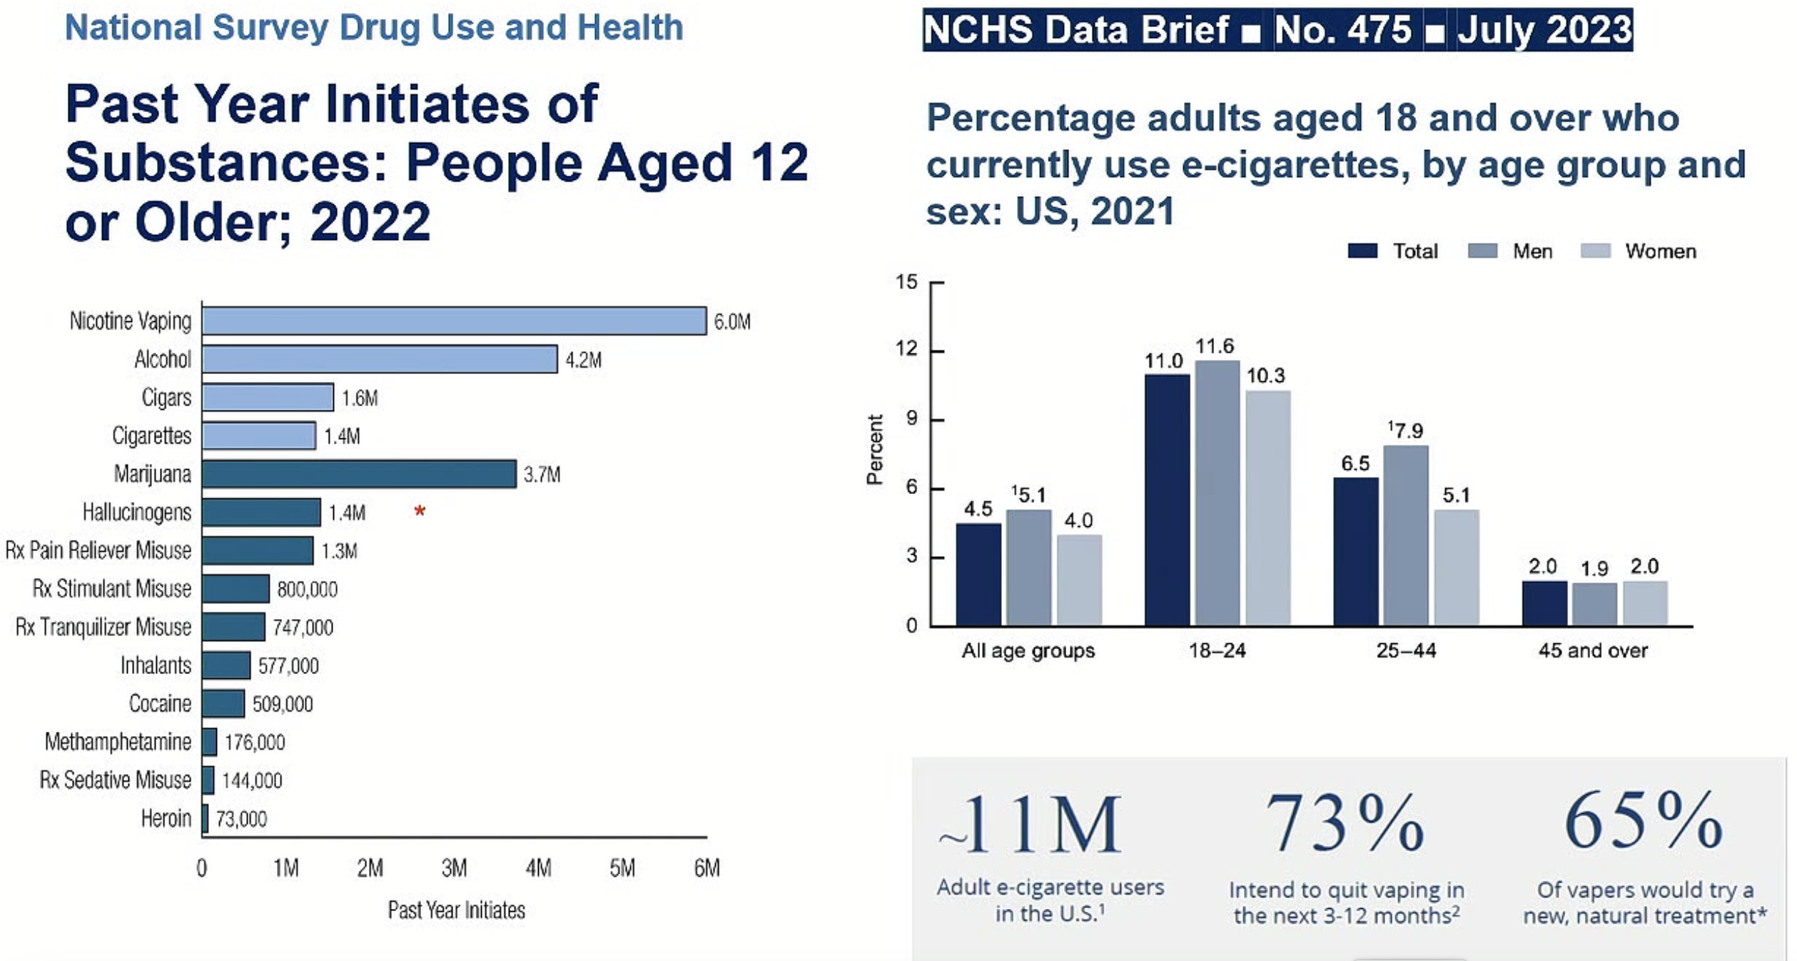
Nora Volkow address, NIDA CTN Annual Meeting, October 22, 2024

Slide 12
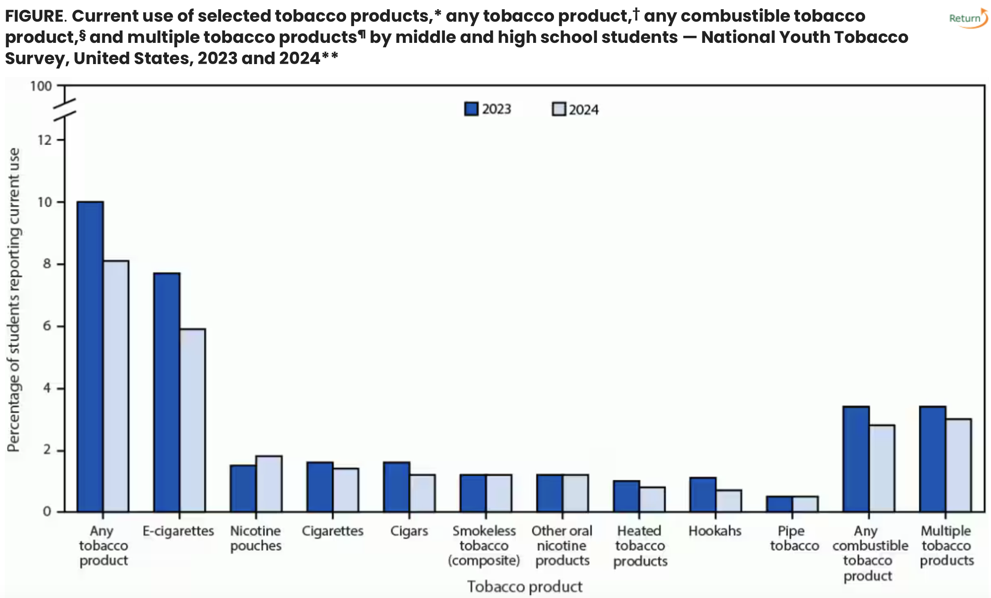
National Tobacco Survey: 2023 to 2024 Findings
Jamal A, Park-Lee E, Birdsey J, et al. Tobacco Product Use Among Middle and High School Students — National Youth Tobacco Survey, United States, 2024. MMWR Morb Mortal Wkly Rep 2024;73:917–924. DOI: http://dx.doi.org/10.15585/mmwr.mm7341a2
Notes:
From 2023 to 2024, current (previous 30-day) use of any tobacco product declined among high school students from 12.6% to 10.1%, largely driven by the decline in high school e-cigarette use (from 10.0% to 7.8%). During 2024, e-cigarettes remained the most commonly used tobacco product among U.S. youths; nicotine pouches were the second most commonly used tobacco product.

Slide 13
National Tobacco Survey 2024 Youth Findings
Current Use of Any Tobacco Product
8.1% (2.25 million) of all students reported current use of tobacco products
10.1% (1.58 million) of high school students reported current use of tobacco products
5.4% (640,000) of middle school students reported current use of tobacco products
2.8% of students (760,000) reported current use of any combustible tobacco product
3.0% of students (840,000) reported current use of multiple (≥2) tobacco products
Demographics (current use of any tobacco product, middle/high school)
16.3% of non-Hispanic American Indian or Alaska Native (AI/AN)
10.0% of Black
8.4% of Hispanic
9.0% of Multiracial
7.8% of non-Hispanic White
3.3% of non-Hispanic Asian
https://www.fda.gov/tobacco-products/youth-and-tobacco/results-annual-national-youth-tobacco-survey

Slide 14
National Tobacco Survey 2024 Youth Findings
Most Commonly-Used Tobacco Products
E-Cigarettes (5.9%)
Nicotine Pouches (1.8%)
Cigarettes (1.4%)
Cigars (1.2%)
Smokeless Tobacco (1.2%)
Other Oral Nicotine Products (1.2%)
Heated Tobacco Products (0.8%)
Hookahs (0.7%)
Pipe Tobacco (0.5%)
https://www.fda.gov/tobacco-products/youth-and-tobacco/results-annual-national-youth-tobacco-survey

Slide 15
National Tobacco Survey 2024 Youth E-Cig Findings
Current E-Cig Use
5.9% of middle and high school students (1.63 million) reported current e-cig use
7.8% (1.21 million) high school students
3.5% (410,000) middle school students
>1 in 4 (26.3%) report daily use
>1 in 3 (38.4%) report using 20+ of past 30 days
Flavored E-Cigarette Use
>4 in 5 (87.6%) used flavored e-cigarettes: fruit flavors were most popular, followed by candy, desserts, or other sweets; mint; and menthol
Over half (54.6%) used flavors with “ice” or “iced” in the name
Type of Device
Most commonly used device was disposables (55.6%), followed by prefilled/refillable pods or cartridges (15.6%)
Commonly Used Brands
Most commonly reported brands reported were: Elf Bar (36.1%), Breeze (19.9%), Mr. Fog (15.8%),
Vuse (13.7%) and JUUL (12.6%)

Slide 16
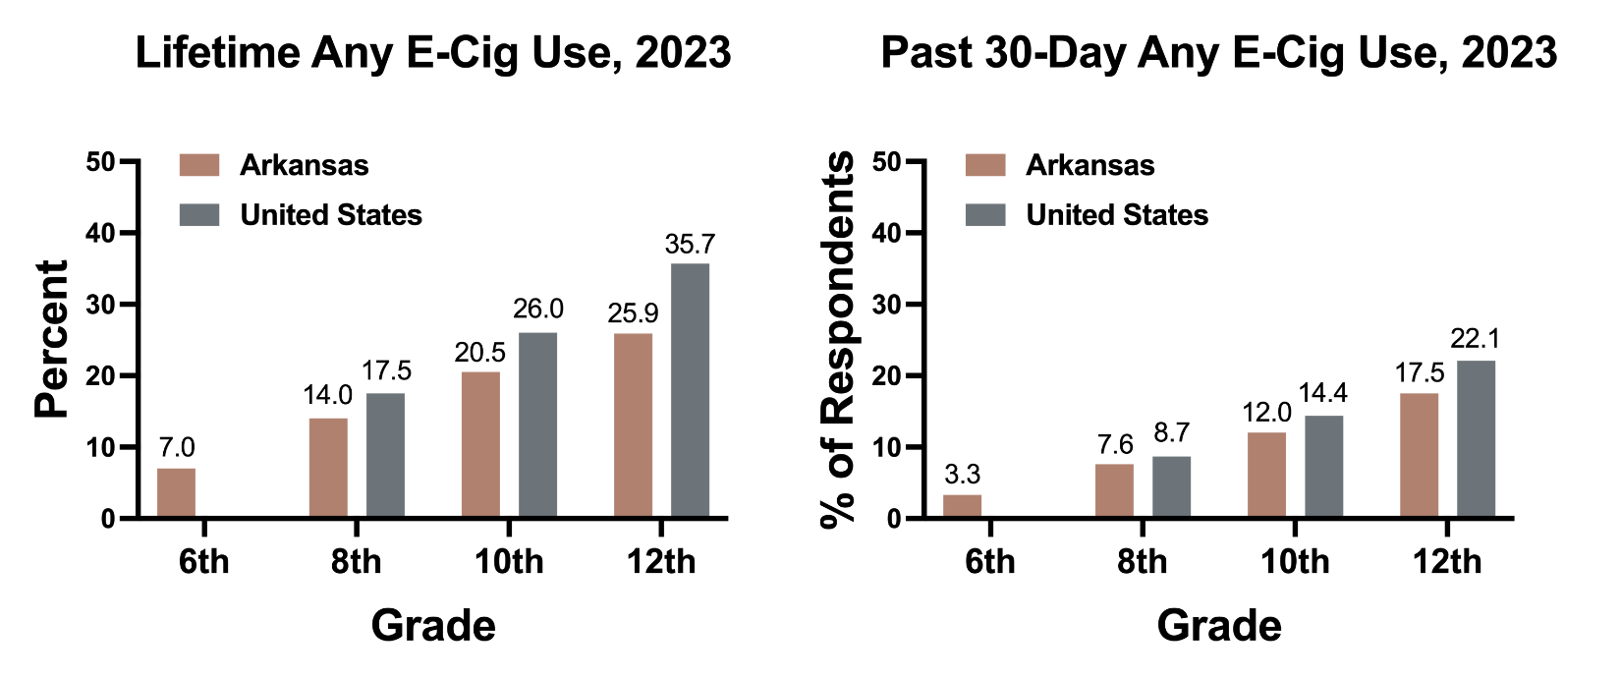
2023 Data for AR vs US
APNA and MTF

Slide 17
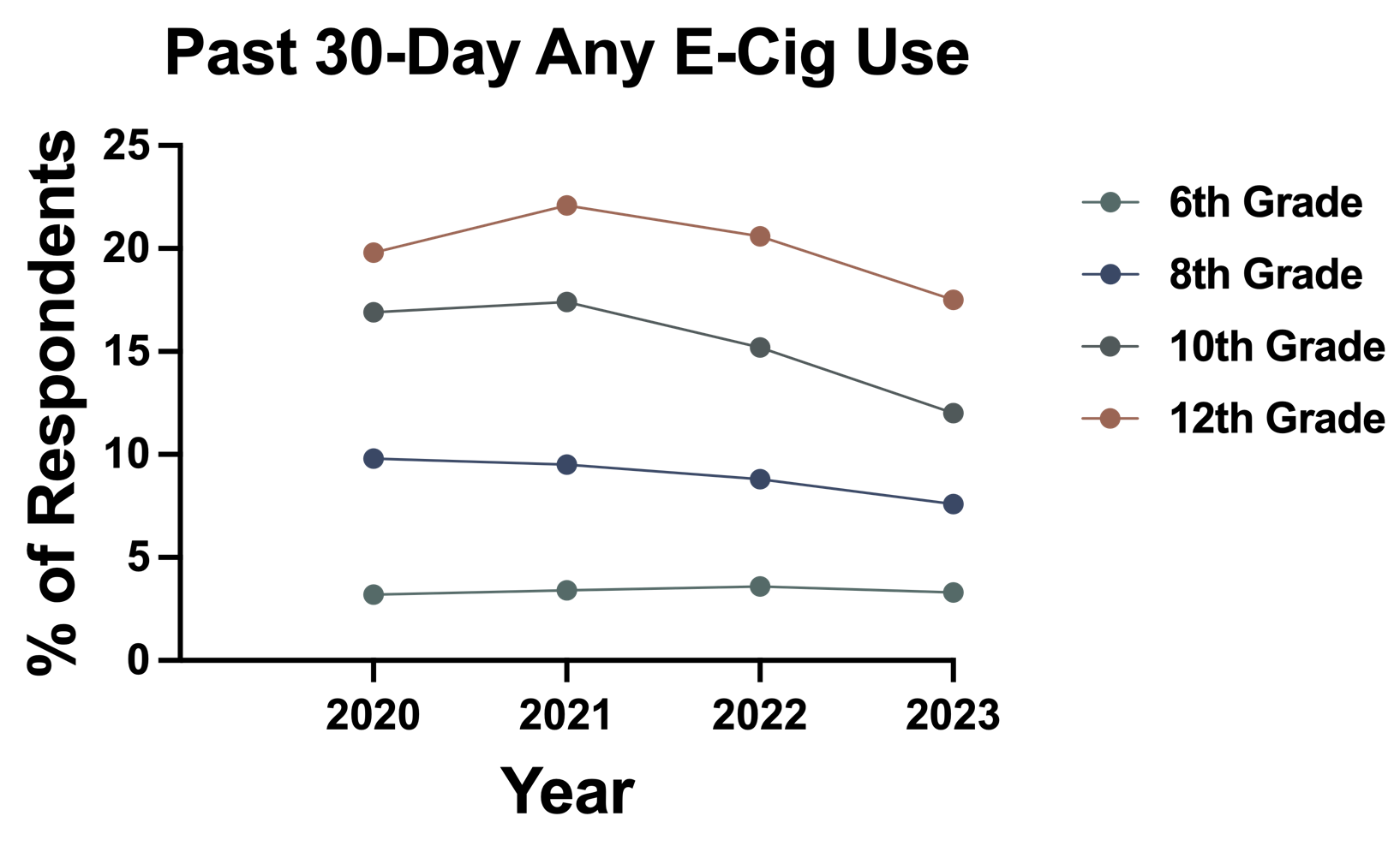
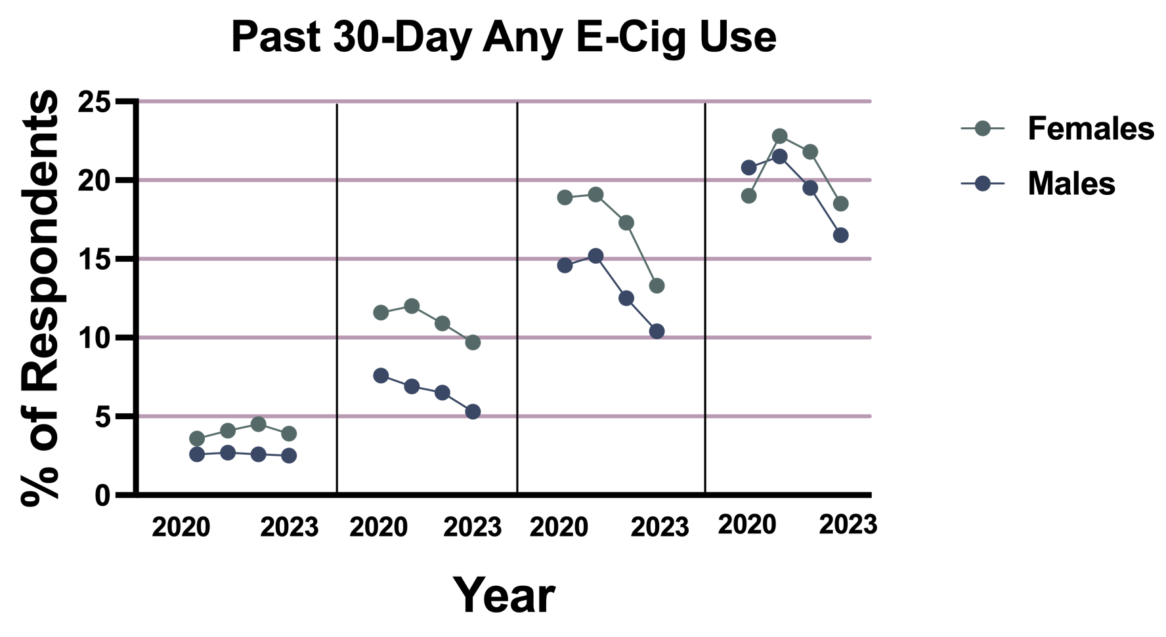
AR Youth Any E-Cig Use Trends
APNA

Slide 18
AR Youth Nicotine E-Cig Use Trends
APNA
APNA

Slide 19
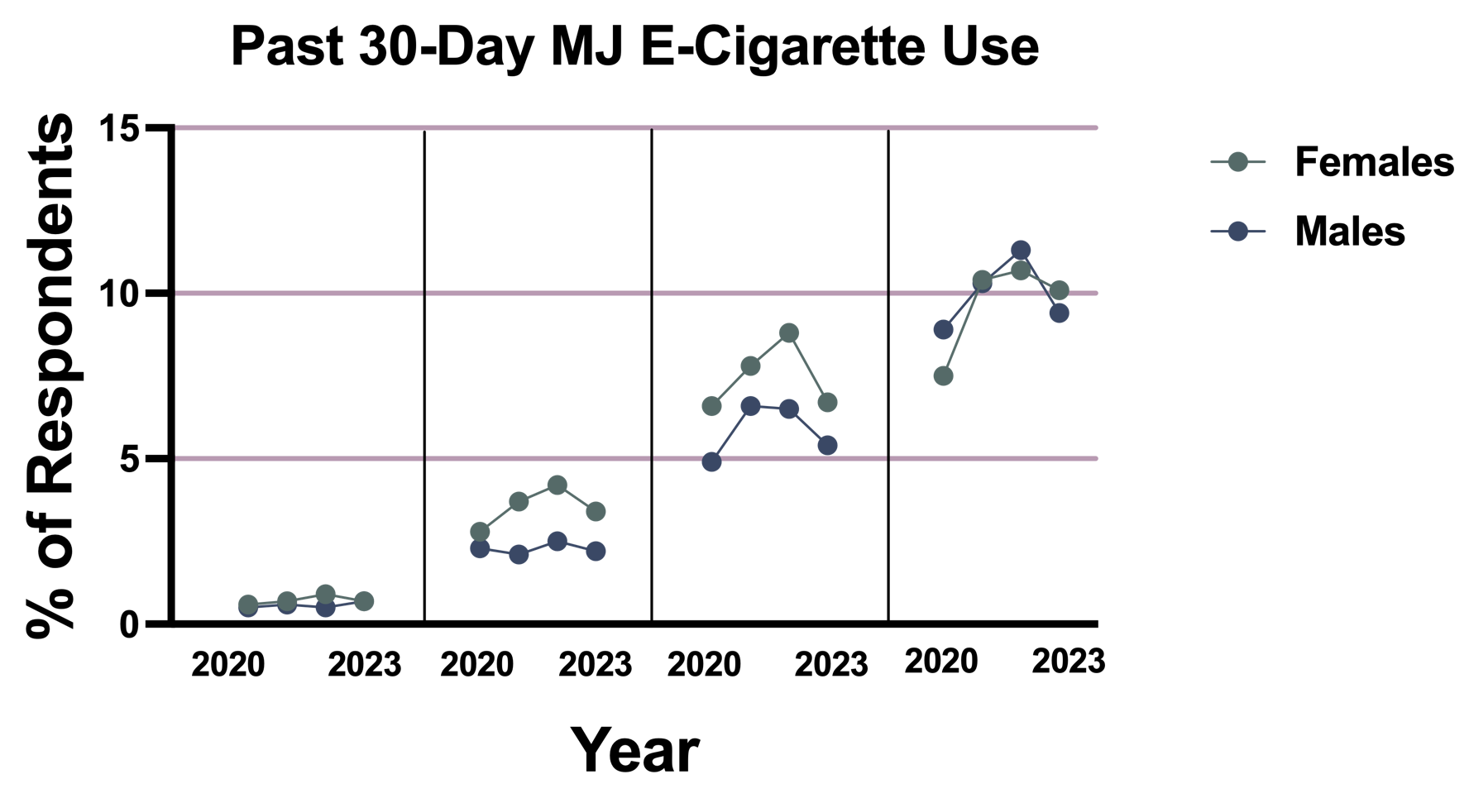
AR Youth Marijuana E-Cig Use Trends
APNA
APNA

Slide 20
Summary
PY Use decreased or remained stable for alcohol, cannabis, Delta-8 THC, illicit drugs other than MJ, and narcotics other than heroin among youth in 2024.
PY use remained stable or increased for nicotine pouch use in 2024.
PY abstinence from MJ, alcohol, or nicotine increased in 2024.
Order of highest prevalence of PY new initiates was nicotine vaping, alcohol and marijuana in 2022.
Arkansas youth appear to reflect national trends in cigarette, nicotine e-Cig and MJ e-Cig use.
AR Female students appear to continue to be especially prone to E-Cig use.

Slide 21
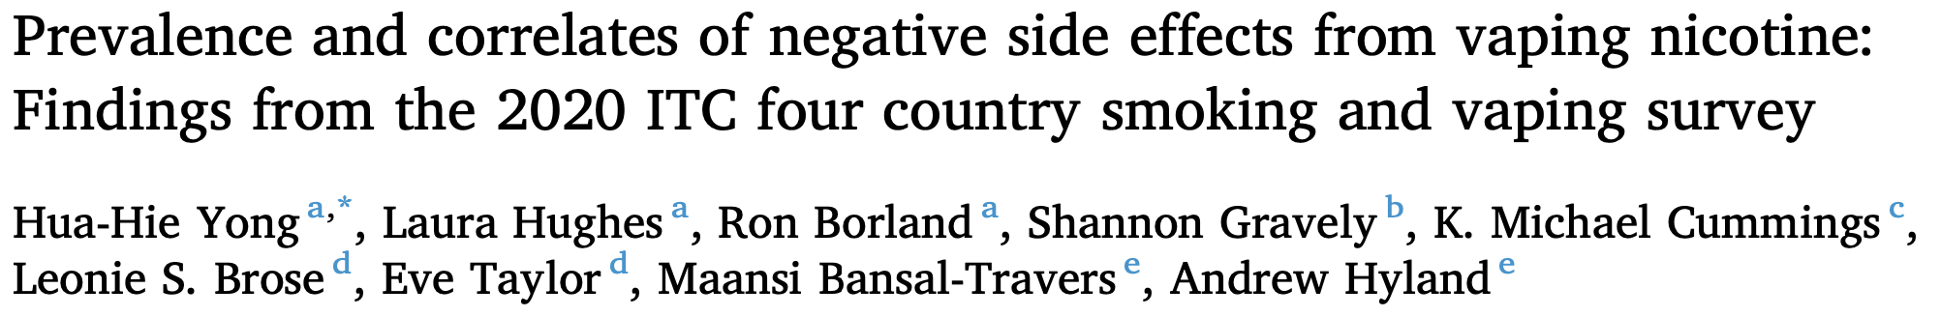

Cross-sectional study of 3906 adults (18+ years) from the 2020 ITC Four Country Smoking and Vaping Survey (Canada, US, England and Australia) who ever smoked cigarettes and were currently vaping asked about experiencing and seeking medical advice for any negative side effects from vaping in the past month:
12.9 % reported 1+ negative side effects from vaping
Most common side effects: throat irritation (5.8 %), cough (5.5 %), mouth irritation (4.1 %).
Mouth irritation (46.8 %) and loss of taste (45.2 %) most common reasons for seeking medical care
Those reporting side effects more likely younger, male, currently smoking (vs quit), vaping for <6 months (vs >1 year), using disposables or cartridges/ pods (vs tanks), using vapes with nicotine (vs without nicotine), using menthol/mint flavor (vs sweet flavor), currently smoking (vs quit), believing vaping causes various diseases (e.g., heart disease), and believing that vaping is equally/more harmful than smoking.
https://www.sciencedirect.com/science/article/pii/S0376871624014285?ref=cra_js_challenge&fr=RR-1

Slide 22
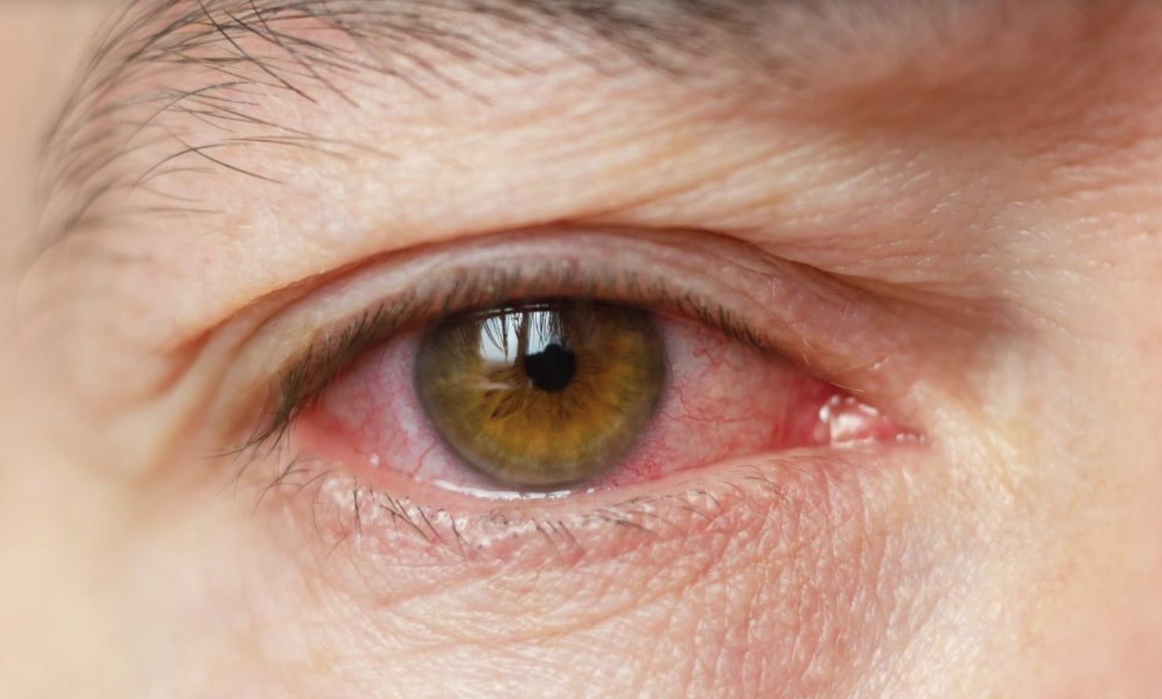
Vaping Linked to Increased Risk of Uveitis
Uveitis is inflammation of various components of the eye.
Symptoms can include (depending on what parts of the eye are affected):
Pain, generally developing over a few hours or days except in cases of trauma
Redness
Light sensitivity
Blurred vision
Increased tearing of the eyes
Floaters
Adult e-cig users had more than double the risk for developing uveitis than nonusers, with ↑ risks as early as within 7 days after e-cig use and persisting for up to 4 years after initial use.
This ↑ risk observed across all age groups and affected both men and women as well as various ethnic groups.
↑ risk for uveitis among those with a history of both e-cig and cigarette use than among cigarette users only
https://www.medscape.com/viewarticle/vaping-linked-higher-risk-blurred-vision-eye-pain-2024a1000l9q?ecd=mkm_ret_241207_mscpmrk_psych_addiction_etid7055961&uac=318511EV&impID=7055961

Slide 23
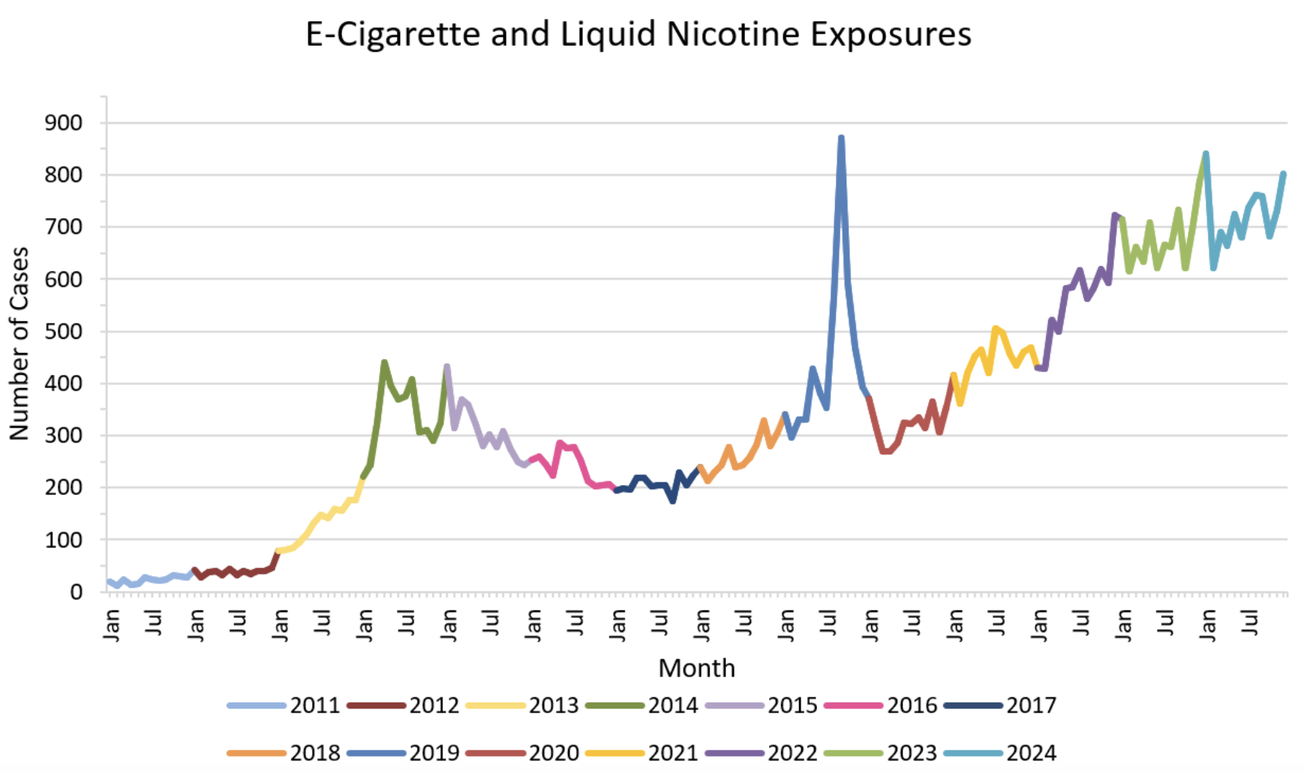
From 2011 to 2024, Poison Centers have managed 56,628 e-cigarette and liquid nicotine related exposure cases
https://poisoncenters.org/track/ecigarettes-liquid-nicotine

Slide 24
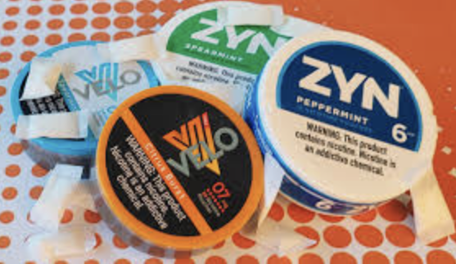
National Tobacco Survey 2024 Youth Nic Pouch Findings
Current Nicotine Pouch Use
1.8% of students (480,000) reported current nicotine pouch use
Frequency of Use
>1 in 5 (22.4%) report using daily use
>1 in 4 (29.3%) use 20+ of the last 30 days
Flavored Nicotine Pouch Use
>4 in 5 (85.6%) used flavored nicotine pouches, with mint flavors being the most popular, followed by fruit
Commonly Used Brands
Most commonly-reported brands were: Zyn (68.7%), on! (14.2%), Rogue (13.6%), Velo (10.7%) and Juice Head ZTN (9.8%)
https://www.fda.gov/tobacco-products/youth-and-tobacco/results-annual-national-youth-tobacco-survey

Slide 25
Nicotine Pouch
Small rectangles that are about the size of a piece of Chiclet® gum that come in a variety of flavors
Contains nicotine (either synthetic or derived from tobacco), particularly dangerous for young people because it can cause physical changes in their still-developing brains.
Nicotine is a highly addictive stimulant, including physiological dependence
Tucked in between lip or cheek and gums; nicotine is absorbed into bloodstream through mucous membranes in mouth
Nicotine poisoning can occur
Nicotine can negatively affect the entire body, causing lung and stomach problems, increasing blood pressure and heart rate, and narrowing arteries, which can lead to a heart attack.
Short- and long-term health consequences of using them are unclear

Slide 26
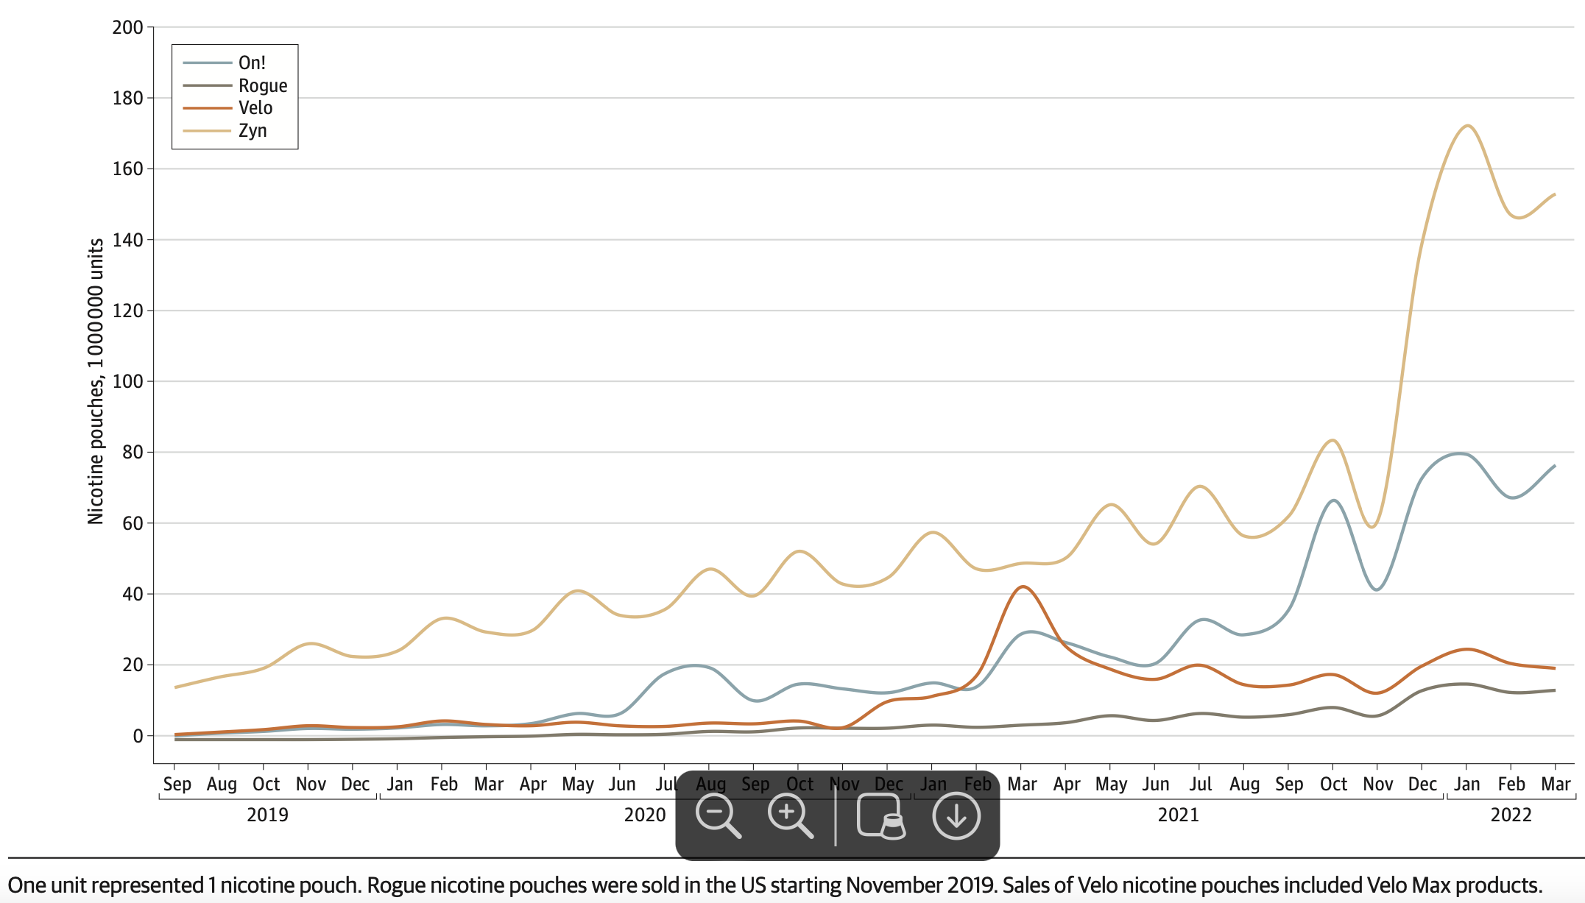
Nicotine Pouch Unit Sales in the US by Brand (2019-2022)
Majmundar A, Okitondo C, Xue A, Asare S, Bandi P, Nargis N. Nicotine Pouch Sales Trends in the US by Volume and Nicotine Concentration Levels From 2019 to 2022. JAMA Netw Open. 2022;5(11):e2242235. doi:10.1001/jamanetworkopen.2022.42235

Slide 27
Smokeless Tobacco
Contains nicotine in tobacco plant (carcinogen)
Chewing tobacco contains cancer-causing chemicals and can increase the risk of:
Nicotine Poisoning
Developing cancer in the mouth, esophagus, throat, and pancreas
Gum disease, tooth decay, dry mouth, bad breath, stained teeth
Heart disease and stroke
Pregnancy complications, including stillbirth, low birth weight, and heart rate issues in infants.
Dry mouth
Weakened sense of taste

Slide 28
Past 30-day Cigarette & Smokeless Tobacco Use
APNA

Slide 29
Summary
PY Use decreased or remained stable for alcohol, cannabis, Delta-8 THC, illicit drugs other than MJ, and narcotics other than heroin among youth in 2024.
PY use remained stable or increased for nicotine pouch use in 2024.
PY abstinence from MJ, alcohol, or nicotine increased in 2024.
Order of highest prevalence of PY new initiates was nicotine vaping, alcohol and marijuana in 2022.
Arkansas youth appear to reflect national trends in cigarette, nicotine e-Cig and MJ e-Cig use.
AR Female students appear to continue to be especially prone to cigarette, E-Cig, but not smokeless tobacco, use.
Notes:
Fig. 2. “All east” is the three-year lagged pooled synthetic narcotic mortality rate across all states that lie entirely east of the Mississippi River, as well Minnesota, Louisiana, and the District of Columbia. “Top 10′′ is the three-year lagged pooled synthetic narcotic mortality across 10 jurisdictions with highest population-adjusted synthetic narcotics mortality rate in 2018 (Delaware, West Virginia, Maryland, New Hampshire, Massachusetts, New Jersey, Ohio, District of Columbia, Connecticut, Rhode Island).

Slide 30
Summary (continued)
Long-term safety of vaping is unknown, although short-term side effects appear to be mild.
People who vape at higher risk of eye condition (uveitis)
Nicotine pouches have been becoming more popular and, while the products MAY be safer than smokeless tobacco, their long-term impacts are unknown, and nicotine is contraindicated in youth.
Smokeless tobacco use among male students has decreased over time and remained relatively low and stable among female students.
Notes:
Fig. 2. “All east” is the three-year lagged pooled synthetic narcotic mortality rate across all states that lie entirely east of the Mississippi River, as well Minnesota, Louisiana, and the District of Columbia. “Top 10′′ is the three-year lagged pooled synthetic narcotic mortality across 10 jurisdictions with highest population-adjusted synthetic narcotics mortality rate in 2018 (Delaware, West Virginia, Maryland, New Hampshire, Massachusetts, New Jersey, Ohio, District of Columbia, Connecticut, Rhode Island).

Slide 31
Discussion
Notes:
How do the AR data line up with national trends?
Should nicotine pouches be added to APNA survey for next year?

Slide 32
Action Plan/Wrap-Up/Next Meeting

Slide 33
Thank you!

