Slide 1
Deeper Data Dives: Association Analyses of APNA Substance Use Prevalence and of Arrest Data
Association of Substance use & Education efforts
Association of Substance arrests & Demographic factors

Slide 2
Association of Substance use & Education efforts
APNA 2023 (47,695 total respondents)
Lifetime & Past 30 day self-reported use of:
  Alcohol, Cigarettes, Marijuana, Meth, RX drugs, Smokeless tobacco, Vaping(Flavoring, Marijuana, Nicotine)
Educational efforts APNA questions: Tobacco-related
  During this school year, were you taught in any of your classes about the dangers of tobacco use? (Never, Rarely, Sometimes, Often, Almost always)

Slide 3
Association of Substance use & Education efforts
Educational efforts APNA questions: Alcohol-related
  During the past 12 months, have you participated in any alcohol prevention programs or seen any alcohol prevention messages in your school or community? (Please check all that apply.)
    A) Yes, a school-based program focused on preventing underage drinking and/or drinking and driving. (No, Yes)
    B) Yes, a community-based program focused on preventing underage drinking and/or drinking and driving (for example, through your church or temple or through youth groups like Boys and Girls Club or 4-H). (No, Yes)
    C) Yes, a media campaign addressing underage drinking and/or drinking and driving (for example, newspaper ads, posters, pamphlets, radio, TV, billboards, etc.). (No, Yes)
    D) No (No, Yes)

Slide 4
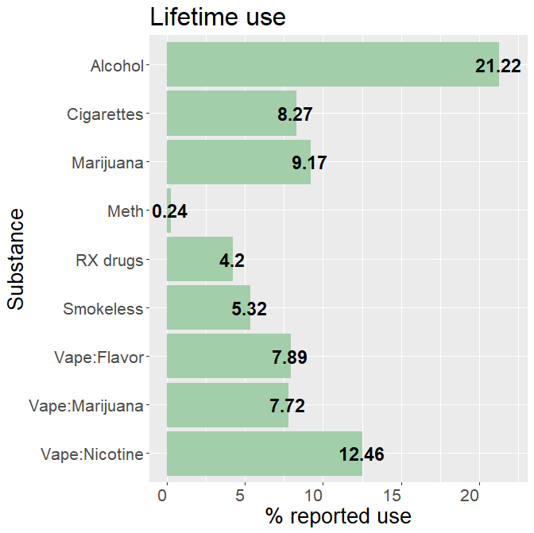
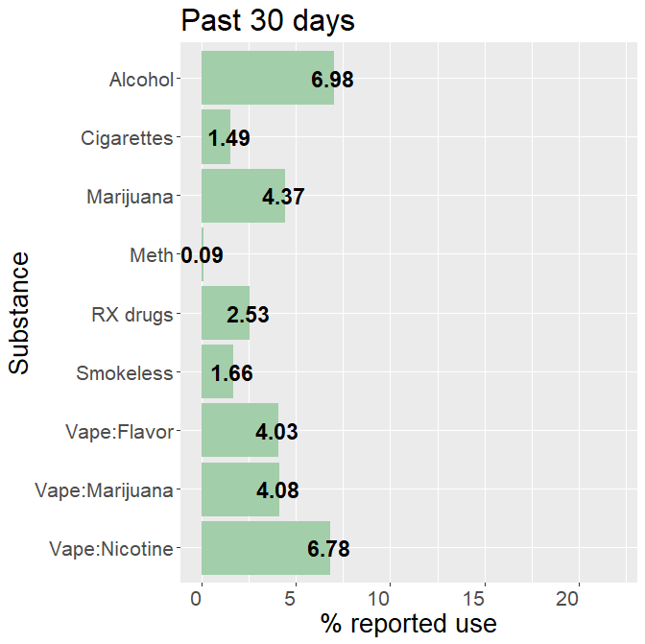
2023 APNA self-reported use
Notes:
Put overall n,

Slide 5
2023 APNA self-reported use
Marijuana X Vaped Marijuana
Smoked Marijuana | Vaped Marijuana | Lifetime | Past 30 days
No | No | 90.03 | 95.11
No | Yes | 0.82 | 0.53
Yes | No | 2.29 | 0.84
Yes | Yes | 6.85 | 3.51

Slide 6
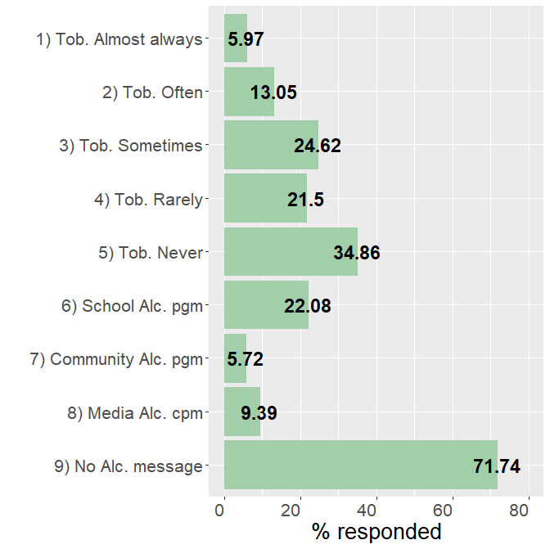
2023 APNA Educational efforts
Notes:
Put overall n,

Slide 7
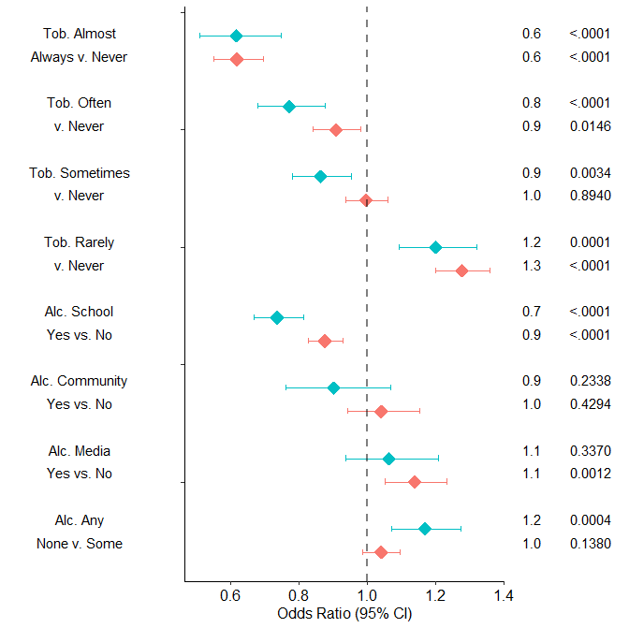
Reading the Forest plots
Reference line: Odds Ratio=1.0
Comparison category vs. Reference category
Odds Ratio point estimates
Odds Ratio and 95% confidence interval for APNA self-reported youth past 30 day use
P-value of Odds Ratio
Lifetime use

Slide 8
Factor Comparison OR p-value
Alcohol
Significant protective effects:
  Tobacco teaching Almost Always, Often, and Sometimes(past 30 only) v. Never
  School Alcohol program
Significant risk effects:
  Tobacco Rarely teaching v. Never
  Alcohol media (lifetime)
  Alcohol message None (past 30) v. Some
Past 30 day
Lifetime

Slide 9
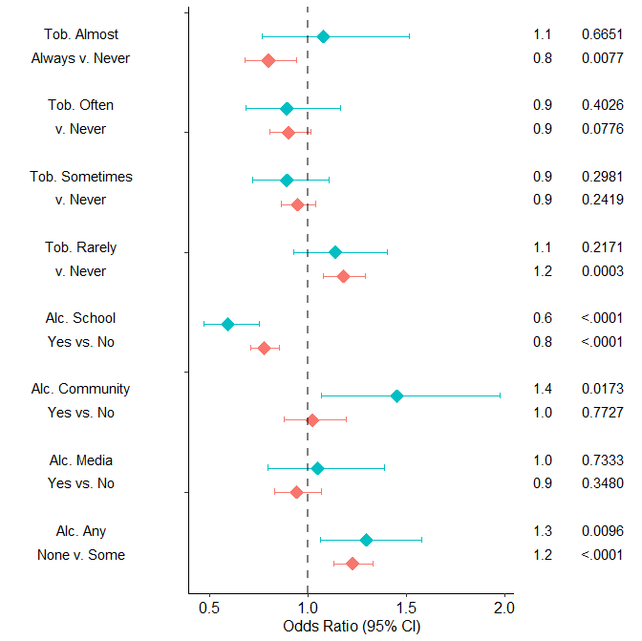
Factor Comparison OR p-value
Cigarettes
Significant protective effects:
  Tobacco teaching Almost Always(lifetime) v. Never
  School Alcohol program
Significant risk effects:
  Tobacco Rarely teaching (lifetime) v. Never
  Alcohol media (past 30)
  Alcohol message None v. Some
Past 30 day
Lifetime

Slide 10
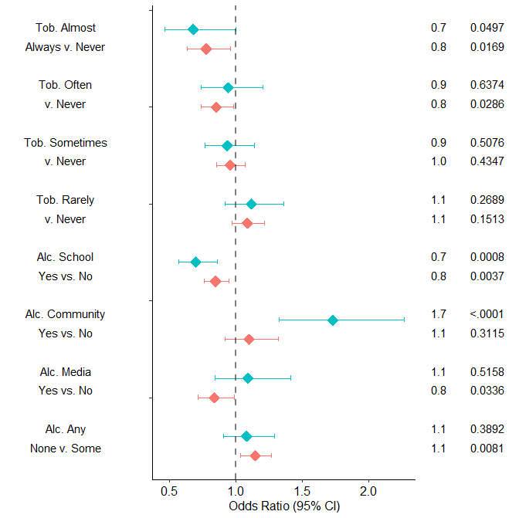
Factor Comparison OR p-value
Smokeless Tobacco
Significant protective effects:
  Tobacco teaching Almost Always, Often(lifetime) v. Never
  School Alcohol program
  Alcohol media(lifetime)
Significant risk effects:
  Community Alcohol program(past 30)
  No Alcohol message (lifetime)
Past 30 day
Lifetime

Slide 11
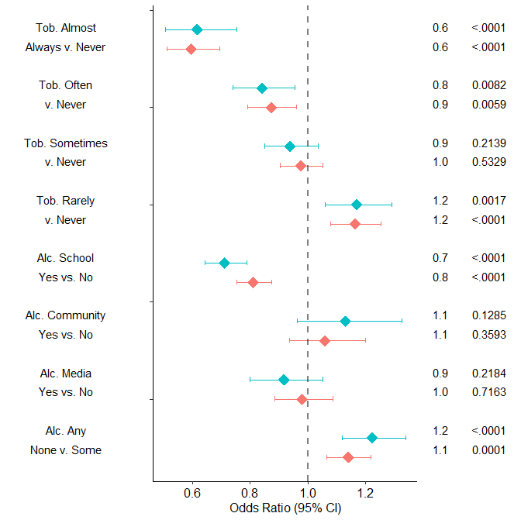
Factor Comparison OR p-value
Nicotine Vaping
Significant protective effects:
  Tobacco teaching Almost Always and Often vs. Never
  School Alcohol program
Significant risk effects:
  Tobacco Rarely teaching vs. Never
  No Alcohol message
Past 30 day
Lifetime

Slide 12
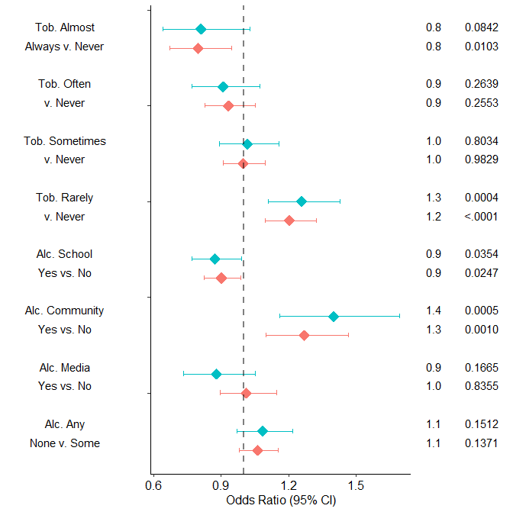
Factor Comparison OR p-value
Flavor Vaping
Significant protective effects:
  Tobacco teaching Almost Always(lifetime) v. Never
  School Alcohol program
Significant risk effects:
  Tobacco Rarely teaching v.. Never
  Community Alcohol program
Past 30 day
Lifetime

Slide 13
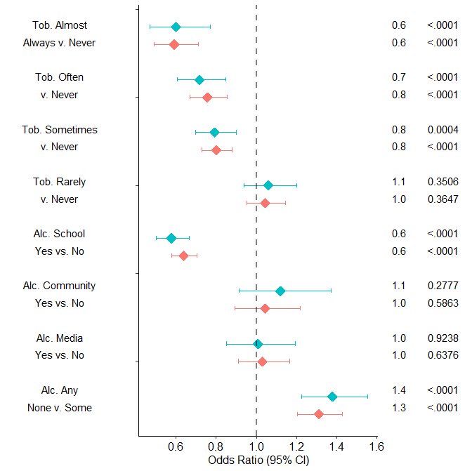
Factor Comparison OR p-value
Marijuana Vaping
Significant protective effects:
  Tobacco teaching Almost Always, Often, and Sometimes v. Never
  School Alcohol program
Significant risk effects:
  No Alcohol message
Past 30 day
Lifetime

Slide 14
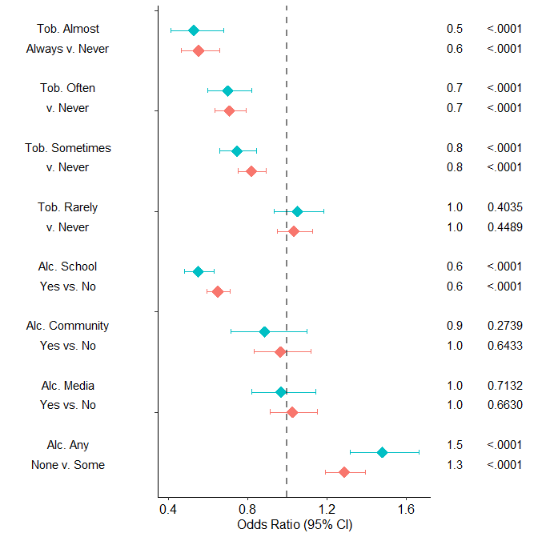
Factor Comparison OR p-value
Marijuana
Significant protective effects:
  Tobacco teaching Almost Always, Often, and Sometimes v. Never
  School Alcohol program
Significant risk effects:
  No Alcohol message
Past 30 day
Lifetime

Slide 15
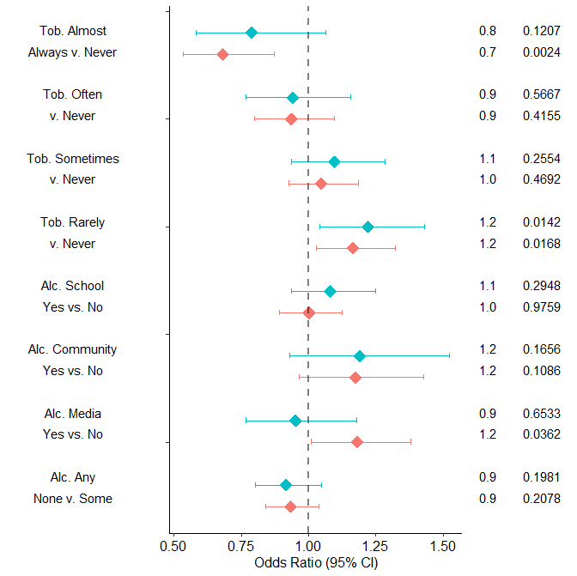
Factor Comparison OR p-value
Prescription Drugs
Significant protective effects:
  Tobacco teaching Almost Always(lifetime) v. Never
Significant risk effects:
  Tobacco Rarely teaching v. Never
  Alcohol media (lifetime)
Past 30 day
Lifetime

Slide 16
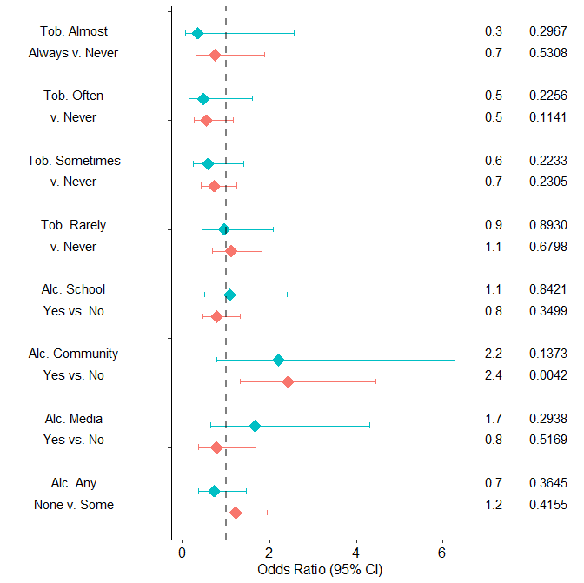
Factor Comparison OR p-value
Meth/Amphetamines
Recall low rate of reported use
Most results not significant
Community-based alcohol program significant protective effect for lifetime use
Past 30 day
Lifetime

Slide 17
Association of Substance use & Education efforts
Summary:
  Teaching of Tobacco Dangers in school (Almost Always, Often, Sometimes) vs. Never have several significant protective effect associations with use of various substances
    Rarely vs. Never occasionally a risk effect association
  School-based Alcohol prevention program has several significant protective affect associations with use of various substances
    Community-based, Media campaign, and having No message exposure vs. any occasionally a risk effect association

Slide 18
Association of Substance arrests & Demographic factors
Arrests for specific substances broken down by demographics factors (race, sex, age) at state level
  Race: Black/White
  Sex: Male/Female
  Age group: Juvenile(under 18), Adult(18 and over)
Substance groups:
  Meth/Amphetamines
  Cocaine/Crack
  Marijuana/Hashish
  Opioids/Opiates
  Hallucinogens
  Results for Juveniles only on Marijuana/Hashish (Juvenile arrest numbers too low for other substances)
Compared with state level population of analogous demographic groups
Calendar year 2023 data

Slide 19
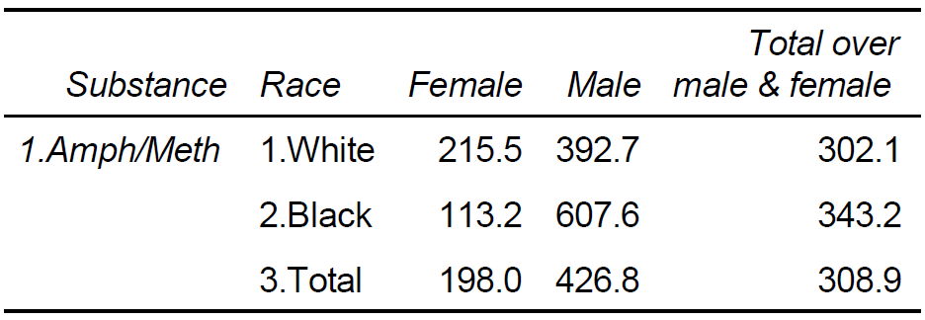
Adult Possession Arrest rate per 100,000: Meth/Amphetamines

Slide 20
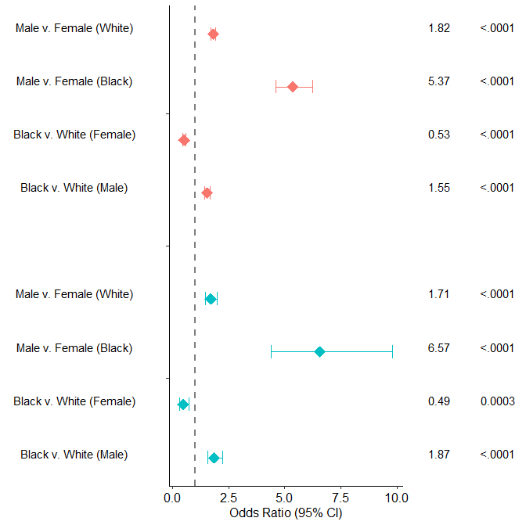
Factor Comparison OR p-value
Adult: Meth/Amphetamines
Male has increased odds of arrest(poss. & s/m), larger in Black than White.
Black has increased odds within males, reduced odds within females
Possession
Sales / Manufacturing

Slide 21
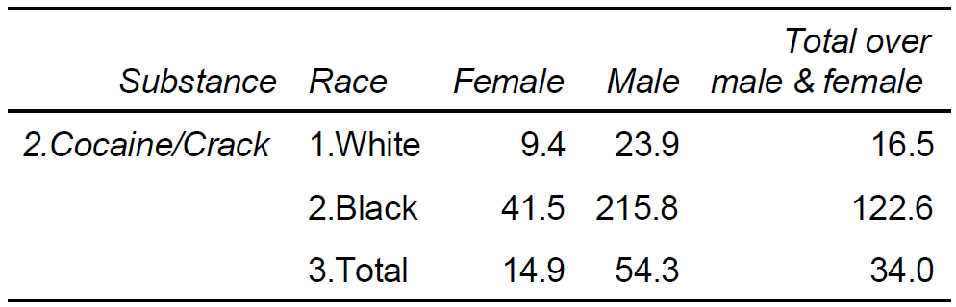
Adult Possession Arrest rate per 100,000: Cocaine/Crack

Slide 22
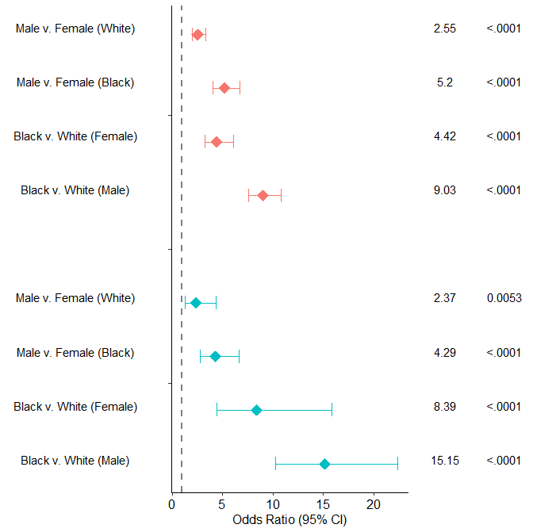
Factor Comparison OR p-value
Adult: Cocaine/Crack
Increased odds of arrest for male irrespective of race and for Black irrespective of sex
Possession
Sales / Manufacturing

Slide 23
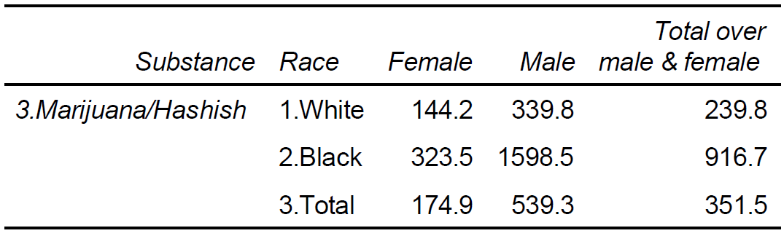
Adult Possession Arrest rate per 100,000: Marijuana/Hashish

Slide 24
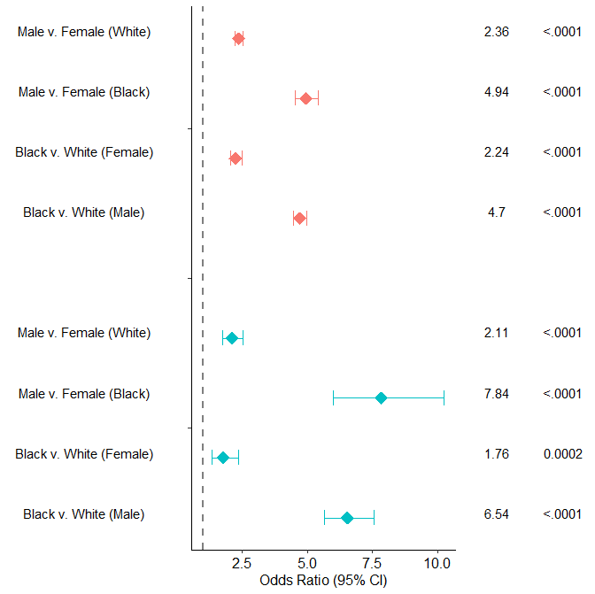
Factor Comparison OR p-value
Adult: Marijuana/Hashish
Increased odds of arrest for male irrespective of race and for Black irrespective of sex
Possession
Sales / Manufacturing

Slide 25
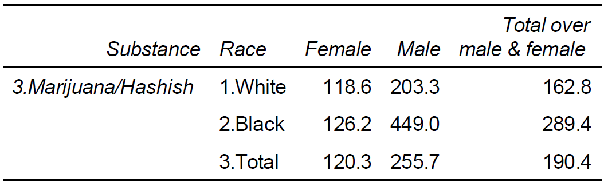
Juvenile Possession Arrest rate per 100,000: Marijuana/Hashish

Slide 26
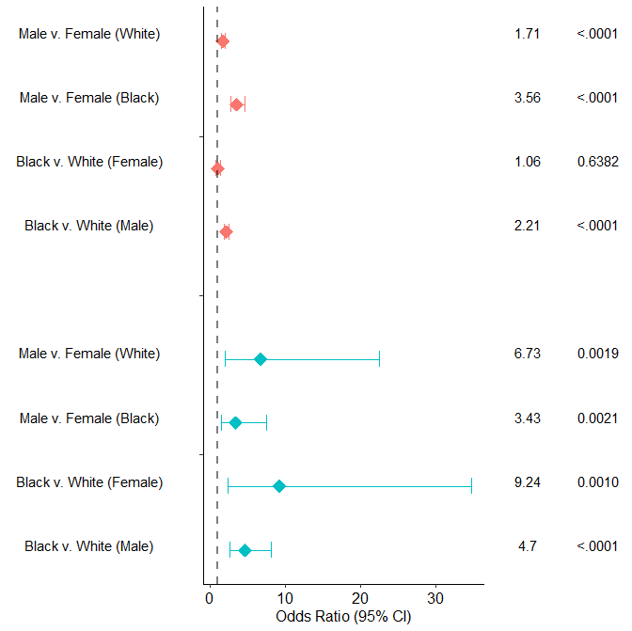
Factor Comparison OR p-value
Juvenile Marijuana/Hashish
Increased odds of arrest for male irrespective of race
Increased odds of arrest for Black within males, and for Black within females for sales/manufacturing but not for possession
Possession
Sales / Manufacturing

Slide 27
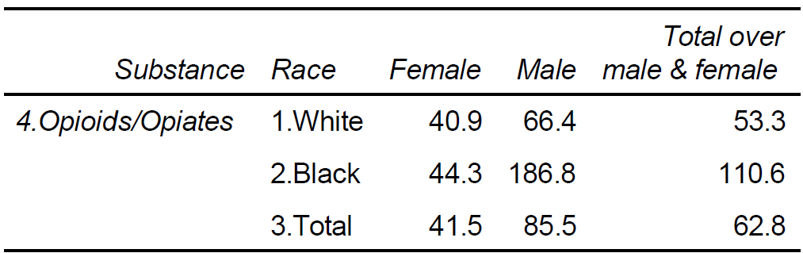
Adult Possession Arrest rate per 100,000: Opioids/Opiates

Slide 28
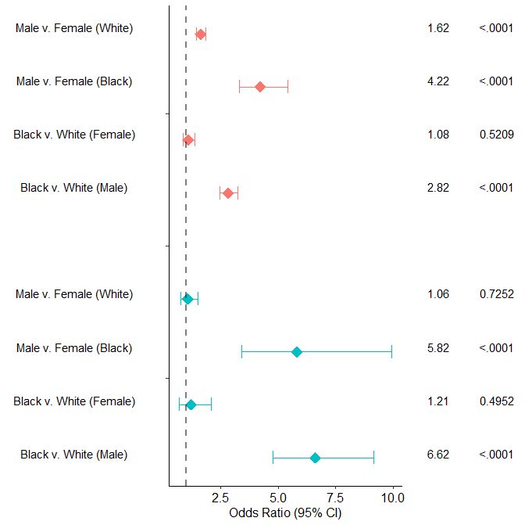
Factor Comparison OR p-value
Adult: Opioids/Opiates
Increased odds of arrest for males within Black and for Black within males.
Increased odds of possession arrest for males within White
Possession
Sales / Manufacturing

Slide 29
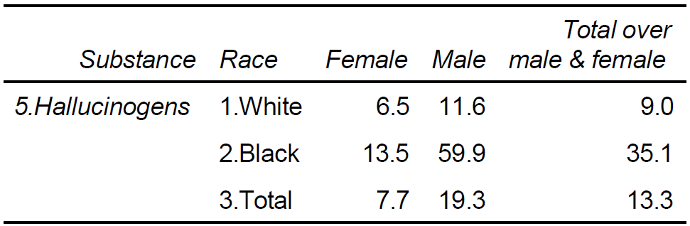
Adult Possession Arrest rate per 100,000: Hallucinogens

Slide 30
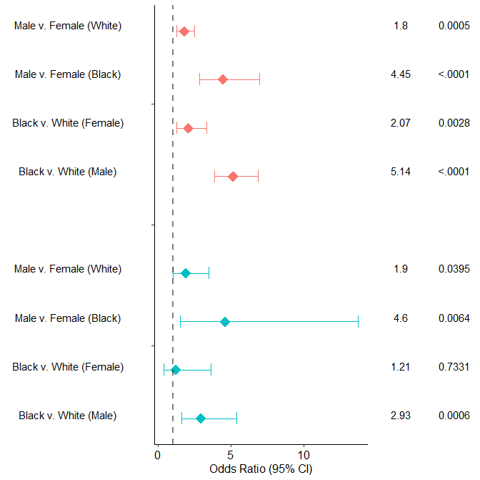
Factor Comparison OR p-value
Adult: Hallucinogens
Increased odds of arrest for male irrespective of race and for Black irrespective of sex
Increased odds of arrest for Black irrespective of sex, except for Sales/Manufacturing arrests in females.
Possession
Sales / Manufacturing

Slide 31
Association of Substance arrests & Demographic factors
Summary:
  In most cases, Black race and Male sex associated with higher arrest risk
  Black race associated with lower arrest risk in the specific case of Females arrested for Meth/Amphetamines
Further investigation:
  Compare arrest rates vs. treatment rates
Notes:
Possibly detect demographic bias in arrest/enforcement vs. treatment
Underlying unknown: rate of use
Measurably proxies(potentially biased?): rate of arrests, rate of treatment admissions

