Slide 1

Arkansas Statewide Epidemiological Outcomes Workgroup Thrice-Annual Meeting 05/22/2025
Supported by: SAMHSA Substance Abuse Block Grant 1B08TI087025-01

Slide 2
Today’s Agenda
Welcome, Introductions, Mission – A. Oliveto
Quick National Updates – A. Oliveto
Arkansas Collegiate Survey: 2021-2024 – D. Slagle
Substance Use Prevalence in AR compared with SSW region: NSDUH and WONDER Updates – K. Chakoian
Injection Drug Use in Arkansas – A. May and L. Cima
Deeper Data Dives: Association Analyses of APNA Substance Use Prevalence and of Arrest Data – J. Thostenson
Deeper Data Dives: ACEs in Arkansas – M. Bollinger
Discussion and Wrap Up

Slide 3
SEOW Mission
SEOW’s mission is to guide successful prevention efforts in the state of Arkansas by:
Analyzing, monitoring and sharing data trends in substance use and other environmental, behavioral, and health-related factors.
Informing data-driven policy and practice decision-making regarding prevention priorities at local and state levels.
Disseminating evidence-based education and prevention materials to the larger public.

Slide 4
National and Local Updates Alison Oliveto, PhD SEOW Leader UAMS

Slide 5
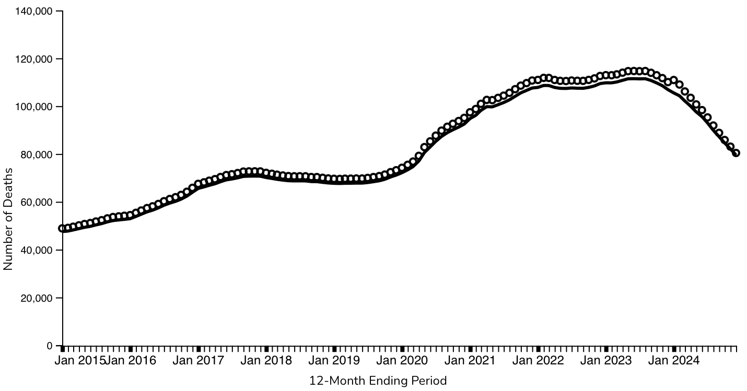
2024 Provisional U.S. Drug-Involved Overdose Deaths ↓ 26.9% from 2023
As of 5/4/25
https://www.cdc.gov/nchs/nvss/vsrr/drug-overdose-data.htm

Slide 6
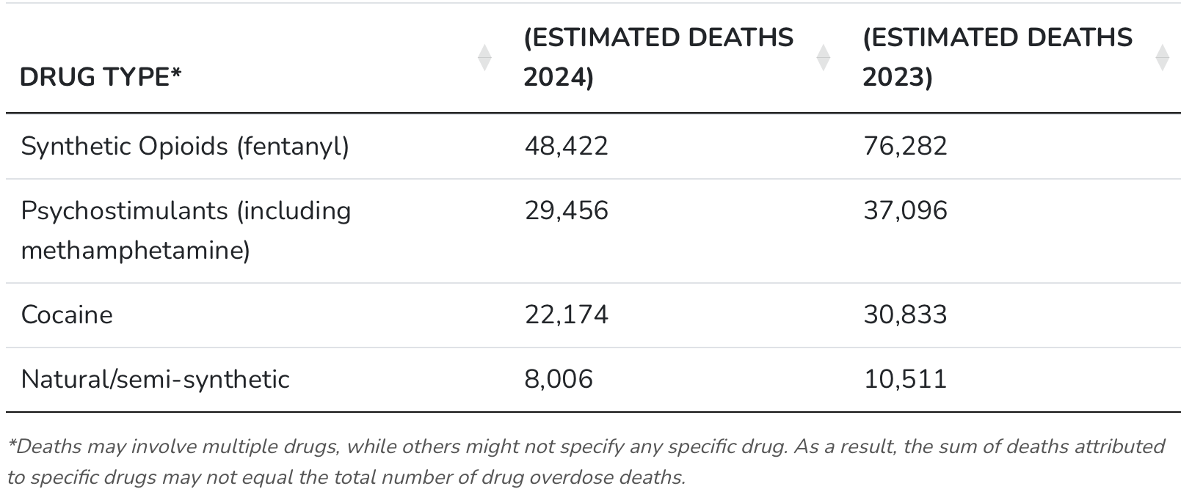
2024 Provisional U.S Drug-Involved Overdose Deaths ↓ 29.9% from 2023
80,391 deaths in 2024
36.5% ↓
20.6% ↓
28.1% ↓
23.8% ↓
https://www.cdc.gov/nchs/pressroom/nchs_press_releases/2025/20250514.htm

Slide 7
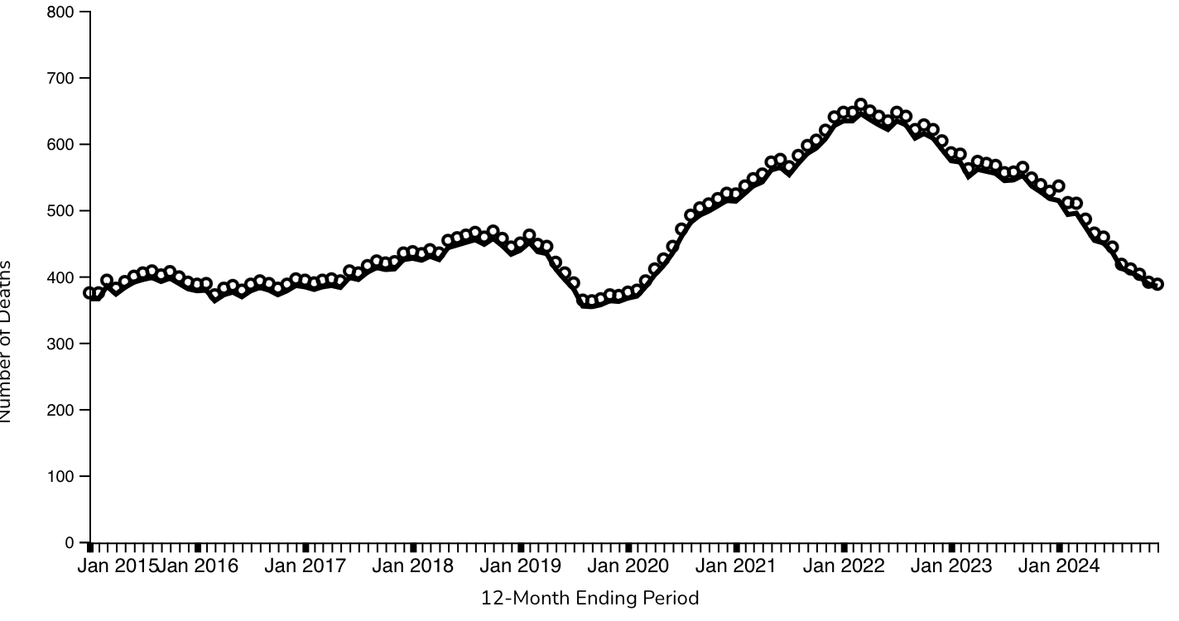
2024 Provisional AR Drug-Involved Overdose Deaths ↓ 26.5% from 2023
Data are incomplete.
https://www.cdc.gov/nchs/nvss/vsrr/drug-overdose-data.htm

Slide 8
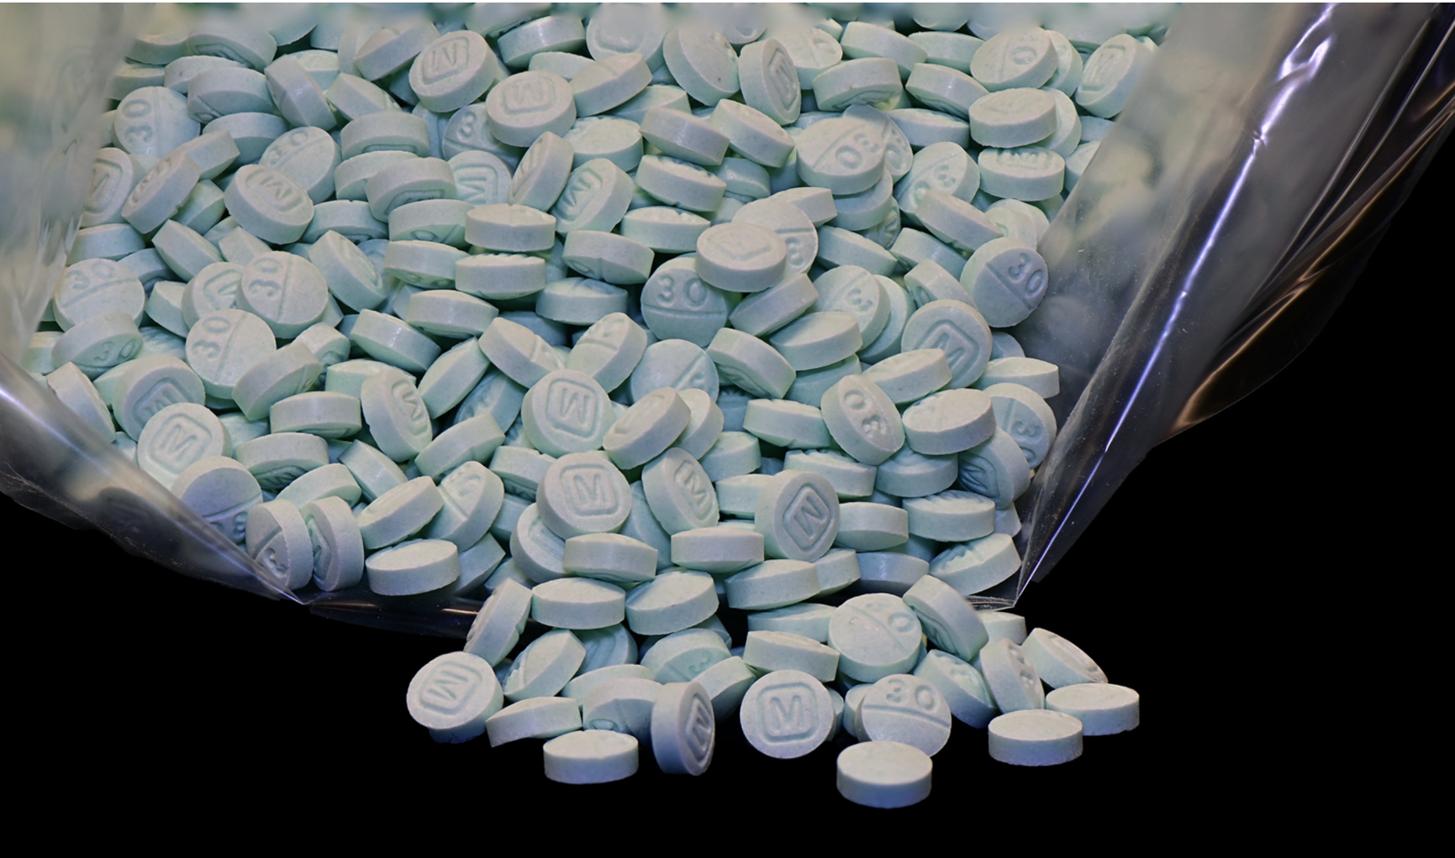
Decline in Fentanyl-Contaminated Pills
In 2024, DEA seized more than 60 million fentanyl-laced fake pills and nearly 8,000 pounds of fentanyl powder. The 2024 seizures are equivalent to more than 380 million lethal doses of fentanyl. The 2025 fentanyl seizures represent over 139 million deadly doses. *
DEA.gov
2022: 7 out of 10 pills contained a potentially lethal dose of fentanyl
2023: 6 out of 10 pills contained a potentially lethal dose of fentanyl
2024: 5 out of 10 pills contained a potentially lethal dose of fentanyl
https://www.dea.gov/press-releases/2024/12/16/overdose-deaths-decline-fentanyl-threat-looms

Slide 9
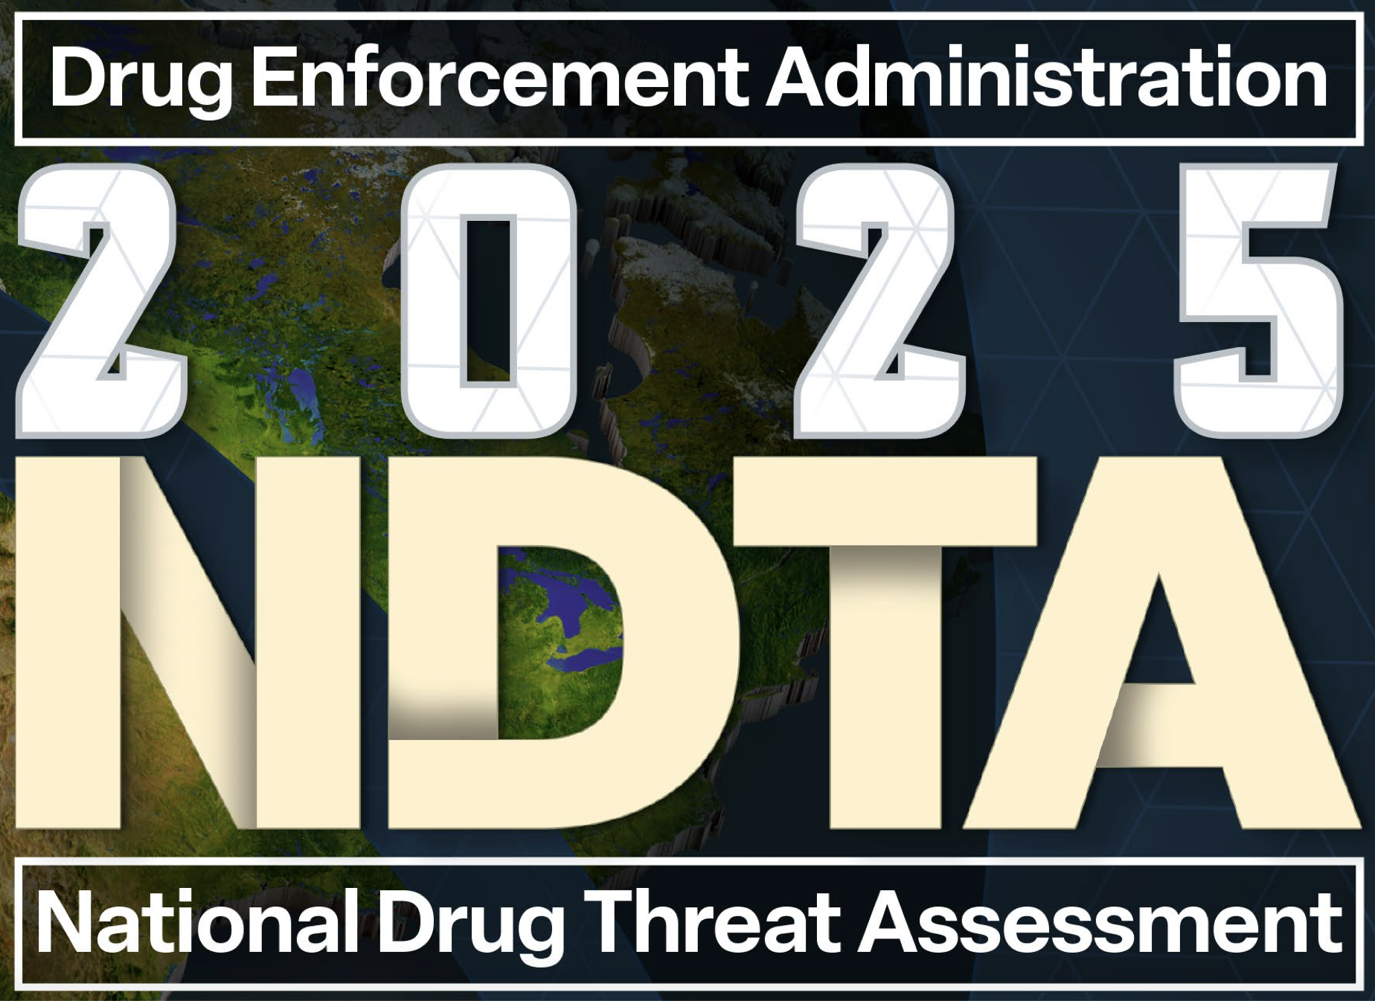
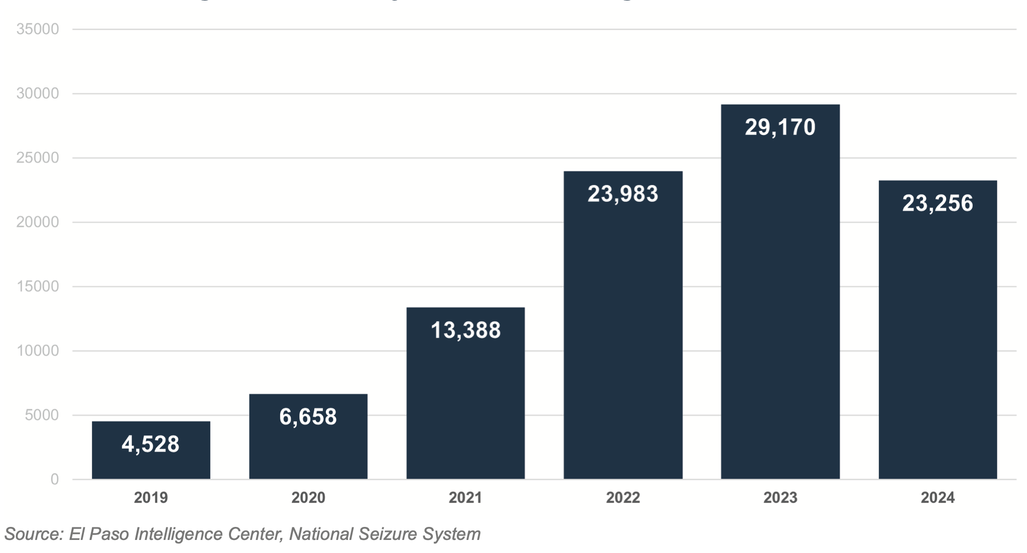
Fentanyl Seizures in Kg, 2019-2024
Fentanyl purity ↓ throughout 2024 and some key precursor chemicals many Mexico-based fentanyl cooks need were unavailable.
US fentanyl supply continue to be adulterated with various animal tranquilizers (such as xylazine), anesthetics (such as ketamine), and other synthetic opioids (such as nitazenes).
https://www.dea.gov/sites/default/files/2025-05/2025%20National%20Drug%20Threat%20Assessment_Web%205-12-2025.pdf

Slide 10
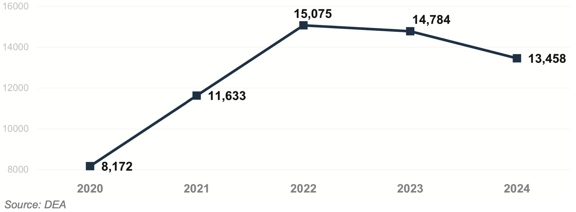
Number of Fentanyl Exhibits Containing Xylazine
Xylazine most prevalent in drug samples seized in New Jersey, Virginia, Ohio, Maryland, Pennsylvania, and Florida.
Has been identified in seized drug samples in every U.S. state, the District of Columbia and Puerto Rico .
While xylazine remains the #1 adulterant found in fentanyl powder, medetomidine adulteration is increasing.
https://www.dea.gov/sites/default/files/2025-05/2025%20National%20Drug%20Threat%20Assessment_Web%205-12-2025.pdf

Slide 11
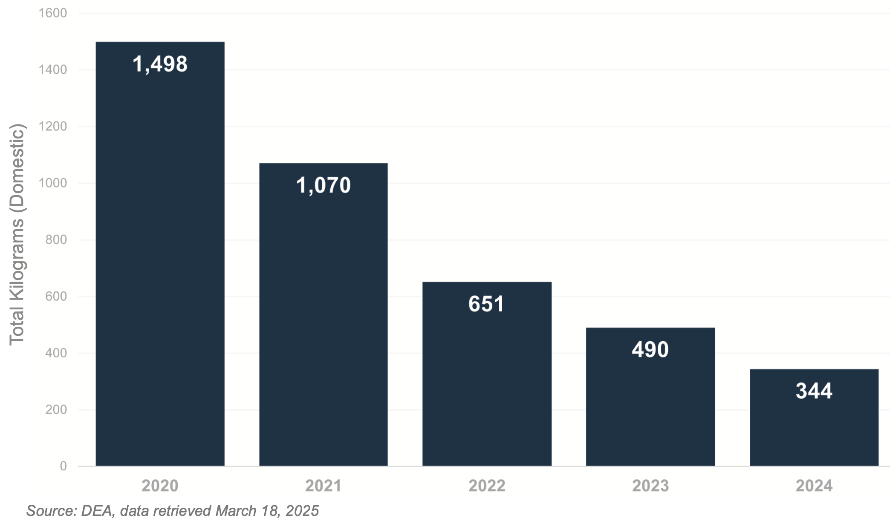
Heroin Seizures by the DEA, 2020-2024
Mixing of fentanyl and heroin so commonplace that both people who use heroin and forensic drug-testing labs indicate it is difficult to find heroin unadulterated with fentanyl.
https://www.dea.gov/sites/default/files/2025-05/2025%20National%20Drug%20Threat%20Assessment_Web%205-12-2025.pdf

Slide 12
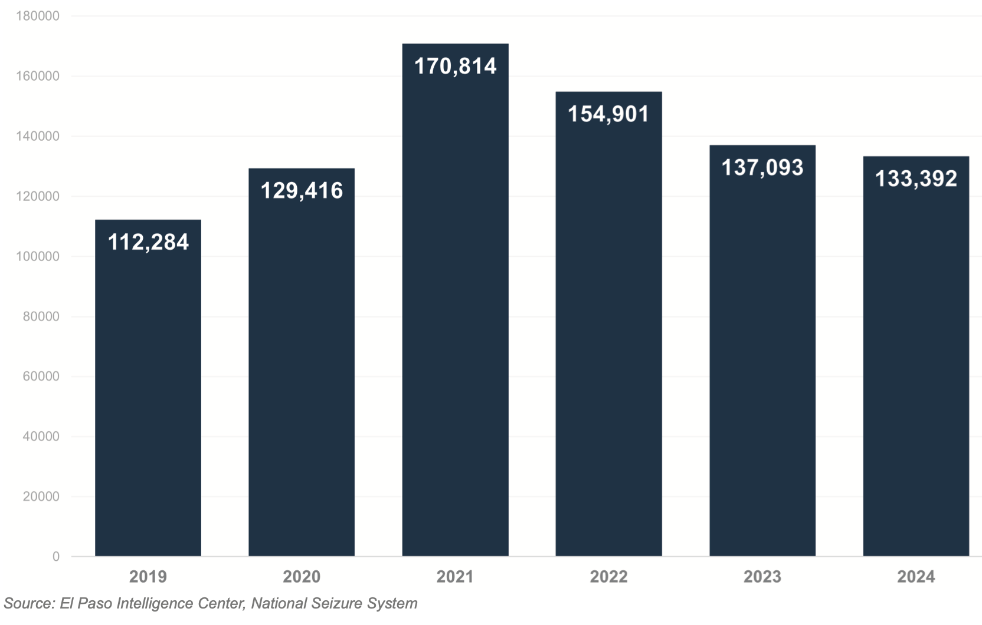
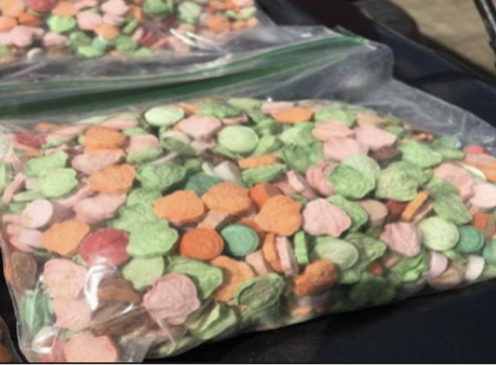
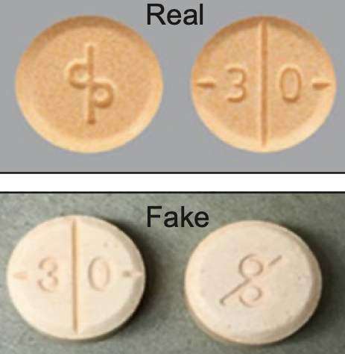
Methamphetamine Seizures in Kg, 2021-2024
Bulk seizures ↓ while pill seizures ↑
https://www.dea.gov/sites/default/files/2025-05/2025%20National%20Drug%20Threat%20Assessment_Web%205-12-2025.pdf
Notes:
The product innovation of methamphetamine in pill form illustrates the determination of Mexican TCOs to make methamphetamine appealing to non-traditional users, particularly those in the prescription pill and “club drug” user population

Slide 13
Top 3 Drugs Seized in AR in 2024:
Methamphetamine
Fentanyl
Cocaine
https://www.dea.gov/sites/default/files/2025-05/2025%20National%20Drug%20Threat%20Assessment_Web%205-12-2025.pdf
Notes:
The product innovation of methamphetamine in pill form illustrates the determination of Mexican TCOs to make methamphetamine appealing to non-traditional users, particularly those in the prescription pill and “club drug” user population

Slide 14

Arkansas Prevention Needs Assessment Survey
2024 APNA report is out!
Can be found at: https://arkansas.pridesurveys.com

Slide 15
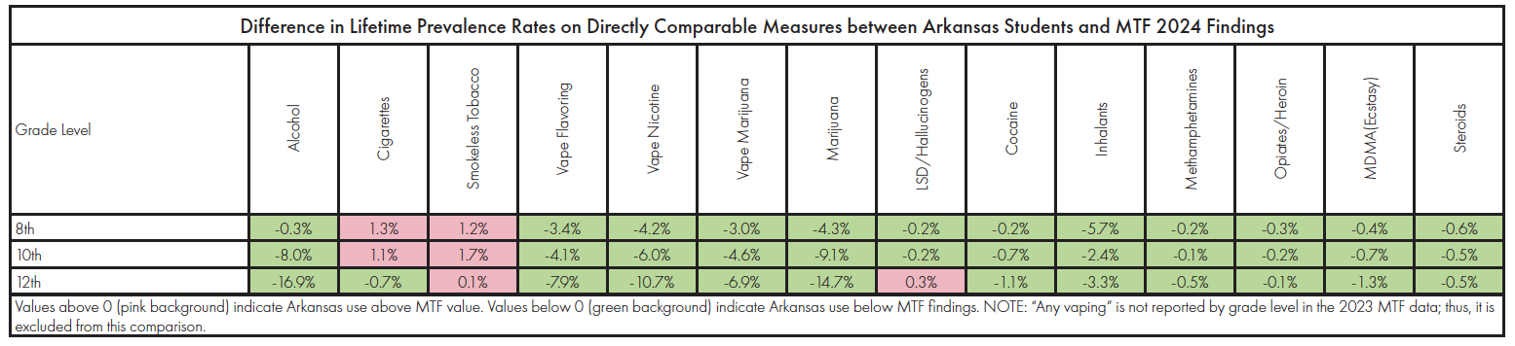
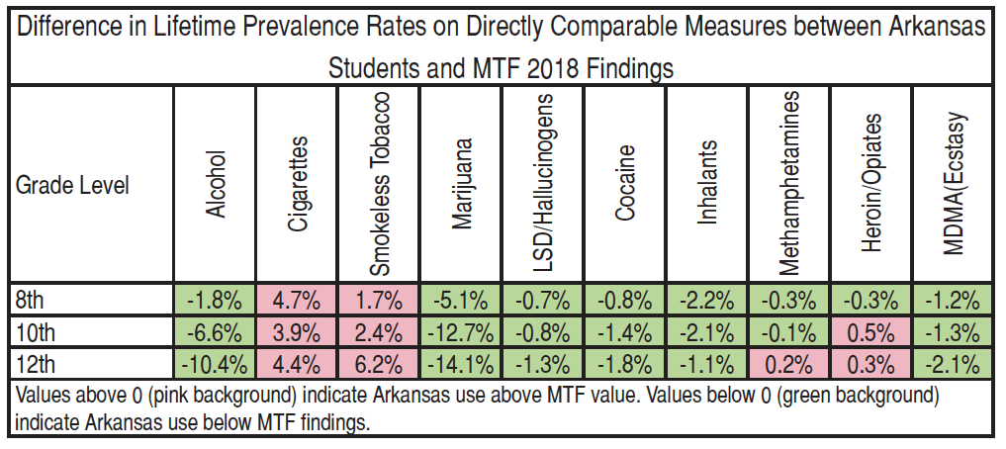
Lifetime Use AR vs US: 2024 vs 2018
https://arkansas.pridesurveys.com
Notes:
adolescents most commonly reported use of alcohol, nicotine vaping, and cannabis in the 12 months prior to the survey
Cigs: 7.1%, 3.8%, 1.9%

Slide 16
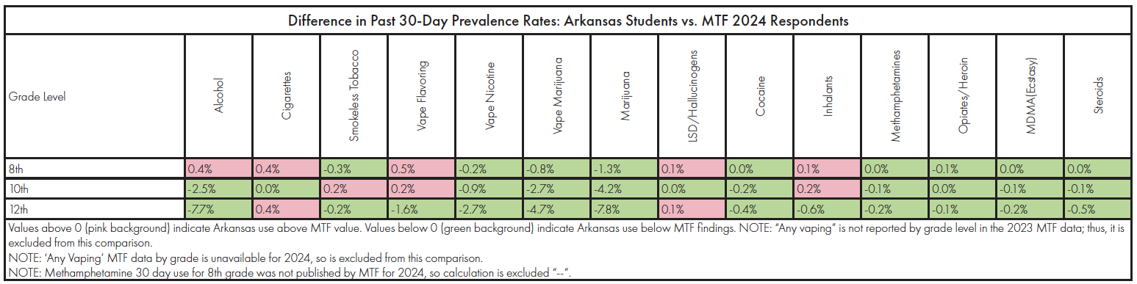
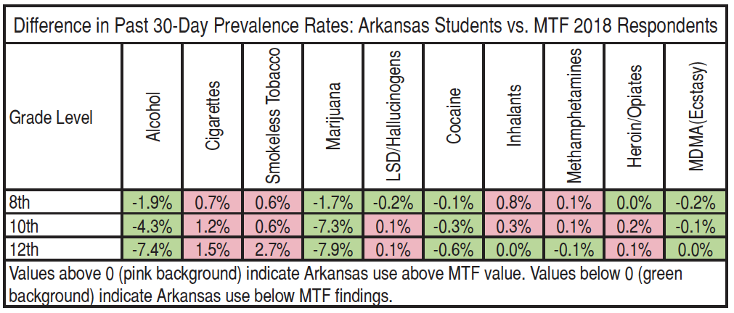
Past 30-Day Use AR vs US: 2024 vs 2018
https://arkansas.pridesurveys.com

Slide 17
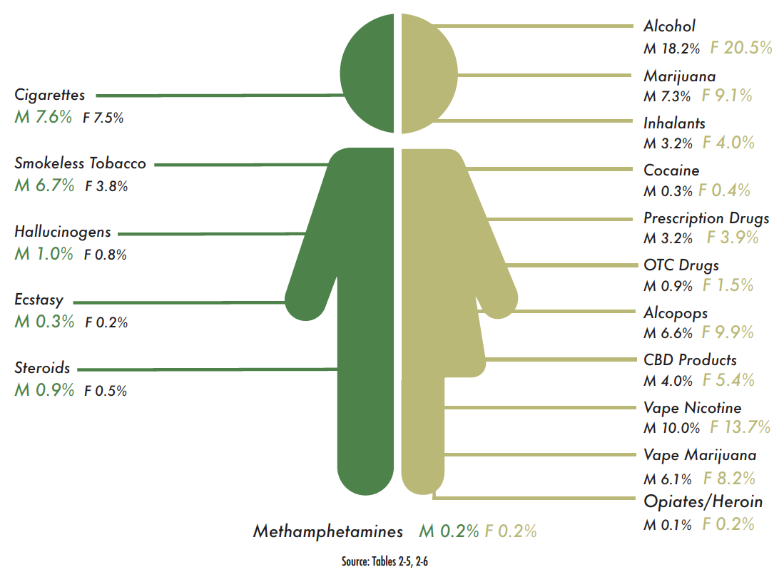
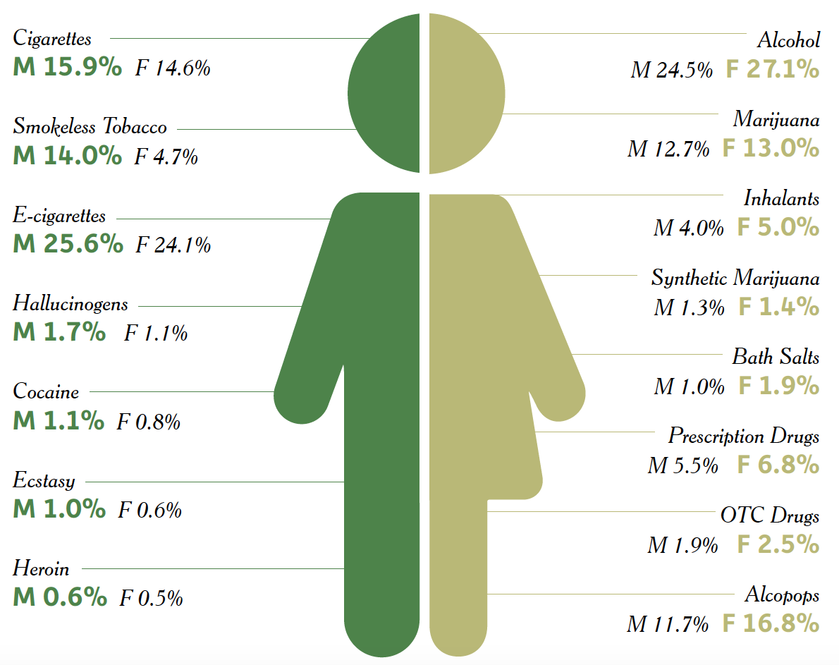
2024 versus 2018 Lifetime Use Data
5. 11
7 8
https://arkansas.pridesurveys.com

Slide 18

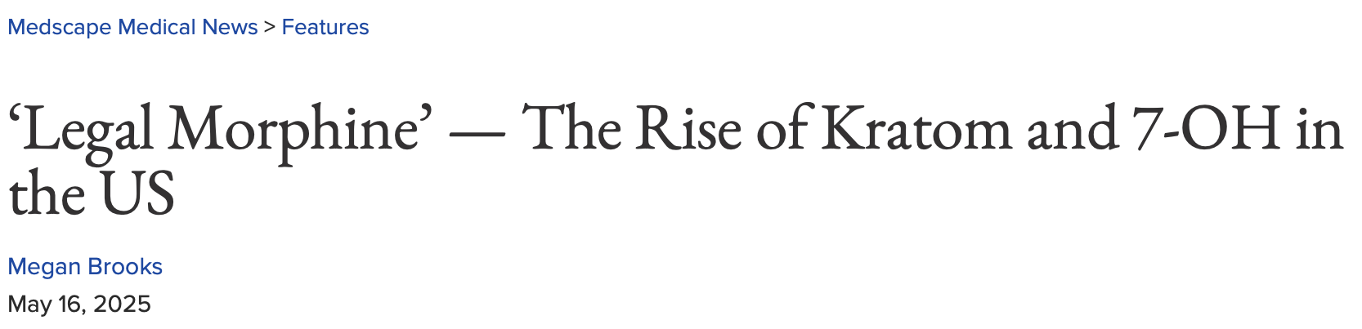
Surge in kratom use: Mitragyna speciosa, a tree native to Southeast Asia
Mitragynine and metabolite 7-hydroxymitragynine (7-OH) most well-studied
Partial mu opioid agonists
Mitragynine also acts at adrenergic, serotonergic, and dopaminergic receptors, producing mild stimulant and mood-boosting effects
Commonly found at gas-station counters, vape and head shops, cannabidiol dispensaries online vendors, and occasionally in “wellness” aisles in mainstream pharmacies
Between 2 million (2022) to 11-16 million users
US retail sales were estimated at roughly $2.2 billion in 2024
Products marketed as “7-OH,” “7-Hydro,” or “legal morphine”
https://www.medscape.com/viewarticle/legal-morphine-rise-kratom-and-7-oh-us-2025a1000cco?ecd=WNL_mdpls_250521_mscpedit_psych_etid7440062&uac=318511EV&spon=12&impID=7440062
Notes:
Traditional kratom products made from the dried leaves of M speciosa naturally contain dozens of bioactive alkaloids.
The most well-studied compounds in kratom are mitragynine and 7-OH. Mitragynine is the predominant alkaloid, making up about 60%-65% of dried leaves, while 7-OH is present only in trace amounts (often < 0.05% of the leaf).
Both molecules are psychoactive and are partial agonists at the µ-opioid receptor, with a binding strength the US Food and Drug Administration (FDA) has said is similar to scheduled opioid drugs.

Slide 19
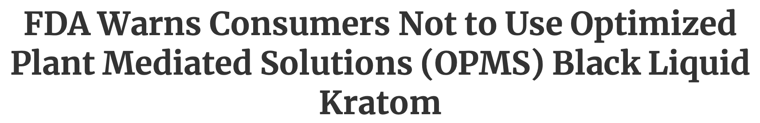

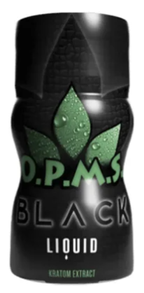
Many reports of serious adverse events individuals have reported experiencing after consuming OPMS Black Liquid Kratom, including at least one death
Other reported adverse health effects include withdrawal symptoms, addiction, digestive issues, restless leg syndrome, skin problems, aggressive behavior, increased anxiety, lack of energy, and inability to focus.
product label indicates presence of kratom alkaloids, mitragynine and 7 hydroxymitragynine (7-OH mitragynine)
Kratom banned in Alabama, Arkansas, Indiana, Rhode Island, Vermont, Wisconsin
https://www.fda.gov/food/alerts-advisories-safety-information/fda-warns-consumers-not-use-optimized-plant-mediated-solutions-opms-black-liquid-kratom?utm_source=chatgpt.com

Slide 20
Discussion

Slide 21
Arkansas Collegiate Survey: 2021-2024 Derek Slagle, PhD Associate Professor of Public Administration Director of School of Public Affairs UA Little Rock
Notes:
adolescents most commonly reported use of alcohol, nicotine vaping, and cannabis in the 12 months prior to the survey
Cigs: 7.1%, 3.8%, 1.9%

Slide 22
Action Plan/Wrap-Up/Next Meeting

Slide 23
Thank you!

