Slide 1

Statewide Epidemiological
Outcomes Workgroup
Quarterly Meeting
05/22/2025
Supported by SAMHSA PFS Grant #6H79SP080990-01M001.

Slide 2
What are Adverse Childhood Experiences?
Childhood stressful experiences with long term impacts
Why do they Matter?
Increase likelihood of depression, substance use, suicide, chronic illness, risky behaviors
Interfere with brain development
Effects are cumulative: more ACEs = greater risk

Slide 3
2021-2023 NHIS Teen

Slide 4
Analyzing NHIS Data
Analyze online (adults only) Biannual Early Release tables
    Limited in looking a pre-defined frequencies
Download data

Slide 5
Stressful Life Events
Death of Parent/Guardian
Divorced Parent/Guardian
Experienced or Witnessed Neighborhood Violence
Incarcerated Parents
Household member with mental illness
Household member with substance abuse
Experienced Emotional Abuse
Unmet basic needs
Race/Ethnic Discrimination
Gender Orientation/Sexual Identity Discrimination

Slide 7
National Survey of Child Health

Slide 8
Analysis Context - NSCH
Multi-prong
  Analyze online
    Combines two years of data
    Limited in looking a pre-defined frequencies
  Download data
    Limited to individual years of data
    Variables are consistent from 2021 forward

Slide 9
Hard to Cover Basics Like Food or Housing
Child Experienced - Treated Unfairly Because of Race
Child Experienced - Treated Unfairly Because of Health Condition
Child Experienced - Parent or Guardian Divorced
Child Experienced - Parent or Guardian Died
Child Experienced - Parent or Guardian Time in Jail
Child Experienced - Adults Slap, Hit, Kick, Punch Others
Child Experienced - Victim of Violence
Child Experienced - Lived with Mentally Ill
Child Experienced - Lived with Person with Alcohol/Drug Problem

Slide 10
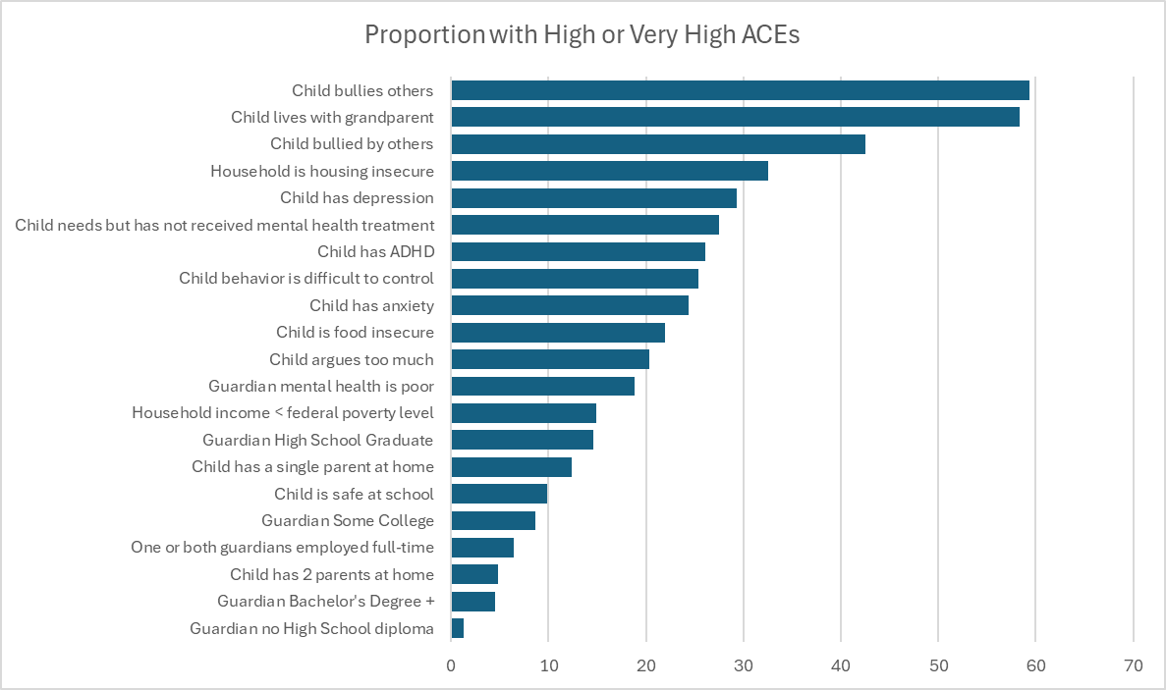
Not significant: Military/Deployment, Sex, Age, Rae/Ethnicity

Slide 11
Regression Results
Not significant: Sex, Depression, Anxiety, Poverty, Unmet Mental Health Needs, Age of Child

Slide 12
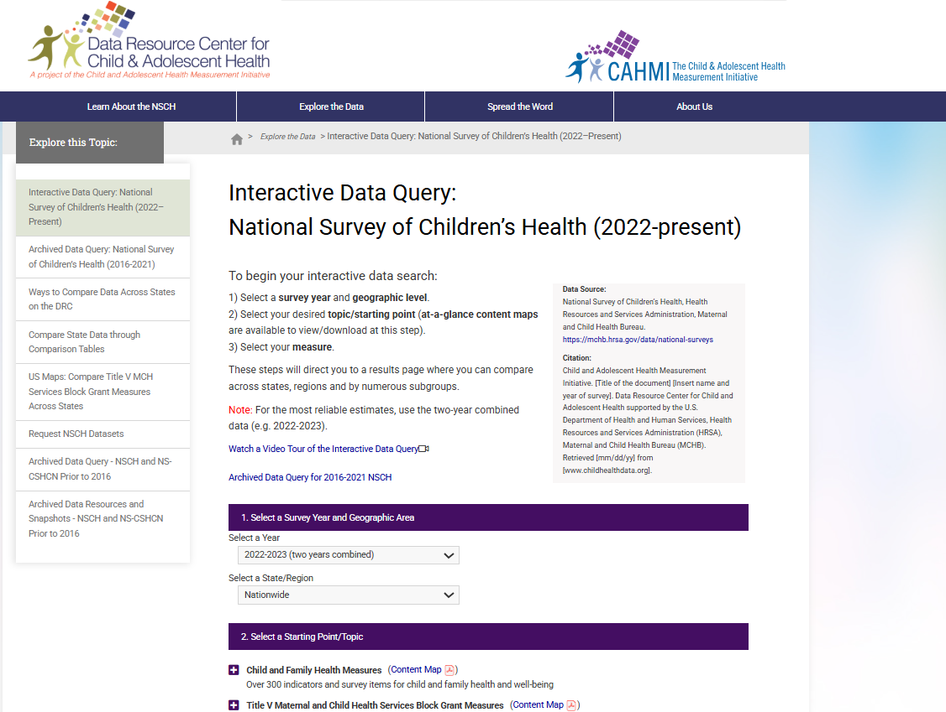
NSCH Online Analysis Tool
NSCH Interactive Data Query (2022 - present) - Data Resource Center for Child and Adolescent Health

Slide 13
ACES and Mental Health Outcomes
ACEs are a strong predictor of suicide risk. Individuals who have experienced four or more ACEs are 12 times more likely to attempt suicide at some point in their lives.
In Arkansas
  High School students who felt sad or hopeless during the past year -- 45.1% (YRBSS-2023)
  Students who felt sad or hopeless during the past month –22.4% (APNA 2023, 2024)

Slide 14
