Slide 1
Injection drug use in Arkansas

Slide 2
Outline
Summary of the problem in Arkansas
Current state and federal actions
Benefits of harm reduction
Conclusion
The views expressed in this presentation are not necessarily those of the Arkansas Department of Health

Slide 3
Summary of the problem in Arkansas

Slide 4
Injection drug use: nationwide data
Higher rates among males, younger adults, non-Hispanic whites, and people in Northeast U.S.¹
 | Group | Prevalence (%) | 95% CI
Sex | Female | 0.84 | 0.43, 1.66
 | Male | 2.10 | 1.06, 4.15
Age | 18-39 | 1.82 | 0.92, 3.59
 | ≥40 | 1.21 | 0.61, 2.39
Race/ ethnicity | Hispanic | 0.93 | 0.47, 1.83
 | Black | 0.92 | 0.46, 1.81
 | Other | 0.32 | 0.16, 0.63
 | White | 1.82 | 0.92, 3.59
Region | Midwest | 1.73 | 0.88, 3.43
 | Northeast | 1.84 | 0.94, 3.64
 | South | 1.02 | 0.52, 2.02
 | West | 1.60 | 0.81, 3.16

Slide 5
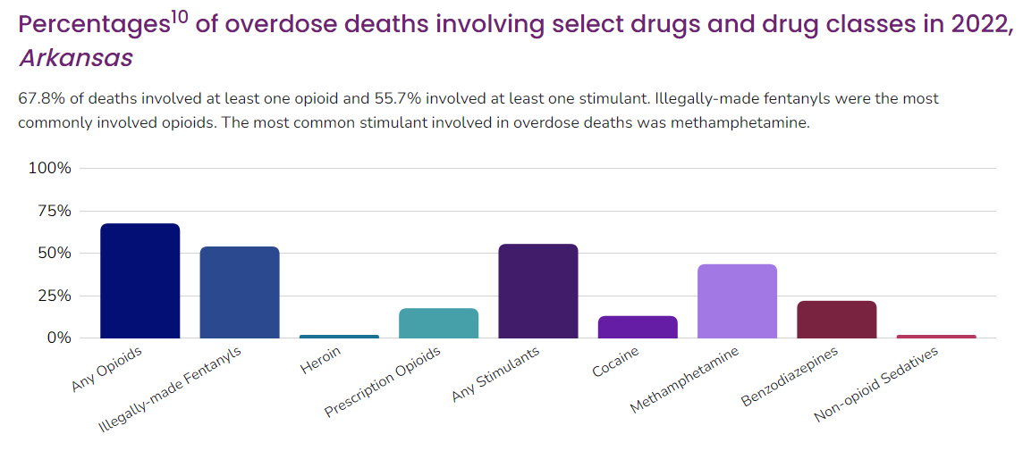
What are people injecting?
Arkansas drug overdose data²
528 overdose deaths in 2022 had autopsy data in the State Unintentional Drug Overdose Reporting System (SUDORS)
  68% involved an opioid
  56% involved a stimulant
  Multiple substances are commonly present

Slide 6
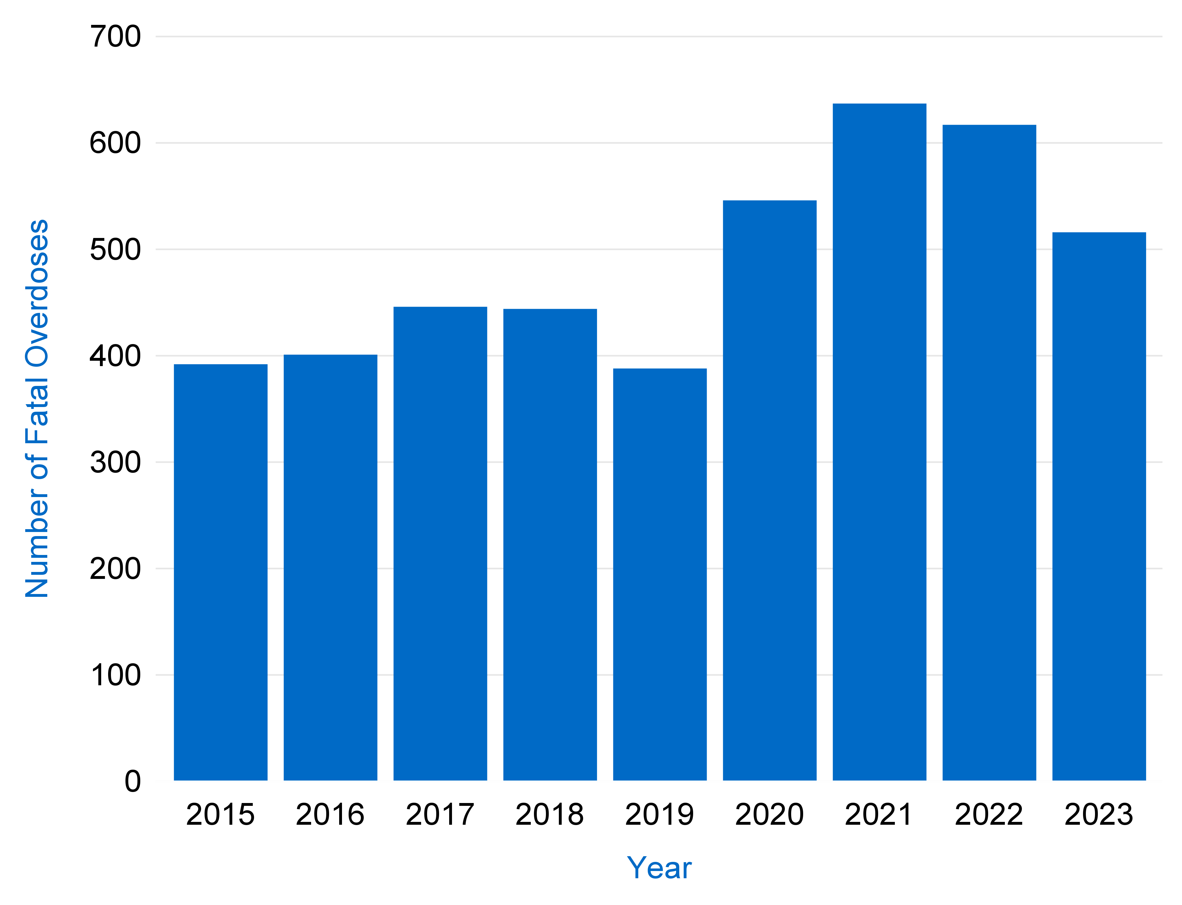
Fatal overdoses in Arkansas, all drug types, 2015-2023³
516
392

Slide 7
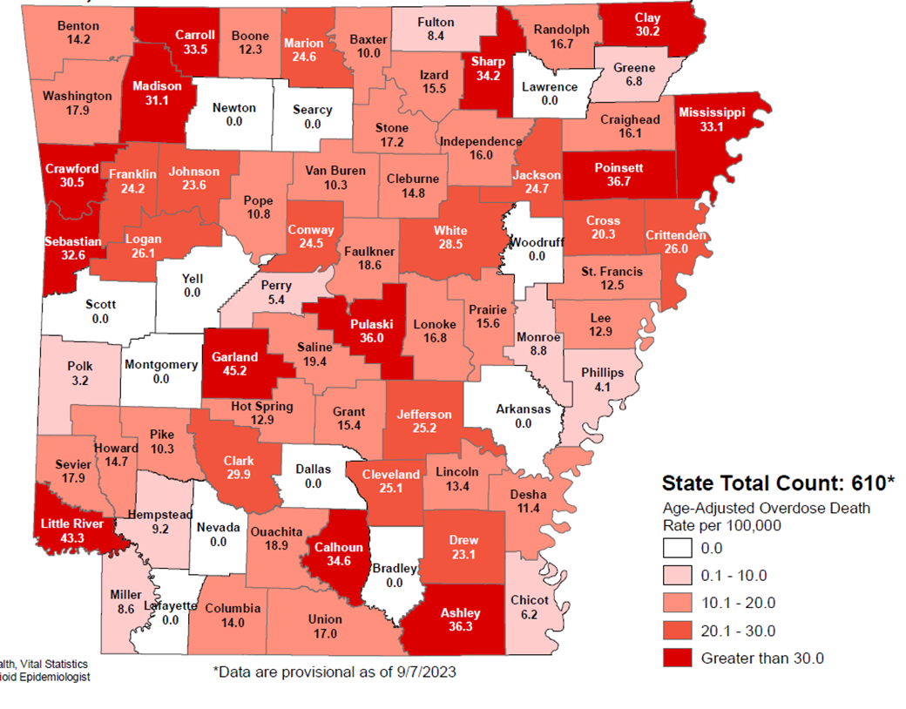
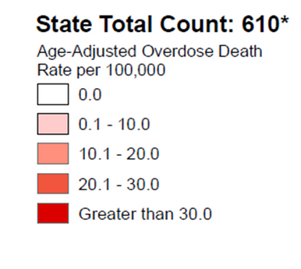
2022 fatal overdose rates by county
Source: ADH Vital Statistics
* Data are provisional as of 9/7/2023³

Slide 8
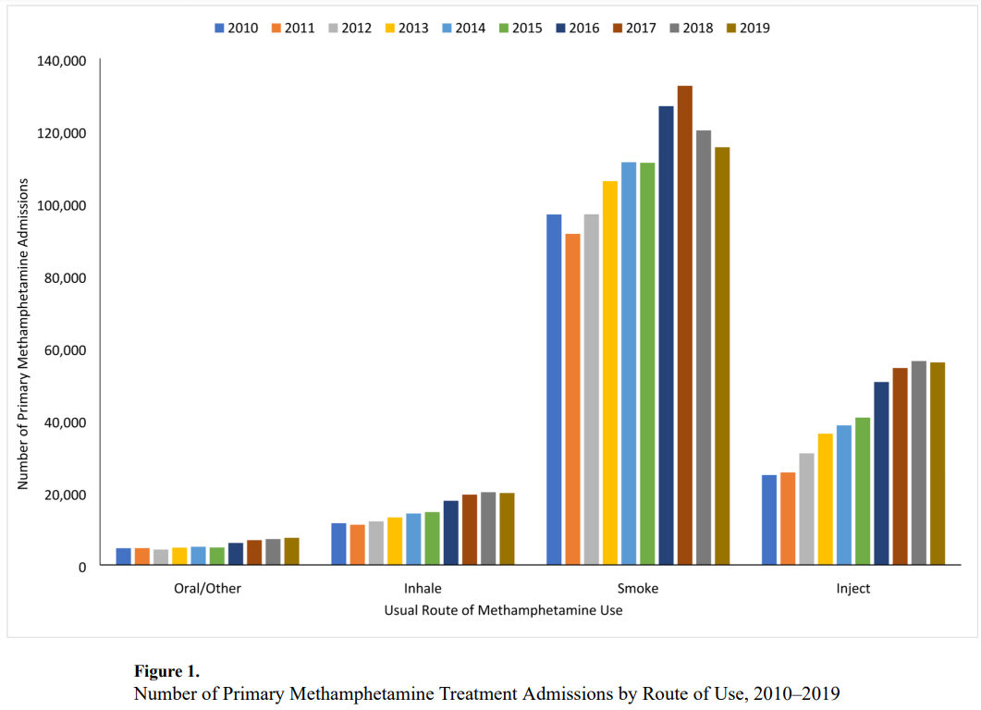
U.S. methamphetamine injection⁴⁻⁸

Slide 9
Why do people use or inject drugs?
Factors that contribute to injection drug use:
Long-term opioid prescriptions⁹
Self-medication for chronic pain¹⁰
Psychological effects (euphoria, coping with stress or trauma)¹⁰
Compensating for tolerance¹⁰

Slide 10
Why does injection matter?
Infections
  Bloodborne pathogens: HIV, hepatitis B, hepatitis C¹¹
  Infectious complications: infective endocarditis, abscesses, skin and soft tissue infections, osteomyelitis, etc. (S. aureus, group A Streptococcus, Candida spp.)¹¹
  Possible associations with sexually transmitted infections¹² and hepatitis A¹³
Overdoses
  Injection associated with 40% higher recent overdose rate among California fentanyl users¹⁴
  34% of sample who injected drugs in New York City reported overdosing during COVID-19 pandemic¹⁵

Slide 11
Sharing of needles and other injection equipment nationwide
Selected metropolitan area NHBS findings, 2015-2018
National HIV Behavioral Surveillance (NHBS) interviews HIV-negative people who inject drugs
  26% of 2018 respondents shared syringes; 55% received syringes from a syringe services program (SSP)¹⁶
  Living farther from a harm reduction program in 2015 increased rate of syringe sharing¹⁷
Location | Year | Measure | Result
Atlanta, Ga.¹⁸ | 2018 | Did not always use sterile syringe | 65%
Baltimore, Md.¹⁹ | 2018 | Used shared syringe | 34%
 |  | Used other shared injection equipment | 60%
Dallas, Tex.²⁰ | 2015 | Shared syringe | 28%
 |  | Shared other injection equipment | 54%
Norfolk, Va.²¹ | 2018 | Did not always use sterile syringe | 81%

Slide 12
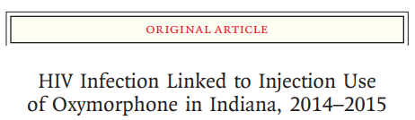
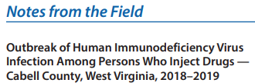
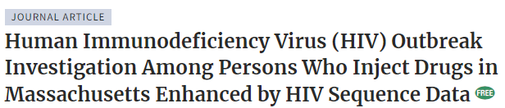
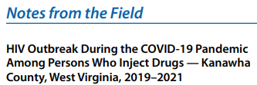
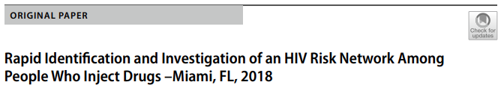

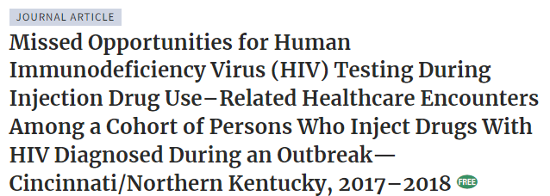
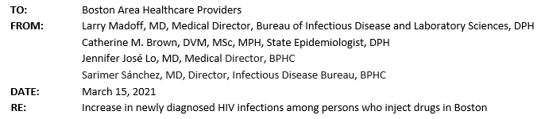
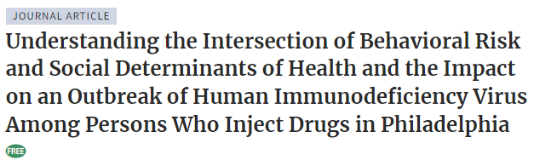
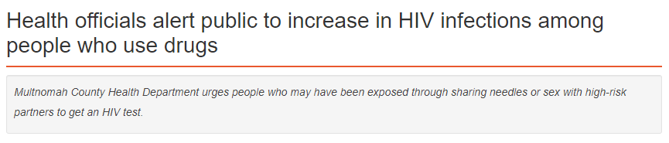
HIV outbreaks and clusters²²⁻³¹

Slide 13
Infectious disease and injection drug use in Arkansas
HIV cases, 2017-2023:³²
  79 associated with injection drug use
  48 associated with men who have sex with men and injection drug use
Hepatitis C cases, 2019-2024:³³
  8,270 associated with injection drug use
Hepatitis A cases, 2018-2024:³³
  428 associated with injection drug use
Hospitalizations with hepatitis C, 2016-2022:³⁴
  20% had co-occurring “other stimulant related disorder” (mostly methamphetamine)
  9% had co-occurring opioid use disorder

Slide 14
Arkansas infectious diseases and substance use disorders, 2010-2016
Table 1: Characteristics of Arkansans hospitalized with select infectious diseases and co-morbid drug abuse, dependence, or poisoning, 2010-2016³⁵
This table shows hospitalizations with injection-related infectious diseases and a diagnosis of drug use between 2010 and 2016 in Arkansas. Most patients were insured by Medicare or Medicaid.
 |  | n (%)
Characteristic | Group | Endocarditis | Hepatitis C | HIV | Osteomyelitis
Age at admission | <18 18 – 25 26 – 40 41 – 60 >60 | 1 (0.3) 35 (10.4) 149 (44.3) 122 (36.3) 29 (8.6) | 11 (0.2) 310 (6.0) 1,705 (32.9) 2,848 (55.0) 302 (5.8) | 2 (0.2) 37 (4.4) 359 (42.4) 432 (51.0) 17 (2.0) | 8 (2.0) 17 (4.3) 88 (22.4) 193 (49.2) 86 (21.9)
Sex | Male Female Unknown | 159 (47.3) 177 (52.7) 0 (0) | 2,909 (56.2) 2,266 (43.8) 1 (<0.0) | 595 (70.2) 252 (29.8) 0 (0) | 242 (61.7) 150 (38.3) 0 (0)
Ethnicity | Non-Hispanic Hispanic Unknown | 317 (94.3) 19 (5.7) 0 (0) | 4,789 (92.5) 380 (7.3) 7 (0.2) | 790 (93.3) 57 (6.7) 0 (0) | 364 (92.9) 28 (7.1) 0 (0)
Race | African American White Other Unknown | 23 (6.8) 295 (87.8) 18 (5.4) 0 (0) | 487 (9.4) 4,421 (85.4) 262 (5.1) 6 (0.1) | 427 (50.4) 361 (42.6) 58 (6.8) 1 (0.1) | 42 (10.7) 326 (83.2) 23 (5.9) 1 (0.3)
Insurance payer | Private Medicaid Medicare Other/Unknown | 69 (20.5) 109 (32.4) 62 (18.5) 96 (28.6) | 952 (18.4) 1,698 (32.8) 1,370 (26.5) 1,156 (22.3) | 113 (13.3) 334 (39.4) 245 (28.9) 155 (18.3) | 65 (16.6) 92 (23.5) 166 (42.3) 69 (17.6)
TOTAL |  | 336 | 5,176 | 847 | 392
Median Charges per Hospitalization Min & Max Total Charges (2010-16) |  | $63,510 $810 - $943,300 $36,776,646 | $12,800 $629 - $1,210,000 $135,343,989 | $13,850 $1,009 - $448,100 $20,997,406 | $46,330 $1,425 - $1,250,000 $28,375,489
During this 7-year period, charges for hospital visits with potentially injection-related infectious diseases surpassed $135,000,000.

Slide 15
Maternal health and substance use
Substance use is a significant cause of pregnancy-related death³⁶ and can also contribute to preterm labor or other pregnancy and birth-related complications³⁷
The rate of neonatal abstinence syndrome (NAS) in Arkansas increased close to seventeen-fold between 2000 and 2021³⁸
Nationally, the overdose death rate among pregnant and postpartum women was 6.9 deaths per 100,000 mothers in the first six months of 2018 and increased to 12.2 deaths per 100,000 mothers in the latter half of 2021³⁹
Many treatment programs do not accept pregnant women and/or Medicaid beneficiaries

Slide 16
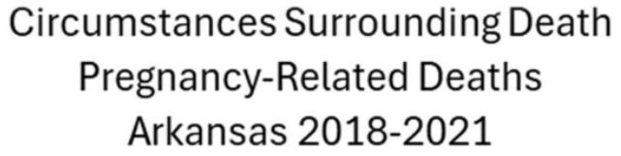
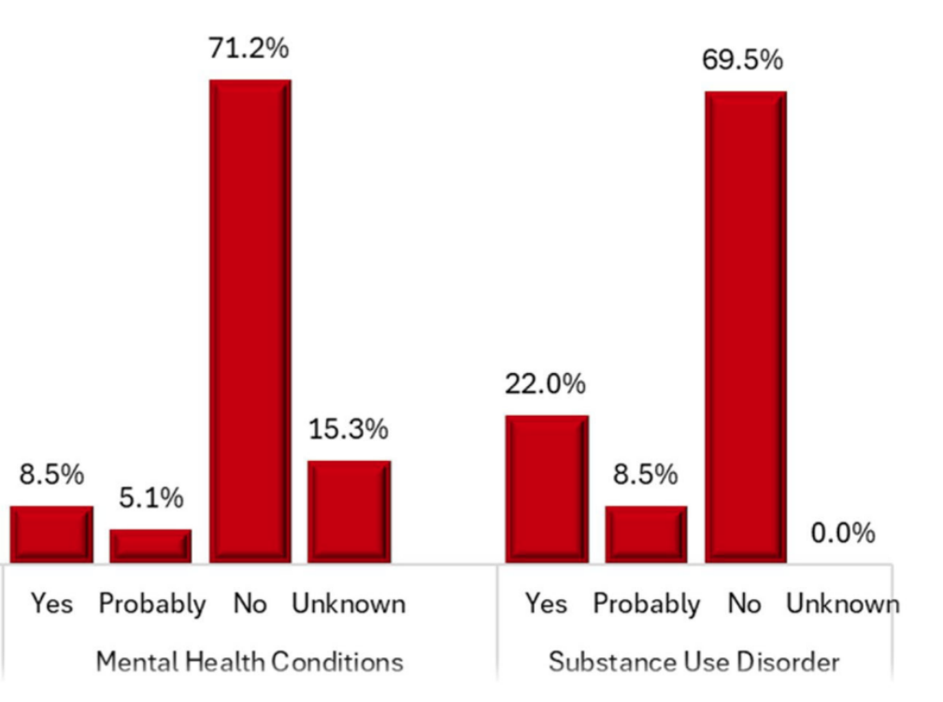
Arkansas Maternal Mortality Review Committee data⁴⁰
Opioid use disorder (OUD) during pregnancy has been linked with serious negative health outcomes⁴¹
Preterm birth
Stillbirth
Maternal mortality
NAS⁴²

Slide 17
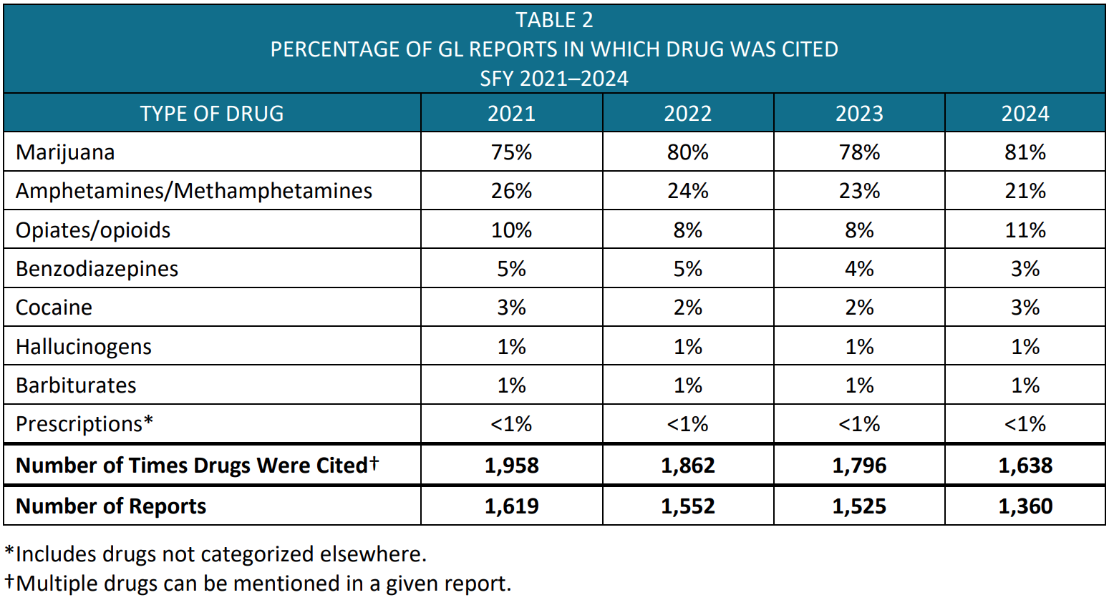
Garrett’s Law referrals by drug, SFY2020-2023⁴³

Slide 18
Arkansas syphilis case reports, women of childbearing age⁴⁴

Slide 19
Centers for
Disease
Control and Prevention,
2024^{45,46}

Slide 20
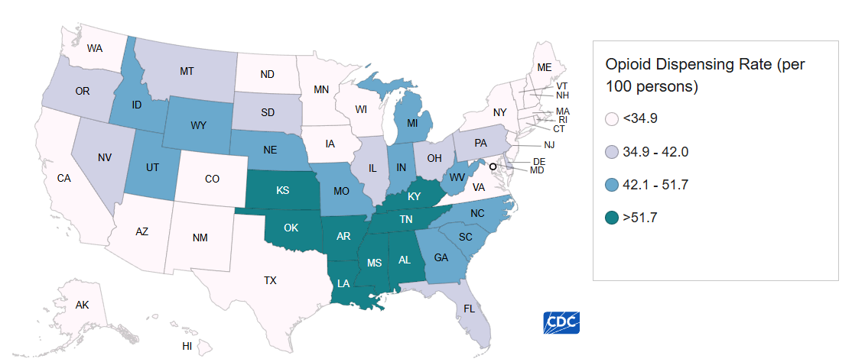
Opioid prescribing as risk factor
Arkansas has the highest opioid dispensing rate⁴⁵
  71.5 prescriptions per 100 in 2023 (national: 37.5)

Slide 21
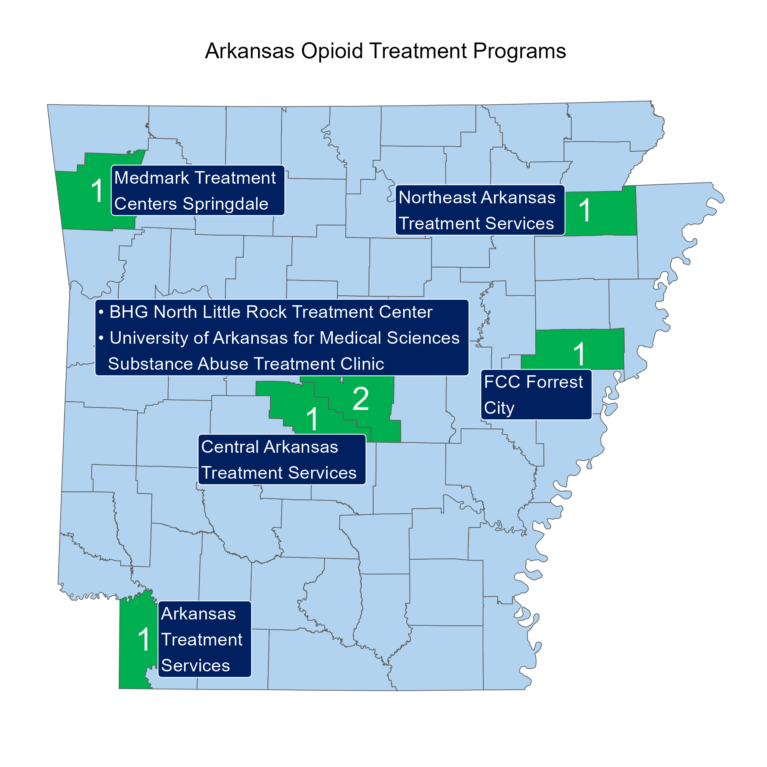
OUD treatment
Standard: medication for opioid use disorder (MOUD)⁴⁷
  Methadone, buprenorphine, and naltrexone reduce opioid use⁴⁸⁻⁵⁰
  Methadone and buprenorphine also reduce mortality⁵¹⁻⁵³
Access challenges
  Methadone is highly regulated⁵⁴ – directly observed therapy often required, only available in Opioid Treatment Programs (OTPs) in six counties⁵⁵
  Buprenorphine prescribing is probably limited in many areas of Arkansas^{56,57}

Slide 22
Centers for
Disease
Control and Prevention,
2024^{46,58}

Slide 23
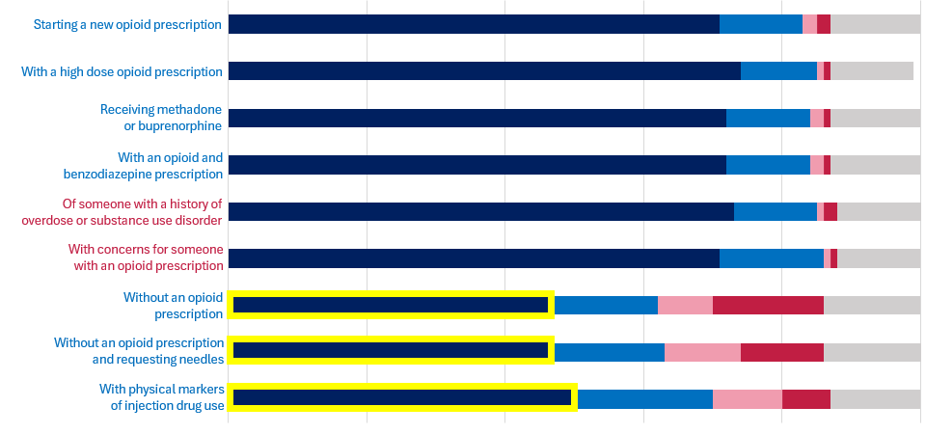
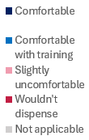
Arkansas pharmacy staff: level of comfort utilizing naloxone standing order⁵⁹
An individual:
A friend or family member:
An individual:

Slide 24
Current state and federal actions

Slide 25
Progress to date
Veterans Affairs health system offers contingency management for stimulant use disorder⁶⁰
Naloxone standing order⁶¹⁻⁶⁴
Arkansas Community Correction provides naltrexone for inmates at release⁶⁵
Insurance must cover MOUD without prior authorization^{66,67}
Pregnant women have priority admission to OTPs⁶⁸
State Opioid Response funds to support buprenorphine providers^{69,70}
Opioid settlement funds to expand substance use treatment^{71,72}
Legalized fentanyl test strips⁷³
Pharmacist-initiated pre-exposure prophylaxis (PrEP) for HIV⁷⁴
Any qualified provider can prescribe buprenorphine without additional paperwork⁷⁵
Medicaid covers hepatitis C treatment for patients with substance use disorder⁷⁶

Slide 26
Ongoing challenges
Many people still untreated for hepatitis C⁷⁷⁻⁷⁹ or syphilis,⁸⁰ or not virally suppressed for HIV⁸¹
Very few methadone⁵⁵ and buprenorphine^{56,57} providers
Unclear availability of evidence-based treatment for methamphetamine^{60,82}
Substance use disorder screening and treatment may be disincentivized for pregnant and postpartum women^{43,83}
Use of non-sterile needles and other injecting equipment¹⁶⁻²¹

Slide 27
Benefits of harm reduction

Slide 28
What can a harm
reduction initiative do?
Reduce new HIV and hepatitis C infections⁸⁴
Help people get into substance use treatment⁸⁵
Distribute naloxone to prevent opioid overdoses⁸⁶
Safely dispose of syringes⁸⁷⁻⁹⁰
Link to testing and treatment for HIV and hepatitis C⁹¹
Offer appropriate vaccines⁹²

Slide 29
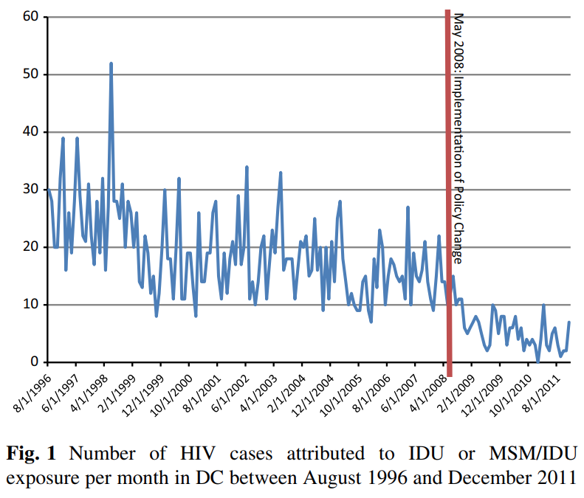
New York City, 1988-1995: 235% greater hazard for incident HIV among injection drug users who did not use interventions⁹³
Interventions, 1990s-2000s, averted 10,600 HIV diagnoses over 10 years in Philadelphia,⁹⁴ 1,900 over 10 years in Baltimore,⁹⁴ and 120 over 2 years in Washington, D.C.⁹⁵
2022 systematic review: “There is now a strong body of empirical evidence for the effectiveness of opioid agonist therapy and [other interventions], alone and in combination, in reducing injecting risk behavior, and hepatitis C virus and HIV transmission.”⁸⁴

Slide 30
Cost impacts
Economic evaluations of harm reduction interventions are generally favorable (cost-effective^{96,97} or cost-saving⁹⁸⁻¹⁰¹)
HIV treatment list prices are over $36,000/year,¹⁰² and average net hepatitis C treatment cost is estimated at $11,500-$17,000¹⁰³
Costs of disease are heavily borne by public programs
  Medicare
  Arkansas Medicaid
  Ryan White

Slide 31
Tying the guidance together
Infectious diseases can occur when someone who has a bloodborne illness shares a syringe or other equipment with someone who does not
Arkansas has made progress, but continues to suffer from these infections
To avoid this, we can:¹⁰⁴⁻¹⁰⁸
  Help people get into recovery from substance use
  Provide universal treatment for hepatitis C and HIV
  Mitigate risks associated with non-sterile needles

Slide 32
Conclusion

Slide 33
Conclusion
Thousands of Arkansans are affected by injection drug use and related harms each year
Arkansas has already taken several steps to reduce these risks
There are growing opportunities to implement evidence-based prevention, treatment, and harm reduction strategies

