Slide 1

Statewide Epidemiological
Outcomes Workgroup
Quarterly Meeting
05/30/2023
Supported by SAMHSA PFS Grant #6H79SP080990-01M001.

Slide 2

The Social Determinants of Health

Slide 3
Defining Health
The state of complete physical, mental and social well-being, and not merely the absence of disease or infirmity (World Health Organization, 1948).
Notes:
The Constitution of the World Health Organization (1948) conceptualizes health as being more than the absence of disease, illness and physical health. Fundamentally, health is about physical, mental, and social well-being, and it is understood that health and well-being can be adversely affected by social policies.

Slide 4
What determines our health
Clinical care
Genetic characteristics
Circumstances and environment
Notes:
Clinical care and genetic characteristics exert a much smaller influence than most people think while communities exert a much larger influence than most people think.
Factors such as where we live, the state of our environment, genetics, our income and education level, and our relationships with friends and family all have considerable impacts on health, whereas the more commonly considered factors such as access and use of health care services often have less of an impact.

Slide 5
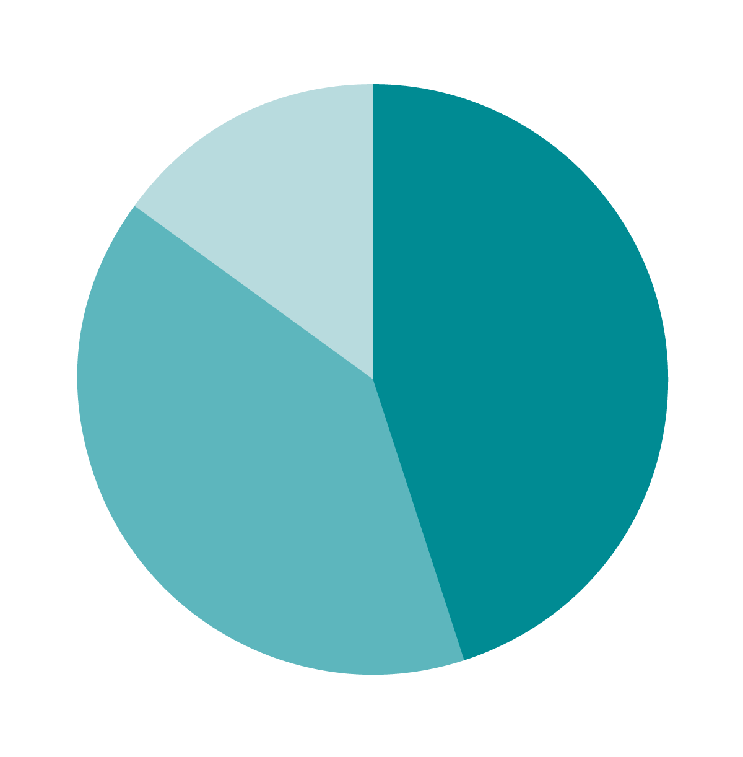
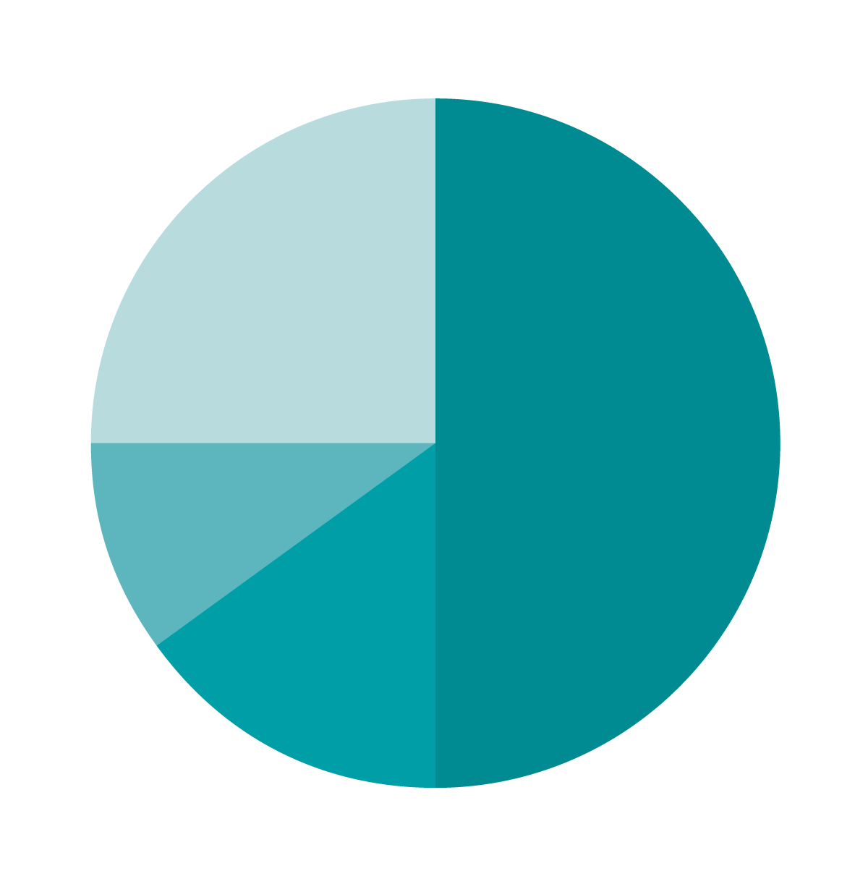
Social Conditions and Health
Canadian Institute of Advanced Research (2012)
Mc Giniss
et al (2002)
Health care
(up to 15%)
Social circumstances
& environmental exposure (45%)
Health behaviour patterns (40%)
Health care
(up to 25%)
Socioeconomic (50%)
Environmental (10%)
Genetics (15%)
Notes:
Societal conditions have a direct impact on health, accounting for an impact of 30-50% or more on levels of the populations’ health, as outlined in this slide.

Slide 6
What are the Social Determinants of Health?
The social determinants of health are the conditions in which people are born, grow, live, work and age. These circumstances are shaped by the distribution of money, power and resources at global, national and local levels.
Notes:
The social determinants of health matter because they set the conditions for the health of individuals, communities and populations, and if the social determinants of health are not distributed fairly, they can lead to health inequities.
Distinguish social needs and SDOH. Social needs are individual needs such as food or income insecurity and homelessness. Meeting these needs requires a person-centered approach that addresses the unique challenges faced by individuals. SDH, in contrast, are population-level factors such county-level rates of poverty or unemployment and median household income. Addressing SDH requires population-level approach focused on addressing the underlying root causes of suicide risk.

Slide 7
Notes:
Imagine a large river with a high waterfall. At the bottom of this waterfall hundreds of people are working frantically trying to save those who have fallen into the river and have fallen down the waterfall, many of them drowning. As the people along the shore are trying to rescue as many as possible one individual looks up and sees a seemingly never-ending stream of people falling down the waterfall and begins to run upstream. One of other rescuers hollers, “Where are you going? There are so many people that need help here.” To which the man replied, “I’m going upstream to find out why so many people are falling into the river.” Saul Alinsky
“As you look further upstream, you notice bridges in various states of repair along the river. Some are strong, made of sturdy components. Others are weak and debilitated, with missing boards or flimsy railings. It doesn’t surprise you that most of the people falling in the river are crossing the poorly made bridges and those individuals that live near or travel across the strong bridges are protected. Of course, all of the bridges could use more reinforcement, but it’s easy to see which bridges need the most attention…
we know that certain groups of people are more likely to fall in the river than others. They do not fall in because of individual weakness or intrinsic flaws. Rather, we know that some people are privileged to live in communities with strong bridges, usually made of high quality materials that protect them from falling in the river and promote their safe passage across.

Slide 8









SOCIOECONOMIC
POLITICAL
CONTEXT
Governance
Macroeconomic
Policies
Social Policies
Labour market,
Housing, Land
Public Policies,
Education, Health,
Social protection
Culture and
Societal value
SOCIOECONOMIC
POSITION
SOCIAL CLASS
GENDER
ETHNICITY (RACISM)
Material Circumstances
(Living and Working, Conditions, Food Availability, etc.)
Behaviours and Biological Factors
Psychosocial Factors
IMPACT ON
EQUITY IN
HEALTH AND
WELL-BEING
EDUCATION
OCCUPATION
INCOME
Social cohesion & Social capital
HEALTH SYSTEM
STRUCTURAL DETERMINANTS
OF HEALTH INEQUITIES
INTERMEDIARY DETERMINANTS OF HEALTH
Notes:
This slide illustrates how the socioeconomic and political context, including governance, policy and cultural and societal values, has a role in determining the position of an individual in society. In this model, there are two categories of social determinants -
a) Structural determinants: two main components;
Socioeconomic and political context: consists of components of governance, macroeconomic and social policy, public policy, social culture, and values;
Socioeconomic position: such as education, occupation, income, social class, ethnicity/race and gender.
These two groups have a reciprocal interaction and can be affected by each other.
b) Intermediary determinants: including environmental condition, psychosocial factors, behavioural factors, biological factors, and health system.
In this model, bridging the structural and intermediary determinants are concepts of social cohesion and social capital mentioned as a cross-cutting determinant, and the structural factors affect health and well-being through affecting on intermediate factors, and the likelihood of exposure to health-compromising conditions.
Illnesses caused by poor living conditions can then circle back to the structural determinants if, for example, a person experiences a loss of employment or income, thereby lowering his or her socioeconomic status.
Therefore, there is constant feedback and interaction across the different levels of determinants.

Slide 9
What does good health look like?
Eat well
Staying active
Enough sleep
And….
  Available resources to meet daily needs
  Access to quality education and jobs and health care services
  Available community-based resources for recreational and leisure-time activities
  Reliable transportation
  Positive social norms and attitudes
  Public safety
  Language/Literacy
  Culture
Notes:
When it comes to health, your zip code matters more than your genetic code

Slide 10
Built Environment
Sidewalks and streets
Public transit
Sewers
Parks
Community centers
Housing
Notes:
The built environment influences health by providing or preventing opportunities for physical activity, adequate transportation and social connectedness.

Slide 11
Economic Environment
Income inequality
Unemployment
Poverty
Notes:
Income inequality in the United States is greater today than at any point since 1928. The top 1% of families have 22.5% of total annual income, while the bottom 90% of families share only 49.6%.1 The median African American household income in 2014 was only 39.5% of the median white household income.2 Wealth inequities are even greater, with the richest 20% of US families holding 88.9% of all wealth.3 This inequity affects not only the health of those with lower incomes and wealth, but also decreases life span and increases illness across the income spectrum, including for those at the very top.4

Slide 12
Community Context
Crime
Vacancy
Food availability
Alcohol Outlets
Mortality

Slide 13
Community Composition
Single Parent Households
Race/Ethnicity
Age structure
Mobility

Slide 14
Effects on Population
Housing Quality
  Depression
Overcrowding
  Noise
  Stress
  Depression
Housing Cost
  Poverty
Housing Availability
  Homelessness
  Mobility
Rural and Remote Communities
  Isolation
  Lack of resources
  Boredom
  Employment
Public Housing
  Drug Markets
  Crime Rates
  Identity
  Social Norms

Slide 15
Effects on Population (continued)
Community Physical Disorder
  Safety
  Isolation
Lack of Public Transportation
  Less safe
  Less friendly
  Increased Stress
  Less exploration of environment
  Reduced social contacts
  Reduced access to employment, recreation
  Isolation, lower SES, depression
Lack of Public Spaces
  Increased access to drug markets
Food Insecurity
Alcohol outlet density
Single Parent Households
  Socioeconomic disadvantage
  Less time with child
  More reliance on peer groups
Health resources
  maldistribution

Slide 16
What can you do?
Engage your community
Policy
Food insecurity
  School meal programs
  Food delivery services
Housing
  Moving to opportunity
Fluoridating Water
Park, Trail, Greenway Interventions
Increase voting
Increase reading to children
Broadband availability
Full day kindergarten
Notes:
The problems are so big.
MTO: MTO provided 4,600 low-income families with children living in public housing within some of the most disadvantaged urban neighborhoods in the nation the chance to move to private-market housing in much less distressed communities
Adults: improved physical and mental health but had no effect on economic self sufficiency
Youth: No effect on health, improved MH for females not males, little impact on arrests, no effects on math/reading achievement
Policy: LA banned flavored tobacco products
VA: mobile markets

