Slide 1
Anti-social behaviors from APNA
State-level trends over 5 years: 2018 to 2022
County-level comparison in 2022

Slide 2
Anti-social behaviors from APNA
3 APNA questions and 5 “scale-score” factors based on multiple APNA questions each:
Have you ever belonged to a gang?
People in my family have serious arguments about the same things, and often insult or yell at each other
Has anyone in your family ever had a severe alcohol or drug problem?
Early initiation of drug use
Peer attitudes favorable to drug use
Parental attitudes favorable to drug use
Poor family management
Family history of anti-social behavior
An analysis of 2022 data showed strong association of each of these anti-social factors with higher likelihood of self-reported past 30 day substance use

Slide 3
APNA question: “Have you ever belong to a gang?”
“Yes” includes the responses:
Yes, in the past
Yes, belong now
Yes, but would like to get out
Does not include:
No
No, but would like to
Notes:
Fairly steady, perhaps slight decrease, relatively low levels (under 5%)

Slide 4
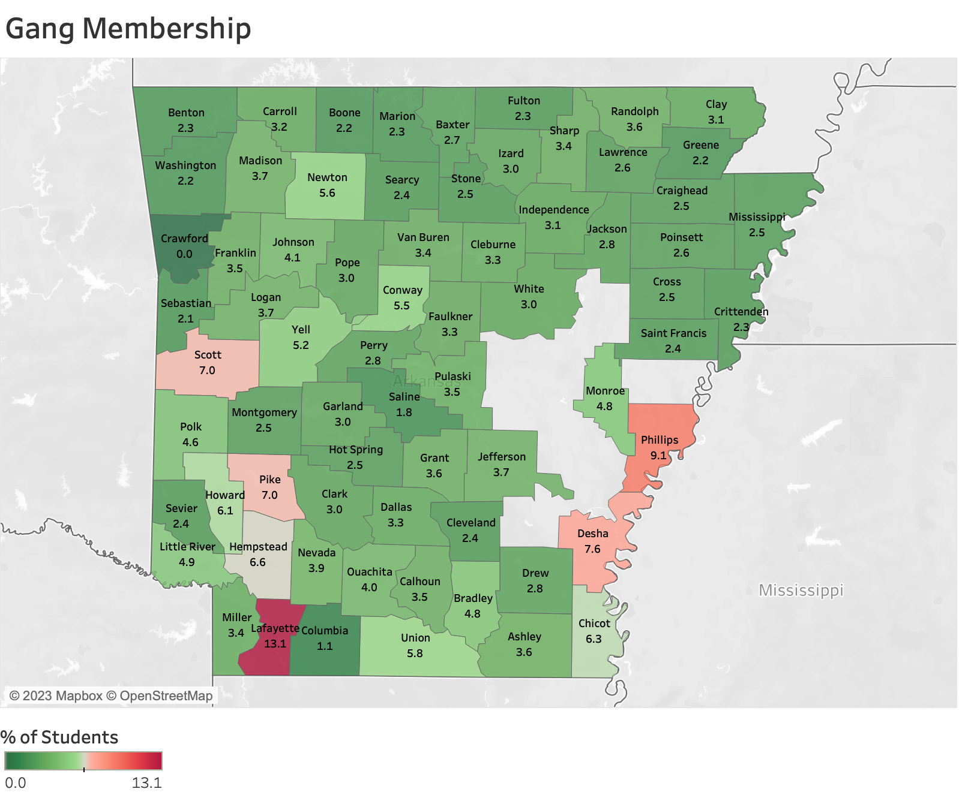

Slide 5
APNA question:
“People in my family have serious arguments about the same things, and often insult or yell at each other.”
“Yes” includes the responses:
YES!
yes
Response options:
no
NO!
Notes:
Fairly steady, perhaps slight increase, relatively high levels (near 30%)

Slide 6
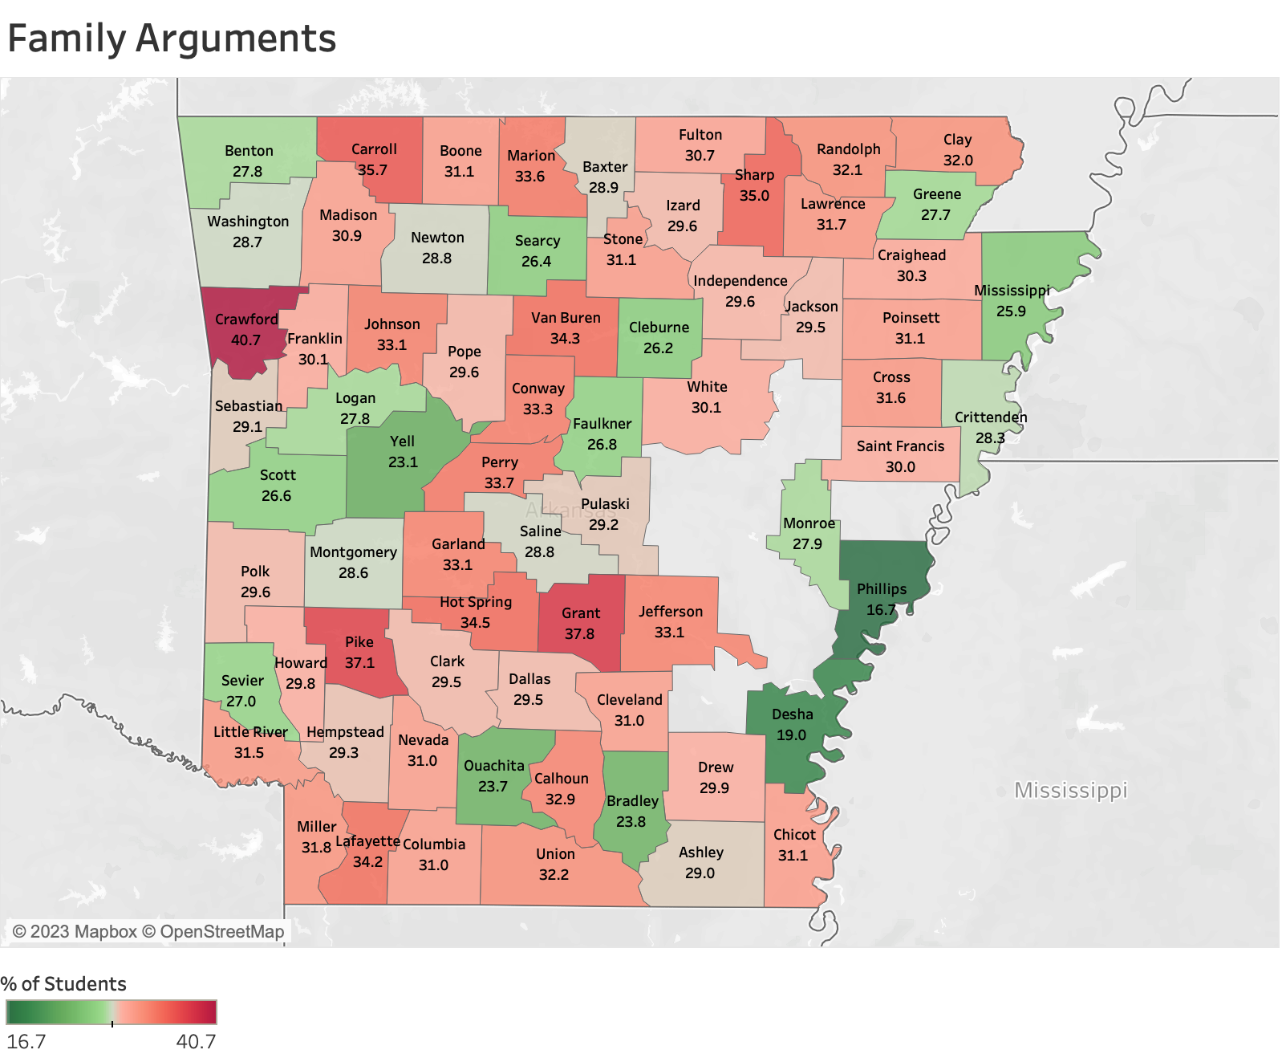

Slide 7
APNA question:
“Has anyone in your family ever had a severe alcohol or drug problem?”
Response options:
Yes
No
Notes:
‘gentle’ increase over time(37.5 to 39.7), relatively high levels, nearly 40%

Slide 8
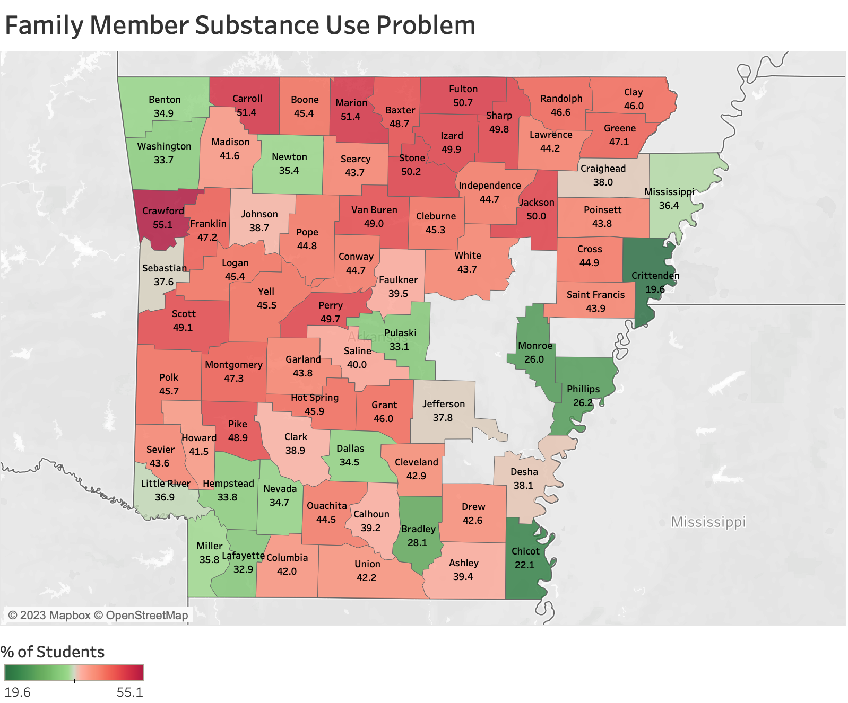

Slide 9
Factor based on these APNA questions:
How old were you when you first:
smoked marijuana?
smoked a cigarette, even just a puff?
had more than a sip or two of beer, wine, or hard liquor (for example, vodka, whiskey, or gin)?
began drinking alcoholic beverages regularly, that is, at least once or twice month?
“Yes” includes scores above the relevant cut-off value (dependent on grade)
Notes:
Slightly decreasing over time (16.6 to 13.8, extra dip at 2020: COVD?), mid-range levels: under 20%

Slide 10
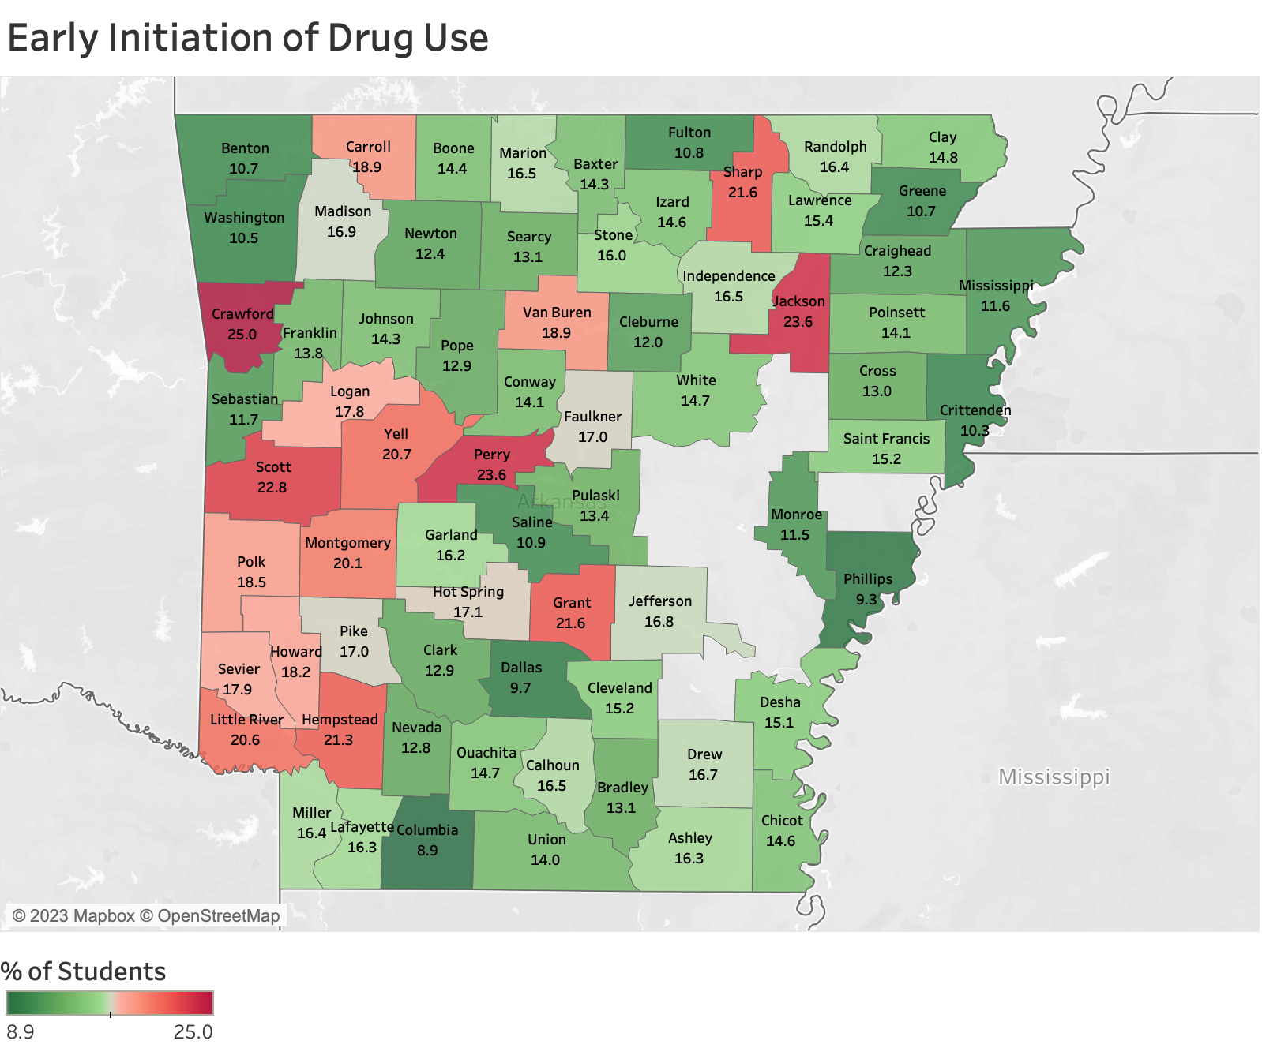

Slide 11
Factor based on these APNA questions:
How wrong do you think it is for someone your age to:
drink beer, wine, or hard liquor (for example, vodka, whiskey, or gin) regularly?
smoke cigarettes?
smoke marijuana?
use LSD, cocaine, amphetamines or another illegal drug?
Notes:
Steady over time with dip in 2020(covid?), mid-range levels ~21%

Slide 12
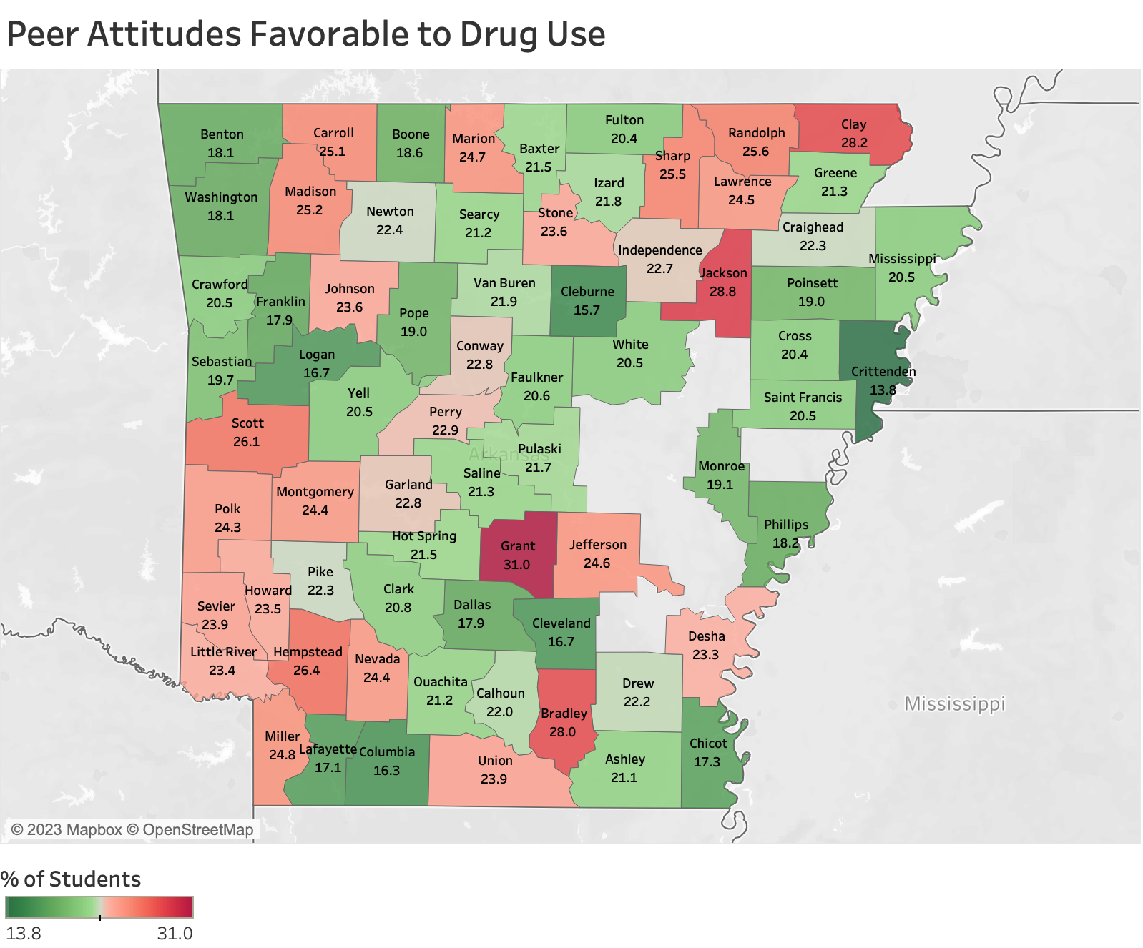

Slide 13
Factor based on these APNA questions:
How wrong do your parents feel it would be for YOU to:
have one or two drinks of an alcoholic beverage nearly every day
smoke tobacco?
smoke marijuana?
Notes:
Steady over time, even in 2020, mid-range levels ~20%

Slide 14
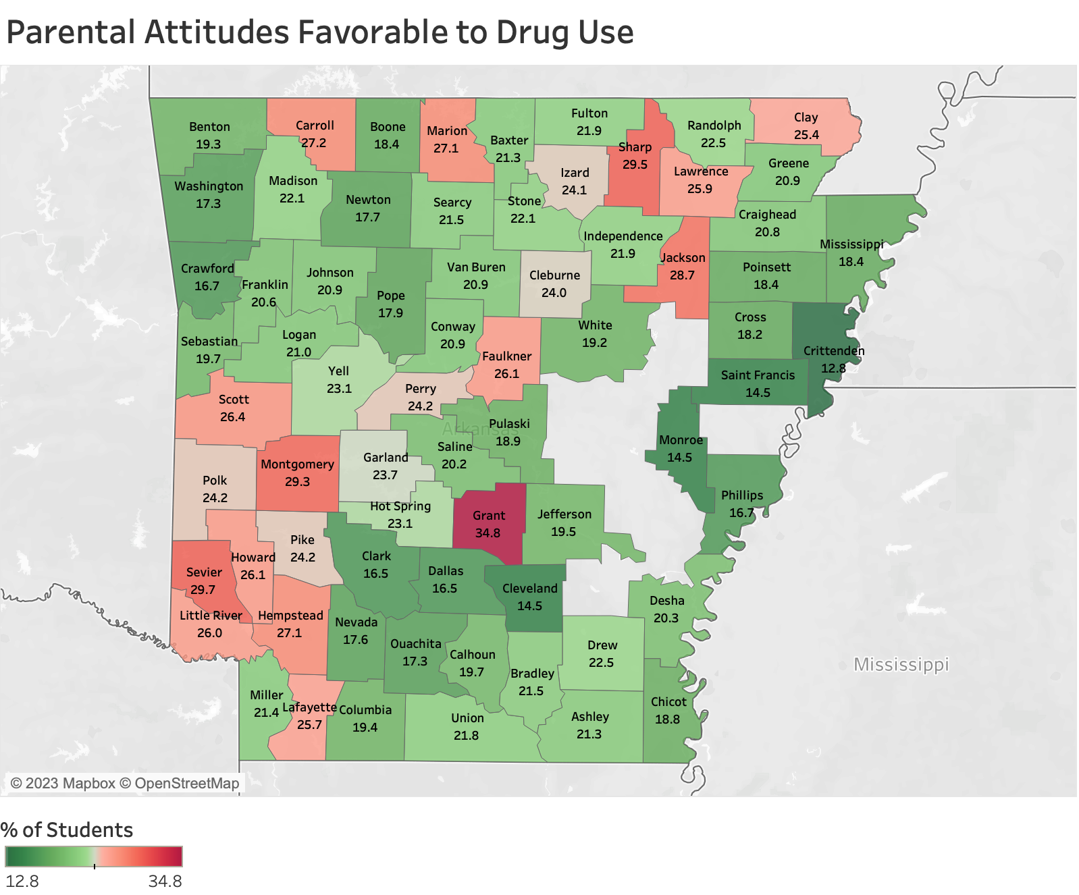

Slide 15
Factor based on these APNA questions:
The rules in my family are clear.
When I am not at home, one of my parents knows where I am and who I am with.
My family has clear rules about alcohol and drug use.
If you skipped school would you be caught by your parents?
My parents ask if I've gotten my homework done.
Would your parents know if you did not come home on time?
Notes:
Increasing over time(29.9 to 34.5, dip in 2020), relatively high levels 30 to 35%

Slide 16
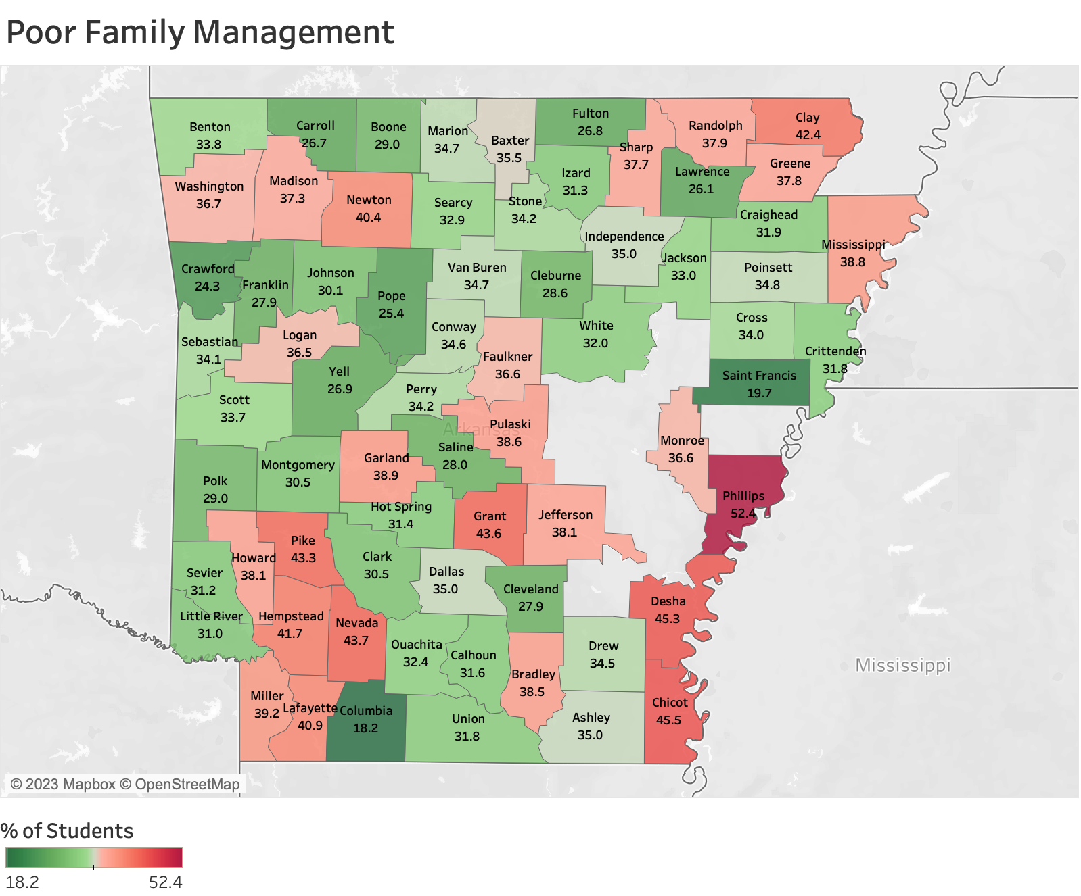

Slide 17
Factor based on these APNA questions:
Have any of your brothers or sisters ever:
drunk beer, wine, or hard liquor (for example, vodka, whiskey, or gin)?
smoked marijuana?
smoked cigarettes?
taken a handgun to school?
been suspended or expelled from school?
Has anyone in your family ever had a severe alcohol or drug problem?
About how many adults (over 21) have you known personally who in the past year have:
used marijuana, crack, cocaine, or other drugs?
sold or dealt drugs?
done other things that could get them in trouble with the police, like stealing, selling stolen goods, mugging, or assaulting others, etc.?
gotten drunk or high?
Notes:
Decreasing (30.4 to 26.7), mid-range levels ~25-30%

Slide 18
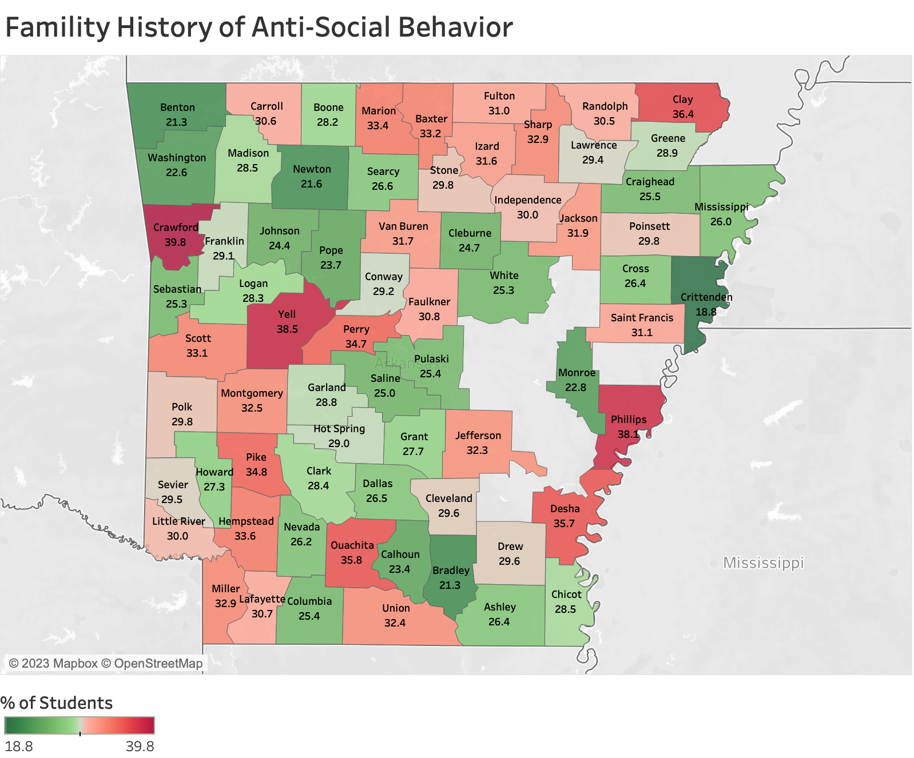

Slide 19
Questions, Comments, Discussion?
Questions?
Comments?
Discussion?

Slide 20
Odds Ratios Table
Past 30 day Substance Use | Early Initiation | Anti-social Fam. Hx | Peer attitudes | Parent attitudes | Gang member | Fam. Substance Problem | Fam. Argues | Poor Fam. Manag.
Alcohol | 7.8 | 4.5 | 6.6 | 5.3 | 2.7 | 3.0 | 2.1 | 1.4
Cigarette | 16.9 | 5.6 | 11.8 | 5.4 | 5.9 | 3.5 | 2.4 | 2.0
Chewing tobacco | 10.2 | 3.9 | 6.8 | 4.3 | 5.9 | 2.2 | 1.7 | 1.8
Marijuana | 10.9 | 7.3 | 9.7 | 7.1 | 4.2 | 3.9 | 2.8 | 1.7
Nicotine vape | 10.1 | 5.5 | 6.8 | 4.8 | 3.7 | 3.8 | 2.5 | 1.5
MJ vape | 11.4 | 7.1 | 10.0 | 6.6 | 4.5 | 4.0 | 2.9 | 1.8
Flav. vape | 9.9 | 5.4 | 6.4 | 4.1 | 5.2 | 3.2 | 2.6 | 2.1
RX drugs | 5.2 | 4.3 | 4.1 | 2.8 | 3.3 | 3.2 | 2.7 | 1.9
Chemical drugs | 2.8 | 2.1 | 1.9 | 1.5 | 2.7 | 1.5 | 1.5 | 1.5
Notes:
All Odds ratios w/ p-value<0.01, based on 2022 APNA sample of 50k+ responses

