Slide 1
Statewide Epidemiological Outcomes Workgroup Quarterly Meeting 09/20/2023
Supported by SAMHSA PFS Grant #6H79SP080990-01M001.

Slide 2
Adverse Childhood Experiences (ACE)

Slide 3
What are Adverse Childhood Experiences
Adverse childhood experiences, or ACEs, are potentially traumatic events that occur in childhood (0-17 years).

Slide 4
How common are ACEs?
ACEs are common.
About 64% of U.S. adults reported they had experienced at least one type of ACE before age 18
Nearly 1 in 6 (17.3%) reported they had experienced four or more types of ACEs.

Slide 5
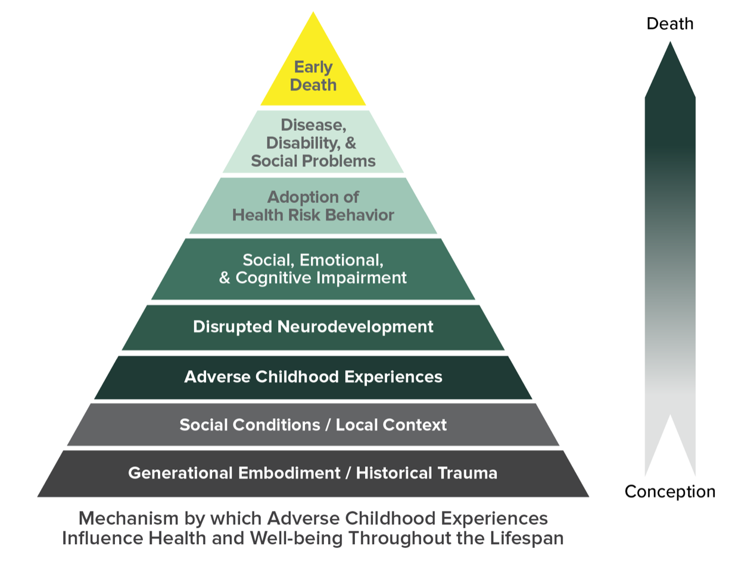
Notes:
ACEs are strongly related to development of risk factors for disease, and well-being throughout the life course.

Slide 6
Notes:
Health
Injuries, STI, teen pregnancy, pregnancy complications, chronic disease, suicide, depression
Toxic stress
Life opportunities
Jobs, education, financial instability, crime
Unhealthy, unstable relationships

Slide 7
Data Sources
National Survey of Children's Health
Health Resources and Services Administration (HRSA) Maternal and Child Health Bureau (MCHB)
Conducted by the Census Bureau
Parent responses for children 0-17
Behavioral Risk Factor Surveillance Survey
Optional State Module
Arkansas: 2021, 2018, 2016
Before you were 18, did you experience…

Slide 8
National Survey of Children's Health
Hard to cover the basics, like food or housing, on family's income
Parent or guardian divorced or separated *
Parent or guardian died
Parent or guardian served time in jail *
Witnessed domestic violence *
Victim or witness of neighborhood violence
Lived with anyone who was mentally ill, suicidal, or severely depressed *
Lived with anyone who had a problem with alcohol or drugs *
Treated or judged unfairly because of their race or ethnic group
Treated or judged unfairly because of sexual orientation or gender identity, 6-17 years

Slide 9
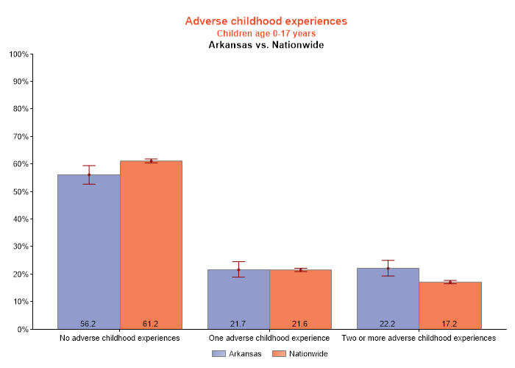
Notes:
Looked at this by age and not surprising that the number of ACEs increase with age
Looked by family type and ACEs are more common for single parent, grandparent, or other family households. Less common for married two parent households
Also, income gradient with higher incomes less likely to experience ACEs

Slide 10
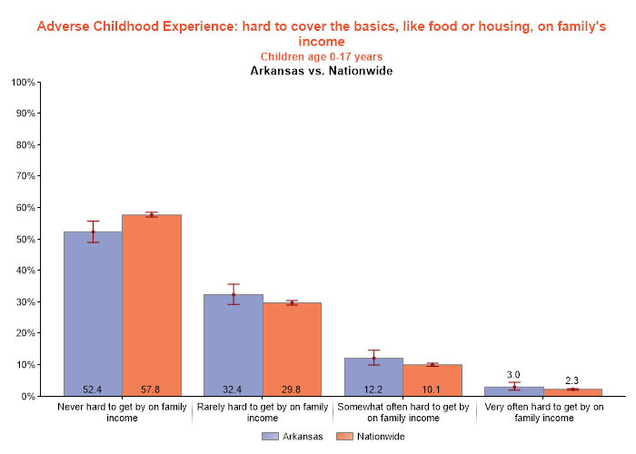
Notes:
Not surprising that this varies by income with lower income levels reporting somewhat or very often

Slide 11
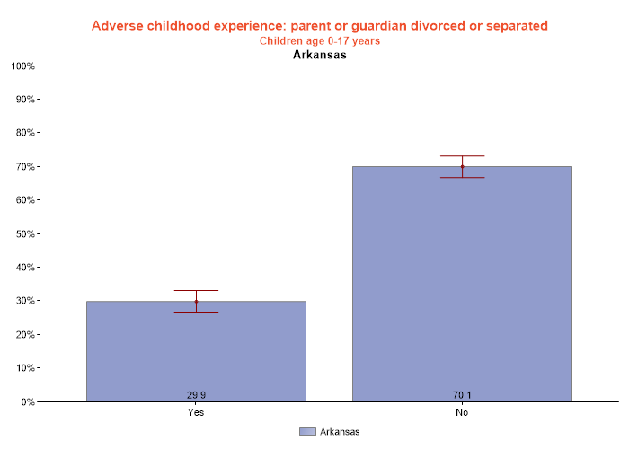
BRFSS 32.7%
Notes:
Lower income more likely to report divorce or separation

Slide 12
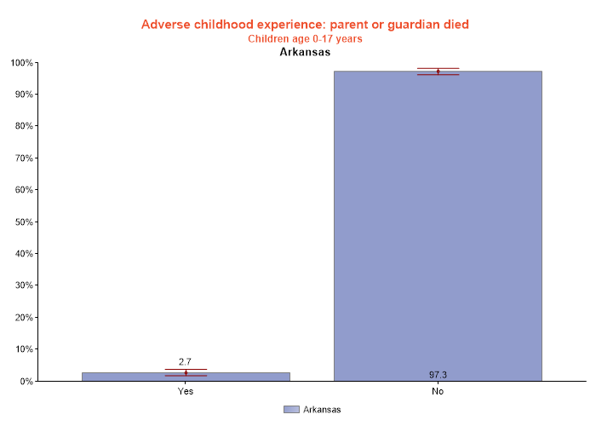
Notes:
No important differences by age, income, family structure.

Slide 13
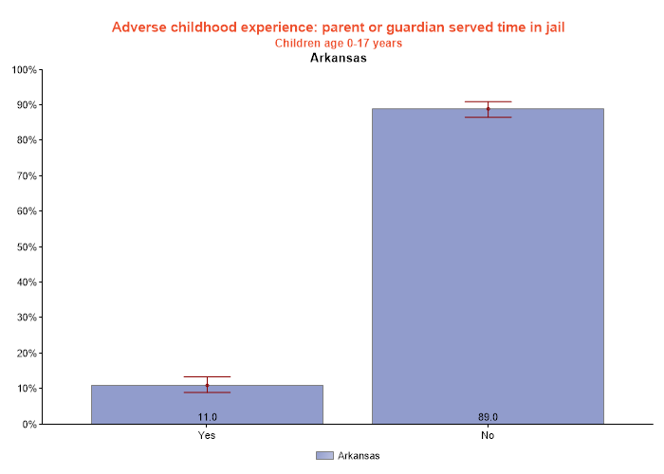
BRFSS 10.8%
Notes:
More likely in single parent or grandparent household, at lower income levels

Slide 14
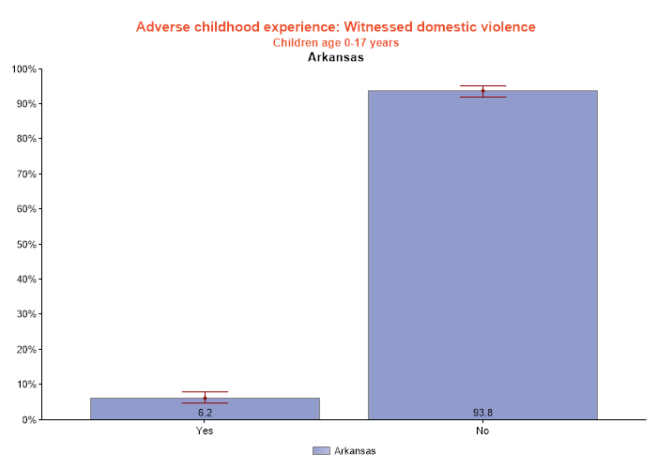
BRFSS 18% at least once
Notes:
Not much difference by education, income

Slide 15
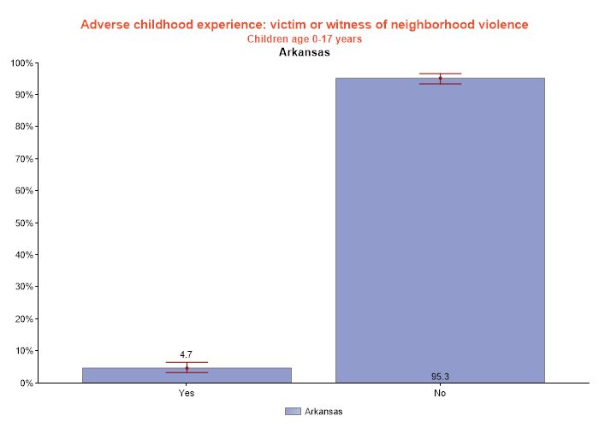
Notes:
No significant difference by income

Slide 16
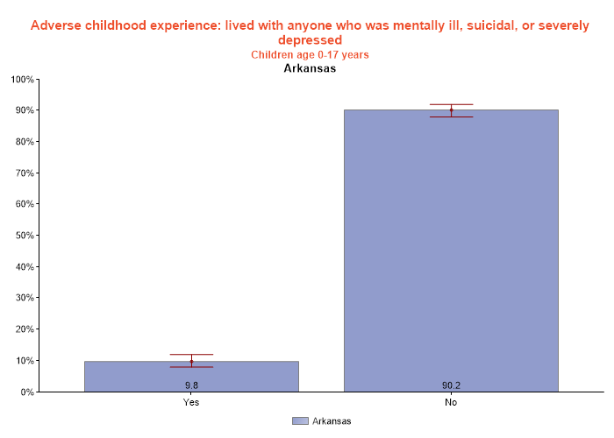
BRFSS 22.1%
Notes:
No significant difference by income, family structure

Slide 17
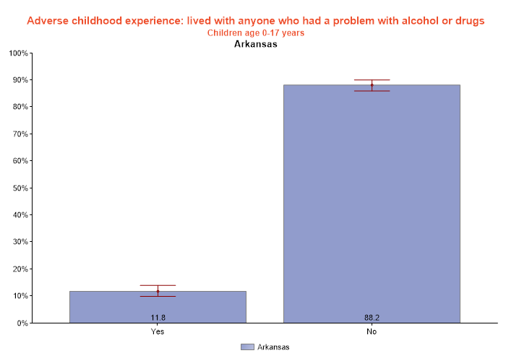
BRFSS 24.6% alcohol, 14.2% drugs
Notes:
Significantly more likely in grandparent households

Slide 18
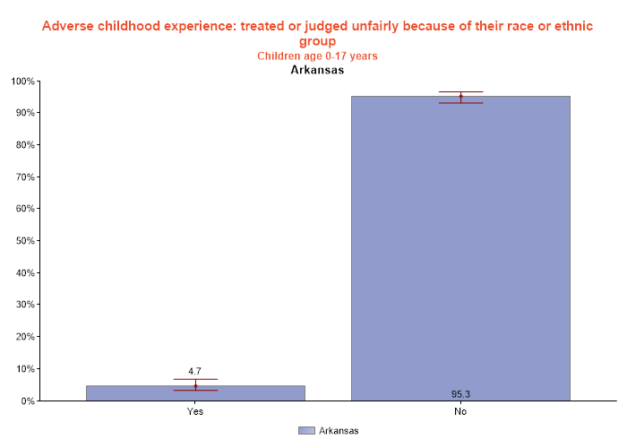
Notes:
No difference by income, family structure

Slide 19
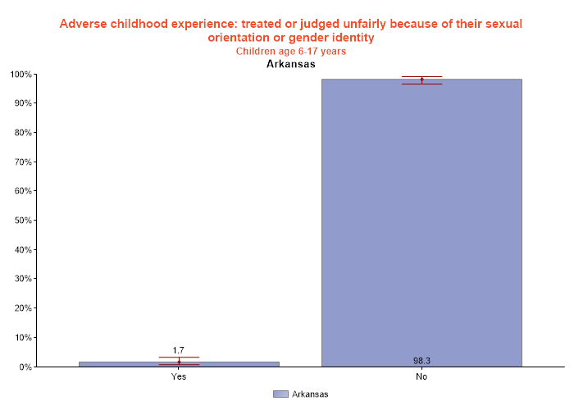
Notes:
No significant difference by income or family structure. According to the Census Pulse survey, 6.6% of Arkansans identify as Lesbian, Gay, Bisexual or Transgender

Slide 20
Behavioral Risk Factor Surveillance Survey
Not including spanking, (before age 18), how often did a parent or adult in your home ever hit, beat, kick, or physically hurt you in any way? 24% at least once
How often did a parent or adult in your home ever swear at you, insult you, or put you down? 36% at least once
How often did anyone at least 5 years older than you or an adult, ever touch you sexually? 14% at least once
How often did anyone at least 5 years older than you or an adult, try to make you touch them sexually? 10% at least once
How often did anyone at least 5 years older than you or an adult, force you to have sex? 6.6% at least once
For how much of your childhood was there an adult in your household who made you feel safe and protected? 84.9% most or all of the time
For how much of your childhood was there an adult in your household who tried hard to make sure your basic needs were met? 91.3% most or all of the time

Slide 21
Individual and Family Risk Factors
Families experiencing caregiving challenges related to children with special needs
Children and youth who don’t feel close to their parents/caregivers and feel like they can’t talk to them about their feelings
Youth who start dating early or engaging in sexual activity early
Children and youth with few or no friends or with friends who engage in aggressive or delinquent behavior
Families with caregivers who have a limited understanding of children’s needs or development
Families with caregivers who were abused or neglected as children
Families with young caregivers or single parents
Families with low income
Families with adults with low levels of education
Families experiencing high levels of parenting stress or economic stress
Families with caregivers who use spanking and other forms of corporal punishment for discipline
Families with inconsistent discipline and/or low levels of parental monitoring and supervision
Families that are isolated from and not connected to other people (extended family, friends, neighbors)
Families with high conflict and negative communication styles
Families with attitudes accepting of or justifying violence or aggression

Slide 22
Community Risk Factors
Communities with high rates of violence and crime
Communities with high rates of poverty and limited educational and economic opportunities
Communities with high unemployment rates
Communities with easy access to drugs and alcohol
Communities where neighbors don’t know or look out for each other and there is low community involvement among residents
Communities with few community activities for young people
Communities with unstable housing and where residents move frequently
Communities where families frequently experience food insecurity
Communities with high levels of social and environmental disorder

Slide 23
Protective Factors – Individual and Family
Children have a consistent family life where they are safe, taken care of, and supported
Children who have positive friendships and peer networks
Children who do well in school
Children who have caring adults outside the family who serve as mentors/role models
Families where caregivers can meet basic needs of food, shelter, and health services for children
Families where caregivers have college degrees or higher
Families where caregivers have steady employment
Families with strong social support networks and positive relationships with the people around them
Families where caregivers engage in parental monitoring, supervision, and consistent enforcement of rules
Families where caregivers/adults work through conflicts peacefully
Families where caregivers help children work through problems
Families that engage in fun, positive activities together
Families that encourage the importance of school for children

Slide 24
Protective Factors - Communities
Communities where families have access to economic and financial help
Communities where families have access to medical and mental health care
Communities with access to safe, stable housing
Communities where families have access to nurturing and safe childcare
Communities where families have access to high-quality preschool
Communities where families have access to safe, engaging after school programs and activities
Communities where adults have work opportunities with family-friendly policies
Communities with strong partnerships between the community and business, health care, government, and other sectors
Communities where residents feel connected to each other and are involved in the community
Communities where violence is not tolerated or accepted

