Slide 1
Statewide Epidemiological Outcomes Workgroup: APNA Survey Modelling Quarterly Meeting 08/05/2020
Supported by SAMHSA PFS Grant #6H79SP080990-01M001.

Slide 2
Preliminary APNA Survey Data Models
Notes:
What part of Arkansas did you travel from for this meeting?
https://www.polleverywhere.com/multiple_choice_polls/EBcIgCkbDPpjHK0BpviwE

Slide 3
Preliminary APNA Survey Data Models
Statistical analyses
Outcome variables analyzed:
Lifetime and past 30 days alcohol use and past 30 days binge drinking
Lifetime and past 30 days marijuana use
Lifetime and past 30 days cigarette use and lifetime e-Cig use
Lifetime and past 30 days smokeless tobacco use
Rates of use were calculated for each county overall and by gender and grade level within each county

Slide 4
Preliminary APNA Survey Data Models
Statistical Analyses
Repeated Measures Mixed effects models estimated overall annual means and means by gender and grade level
Differences between genders, consecutive grades, consecutive years, and 2014 vs. 2019 were estimated and tested for significance
P-values were adjusted by the False Discovery Rate(FDR) procedure
Significant changes reported when FDR p-value < 0.05

Slide 5
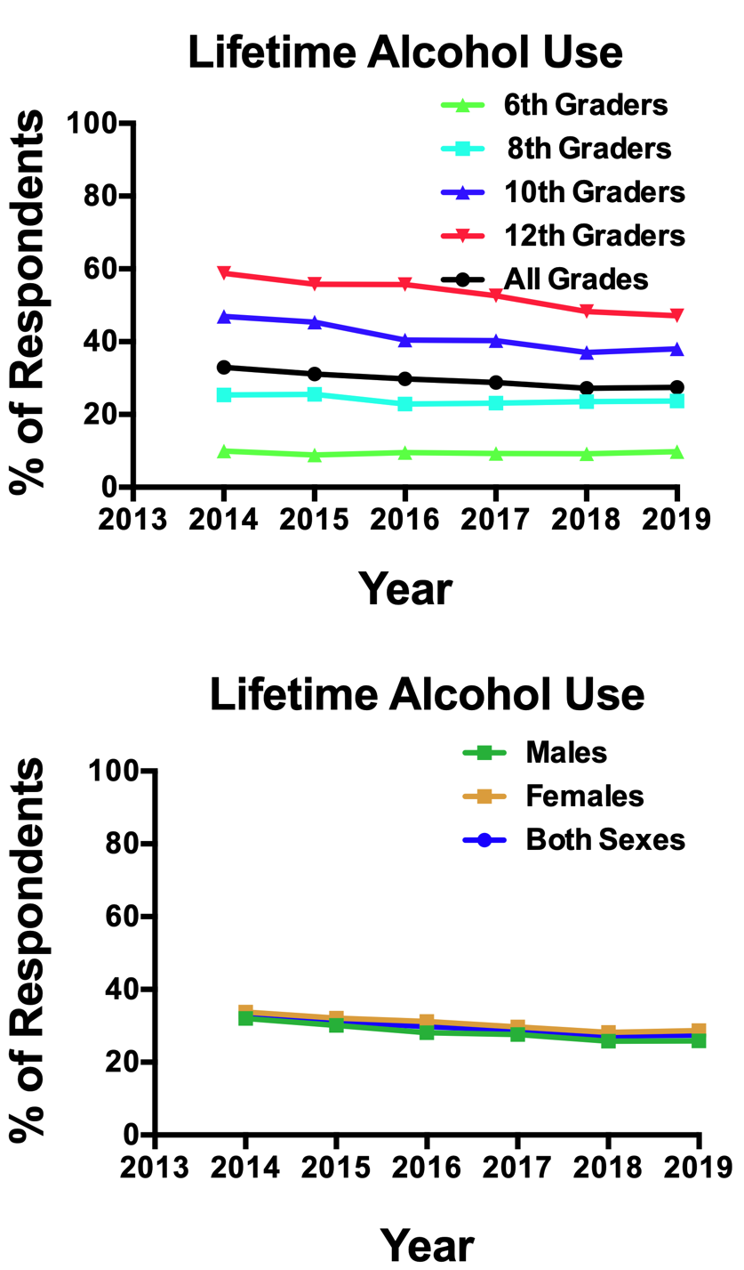
Lifetime Alcohol Use
Overall
2014 > 2019
No significant consecutive year changes
Grade
Use ↑ as grade ↑
10th / 12th both ↓ 2014:2019
10th grade ↓ 2015:2016
12th grade ↓ 2017:2018
Sex
Females, Males both ↓ 2014:2019
Females > Males in 2016 & 2019

Slide 6
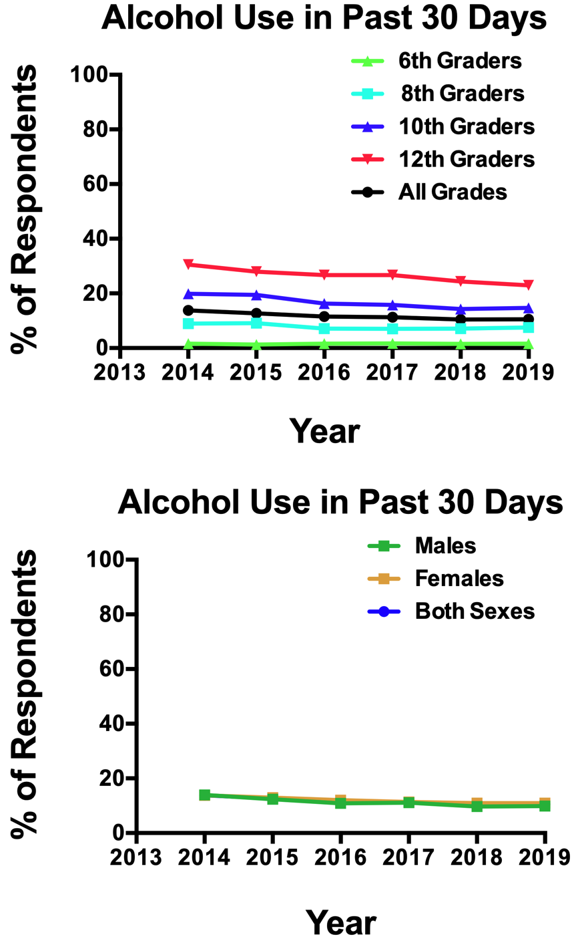
Past 30-Day Alcohol Use
Overall
2014 > 2019
No significant consecutive year changes
Grade
Use ↑ as grade ↑
10th / 12th both ↓ 2014:2019
12th grade ↓ 2014:2015, 2017:2018
10th grade ↓ 2015:2016
Sex
Females, Males both ↓ 2014:2019
Males ↓ 2014:2015, 2015:2016, 2017:2018

Slide 7
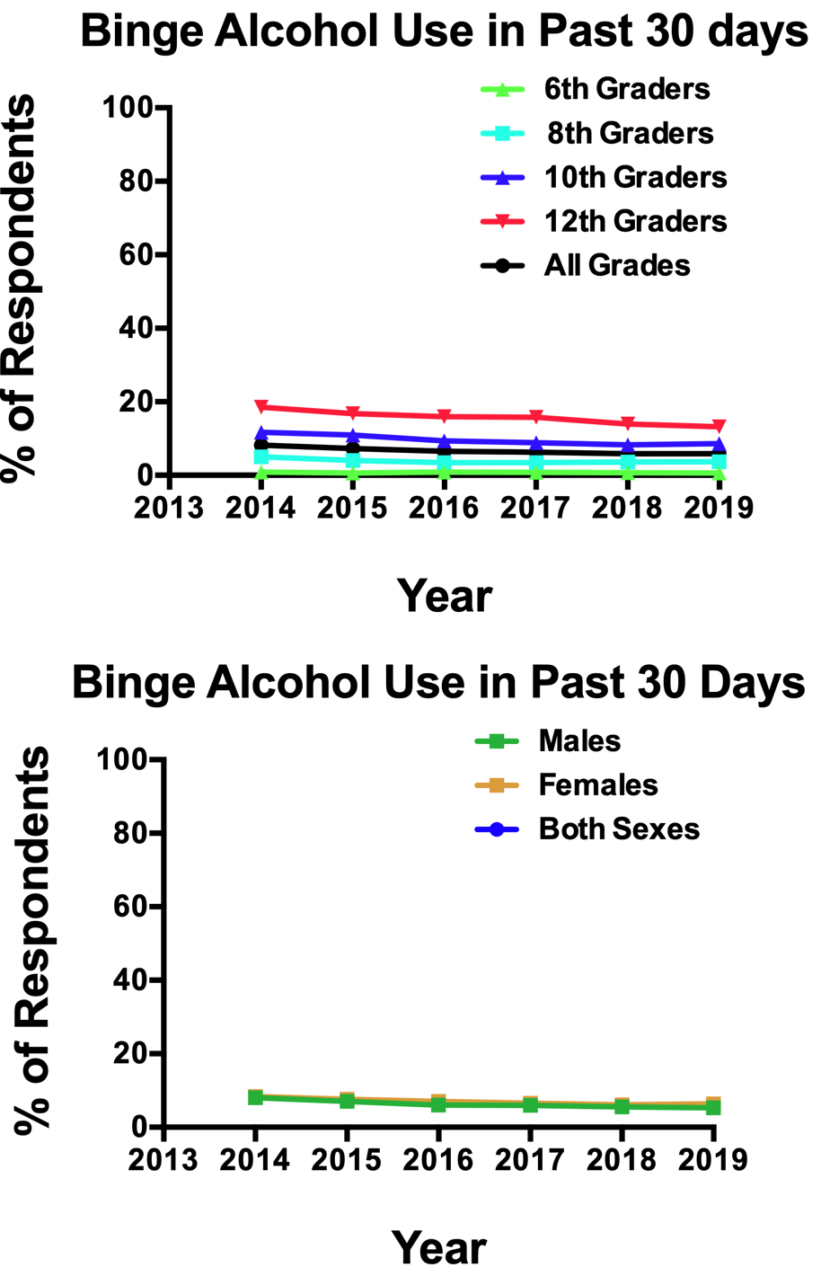
Past 30-Day Alcohol Binge
Overall
2014 > 2019
↓ 2014:2015
Grade
Use ↑ as grade ↑
10th / 12th both ↓ 2014:2019
12th grade ↓ 2014:2015, 2017:2018
Sex
Females, Males both ↓ 2014:2019

Slide 8
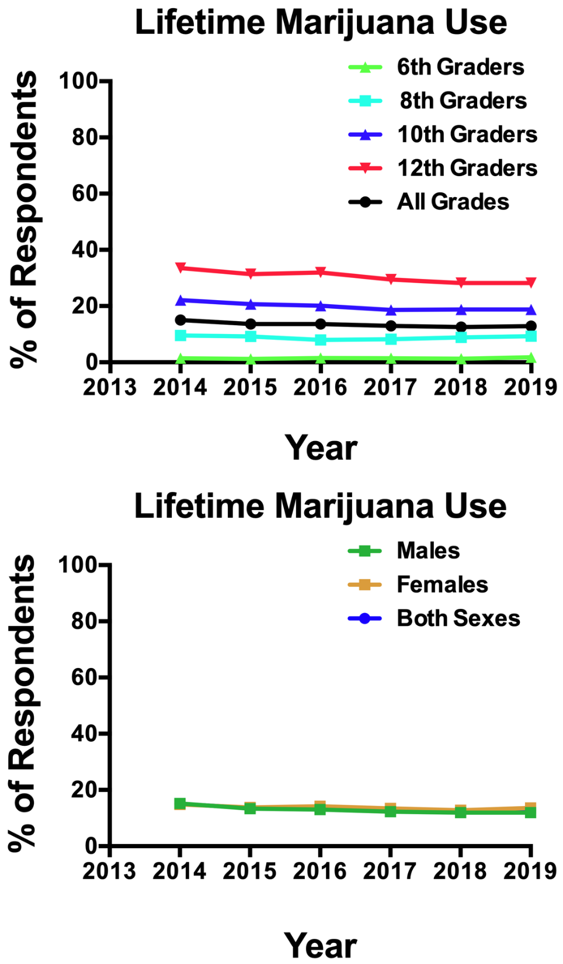
Lifetime Marijuana Use
Overall
2014 > 2019
↓ 2014:2015
Grade
Use ↑ as grade ↑
10th / 12th both ↓ 2014:2019
12th grade ↓ 2016:2017
Sex
Males ↓ 2014:2019, 2014:2015
Females > Males in 2019

Slide 9
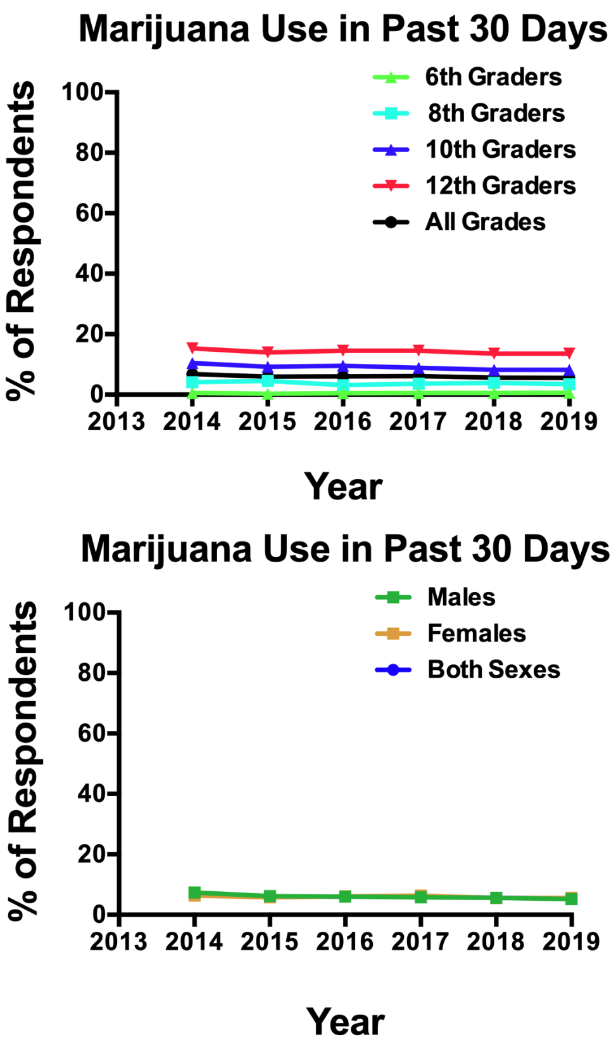
30-Day Marijuana Use
Overall
2014 > 2019
↓ 2014:2015
Grade
Use ↑ as grade ↑
10th grade ↓ 2014:2019
Sex
Males ↓ 2014:2019, 2014:2015
Females < Males in 2014

Slide 10
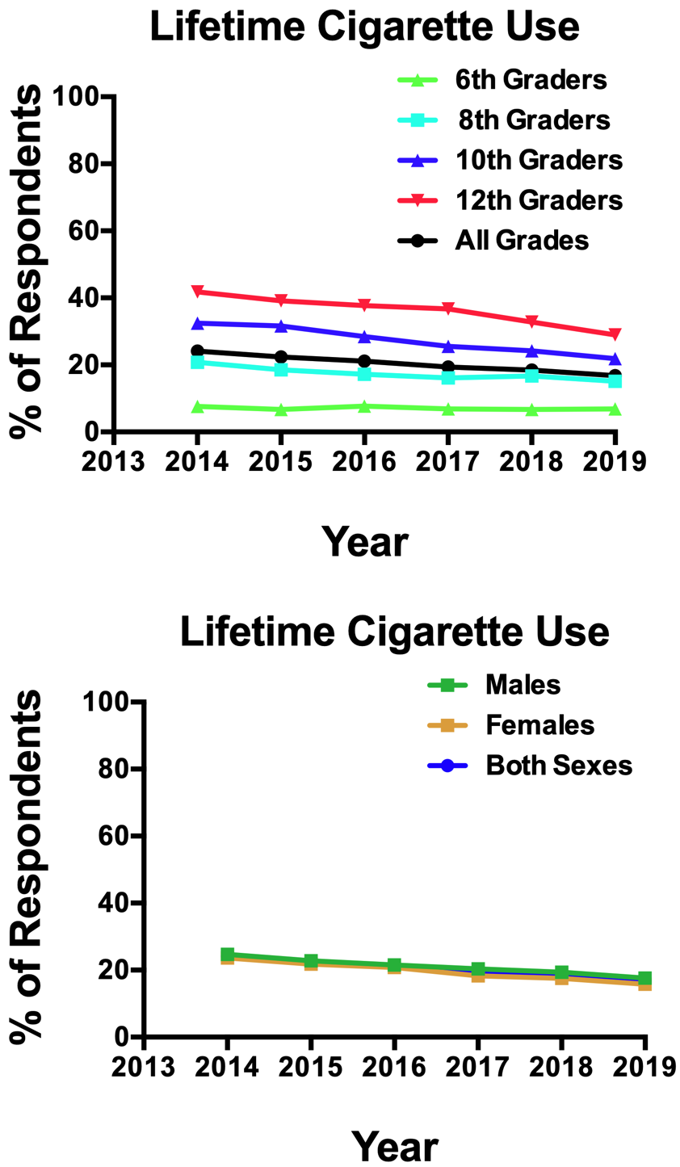
Lifetime Cigarette Use
Overall
2014 > 2019
Grade
Use ↑ as grade ↑
8th, 10th, 12th grades ↓ 2014:2019
10th ↓ 2015:2016
12th ↓ 2017:2018, 2018:2019
Sex
Females & Males ↓ 2014:2019
Females ↓ 2016:2017

Slide 11
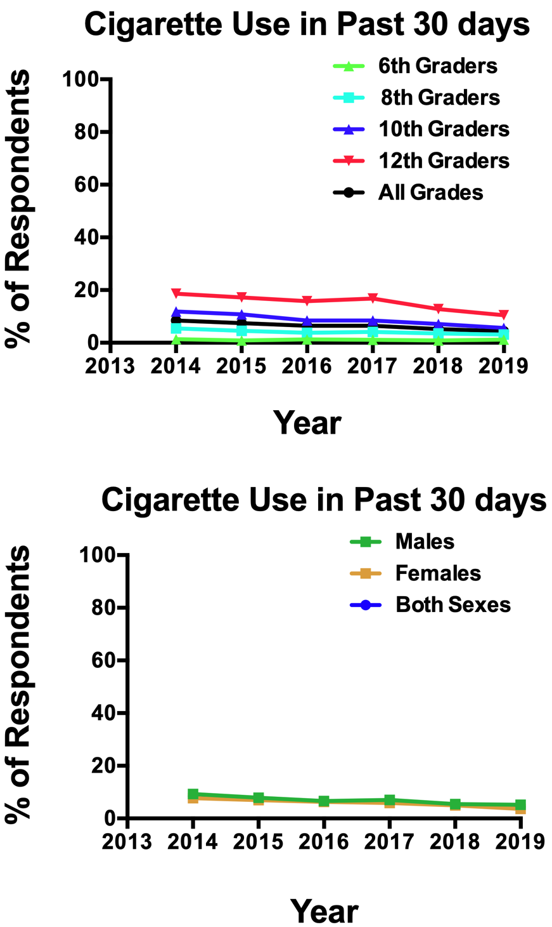
30-Day Cigarette Use
Overall
2014 > 2019, ↓ 2014:2015, 2017:2018
Grade
Use ↑ as grade ↑
8th, 10th, 12th grades ↓ 2014:2019
10th ↓ 2015:2016
12th ↓ 2017:2018, 2018:2019
Sex
Females & Males ↓ 2014:2019,
Females < Males in 2014, 2017, 2019
Females ↓ 2018:2019, Males ↓ 2014:2015, 2017:2016, 2017:2018

Slide 12
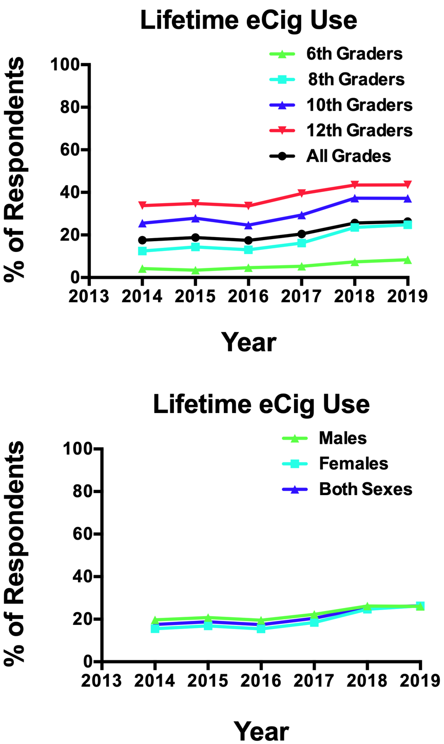
Lifetime eCigarette Use
Overall
2014 < 2019, ↑ 2016:2017, 2017:2018
Grade
Use ↑ as grade ↑
All 4 grades ↑ 2014:2019
8th, 10th, 12th ↑ 2016:2017, 2017:2018
10th ↓ 2015:2016
Sex
Females & Males ↑ 2014:2019, 2016:2017, 2017:2018
Females < Males in 2014-2017
by 2018 Females ‘caught up’ to Males

Slide 13
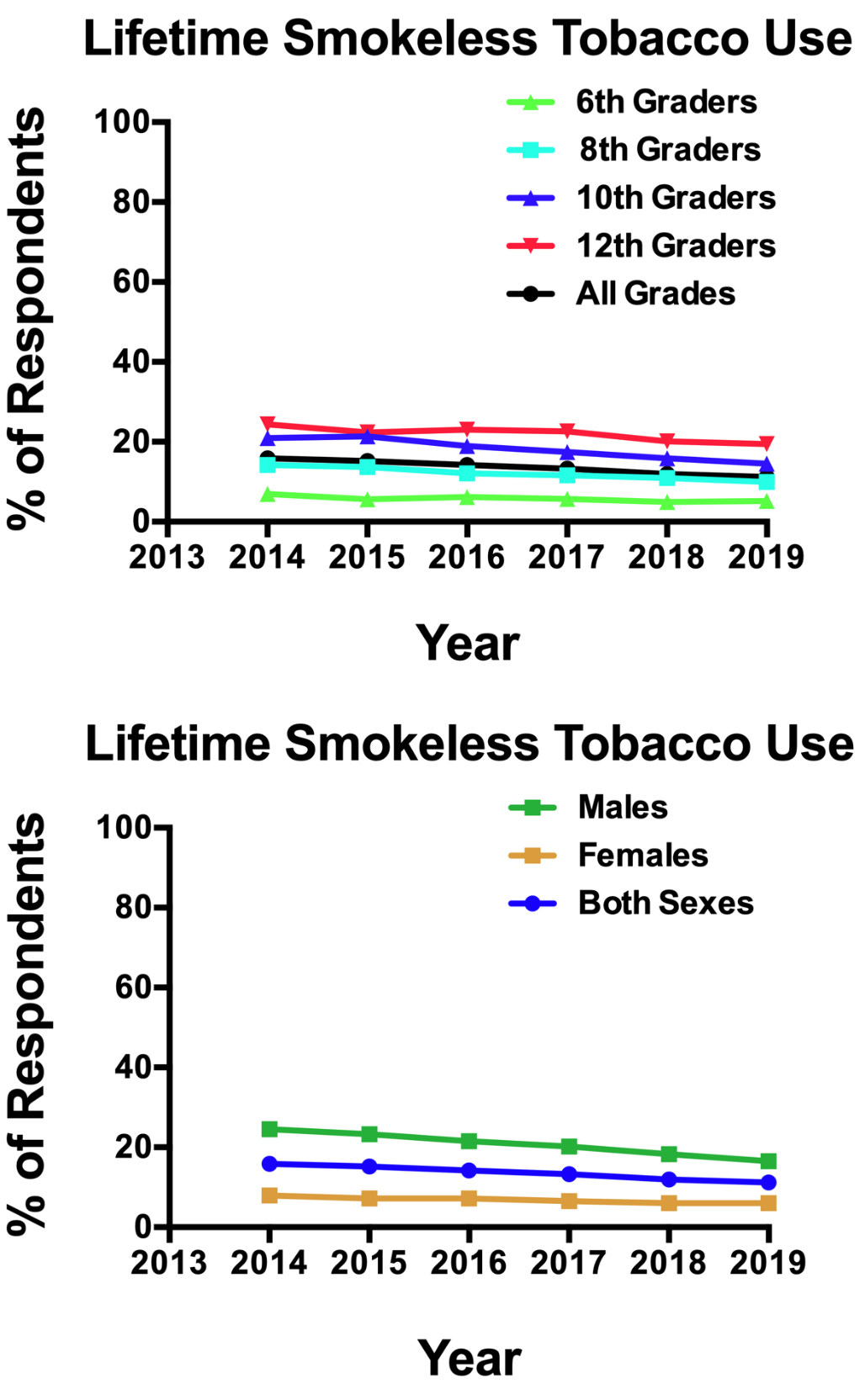
Lifetime Smokeless Tobacco Use
Overall
2014 > 2019
Grade
Use ↑ as grade ↑
8th, 10th 12th, grade ↓ 2014:2019
Sex
Females < Males every year, from about 15% to about 10%
Males ↓ 2014:2019
Females appear steady, the decreasing gender difference is due to males decreasing.

Slide 14
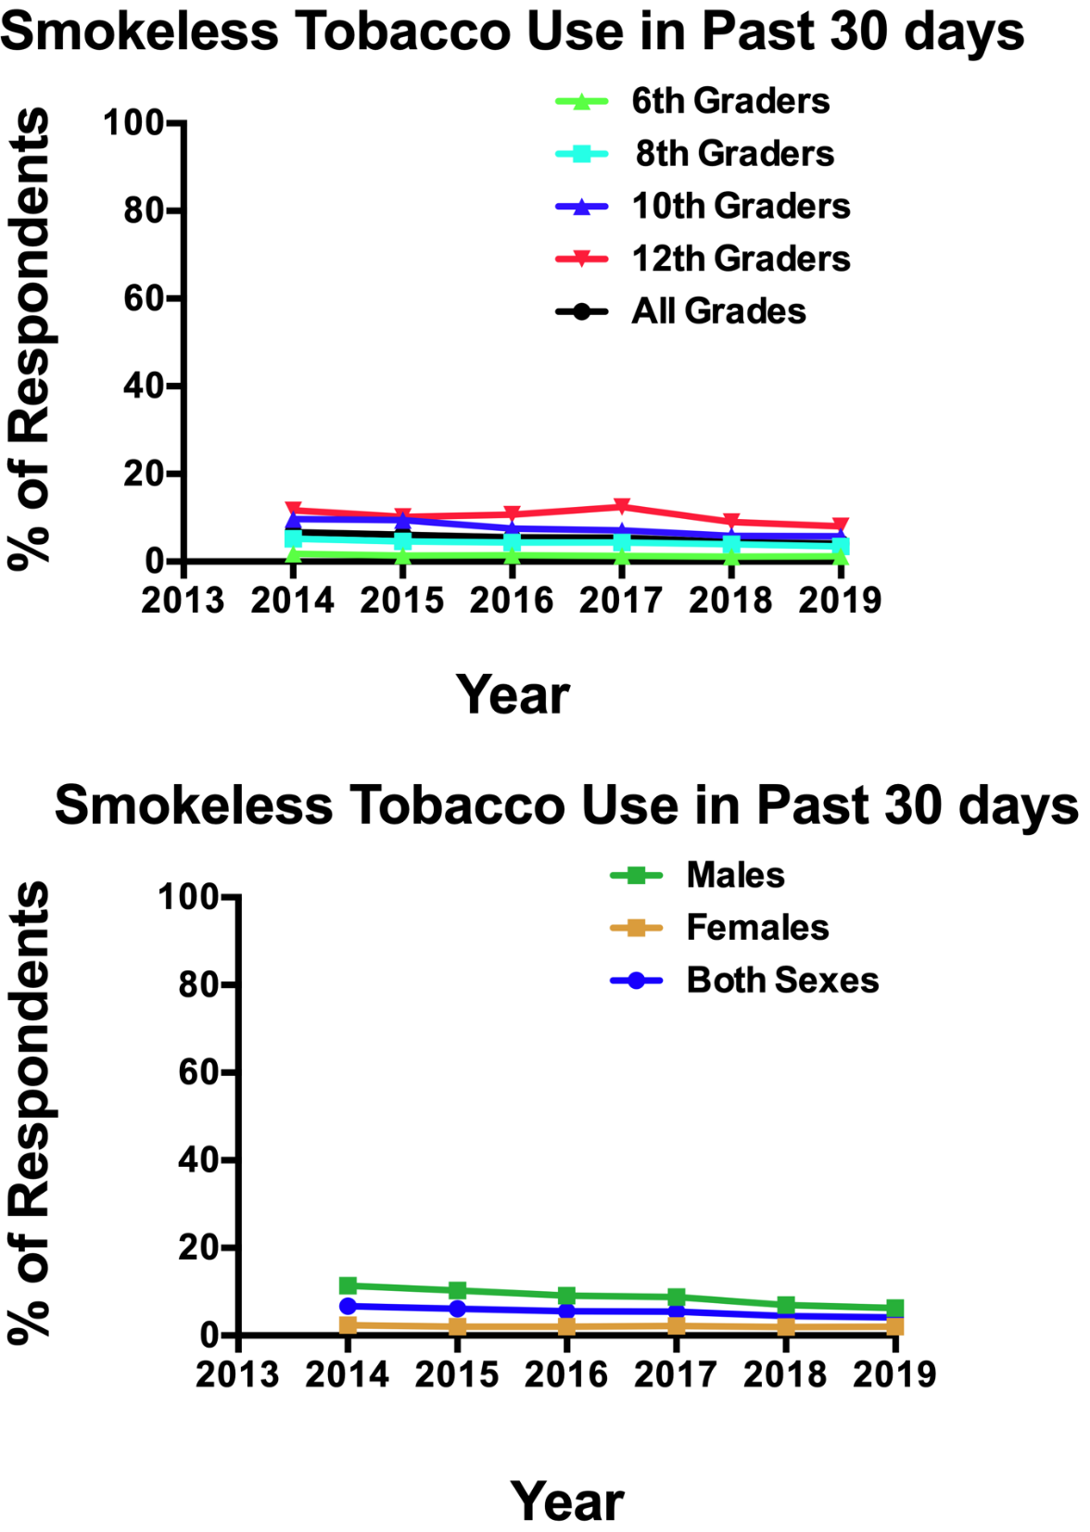
30-Day Smokeless Tobacco Use
Overall
2014 > 2019, also ↓ 2017:2018
Grade
Use ↑ as grade ↑
8th, 10th 12th, grade ↓ 2014:2019
10th ↓ 2015:2016, 12th ↑ 2016:2017, ↓ 2017:2018
Sex
Females < Males every year, from about 10% to about 5%
Males ↓ 2014:2019, 2015:2016, 2017:2018
Similar story

Slide 15
Preliminary APNA Survey Data Models
Summary
Virtually every substance used is ↓ 2014:2019: overall, within each grade(except 6th), and within each gender
Except eCigs which are ↑, but the strong ↑ from 2016 to 2018 appears to have slowed in 2019
Females were lagging behind males in eCig use, but have 'caught up'
↑ grades have consistently ↑ use rates
Males have ↑ smokeless tobacco use than Females, but male use is ↓ while female use is steady(but low)

Slide 16
Discussion

Slide 17
We
!
Thank you!

